Slide 1


SOFTWARE PROJECT MANAGEMENT
Subject presented by:
PhD. Trần Khánh Dung
Department of Software Engineering
Email: khanhdung218@yahoo.com
01- 2017

Slide 2
Interest
Basic software project management concepts and principles
Process and project metrics
Basis for effective management decision making
Techniques used to
estimate cost,
resource requirements,
and establish an effective project plan
Management activities that lead to effective risk monitoring, mitigation, and management
Activities required to define project tasks and establish a workable project schedule
Techniques for ensuring quality and controlling changes

Slide 3
State of problem
“I've visited dozens of commercial shops, both good and bad, and I've observed scores of data processing managers, again, both good and bad. Too often, I've watched in horror as these managers futilely struggled through nightmarish projects, squirmed under impossible deadlines, or delivered(bàn giao) systems that outraged( xúc phạm) their users and went on to devour huge chunks of maintenance time.”
[Page-Jones, M., Practical Project Management, Dorset House, 1985]

Slide 4
Content
Part I
Key concepts(khái niệm) & principles(nguyên tắc)

Slide 5
Key concepts - Players
Senior managers who define the business issues
Project (technical) managers who must plan, motivate, organize, and control the practitioners who do software work.
Practitioners who deliver the technical skills that are necessary to engineer a product or application.
Customers who specify the requirements for the software to be engineered
End-users who interact with the software once it is released for production use.

Slide 6
Key concepts – Team leader
Motivation. The ability to encourage (by “push or pull”) technical people to produce to their best ability.
Organization. The ability to mold existing processes (or invent new ones) that will enable the initial concept to be translated into a final product.
Ideas or innovation. The ability to encourage people to create and feel creative even when they must work within bounds established for a particular software product or application.

Slide 7
Key concepts – Software Team
A project that will require n people working for k years:
1. n individuals(cá nhân) are assigned to m different functional tasks, relatively little combined work occurs; coordination(sự phối hợp, sắp đặt) is the responsibility of a software manager who may have other projects to be concerned with
2. n individuals are assigned to m different functional tasks ( m < n ) so that informal "teams" are established; an ad hoc team leader may be appointed; coordination among teams is the responsibility of a software manager
3. n individuals are organized into t teams; each team is assigned one or more functional tasks; each team has a specific structure that is defined for all teams working on a project; coordination is controlled by both the team and
a software project manager

Slide 8
Key concepts – Software Team
To achieve a high-performance team:
• Team members must have trust in one another.
• The distribution of skills must be appropriate to the problem.
• Mavericks may have to be excluded from the team, if team cohesiveness is to be maintained.

Slide 9
Key concepts - Process
the linear sequential model
the prototyping model
the incremental model
the component-based development model
the fourth generation techniques model

Slide 10
Framework activities
Customer communication—tasks required to establish effective requirements elicitation between developer and customer.
Planning—tasks required to define resources, timelines, and other project related information.
Risk analysis—tasks required to assess both technical and management risks.
Engineering—tasks required to build one or more representations of the application.
Construction and release—tasks required to construct, test, install, and provide user support (e.g., documentation and training).
Customer evaluation—tasks required to obtain customer feedback based on evaluation of the software representations created during the engineering activity and implemented during the construction activity.

Slide 11
What can go wrong in a project?
1. Software people don’t understand their customer’s needs.
2. The product scope is poorly defined.
3. Changes are managed poorly.
4. The chosen technology changes.
5. Business needs change [or are ill-defined].
6. Deadlines are unrealistic.
7. Users are resistant.
8. Sponsorship is lost [or was never properly obtained].
9. The project team lacks people with appropriate skills.
10. Managers [and practitioners] avoid best practices and lessons learned.

Slide 12
W⁵HH principle
Why is the system being developed?
What will be done, by When?
Who is responsible for a function?
Where are they organizationally located?
How will the job be done technically and managerially?
How much of each resource is needed?

Slide 13
Content
Part II
Measures, metrics, and Indicators
Notes:
Cach do, do do, va so do

Slide 14
Sate of problem
“When you can measure what you are speaking about and express it in numbers, you know something about it; but when you cannot measure, when you cannot express it in numbers, your knowledge is of a meager (ít ỏi) and unsatisfactory kind: it may be the beginning of knowledge, but you have scarcely, in your thoughts, advanced to the stage of a science.”
[Lord Kevin]

Slide 15
Goals of software measurement
to assist in estimation, quality control, productivity assessment, and project control
can be used by software engineers to help assess the quality of technical work products and to assist in tactical decision making as a project proceeds

Slide 16
Concepts
A measure provides a quantitative indication of the extent, amount, dimension, capacity, or size of some attribute of a product or process
Measurement is the act of determining a measure
Metric is a quantitative measure of the degree to which a system, component, or process possesses a given attribute [IEEE93, Standard Glossary of Software Engineering Terms]
A software metric relates the individual measures in some way (process, project, and product metrics)
An indicator is a metric or combination of metrics that provide insight into the software process, a software project, or the product itself

Slide 17
Software Measurement
Direct measures
include cost and effort applied.
include lines of code (LOC) produced, execution speed, memory size, and defects reported over some set period of time.
Indirect measures
include functionality, quality, complexity, efficiency, reliability, maintainability, and many other "–abilities"

Slide 18
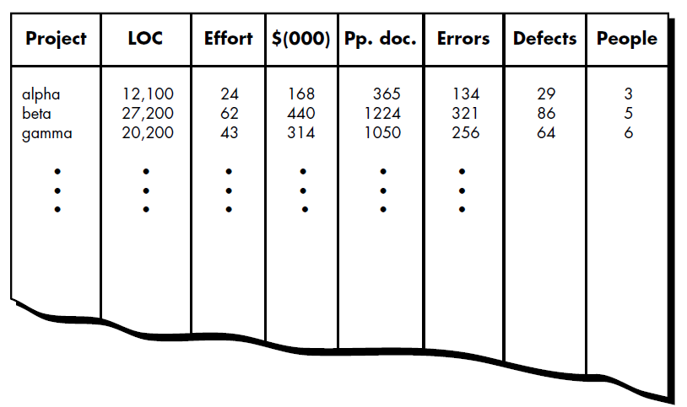
Sized-Oriented Metrics
Size-oriented software metrics are derived by considering the size of the software that has been produced

Slide 19
Sized-Oriented Metrics
Errors per KLOC (thousand lines of code).
Defects per KLOC.
$ per LOC.
Page of documentation per KLOC.
Efforts per person-month.
LOC per person-month.
$ per page of documentation.

Slide 20
Function-Oriented Metrics
Function-oriented software metrics use a measure of the functionality delivered by the application as a normalization value
‘functionality’ cannot be measured directly, it must be derived indirectly using other direct measures
A measure called the function point is suggested. Function points are based on countable (direct) measures of software's information domain and assessments of software complexity

Slide 21
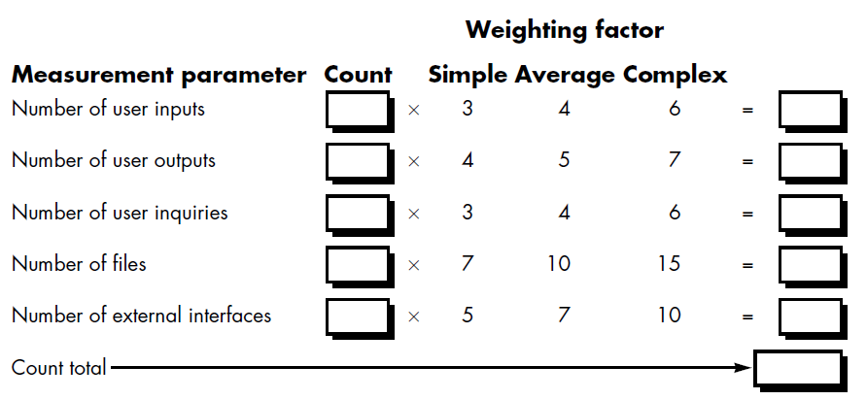
Function-Oriented Metrics
Function points are computed by completing table following

Slide 22
Function-Oriented Metrics
Five information domain characteristics are determined and counts are provided in the appropriate table location. Information domain values are defined in the following manner:
Number of user inputs
Number of user outputs
Number of user inquiries
Number of files
Number of external interfaces

Slide 23
Function-Oriented Metrics
Number of user inputs. Each user input that provides distinct application oriented data to the software is counted. Inputs should be distinguished from inquiries, which are counted separately
Number of user outputs. Each user output that provides application oriented information to the user is counted. In this context output refers to reports, screens, error messages, etc. Individual data items within a report are not counted separately

Slide 24
Function-Oriented Metrics
Number of user inquiries. An inquiry is defined as an on-line input that results in the generation of some immediate software response in the form of an on-line output. Each distinct inquiry is counted
Number of files. Each logical master file (i.e., a logical grouping of data that may be one part of a large database or a separate file) is counted
Number of external interfaces. All machine readable interfaces (e.g., data files on storage media) that are used to transmit information to another system are counted

Slide 25
Function-Oriented Metrics
To compute function points (FP), the following relationship is used:
FP = count total [0.65 + 0.01 Σ(Fi)]
Fi (i = 1 to 14) are "complexity adjustment values"

Slide 26
Function-Oriented Metrics
Fi based on responses to the following questions
1. Does the system require reliable backup and recovery?
2. Are data communications required?
3. Are there distributed processing functions?
4. Is performance critical?
5. Will the system run in an existing, heavily utilized operational environment?
6. Does the system require on-line data entry?

Slide 27
Function-Oriented Metrics
7. Does the on-line data entry require the input transaction to be built over multiple screens or operations?
8. Are the master files updated on-line?
9. Are the inputs, outputs, files, or inquiries complex?
10. Is the internal processing complex?
11. Is the code designed to be reusable?
12. Are conversion and installation included in the design?
13. Is the system designed for multiple installations in different organizations?
14. Is the application designed to facilitate change and ease of use by the user?

Slide 28
Function-Oriented Metrics
Each of these questions is answered using a scale that ranges from 0 (not important or applicable) to 5 (absolutely essential).
Once function points have been calculated, they are used in a manner analogous to LOC as a way to normalize measures for software productivity, quality, and other attributes:
Errors per FP
Defects per FP
$ per FP
Pages of documentation per FP
FP per person-month

Slide 29
Metrics for Software Quality
The quality of a system is only as good as the requirements that describe the problem (requirement specification), the design that models the solution (design models), the code that leads to an executable program (source code), and the tests that exercise the software to uncover errors (test case), and also the project progresses

Slide 30
Measuring Quality Indicators
Useful indicators:
Correctness. A program must operate correctly or it provides little value to its users. Correctness is the degree to which the software performs its required function; defects per KLOC counted over a standard period of time, typically one year.
Maintainability. Maintainability is the ease with which a program can be corrected if an error is encountered, adapted if its environment changes, or enhanced if the customer desires a change in requirements; a simple time-oriented metric is mean-time-to change (MTTC), the time it takes to analyze the change request, design an appropriate modification, implement the change, test it, and distribute the change to all users.

Slide 31
Measuring Quality Indicators
Useful indicators:
Integrity. This attribute measures a system's ability to withstand attacks (both accidental and intentional) to its security. Attacks can be made on all three components of software: programs, data, and documents.
To measure integrity, two additional attributes must be defined: threat and security.

Slide 32
Measuring Quality Indicators
Useful indicators:
Integrity. The integrity of a system can then be defined as
integrity = summation [(1 – threat) (1 – security)]
where threat and security are summed over each type of attack.
Threat is the probability (which can be estimated or derived from empirical evidence) that an attack of a specific type will occur within a given time.
Security is the probability (which can be estimated or derived from empirical evidence) that the attack of a specific type will be repelled.

Slide 33
Measuring Quality Indicators
Useful indicators:
Usability. If a program is not user-friendly, it is often doomed to failure, even if the functions that it performs are valuable. Usability is an attempt to quantify user-friendliness;

Slide 34
Measuring Quality Indicators
Useful indicators:
Usability can be measured in terms of four characteristics:
(1) the physical and or intellectual skill required to learn the system,
(2) the time required to become moderately efficient in the use of the system,
(3) the net increase in productivity (over the approach that the system replaces) measured when the system is used by someone who is moderately efficient,
(4) a subjective assessment (sometimes obtained through a questionnaire) of users attitudes toward the system.

Slide 35
Defect Removal Efficiency
A quality metric that provides benefit at both the project and process level is defect removal efficiency (DRE).
DRE is a measure of the filtering ability of quality assurance and control activities as they are applied throughout all process framework activities.
DRE is defined in the following manner:
DRE = E/(E + D)
where E is the number of errors found before delivery of the software to the end-user and D is the number of defects found after delivery.
The ideal value for DRE is 1

Slide 36
Content
Part III
Software Project Planning
Notes:
Cach do, do do, va so do

Slide 37
Software Project Planning
Software project management begins with a set of activities that are collectively called project planning.
Before the project can begin, the manager and the software team must estimate
the work to be done,
the resources that will be required,
and the time that will elapse from start to finish,

Slide 38
Project Planning Objectives
Software Scope. Software scope describes the data and control to be processed, function, performance, constraints, interfaces, and reliability.
Obtaining Information of Software Scope
Who is behind the request for this work?
Who will use the solution?
What will be the economic benefit of a successful solution?
Is there another source for the solution?, etc.
Feasibility
Once scope is understood, the software team and others must work to determine if it can be done within the dimensions just noted

Slide 39
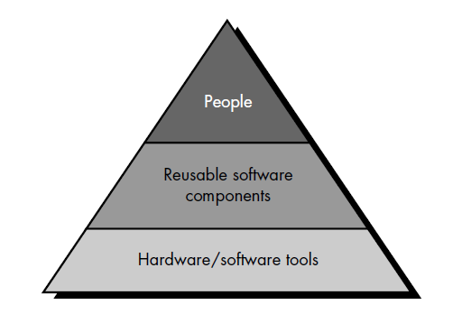
Project Planning Objectives
Resources. The second software planning task is estimation of the resources required to accomplish the software development effort .

Slide 40
Project Planning Objectives
Resources. Each resource is specified with four characteristics:
description of the resource,
a statement of availability,
time when the resource will be required;
duration of time that resource will be applied

Slide 41
Project Planning Objectives
Resources.
Human Resources.
The planner begins by evaluating scope and selecting the skills required to complete development. Both organizational position (e.g., manager, senior software engineer) and specialty (e.g., telecommunications, database, client/server) are specified.
For relatively small projects (one person-year or less), a single individual may perform all software engineering tasks, consulting with specialists as required.
The number of people required for a software project is determined only after an estimate of development effort (person-months) is made.

Slide 42
Project Planning Objectives
Resources.
Reusable Software Resources. Four software resource categories:
Off-the-shelf components. Existing software that can be acquired from a third party or that has been developed internally for a past project
Full-experience components. Existing specifications, designs, code, or test data developed for past projects that are similar to the software to be built for the current project. Members of the current software team have had full experience in the application area represented by these components.

Slide 43
Project Planning Objectives
Resources.
Reusable Software Resources. Four software resource categories (cont.):
Partial-experience components. Existing specifications, designs, code, or test data developed for past projects that are related to the software to be built for the current project but will require substantial modification. Members of the current software team have only limited experience in the application area represented by these components
New components. Software components that must be built by the software team specifically for the needs of the current project.

Slide 44
Project Planning Objectives
Resources.
Environmental Resources. Software engineering environment (SEE) incorporates hardware and software. A project planner must prescribe the time window required for hardware and software and verify that these resources will be available.

Slide 45
Software Project Estimation
Software cost and effort estimation.
Many variables - human, technical, environmental, political - can affect the ultimate cost of software and effort .
To achieve reliable cost and effort estimates:
Delay estimation until late in the project (obviously, we can achieve 100% accurate estimates after the project is complete!).
Base estimates on similar projects that have already been completed.
Use relatively simple decomposition techniques to generate project cost and effort estimates.
Use one or more empirical models for software cost and effort estimation.

Slide 46
Software Project Estimation
Software Project Estimation Techniques
Decomposition techniques take a "divide and conquer’’ approach to software project estimation. By decomposing a project into major functions and related software engineering activities, cost and effort estimation can be performed in a stepwise fashion (LOC-based, FP-based Estimation).
Empirical estimation models can be used to complement decomposition techniques and offer a potentially valuable estimation approach in their own right (COCOMO Model).
Automated estimation tools implement one or more decomposition techniques or empirical models.

Slide 47
Content
Part IV
Risk Analysis & Management
Notes:
Cach do, do do, va so do

Slide 48
Software Risk
Risk always involves two characteristics
Uncertainty - the risk may or may not happen; that is, there are no 100% probable risks.
Loss - if the risk becomes a reality, unwanted consequences or losses will occur.

Slide 49
Software Risk
Risk always involves two characteristics
Uncertainty - the risk may or may not happen; that is, there are no 100% probable risks.
Loss - if the risk becomes a reality, unwanted consequences or losses will occur.

Slide 50
Software Risk
Project risks threaten the project plan, if project risks become real, it is likely that project schedule will slip and that costs will increase (budgetary, schedule, personnel, resource, customer and requirements problems).
Technical risks threaten the quality and timeliness of the software to be produced. If a technical risk becomes a reality, implementation may become difficult or impossible (design, implementation, interface, verification, and maintenance problems).
Business risks threaten the viability of the software to be built.

Slide 51
Software Risk
Risk identification is a systematic attempt to specify threats to the project plan (estimates, schedule, resource loading, …)
Risk item checklist
Product size—risks associated with the overall size of the software to be built or modified.
Business impact—risks associated with constraints imposed by management for the marketplace
Customer characteristics—risks associated with the sophistication of the customer and the developer's ability to communicate with the customer in a timely manner.

Slide 52
Software Risk
Risk item checklist (cont.)
Process definition—risks associated with the degree to which the software process has been defined and is followed by the development organization
Development environment—risks associated with the availability and quality of the tools to be used to build the product
Technology to be built—risks associated with the complexity of the system to be built and the "newness" of the technology that is packaged by the system
Staff size and experience—risks associated with the overall technical and project experience of the software engineers who will do the work.

Slide 53
Software Risk
Risk projection (called risk estimation), attempts to rate each risk in two ways
the likelihood or probability that the risk is real
the consequences of the problems associated with the risk, should it occur.

Slide 54
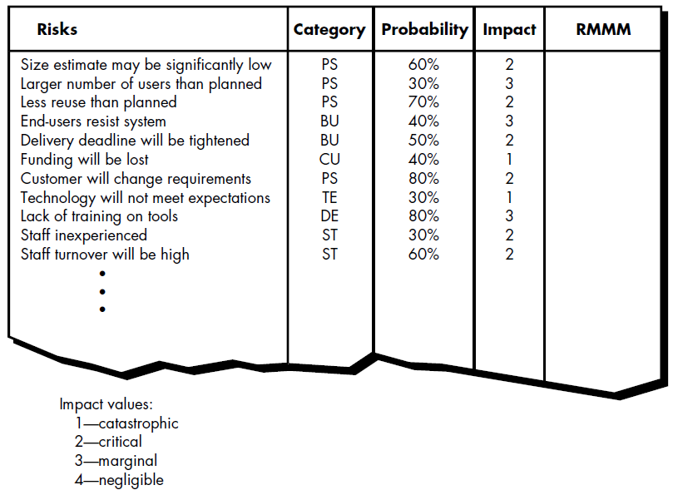
Software Risk
Risk projection
Developing a Risk Table

Slide 55
Software Risk
Risk Refinement
To refine the risk into a set of more detailed risks
Represent the risk in condition-transition-consequence (CTC)
“Given that <condition> then there is concern that (possibly) <consequence>.”
Then <condition> will be refined in <subcondition 1>, <subcondition 2>, <subcondition 3>,…

Slide 56
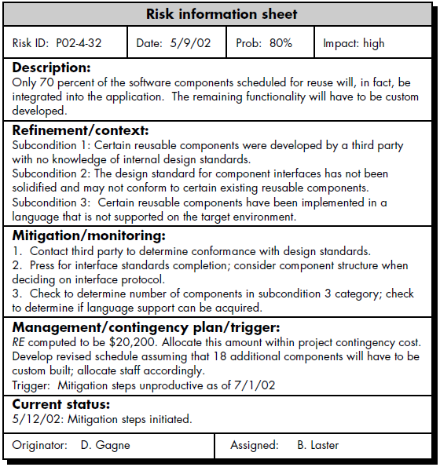
Software Risk

Slide 57
Content
Part V
Project Scheduling and Tracking
Notes:
Cach do, do do, va so do

Slide 58
Project Scheduling
Software project scheduling is an activity that distributes estimated effort across the planned project duration by allocating the effort to specific software engineering tasks.
A macroscopic schedule is refined into a detailed schedule.
Effort Distribution: 40–20–40 rule.

Slide 59
Project Scheduling
Defining a task set
A task set is a collection of software engineering work tasks, milestones, and deliverables that must be accomplished to complete a particular project.
Defining a task network
A task network (activity network) is a graphic representation of the task flow for a project.

Slide 60
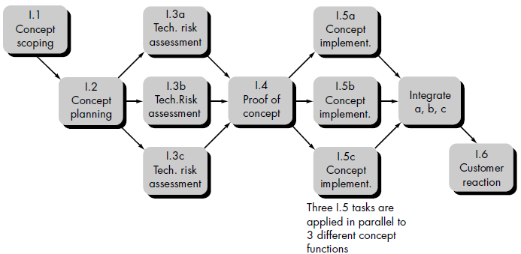
Project Scheduling
A task network example for concept development

Slide 61
Project Scheduling
Scheduling
Two methods: Program evaluation and review technique (PERT) and critical path method (CPM).
Driven by: estimates of effort, a decomposition of the product function, the selection of the appropriate process model and task set, decomposition of tasks.
Determine the critical path—the chain of tasks that determines the duration of the project;
Establish “most likely” time estimates for individual task by applying statistical models;
Calculate “boundary times” that define a time “window” for a particular task.

Slide 62
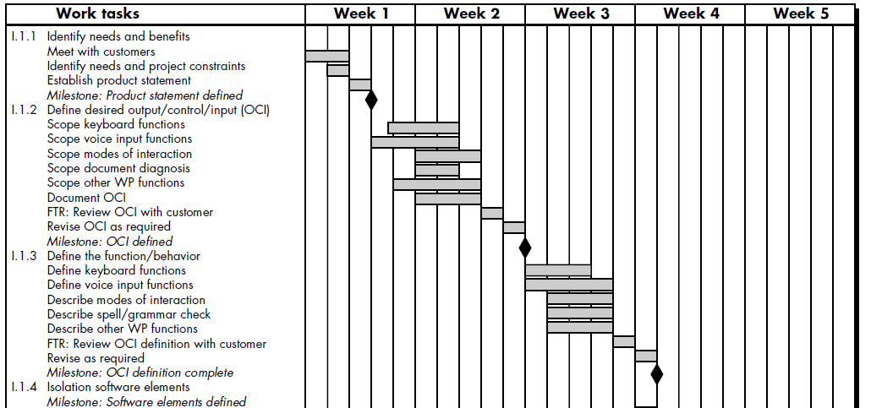
Project Scheduling
Timeline chart (Gantt chart)
begins with a set of tasks (the work breakdown structure)
effort, duration, and start date are then input for each task (may assign specific individuals).

Slide 63
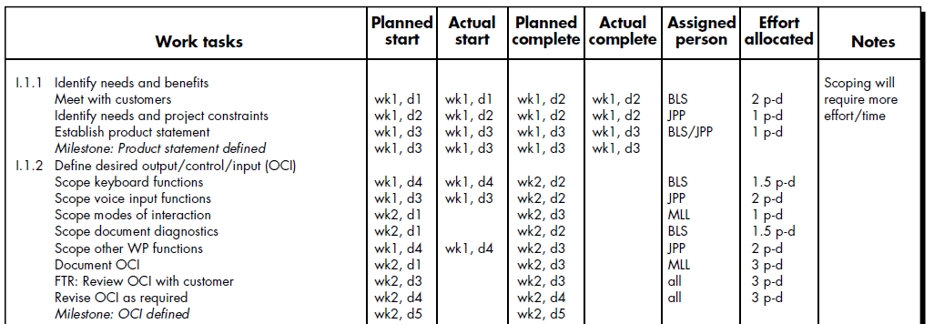
Project Scheduling
Project Table
listing of all project tasks, their planned and actual start- and end-dates, and a variety of related information
project tables enable the project manager to track progress.

Slide 64
Tracking the Schedule
Conducting periodic project status meetings in which each team member reports progress and problems.
Evaluating the results of all reviews conducted throughout the software engineering process.
Determining whether formal project milestones have been accomplished by the scheduled date.
Comparing actual start-date to planned start-date for each project task listed in the project table.
Meeting informally with practitioners to obtain their subjective assessment of progress to date and problems on the horizon.

Slide 65
Project Plan
Software Project Plan
communicate scope and resources to software management, technical staff, and the customer;
define risks and suggest risk aversion techniques;
define cost and schedule for management review;
provide an overall approach to software development for all people associated with the project;
outline how quality will be ensured and change will be managed.

