Slide 1
TRANSACTION
Lê Hồng Hải
UET-VNUH
Notes:
This template can be used as a starter file for presenting training materials in a group setting.
Sections
Right-click on a slide to add sections. Sections can help to organize your slides or facilitate collaboration between multiple authors.
Notes
Use the Notes section for delivery notes or to provide additional details for the audience. View these notes in Presentation View during your presentation.
Keep in mind the font size (important for accessibility, visibility, videotaping, and online production)
Coordinated colors
Pay particular attention to the graphs, charts, and text boxes.
Consider that attendees will print in black and white or grayscale. Run a test print to make sure your colors work when printed in pure black and white and grayscale.
Graphics, tables, and graphs
Keep it simple: If possible, use consistent, non-distracting styles and colors.
Label all graphs and tables.

Slide 2
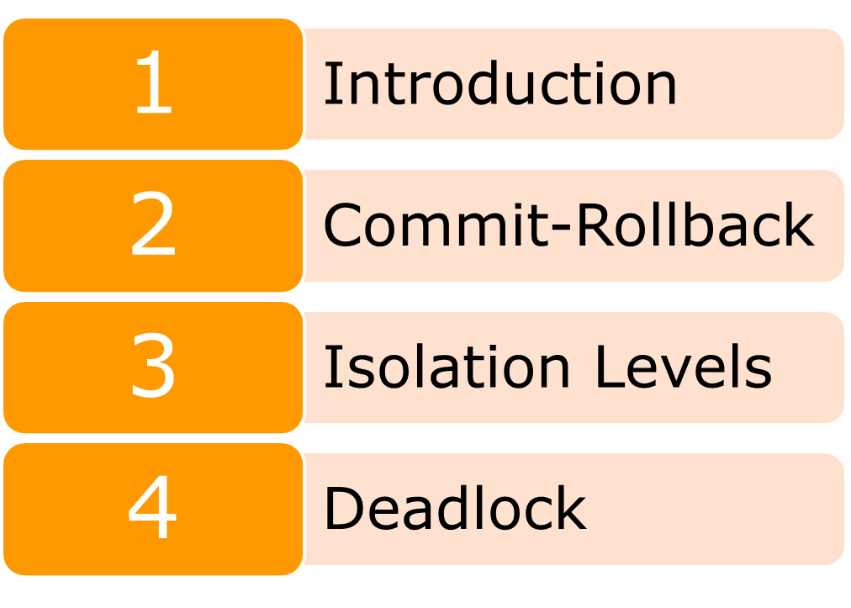
Notes:
This is another option for an Overview slide.

Slide 3
A bank customer transfers money from his savings account to his current account
A transaction to add new sales order:
  Insert a new sales order into the orders table for a given customer.
  Insert new sales order items into the orderdetails table
Notes:
We need to update both accounts

Slide 4

Now, imagine what would happen if one or more steps above fail due to some reasons

Slide 5
Transaction allows you to execute a set of operations to ensure that the database never contains the result of partial operations
If one of them fails, the rollback occurs to restore the database to its original state
If no error occurs, the entire set of statements is committed to the database

Slide 6
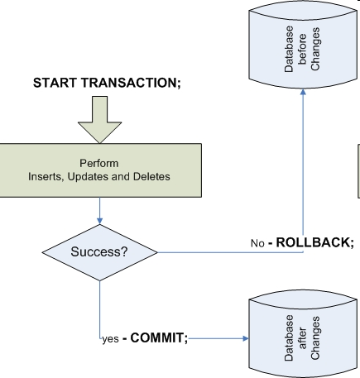
Notes:
If one of them fails, the rollback occurs to restore the database to its original state
If no error occurs, the entire set of statements is committed to the database

Slide 7
-- 1. start a new transaction
START TRANSACTION;
-- 2. Get the latest order number
SELECT
@orderNumber:=MAX(orderNUmber)+1
FROM
orders;
-- 3. insert a new order for customer 145
INSERT INTO orders(orderNumber,
orderDate,
requiredDate,
shippedDate,
status,
customerNumber)
VALUES(@orderNumber,
'2005-05-31',
'2005-06-10',
'2005-06-11',
'In Process',
145);

Slide 8
-- 4. Insert order line items
INSERT INTO orderdetails(orderNumber,
productCode,
quantityOrdered,
priceEach,
orderLineNumber)
VALUES(@orderNumber,'S18_1749', 30, '136', 1),
(@orderNumber,'S18_2248', 50, '55.09', 2);
-- 5. commit changes
COMMIT;

Slide 9
The SAVEPOINT command defines a marker in a transaction
The ROLLBACK TO SAVEPOINT command allows rolling back to a previous marker

Slide 10
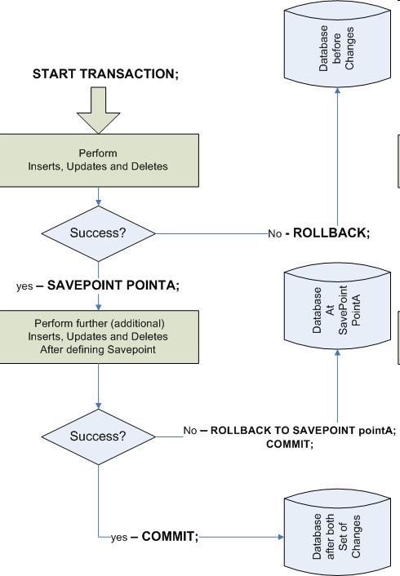

Slide 11
MySQL InnoDB storage engine supports transactions
MyISAM does not support transactions

Slide 12
ACID (Atomic, Consistent, Isolated, Durable)
https://www.ibm.com/docs/en/cics-ts/5.4?topic=processing-acid-properties-transactions

Slide 13
http://www.mysqltutorial.org/mysql-transaction.aspx
http://www.mysqltutorial.org/mysql-jdbc-transaction/

Slide 14
The two-phase commit protocol provides atomicity for distributed transactions to ensure that each participant in the transaction agrees on whether the transaction should be committed or not

Slide 15
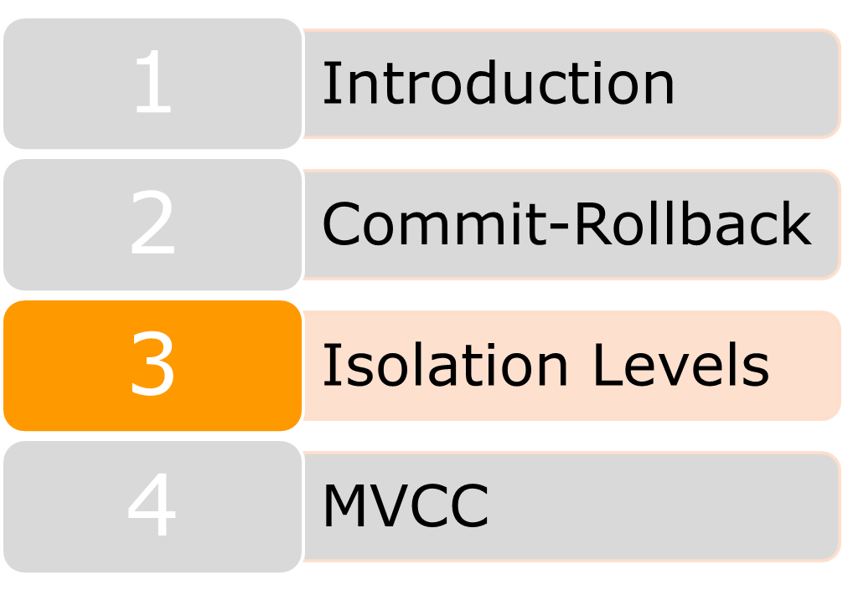
Notes:
This is another option for an Overview slide.

Slide 16
In databases, multiple users can view and edit data simultaneously
Concurrent operations can result in inconsistent and inaccurate data
Notes:
At the same time

Slide 17
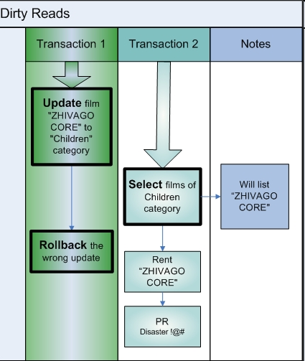
Dirty read occurs when a transaction is allowed to read data being updated by another uncommitted transaction

Slide 18
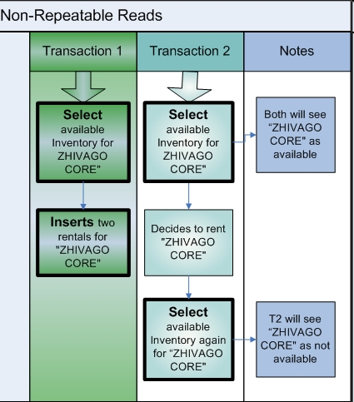

Slide 19
Occurs when within a transaction, two identical queries return different sets of rows when executed

Slide 20
Isolation Levels | Usage | Dirty reads | Nonrepeatable reads | Phantom reads
READ UNCOMMITTED | Use in situations where accuracy is not so important | Yes | Yes | Yes
READ COMMITTED | Prevent dirty reads | No | Yes | Yes
REPEATABLE-READ | Default Isolation level in MySQL | No | No | Yes
SERIALIZABLE | Transactions are completely isolated from each other and are processed sequentially | No | No | No

Slide 21
To decide the isolation level to use, it is necessary to balance between the required level of accuracy of the retrieved data and the processing performance
The higher the isolation level, the more impact it has on performance

Slide 22
SET SESSION tx_isolation='READ-COMMITTED';
SELECT @@global.tx_isolation, @@session.tx_isolation
Mysql8 has renamed tx_isolation to transaction_isolation.

Slide 23
MySQL uses MVCC in transaction management
MVCC provides each connection to the database with a snapshot of the data
Any changes will not be visible to other users until the transaction is committed
http://en.wikipedia.org/wiki/Multiversion_concurrency_control

Slide 24
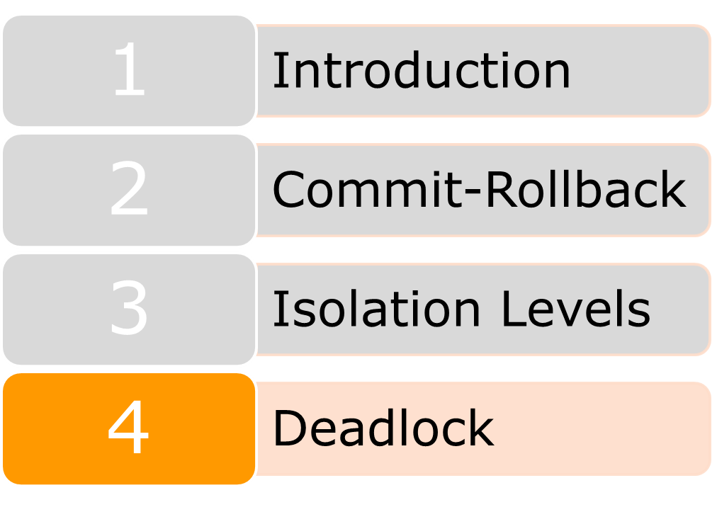
Notes:
This is another option for an Overview slide.

Slide 25
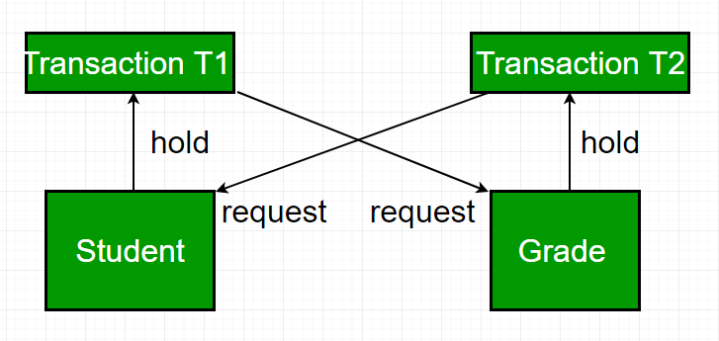
A deadlock happens when two or more transactions are mutually holding and requesting locks on the same resources, creating a cycle of dependencies

Slide 26
To solve this problem, database systems implement various forms of deadlock detection and timeout
The InnoDB storage engine will notice circular dependencies and return an error instantly
SELECT * from performance_schema.data_locks;

Slide 27
To lock tables that do not support transactions, use the LOCK TABLES statement
Once you have completed updating the tables, you need to use the UNLOCK TABLES statement to release the tables

Slide 28
REPLICATION
Notes:
This template can be used as a starter file for presenting training materials in a group setting.
Sections
Right-click on a slide to add sections. Sections can help to organize your slides or facilitate collaboration between multiple authors.
Notes
Use the Notes section for delivery notes or to provide additional details for the audience. View these notes in Presentation View during your presentation.
Keep in mind the font size (important for accessibility, visibility, videotaping, and online production)
Coordinated colors
Pay particular attention to the graphs, charts, and text boxes.
Consider that attendees will print in black and white or grayscale. Run a test print to make sure your colors work when printed in pure black and white and grayscale.
Graphics, tables, and graphs
Keep it simple: If possible, use consistent, non-distracting styles and colors.
Label all graphs and tables.

Slide 29
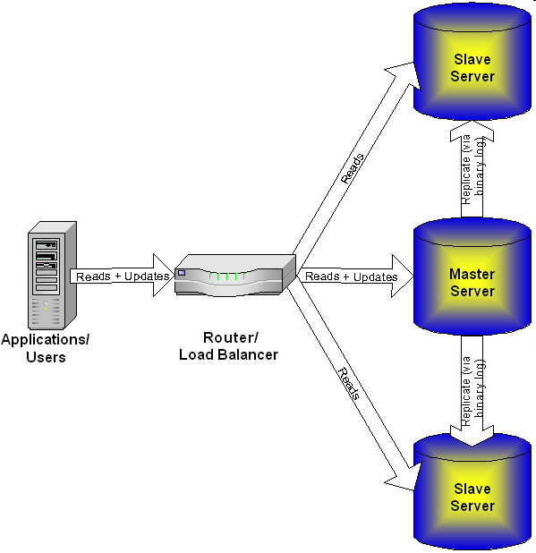
Notes:
Updates to one database are automatically replicated to other replicas
Updates to the master server
Queries that read data can be assigned to the master server or slave servers

Slide 30
Updates to one database are automatically replicated to other replicas
Updates to the master server (primary)
Queries that read data can be assigned to the master server or slave servers (replicas)

Slide 31
Availability: Replicas can be used as "hot" backups; if the master database is not available, the replicas can take over as the master until the error is resolved
Backups: Replicas can be used as backups, which can be used to perform long backups without locking the master
Load Balancing: Read queries can be distributed to different replicas

Slide 32
In MySQL, replication is a one-way, asynchronous process
The master database will store all updates in a binary log file. Updates in the log file are then used to synchronize the database on the slave server
Slave servers connect to the master server to read log files and update changes

Slide 33
Statement-based binary logging: the master writes SQL statements to the binary log
Row-based logging: the master writes events to the binary log that indicate how individual table rows are changed
Depending on certain statements, and also the storage engine being used, the log is automatically switched to row-based in particular cases

Slide 34
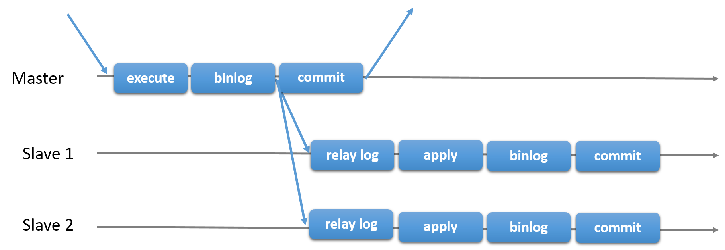

Slide 35
  CHANGE MASTER TO MASTER_HOST='192.168.0.100', MASTER_USER='slave_user', MASTER_PASSWORD='<some_password>', MASTER_LOG_FILE='mysql-bin.006', MASTER_LOG_POS=183;

Slide 36
  START SLAVE;
  SHOW SLAVE STATUS

Slide 37
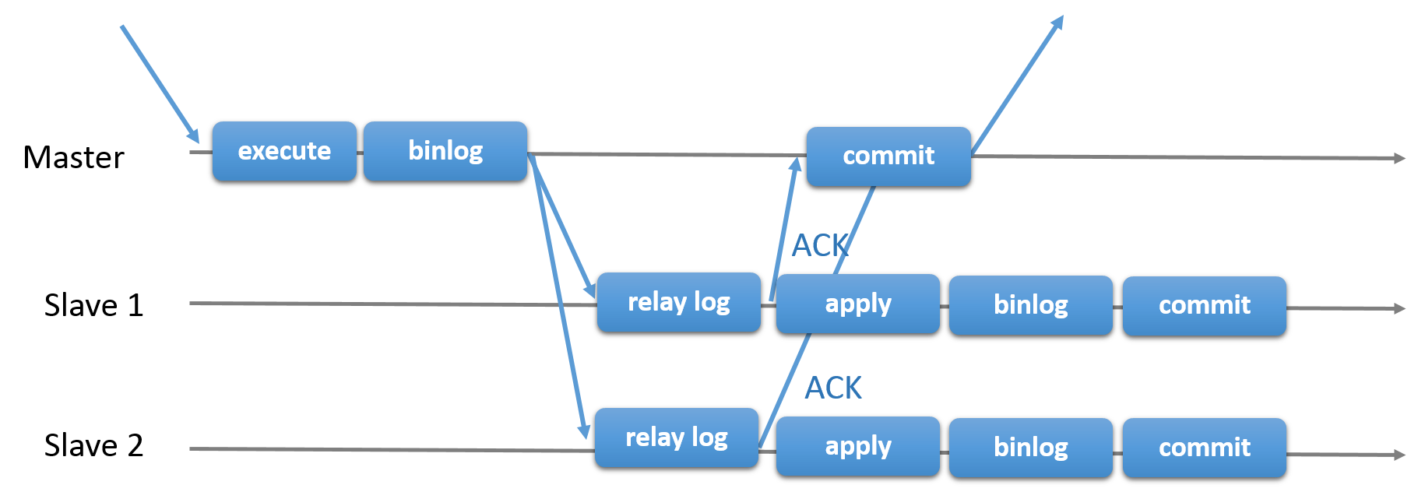

Slide 38
While the master is blocking (waiting for acknowledgment from a slave), it does not return to the session that performed the transaction
When the block ends, the master returns to the session, which then can proceed to execute other statements

Slide 39
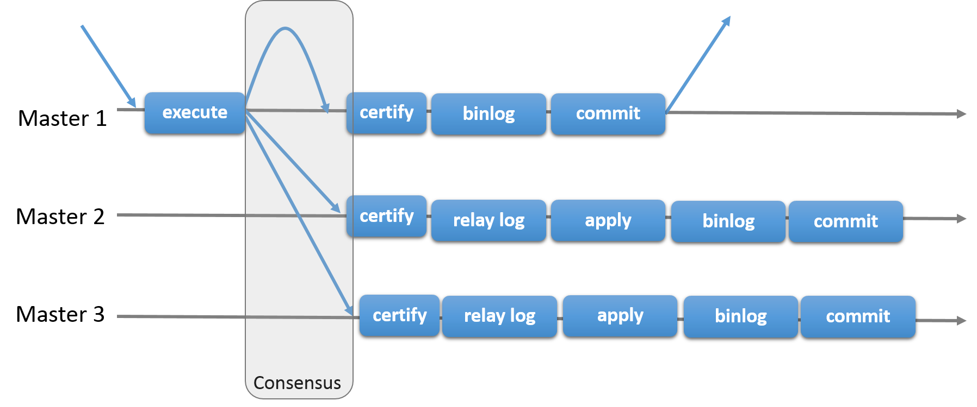
Implements a multi-master update everywhere replication protocol.

Slide 40
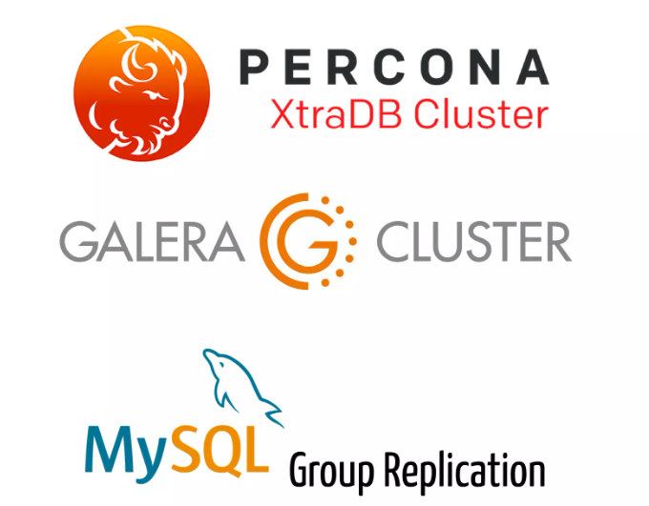

Slide 41
THANKS YOU
Notes:
Microsoft Engineering Excellence
Microsoft Confidential

