Slide 1
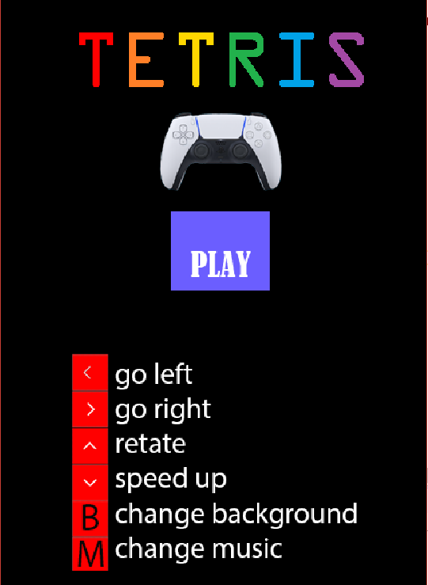
TETRIS
Group 20:
TRẦN THANH LẬP
BÙI QUANG HIẾU

Slide 2
I.INTRO
Tetris is a tile-matching video game created by Russian software engineer Alexey Pajitnov in 1984
In Tetris, players complete lines by moving differently shaped pieces , which descend onto the playing field. The completed lines disappear and grant the player points, and the player can proceed to fill the vacated spaces. The game ends when the playing field is filled. The longer the player can delay this inevitable outcome, the higher their score will be

Slide 3
II.CLASS
BOARD
IMAGE LOADER
SHAPE
TITLE
WINDOW

Slide 4
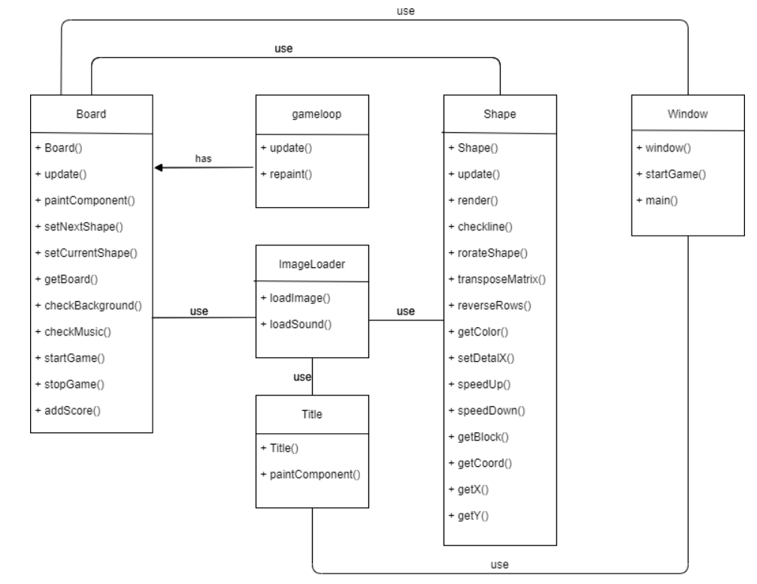
III.CLASS DIAGRAM

Slide 5
IV.DEMO

