Slide 1
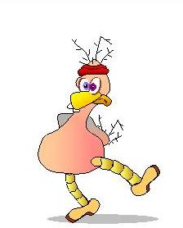
John
john@build-it-yourself.com
Bio
Projects
Skills
Resume

Slide 2
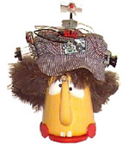
John’s Bio
john@build-it-yourself.com
Heroes:
Muhammad Ali, don Quixote, and Popeye
because at great peril, they stick to their moral compass.
Quote Fav:
“You can't win if you don't bet.” Anonymous
Most Fun:
- Playing Antonio Palafox at the Forest Hills Nationals
- Swatting a tennis balls on the Spanish circuit and chasing senoritas
- Jamming with Duke Robillard
Running the Bermuda marathon
Moving earth for a water garden
Sailing an RC pirate ship on the Thames in a model boat regatta
Building a nipa hut in the Philippines
Building action contraptions with kids
Book Favs:
- Fountainhead and Atlas Shrugged
- The World is Flat
Donald Duck comics
Home

Slide 3
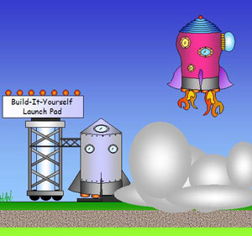
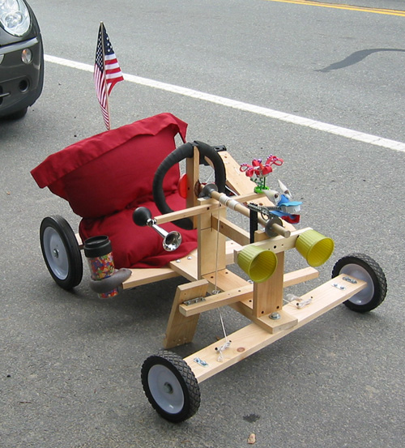
John’s Projects john@build-it-yourself.com
Rocket Works
Scratch Game
Soap Box Racer
Pirate Ship
Home

Slide 4
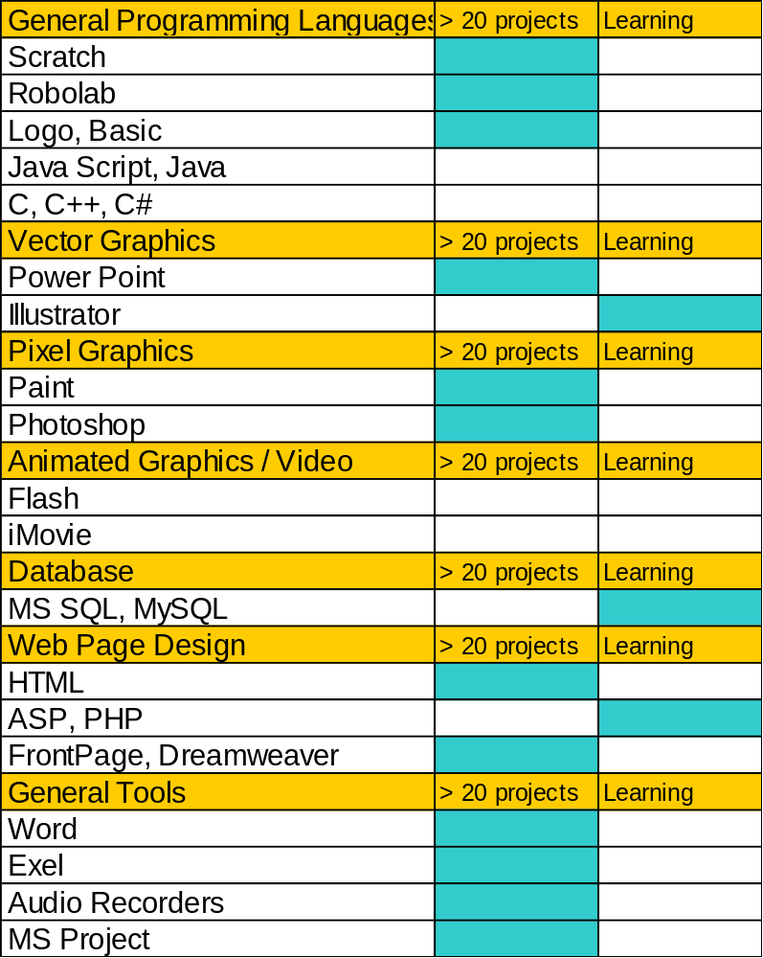
John’s Skills john@build-it-yourself.com
Home

Slide 5
John john@build-it-yourself.com
School: | Cornell MEE, BEE
Favorite Courses: | - Philosophy of religion Arc Welding Digital circuit design Principles of graphic design
Describe a problem you would like to solve. | Adults have left some big messes for the next generation to fix, including a mucked up environment, nasty diseases, illogical wars and toilet economics. Entrepreneurs using complex technology will be needed to solve many of these problems. What if we could crete a global laboratory to inspire and empower the next generation of builders and problem solvers?
What skills are you planning to learn? | - Play drums in a blues band. - Design a database driven Web site. - Speak and write Spanish fluently
Project Experience: | - Lunar Excursion Module - SAM-D display controller - Submarine detection system - Telemetry for a Venus fly-by - $500,000 electronic drawing board - Electronic chess terminal - Alarm clock that dumps water on your bed
Home

Slide 6
Profile Page Components
myspace.com/barackobama
Alias Name
Character Avatar (and/or real picture?)
Rocket Avatar
Heroes
Favorite things to do
Least favorite things to do
Favorite quote
Most satisfying accomplishments
Wish list
Collaborate / Contact info
Projects
- Project description
Lab book
Pictures
Videos
JG Notes

Slide 7
John Galinato
john@build-it-yourself.com
School:
Cornell MEE, BEE
Describe a problem you would like to solve:
Adults have left some big messes for the next generation to fix, including a mucked up environment, nasty diseases, illogical wars and toilet economics. Entrepreneurs using complex technology will be needed to solve many of these problems. What if we could use technology, especially Internet collaboration tools, to help inspire and empower the next generation of builders and problem solvers?
Heroes:
Muhammad Ali and Popeye because at great peril, they stick to their moral compass.
Quote Fav:
You can't win if you don't bet.
Hobby Favs:
- Building,
- Strumming the guitar
Swatting at tennis balls.
Project Favs:
- Lunar Excursion Module
- SAM-D display controller
- Submarine detection system
- Telemetry for a Venus fly-by
- $.5M electronic drawing board
- Alarm clock that dumps water on your bed
Wish List Tricks:
- how to play drums in a blues band.
- how to design a database driven Web site.

Slide 8
Please let me know what computer skills you know or want to learn.
1) Know well (>20 projects)
2) Learning
3) Want to learn
General Programming Languages (Scratch, Robolab, JAVA, JAVA Script, C++, C#)
Vector Graphics (PowerPoint, Illustrator)
Pixel Graphics (Photoshop, Paint)
Animated Graphics and Video (Flash, iMovie)
Database (MS SQL, MySQL)
Web Page Design (HTML, ASP, PHP, Front Page, Dreamweaver)
General Tools (Word, Excel, Audio Recorder, ???)
Your computer skills may be an important part of your resume.
I need emails for:
Daniel
Carolyn
Ann
Giuliano
Nathan
Pictures for everyone

Slide 9
Invention Universe Feedback
1) What is the most interesting part of the UI prototype?
Google Map exploration
Integration of popular Internet apps
- Spore
- FaceBook (customizable squarespace.com)
- YouTube
- Make your own planet
2) What is the least interesting?
Avatar
3) What functionality would you most want to work on?
- Kentaro - Templates
- Jonathan - Scratch templates, Flash and HTML
- Nathan - Scratch templates
- Nathaniel - UI / Google Maps
4) If you described the Invention Universe to a buddy, what would be the 2
or 3 features you would focus on and how would you describe these features?
- Google maps navigation
- Make your own planet / profile page
-
5) What components should be on your profile page?
- Flexible essay section
- Establish fixed fields for index and search

