Slide 1
Invention Universe Concept Drawings
Jamie McKiernan
070709
For Build-It-Yourself
John G additions - 070709

Slide 2
Elevator Pitch:
Invention Universe empowers kids to use technology constructively.
Functionality:
Flash intro (Sell Invention Universe
Explore universe
Registration (registration,
log in/out, personal information
management)
Post projects
Project page (create, modify,
commenting system)
User bio/resume page
(create,modify)
Administration /usage monitoring
(user list/ online activity log,
project list, view counts)
Broadcast emails
Collect monthly membership fees
Wins awards and earn points and money (Gold coin system)
Forum for help and discussion
Selling Points:
Fun place to share inventions with others around the world
Serious place to build a valuable school portfolio.
Unique opportunity to collaborate with hot shot student artists and
engineers.
Opportunity to earn fame and fortune.
* V1 Mid-August Functionality
Notes

Slide 3
Wish List:
Wins awards and gold coins
Support user defined graphics
Go to planet address (quadrant / galaxy / star system / planet)
Search for project key words
Support scheduling Webcast workshops
Explore universe with challenges along the way
Add functionality to project page - commenting system, awards
Post expanded user bio/resume (Version 2)
Registration (registration, log in/out, personal information management)
Collect monthly membership fees
Forum for help and discussion
Administration /usage monitoring (user list/ online activity log, project list, view counts)
Support multiple languages
Security
Self-policing system

Slide 4
Wish List:
Challenges to get to a planet should be quick, optional, very fun and have rewards.
New users can download a free trial.
Members can make their own planets, aliens, and rockets.
What can you buy with gold coins?
  Rocket parts
  Access to new graphics and sound effects
  Less challenges to arrive at destination
How do you win gold coins?
When member opens IU they start on their own planet

Slide 5
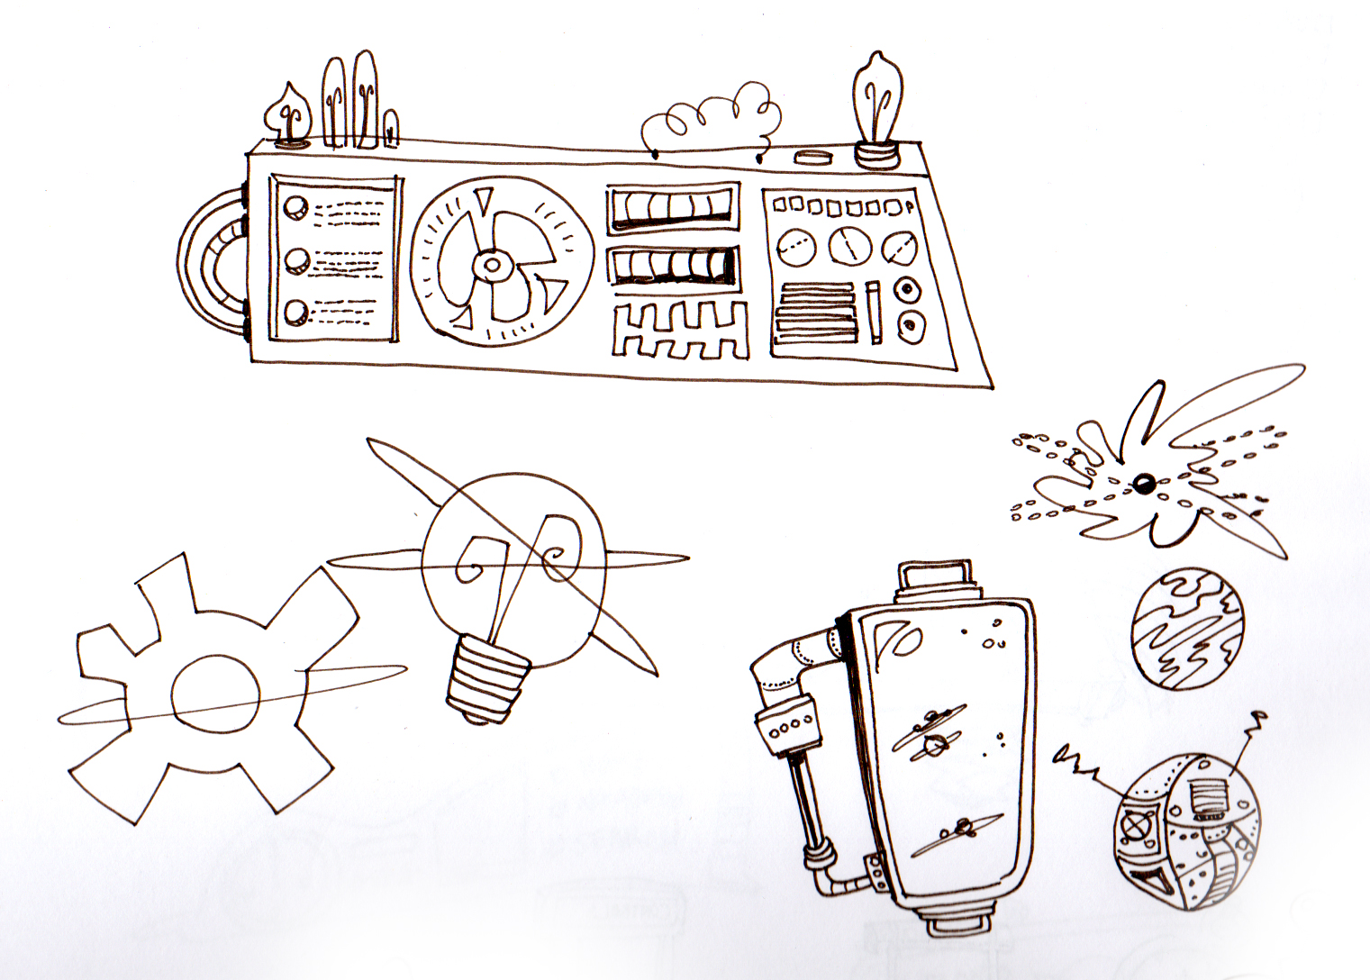
Examples of fun funky line style

Slide 6
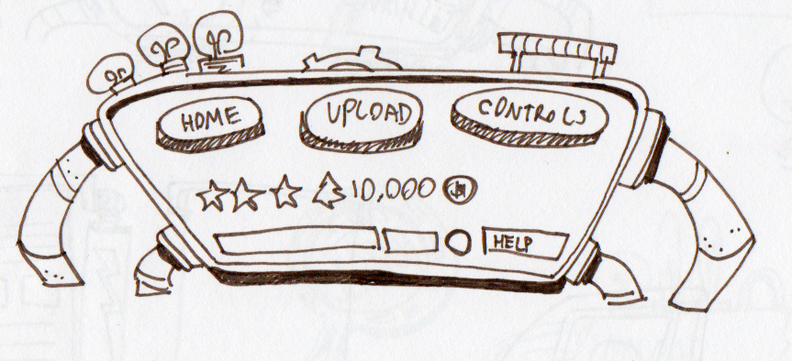
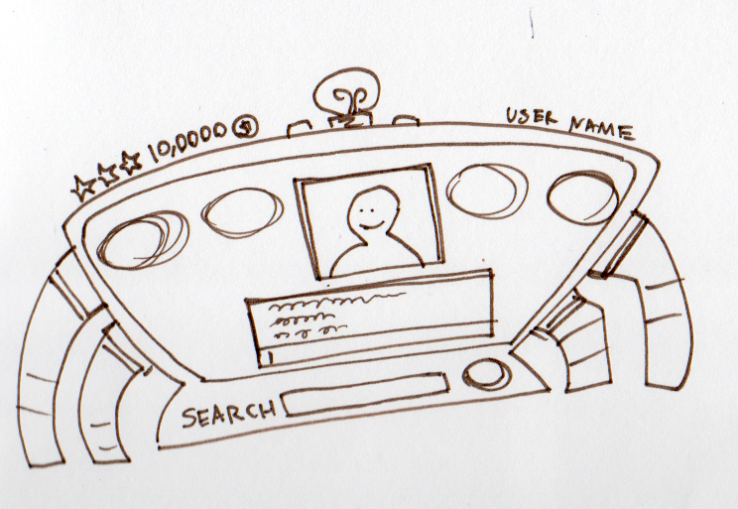
Added potential placement for chat
Box and gold coin count/rating
Nice option for the search bar
position

Slide 7


Slide 8
Build-It-Yourself

