Slide 1

K ickstarter Success
Shark Tank Demo
By Shenica r. Graham
Lambda School Student, WEBPT23
WEB Unit 1 Build, October 24, 2020

Slide 2

Introduction
Hi Sharks. Have you ever lost time and money on a failed fundraising campaign? Crowdfunding is a growing source for the entrepreneurial minded fundraiser. One of the crowdfunding gurus is Kickstarter. According to statista.com, about 17 million people have pledged monetary support of Kickstarter projects. However, Kickstarter reports that 11% of projects finish without ever receiving a single pledge. How can you know if a campaign is likely to fail before investing? You need an edge – a campaign success predictor. Welcome to Kickstarter Success!
By Shenica r. Graham

Slide 3
The Kickstarter Problem
Before I introduce the team, let’s look at the Kickstarter problem. Sure, the idea of raising unlimited funds for your project is inviting. However, the all-or-nothing model of Kickstarter means that if your goal is not met, you lose all pledges – even if you are very close to meeting your fundraising goal. This problem was important to our team because we felt that most campaigns were failing not because of a lack of effort, but because of other factors such as viability in terms of some campaign variables that we will address.
By Shenica r. Graham

Slide 4

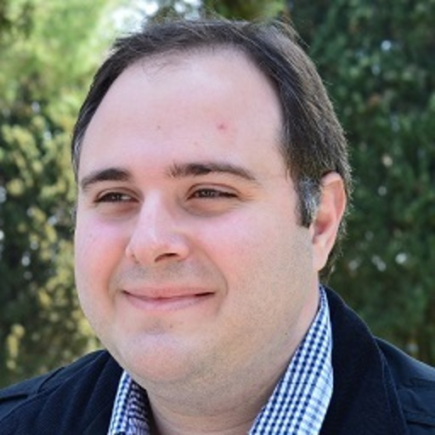



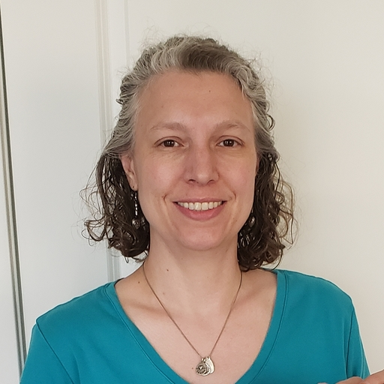
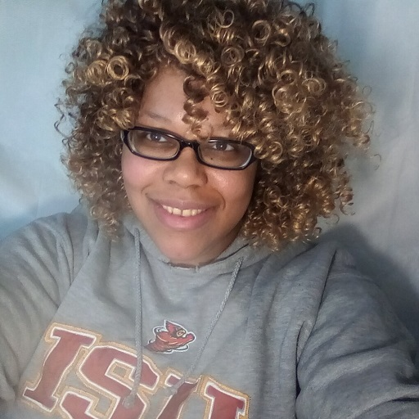

Meet The Team
Project Lead
Frontend Devs
Data Scientists
UI Developers
David Betts
Ismail Al Kamal
Charlie May
Teresa Franxman
Backend Dev
Brian Clayton
Sara West
Shenica Graham
Shomari Roberts
By Shenica r. Graham

Slide 5
Our Story
We are a group of former Kickstarter campaign owners who met through support of each other’s campaigns. When some failed, we decided to collaborate and develop an app that would help end failed campaigns. Being able to predict the likelihood of campaign success or failure before investing time, money, and other resources, was an edge up on the Kickstarter process that would help campaign owners eliminate failure. We analyzed hundreds of thousands of Kickstarter campaigns and found trends in campaign categories, fundraising days, and goals. We developed a success predictor app to identify projects that were likely to succeed or fail. We launched the Kickstarter Success App in October of 2020 and developed a website to allow anyone to use our app for free!
By Shenica r. Graham

Slide 6
About The App
The Kickstarter Success Campaign Predictor (KS) App was created by a team of Lambda School students. It predicts the likelihood of success of your Kickstarter campaign based on details the user submits. The KS app returns a campaign prediction of either “success” or “failure.” This information can be used to help determine whether a campaign is viable or not, before investing time, money, and other resources. Predictions vary based on campaign category, fundraising goal, description, and length in terms of how many days the campaign will run. This app is available to anyone, free of charge at https://kickstarter-success-1.vercel.app/.
By Shenica r. Graham

Slide 7
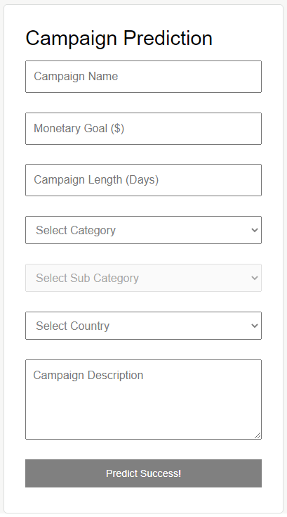
How It Works
The user must first enter a campaign name, monetary goal, and length of campaign in number of days. Next, the user selects a campaign category and subcategory, then his or her country of residence. Finally, the user must enter a campaign description before clicking the “Predict Success!” button. On this event, the KS app uses machine learning techniques to analyze past Kickstarter campaign data and compare it to the user’s submitted parameters.
By Shenica r. Graham

Slide 8
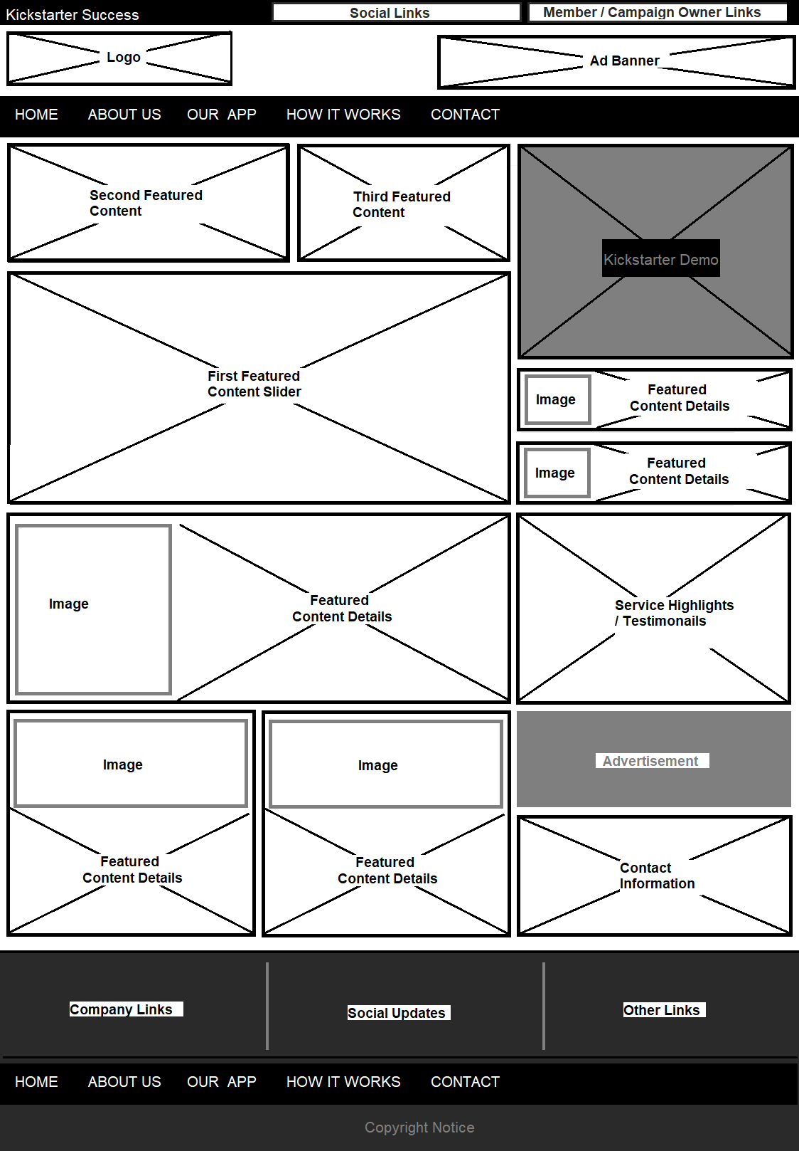
The Website: HTML
The Kickstarter Success marketing website is deployed to Netlify. All elements are laid out using semantic HTML. The code is properly indented with helpful comments making it easier for the next developer to read. The project layout matches choice wireframes and delivers robust content. The header and footer HMTL is shared by all pages. A call to action on the home page (Login) links to the project app.
By Shenica r. Graham

Slide 9
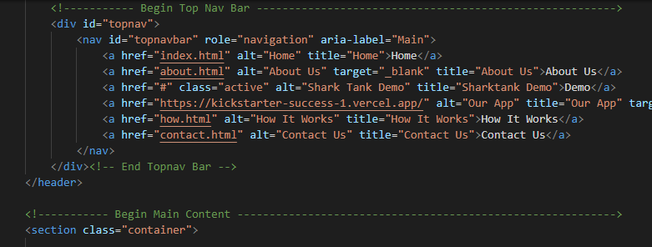
The Website: HTML Sample
By Shenica r. Graham

Slide 10
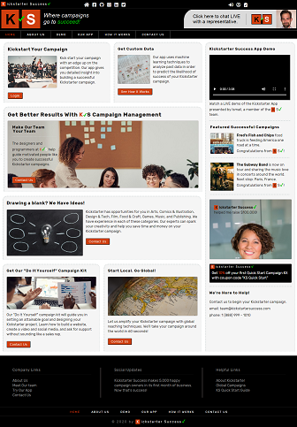
The Website: CSS
The Kickstarter Success website includes clean CSS in an external stylesheet matching design files and using flexbox to achieve the layout. A CSS reset is implemented before custom styles. Scalable units are used throughout the style for images and large containers. Comments are added to make to make it easier for the next developer to read. Helper classes are used to avoid repeating styles. CSS matches design files.
By Shenica r. Graham

Slide 11
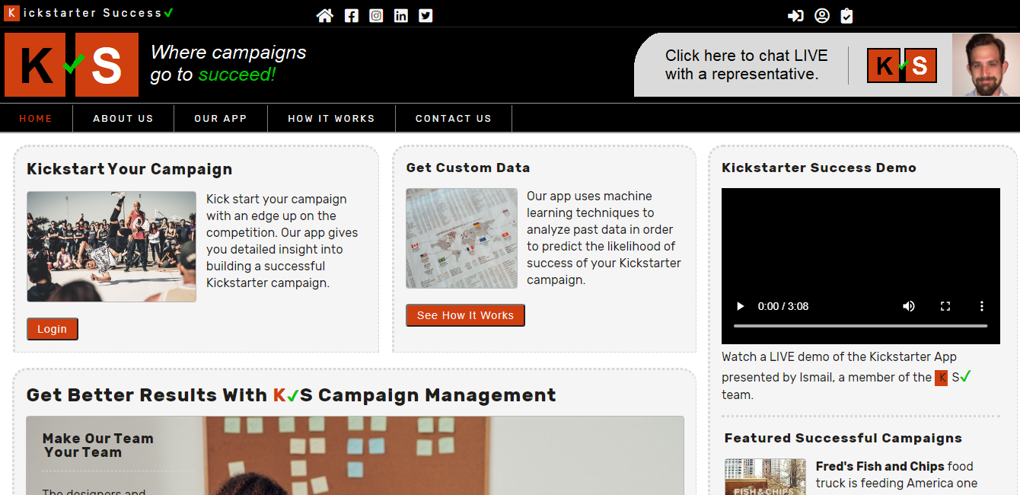
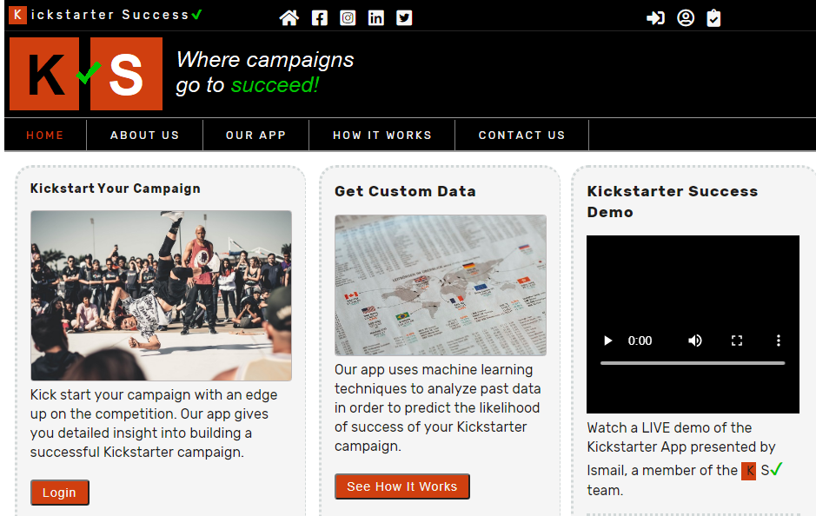
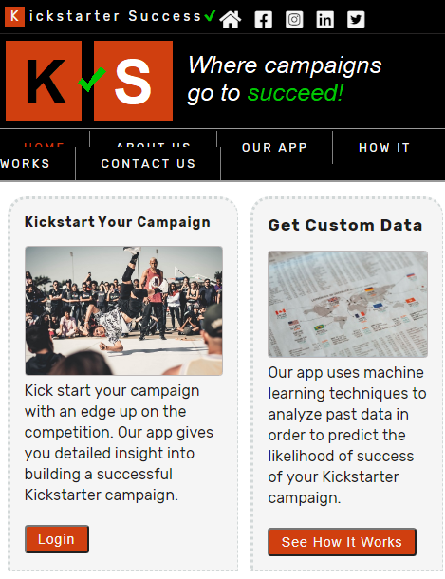
The Website: Responsiveness
The Kickstarter Success site is responsive at desktop (1024px), tablet (800px), and mobile (500) breakpoints. The site looks well between breakpoints due to use of scalable units. Media queries are added for extra breakpoints when site looks abnormal. Images are optimized for fast loading.
By Shenica r. Graham

Slide 12
The Website: Accessibility
Semantic elements are used as much as possible. Alt attributes contain an appropriate image description. The contact form has added labels for each input. The “for” attribute in the label matches the id in the input. ARIA roles are added to elements where needed.
By Shenica r. Graham

Slide 13
Summary
The Kickstarter Success Campaign Predictor (KS) App is ideal to predict the likelihood of success of a Kickstarter campaign before you spend time, money, and other resources. Predictions vary based on category, fundraising goal, description, and campaign length in days. This app is available to anyone, free of charge at https://kickstarter-success-1.vercel.app/.
By Shenica r. Graham

