Slide 1
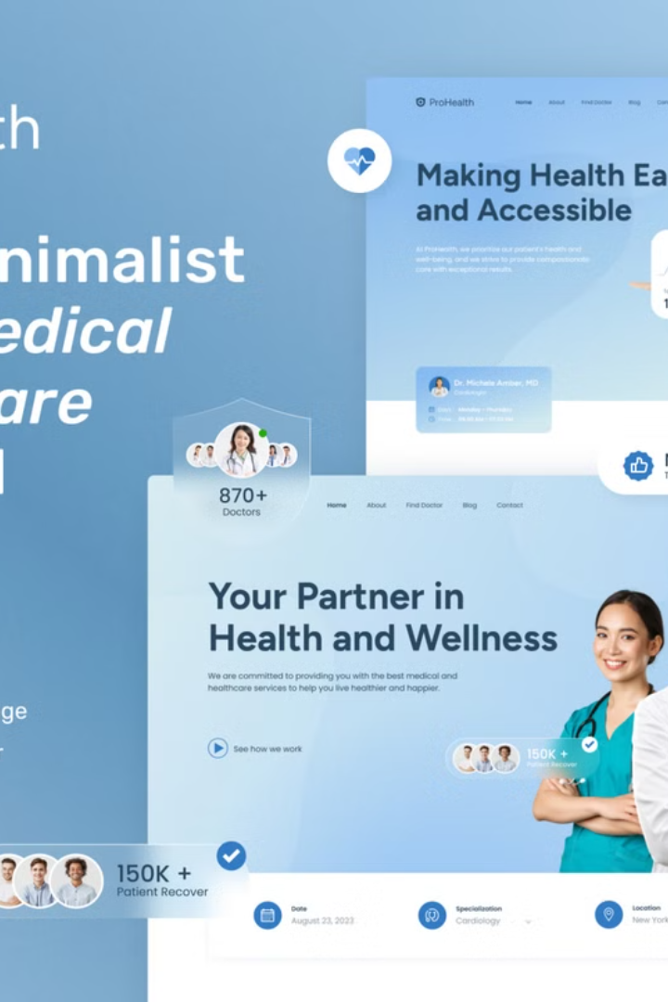
Introduction to Responsive Healthcare Website
Introducing a responsive, feature-rich healthcare website built using the latest web technologies. Designed to provide patients with seamless access to medical services and empower healthcare providers to deliver exceptional care.

Slide 2


Features: Appointment Booking
1
Easy Scheduling
Patients can quickly and conveniently book appointments with healthcare providers.
2
Automated Reminders
Receive timely notifications about upcoming appointments to avoid missed visits.
3
Detailed Profiles
View provider credentials, specialties, and patient reviews to make informed choices.

Slide 3
Features: Doctor Registration
Streamlined Sign-Up
Practice Management
Secure Communication
Healthcare providers can easily register and create their profiles on the website.
Manage appointments, patient records, and billing information in one centralized platform.
Securely communicate with patients, share test results, and provide virtual consultations.

Slide 4

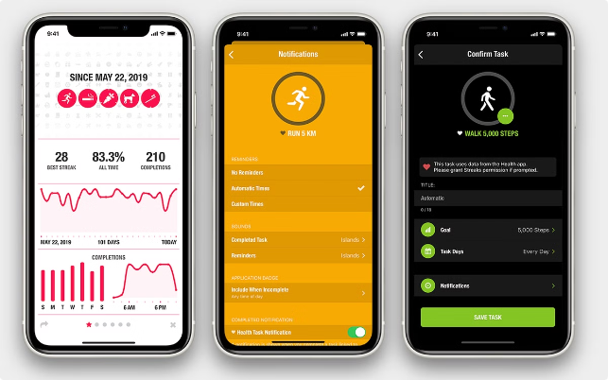
Features: Wellness Tracking Tool
1
Fitness Monitoring
2
Personalized Insights
Monitor physical activity, sleep patterns, and nutrition intake to promote a healthy lifestyle.
Receive tailored recommendations based on individual health data and goals.
3
Progress Tracking
4
Telehealth Integration
Visualize health improvements over time and celebrate milestones.
Seamlessly connect with healthcare providers to discuss wellness progress and concerns.

Slide 5

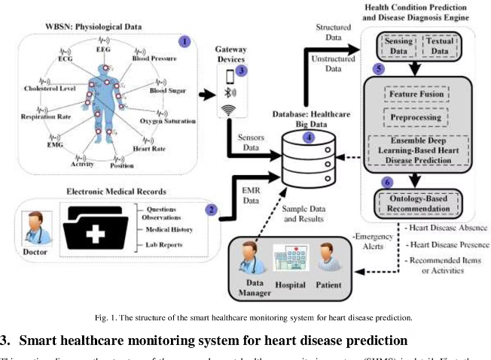
Features: Disease Predictor using Decision Tree Algorithm
Early Detection
Personalized Recommendations
Leveraging advanced algorithms, the website can provide early detection of potential health issues.
Receive tailored suggestions for preventive measures and next steps based on the disease prediction.
Improved Outcomes
Continuous Learning
Early intervention and proactive care can lead to better health outcomes and reduced healthcare costs.
The algorithm continuously learns and improves its accuracy over time, enhancing the predictive capabilities.

Slide 6


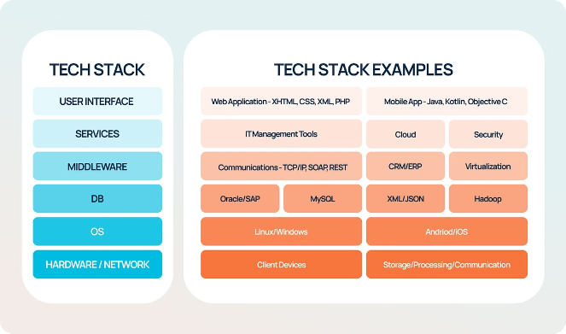


Technology Stack
HTML
Markup language for building the website's structure and content.
CSS
Styling and layout, ensuring a responsive and visually appealing design.
Bootstrap
Rapid development of mobile-first interfaces with pre-built components.
PHP
Server-side scripting for dynamic content, user management, and data processing.
JavaScript
Interactivity, form validation, and client-side functionality for enhanced user experience.

Slide 7
Benefits of Responsive Design for Healthcare
Accessibility
Improved Engagement
Enhanced Efficiency
Patients can access medical services and information anytime, anywhere, on any device.
A user-friendly, responsive design encourages patients to actively manage their health.
Healthcare providers can streamline operations and improve workflow through the website.

Slide 8

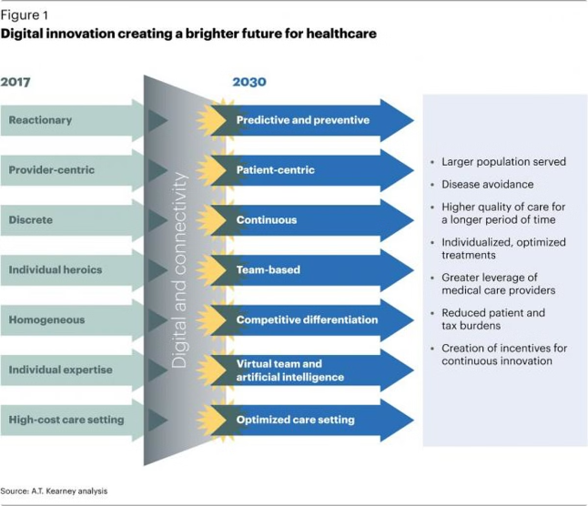



Future Enhancements and Roadmap
AI-Powered Diagnostics
Leveraging machine learning to enhance the disease prediction capabilities.
Telehealth Integration
Seamless virtual consultations and remote patient monitoring.
Personalized Recommendations
Tailored health advice and treatment plans based on individual needs.

