Slide 1







FINDINGS SUMMARY
When a Ride is the Missing Treatment
An investigation into transportation barriers and patient journeys within a regional health system.
DATAFEST 2026
OLAYINKA VAUGHAN
"Do patients who report a transportation barrier use acute care differently than otherwise similar patients?"
TEAM
INSTITUTION
DATE
TEAM 13
Wesleyan University
April 19, 2026
Notes:
We're Team XX from DataFest 2026, and we're here to talk about how transportation access can profoundly shape patient care. Our core finding is that where people get care might be directly tied to whether they can get to their appointments. We've analyzed de-identified encounter and social determinants of health survey data, treating our data sponsor as a regional health system for this presentation. This framing helps us understand the broader implications of our findings. Let's dive into the problem statement and the cohort I studied.

Slide 2



The Question: Does one transportation answer predict a different patient journey?
THE PREMISE
WHAT I MEAN BY ONE TRANSPORTATION ANSWER
Missed Rides, Downstream Costs:
Transportation barriers often lead to missed routine appointments.
Transportation Needs (Q1)
"In the past 12 months, has lack of transportation kept you from medical appointments, meetings, work, or from getting things needed for daily living?"
Reactive Care:
Without preventive access, patients may rely more heavily on acute settings like the ED.
Transportation Needs (Q2)
"In the past 12 months, have you ever had to worry about not having a way to get to your medical appointments?"
"If transportation keeps people from care, I expect to see more reactive use of the hospital system—not as a choice, but as a consequence of blocked access."
Notes:
From our title slide, I move to the central question: does a patient's transportation status predict a different care journey? I hypothesize that if transportation barriers prevent people from accessing care, we'll see that signal in their emergency department and hospital use. I define 'person-years' as the time a patient is observed in our dataset, from their first to last encounter, not their entire lifetime. Similarly, 'window censoring' means I only consider data within this specific observation window. It's crucial to remember that only about 6% of patients in the larger dataset have transportation answers, so our results focus on this screened cohort. We're looking for associations here, not claiming direct causation, and our goal is to understand patient journeys, not to assign blame. Now, let's look at the evidence supporting this hypothesis.

Slide 3

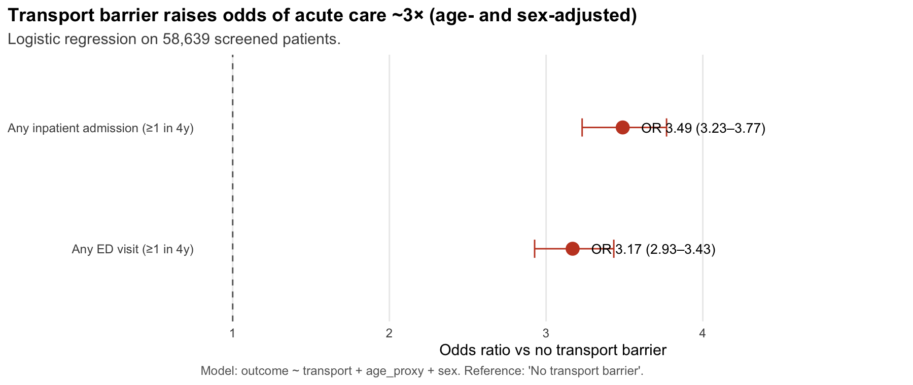

Transport barrier predicts acute-care use after age and sex adjustment
Logistic: outcome ~ transport + age + sex
n = 58,639 | Screening Rate ~6%
3.17
Any ED Visit
[95% CI: 2.93–3.43]
[FIGURE: fig2_transport_adjusted_or.png]
Odds ratio vs no transport barrier (Reference = 1.0)
3.49
Any Inpatient
[95% CI: 3.23–3.77]
Barrier group is younger (median 51 vs 61) — effect is independent
of age.
180-day ED return after index encounter (2022–2025)
CONDITION (INDEX)
NO BARRIER — % WITH ED VISIT (N)
BARRIER — % WITH ED VISIT (N)
Hypertension (I10)
15% (18,890)
33% (672)
Type 2 Diabetes (E11)
17% (7,989)
40% (541)
CKD (N18)
21% (4,118)
37% (238)
AFib / Flutter (I48)
24% (4,166)
34% (183)
Index = first qualifying encounter; barrier n smaller by cell — interpret as descriptive shares.
DATAFEST 2026 · TECHNICAL ANALYSIS · REGIONAL HEALTH SYSTEM
Notes:
We've established the problem, and now we'll look at the evidence. I see clear evidence of higher acute-care intensity for patients facing transportation barriers. Our first point is about magnitude: patients with transportation barriers use acute care three to four times more often. For example, they have 1.94 ED visits per person-year compared to 0.48 for those without barriers. This isn't just an age effect. Our adjusted odds ratios are 3.17 for any ED visit and 3.49 for any inpatient stay, even though the barrier group is actually younger, with a median age of 51 versus 61. Finally, I see the impact within chronic disease cohorts, where the 180-day ED return rate roughly doubles for patients with transportation barriers. While the numbers in the barrier cells are smaller, the higher proportion is striking. These findings point to a clear signal that I can act on. Let's explore some potential solutions.

Slide 4

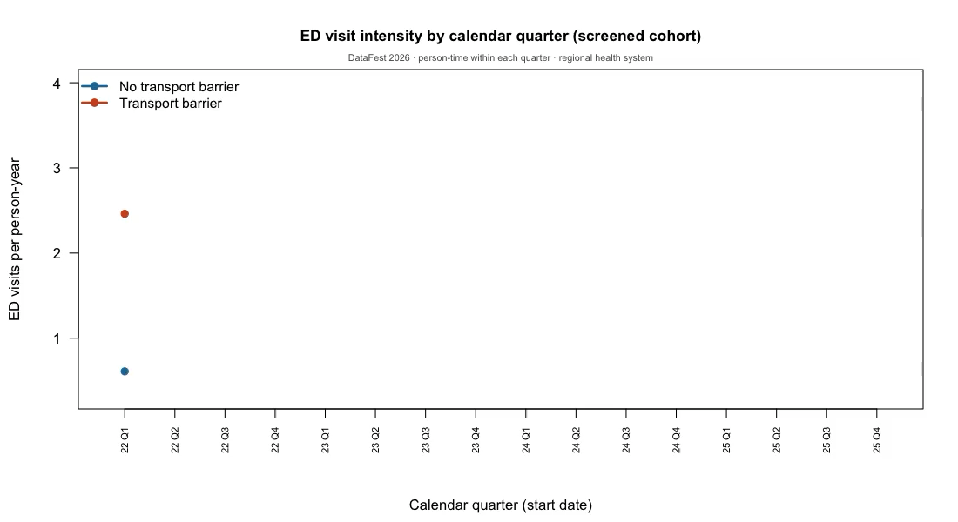





From Signal to Action: Moving Towards Solutions
STRATEGIC INTERVENTIONS
Targeted Transit: Rides and shuttles for high-risk acute-care users.
Telehealth Bridge: Virtual follow-ups to bypass physical distance.
Pharmacy Delivery: Home access for chronic disease management.
CRITICAL CAVEATS
Selection Bias: Non-random screening (~6% of population).
Data Integrity: ~20% of encounters lack matched diagnosis keys.
Geographic Gaps: Missing FIPS data limits spatial modeling.
One transportation screen identifies patients with ~3x adjusted odds of acute care. Ask the question more, and resource the response.
Notes:
Having established the strong signal of transportation barriers impacting acute care, I now turn to actionable solutions. This interactive component, if live, would show how ED intensity evolves over time for both groups. I can reiterate that this is an association, not necessarily causation. For Q&A, consider why I didn't use geographic data—it was missing FIPS codes. I used logistic odds ratios because we're looking at the likelihood of an event. I could also discuss a pilot program, perhaps targeting reduced 30-day readmissions as a success metric. Ultimately, the conclusion is clear: one transportation screen identifies patients with about three times the adjusted odds of acute care. I need to ask this question more often and resource the responses appropriately. Acting on this existing data is a concrete next step for any regional health system.

