Slide 1

01
STUDY SPRINT TRACKER
Master Your Academic Momentum
Presented by: Olayinka Vaughan, Osmani Hernandez, & Adit Syed Afnan
CODEPATH WEB103 FINAL PROJECT

Slide 2

02
THE HIGH COST OF UNSTRUCTURED STUDY
Traditional study methods often lack a centralized way to track deliberate practice, leading to fragmented effort and a loss of academic momentum.
40%
Students frequently struggle to see the "big picture" of their progress across multiple subjects, making abstract intentions difficult to sustain.
PRODUCTIVITY LOSS DUE TO CONTEXT SWITCHING
Fragmented study sessions lead to a significant decrease in retention and focus.
Study Sprint Tracker transforms this by making every minute of study visible and every goal achievable.

Slide 3

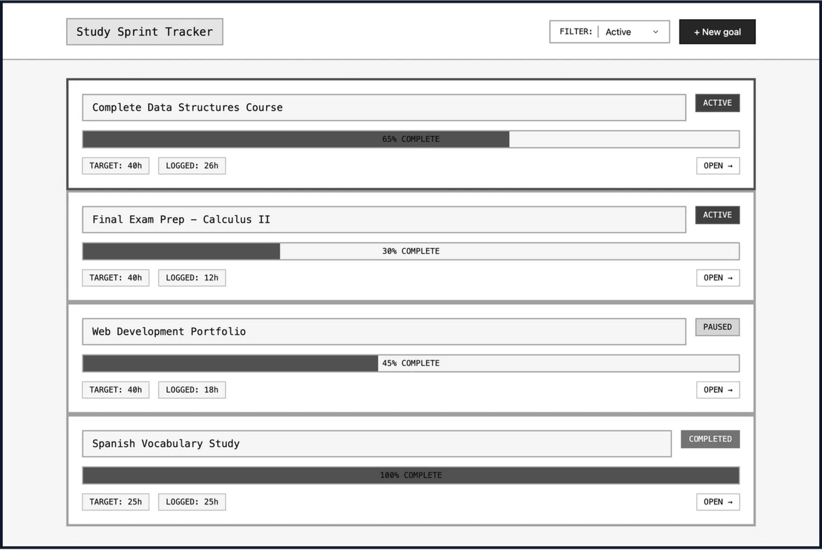
03
TURNING INTENTIONS INTO RESULTS
THE HIGH-IMPACT WORKFLOW
PLAN
Define clear, time-bound objectives to eliminate ambiguity in your study schedule.
TRACK
Use the integrated live timer to log focused effort without leaving your workspace.
VISUALIZE
See real-time progress bars that turn hard work into motivating visual data.

Slide 4

04
DESIGNED FOR THE "FLOW STATE"
MINIMAL FRICTION
MISSION CONTROL
The application's core philosophy is minimal context switching. By utilizing same-page interactions, students can log their work without losing their place.
The Goal Detail View serves as a mission control for every subject, featuring a high-precision timer and recent session history in one unified interface.
SEAMLESS INTERACTION
VISUAL FEEDBACK
Interactive modals for session logging ensure that the user's current workspace remains intact, fostering a deeper level of concentration and focus.
Real-time progress updates provide immediate positive reinforcement, helping students maintain their academic momentum throughout the semester.

Slide 5

05
BUILT FOR RELIABILITY AND SCALE
While the user experience is simple, the underlying technology is built for reliability and performance. The application leverages a modern stack to ensure that student data is always secure and accessible.
React
Responsive, component-driven user interface for seamless interaction.
Express.js
Fully functional and hosted on Render, ready for immediate student adoption.
Robust backend framework handling complex business logic and API requests.
PostgreSQL
Scalable relational database ensuring data integrity and secure persistence.

Slide 6

06
THE FUTURE OF ACADEMIC EXCELLENCE
Study Sprint Tracker is more than just a timer; it is a catalyst for academic growth. By making deliberate practice measurable, we empower students to take full control of their time and academic destiny.
"What gets measured, gets managed. Study Sprint Tracker makes academic success a visible reality."
READY FOR ADOPTION

