Slide 1

Builders Club Sentiment Analysis Challenge
By Roman Kuroptev

Slide 2
Introduction
Objective:
Develop a Sentiment Analysis model that classifies text input as positive or negative.
Evaluate the model using Accuracy, Precision, Recall, and F1 Score.

Slide 3


What is Sentiment Anslysis?

Slide 4
What is Sentiment Anslysis?
Sentiment analysis is a branch of natural language processing (NLP)
Determines the emotional tone or sentiment behind a piece of text. It helps classify text as positive, negative, or neutral,
How It Works:
Text Preprocessing: Cleaning and preparing the text data.
Feature Extraction: Converting text into numerical features (e.g., using TF-IDF, word embeddings).
Modeling: Applying machine learning or deep learning algorithms to classify sentiment.
Applications:
Analyzing customer reviews & feedback
Market Research & Brand Monitoring
Financial Sentiment Analysis
Political & Social Sentiment

Slide 5

Dataset Description
Dataset Name:
Stanford IMDB (Large Movie Review Dataset)
Source:
Developed by the Stanford AI Lab
Content:
50,000 movie reviews in total
Binary sentiment labels: positive and negative
Data Split:
25,000 reviews for training
25,000 reviews for testing
Purpose:
Benchmark sentiment analysis models
Provide a rich, real-world dataset for evaluating NLP algorithms
Key Characteristics:
Natural language reviews with diverse expressions
Balanced classes, ensuring equal representation of sentiments

Slide 6
Data folder structure
aclImdb/
├── train/
│ ├── pos/ <-- Positive reviews for training
│ └── neg/ <-- Negative reviews for training
├── test/
│ ├── pos/ <-- Positive reviews for testing
│ └── neg/ <-- Negative reviews for testing
└── unsup/ <-- Optional: Unlabeled reviews

Slide 7
Data Example
My boyfriend and I went to watch The Guardian.At first I didn't want to watch it, but I loved the movie- It was definitely the best movie I have seen in sometime.They portrayed the USCG very well, it really showed me what they do and I think they should really be appreciated more.Not only did it teach but it was a really good movie. The movie shows what the really do and how hard the job is.I think being a USCG would be challenging and very scary. It was a great movie all around. I would suggest this movie for anyone to see.The ending broke my heart but I know why he did it. The storyline was great I give it 2 thumbs up. I cried it was very emotional, I would give it a 20 if I could!

Slide 8




Tools used

Slide 9
Tools used
Python, has a lot AI libs
Pandas:
Used for data manipulation and analysis.
Helps in cleaning, transforming, and preparing data for modeling.
scikit-learn:
Provides machine learning utilities such as data splitting, preprocessing, and evaluation metrics.
Used in the baseline (logistic regression) approach.
Joblib:
Facilitates efficient model serialization.
Saves trained models and vectorizers for future use.
TensorFlow:
A deep learning framework.
Powers the advanced model with Embedding and Bidirectional LSTM layers.

Slide 10
First Approach:Machine learning
Bag-of-Words (BoW)
CountVectorizer
Logistic Regression
Gradient descend

Slide 11
First Approach
Bag-of-Words (BoW) Representation:
Converts text into a numerical format by representing each document as a vector of word counts.
Ignores word order and grammar; focuses solely on the frequency of each word.
CountVectorizer:
A tool from scikit-learn that automatically converts a collection of text documents into a BoW matrix.
How It Works:
Vocabulary Building: Scans all documents to build a vocabulary of unique words.
Vector Transformation: Counts the occurrence of each word in every document, resulting in a sparse matrix.

Slide 12
Example
Corpus:
Sentence 1: "I love this movie"
Sentence 2: "This movie is great"
Process:
Vocabulary Creation:
Vocabulary might be: ['great', 'is', 'love', 'movie', 'this']
Feature Matrix Generation:
Each sentence is represented as a vector of word counts.
[[0 0 1 1 1],
[1 1 0 1 1]]

Slide 13
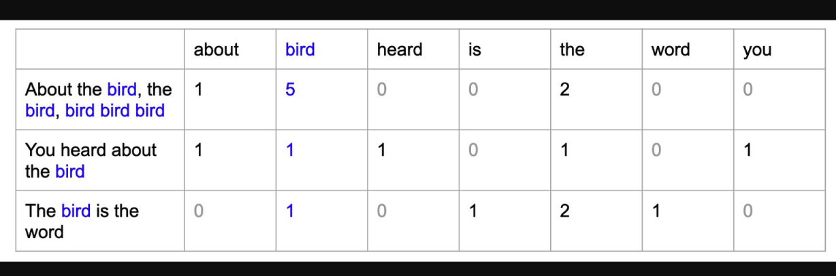

Slide 14
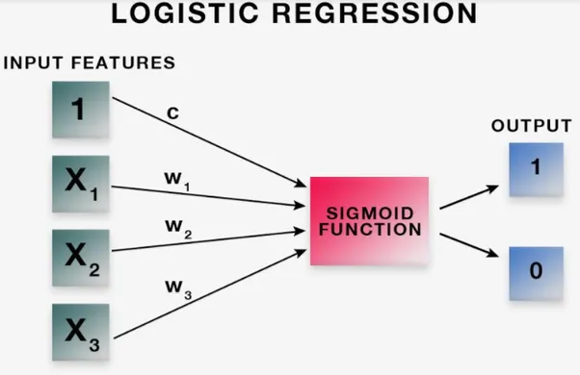

Slide 15
Model training
What is Logistic Regression?
A simple method to decide between two choices (like "yes" or "no"). In our case, it tells whether a review is positive or negative.
How Does It Work?
Inputs:
It takes a set of numbers representing the words in a review (from our bag-of-words approach).
Weighted Sum:
Each word has a weight. The model adds up these weights multiplied by the word counts.
Sigmoid Function:
This sum is run through a function (the sigmoid) that squashes it into a number between 0 and 1.
Decision:
If the result is above 0.5, it classifies the review as positive; if below, as negative.

Slide 16
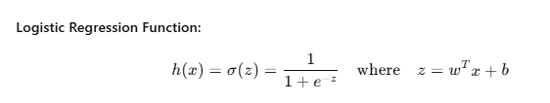
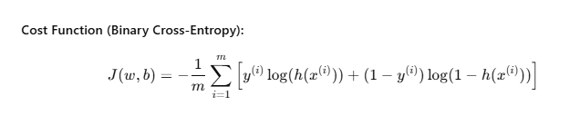
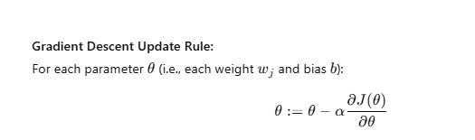
Logistic regression & Gradient descent

Slide 17
Logistic regression & Gradient descent
Input (x) Weights (w) Bias (b)
│ │ │
▼ ▼ │
Compute z = wᵀx + b ──────────────
│
▼
Apply Sigmoid: h(x) = 1 / (1 + e⁻ᶻ)
│
▼
Compute Cost J(w,b)
│
▼
Compute Gradients ∂J/∂w, ∂J/∂b
│
▼
Update Weights and Bias (Gradient Descent)

Slide 18
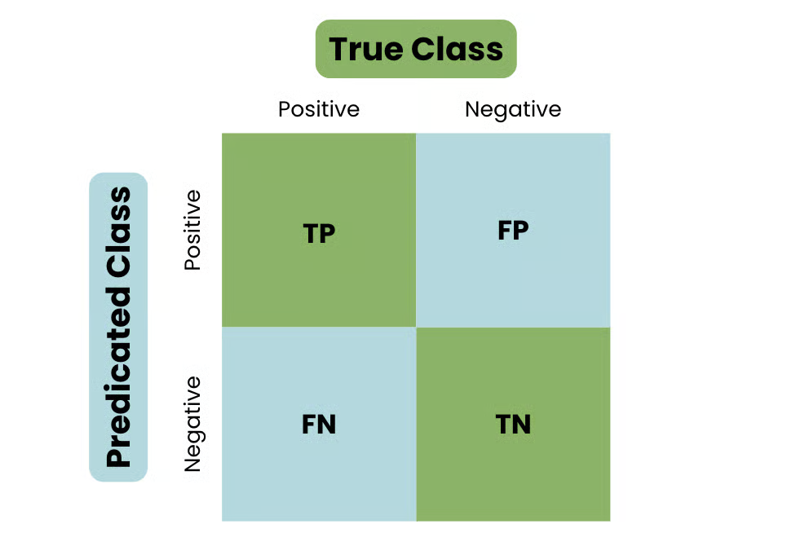
Confusion matrix

Slide 19




Evaluation Metrics
Confusion Matrix Overview:
TP (True Positives): Correctly predicted positive cases.
TN (True Negatives): Correctly predicted negative cases.
FP (False Positives): Incorrectly predicted positive cases.
FN (False Negatives): Incorrectly predicted negative cases.
Meaning:Proportion of total correct predictions.
Meaning: Of all predicted positives, the percentage that were actually positive.
When to Use: Important when the cost of false positives is high.
Meaning: Of all actual positives, the percentage that were correctly predicted.
When to Use: Important when missing a positive case is costly.
Meaning: Harmonic mean of precision and recall; balances both metrics, especially useful when classes are imbalanced.

Slide 20
First approach results
Negative Reviews (Class 0):
Precision: 0.51
(51% of reviews predicted as negative were actually negative)
Recall: 0.06
(Only 6% of actual negative reviews were correctly identified)
F1 Score: 0.11
(Low balance between precision and recall)
Support: 12,500 samples
Positive Reviews (Class 1):
Precision: 0.50
(50% of reviews predicted as positive were correct)
Recall: 0.94
(94% of actual positive reviews were detected)
F1 Score: 0.65
(Reasonable balance, thanks to high recall)
Support: 12,500 samples

Slide 21
First approach results
Macro Average F1 Score: 0.38
(Average performance across both classes, showing overall imbalance)
Weighted Average F1 Score: 0.38
Key Insights:
The model performs well in identifying positive reviews but struggles to correctly classify negatives.
The high recall for positives is offset by the very low recall for negatives, indicating a need for improvement in handling negative sentiment.

Slide 22
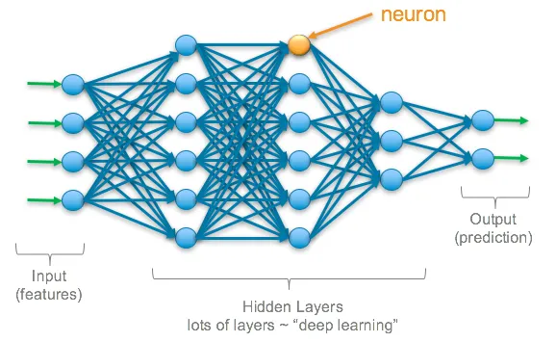
Second Approach: Deep learning
Better pre-processing by cleaning Text
Stacked Bidirectional LSTM Model.
Deep Recurrent Neural Network (RNN)

Slide 23
Data pre processing
Cleaning Text:
Uses a regular expression to remove non-alphabet characters. “!?.” etc
Eliminates stop words using NLTK to focus on informative words.
a, an, the. and, but, or. he, she, it, they.
Tokenization:
Applies Keras’ Tokenizer with a vocabulary size of 10,000 and an out-of-vocabulary token (<OOV>).
Fits the tokenizer on the training texts to build a word-index mapping.
Sequence Transformation & Padding:
Converts texts to sequences of integers.
Pads or truncates sequences to a fixed length (default of 500) ensuring uniform input dimensions.

Slide 24
Example
Original Sentence:
"I love this movie"
Tokenization:
Step 1: Splitting Text Converts the sentence into tokens:
"I love this movie" → ["i", "love", "this", "movie"]
Step 2: Mapping Tokens to Integers
For example, the tokenizer might create a word-index like:
<OOV>: 1
"i": 2
"love": 3
"this": 4
"movie": 5
The sentence then becomes: [2, 3, 4, 5]
Sequence Transformation & Padding:
Transformation:
The text is now represented as a sequence of numbers: [2, 3, 4, 5]
Padding Example:
If we set a fixed sequence length of 6, the padded sequence becomes:
[2, 3, 4, 5, 0, 0]
(0's are added to maintain a consistent length.)

Slide 25
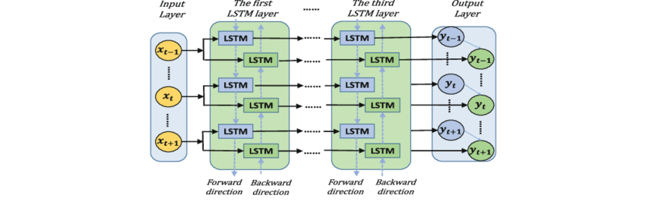
Deep neural network

Slide 26
Embedding Layer
What is an Embedding Layer?
It converts integer word indices into dense (no zeros), continuous vectors.
Learns meaningful representations for words during training.
Captures semantic similarities (e.g., similar words get similar vectors).
How It Works:
Input: Sequences of integers (from tokenization).
Output: Each integer is mapped to a fixed-size vector (e.g., 128-dimensional).
Learning: The model adjusts these vectors as part of the training process.
Example:
Word Mapping:
Suppose the word "happy" has index 45.
The embedding layer might represent "happy" as a vector:
[0.12, -0.03, 0.58, ..., 0.04] (128 values in total).

Slide 27
Understanding LSTM Networks
What is an LSTM?
A special type of recurrent neural network (RNN) designed to capture long-term dependencies in sequence data.
Addresses the vanishing gradient problem that can occur with traditional RNNs.
Key Components:
Cell State:
Acts as a memory that carries information across time steps.
Gates:
Forget Gate: Decides what information to discard from the cell state.
Input Gate: Determines what new information to add to the cell state.
Output Gate: Controls what information from the cell state to output as the hidden state.

Slide 28
Understanding LSTM Networks
How It Works:
At each time step, the LSTM takes an input (e.g., a word embedding) and its previous hidden state.
The gates regulate the flow of information, allowing the model to maintain or forget information as needed.
The updated cell state and hidden state are passed on to the next time step.
Key Takeaway:
LSTMs effectively capture sequential dependencies, making them ideal for tasks like sentiment analysis where context and order of words are crucial.

Slide 29
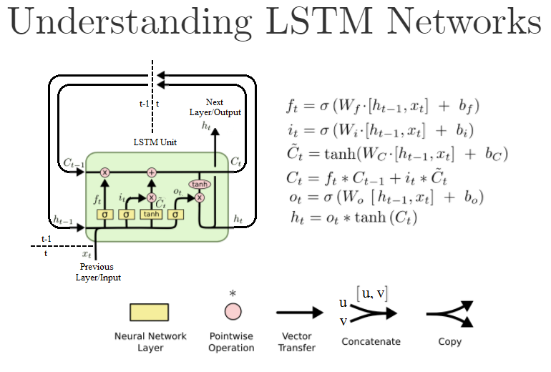

Slide 30
Results
Overall Performance:
Accuracy: 81.44%
Class-Specific Metrics:
Negative Reviews:
Precision: 80%
Recall: 85%
Positive Reviews:
Precision: 84%
Recall: 78%
F1 Score:
Overall: 81%
Key Takeaways:
Significant improvement over the initial logistic regression model.
Balanced performance across both negative and positive classes.
Demonstrates the effectiveness of the deep learning approach (using Embedding and Bidirectional LSTMs) in capturing context and improving sentiment classification accuracy.

Slide 31
Live Demo

Slide 32
Sources
https://www.tensorflow.org/text/tutorials/text_classification_rnn

