Slide 1
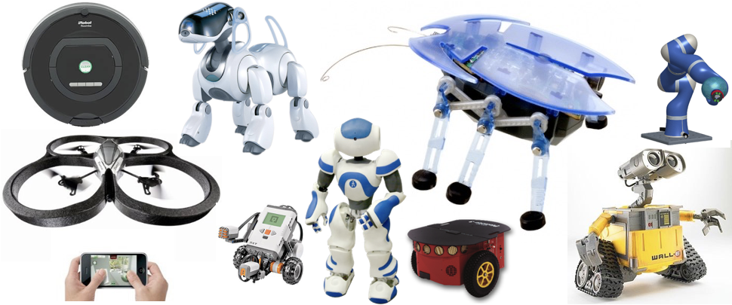
HRI
Lezione BT

Slide 2
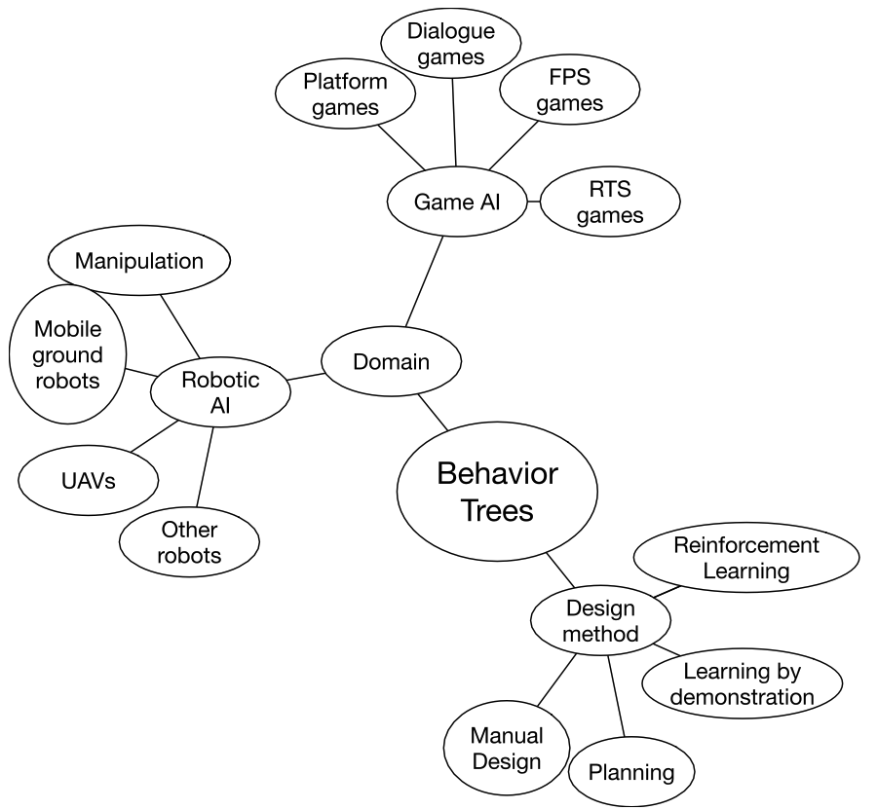
Behavior Trees
Behavior Trees (BT) are a Control Architecture, that allow to structure the switching between different tasks in an autonomous agent.
They were originally designed for controlling non-player characters in video games.
Can be used to formalize the logic behind games and robotic applications.

Slide 3
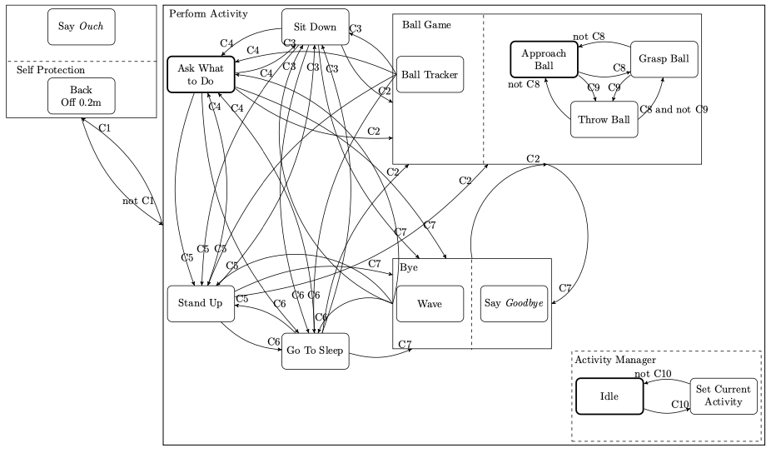
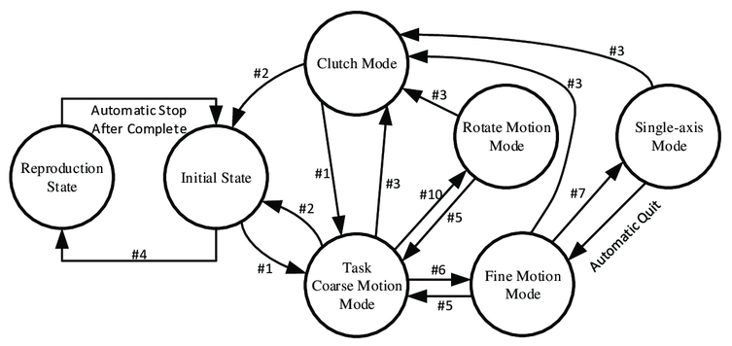
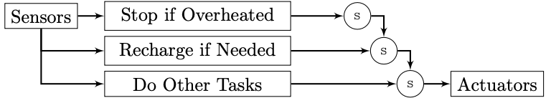
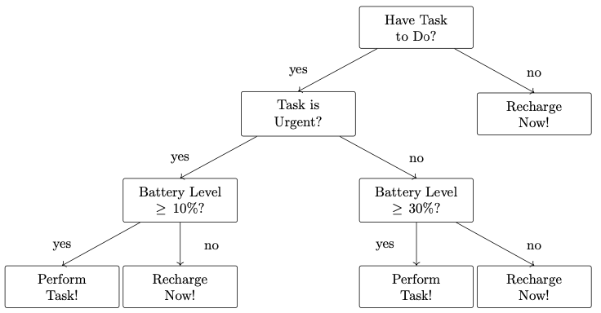
Why Behavior Trees?
Finite State Machines and Hierarchical FSMs:
  Maintainability: Adding or removing states requires the re-evaluation of a large number of transitions and internal states of the FSM.
  Scalability: FSMs with many states and many transitions between them are hard to modify.
  Reusability: The transitions between states may depend on internal variables, making it unpractical to reuse the same sub-FSM.
  Manually created hierarchies.
Subsumption:
  Scalability: action selection through a distributed system of inhibition and suppression can be hard.
  Maintainability: Due to the lack of structure, consequences of adding or removing controllers can be hard to estimate.
Decision Trees:
  Highly dependent on the data used for training.
  No information flow out from the nodes, making failure handling very difficult

Slide 4
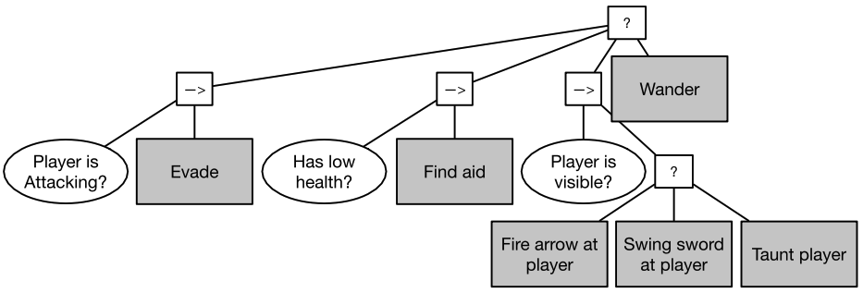
Why Behavior Trees?
Behavior Trees:
  Describes a policy (or controller) of an agent.
  Stateful: every element in the tree returns the state of its task, success, failure or running.
  Task Hierarchies: one task can be made up of a number of subtasks.
  Reactivity: more important tasks can interrupt less important ones.
  Modularity: each task at each level of the hierarchy uses the same state interface (success, failure, running).

Slide 5
Core parts of a BT
A BT is a directed tree.
A leaf is called execution node. A non-leaf is called control flow node.
The execution of the BT starts from the root.
Signals (ticks) are generated with a given frequency.
Ticks enable the execution of a node (if and only if) and are propagated to its children, which return their current state to the father: running, success or failure.

Slide 6
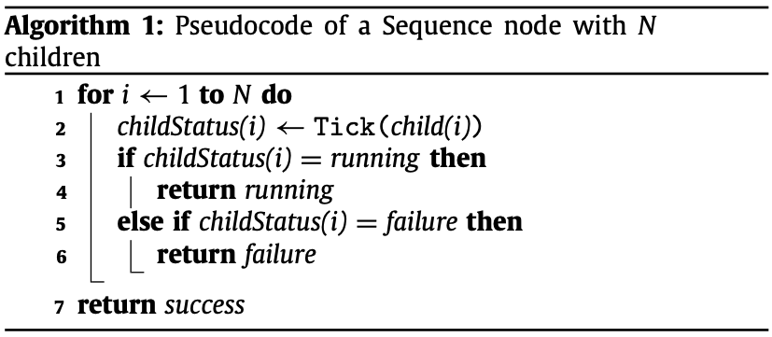
Sequence
Used when actions or condition checks, are meant to be carried out in sequence (→).
The Success of one action is needed for the execution of the next.
A tick to a Sequence node is routed to its children from left to right. If a child returns running or failure, it is returned to the parent.
When all children return success, it returns it to its parent (if and only if).

Slide 7
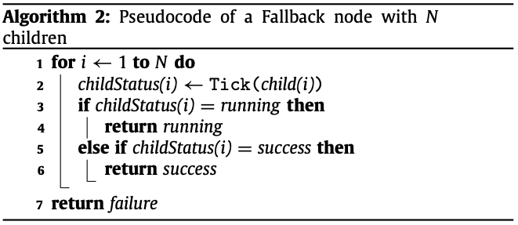
Fallbacks
Set of actions that present alternative ways of achieving a similar goal (?).
Parent routes a tick to its children from left to right, until one returns running or success.
If all return failure, it returns failure.
Also called selector.

Slide 8
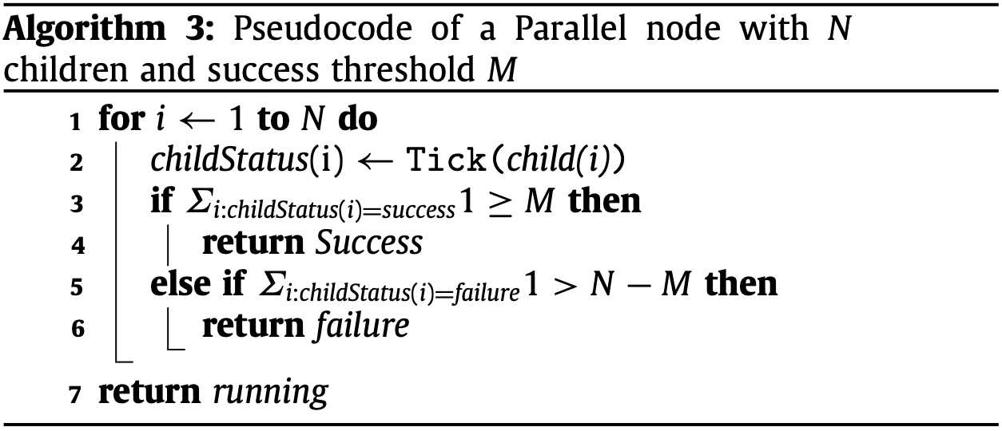
Parallel
All children ticked at the same time (⇉).
  If M out of the N children return success, then so does the parallel node (M<N).
  If more than N − M return failure, thus rendering success impossible, it returns failure.
  If none of the conditions above are met, it returns running.
Normally used when the sub-tree tasks are orthogonal, i.e., independent.
In robotic applications, it can help mitigating the curse of dimensionality.
Extensions:
  Synchronized Parallel operator: all the children share a minimum progress value that they have to reach in order to proceed with the execution.
  Mutually Exclusive Parallel operator: only executes a child if it uses resources which are not needed by other running children.
⇉

Slide 9
Action
Executes a command upon receiving a tick.
  E.g., move the agent, grasp the arrow, pick the box.
  Represented with boxes with text (shaded background in the example).
Returns success when done, failure if unsuccessful, and running if executing.
Might need to access stored data about the world.
Can be parametrized:
  Hard coded parameters.
  Depending on the state of the world.
  Using Parametrized Action Representation (PAR).

Slide 10
Condition
Checks propositions upon receiving a tick.
Can only return success or failure.
They are essentially actions.

Slide 11
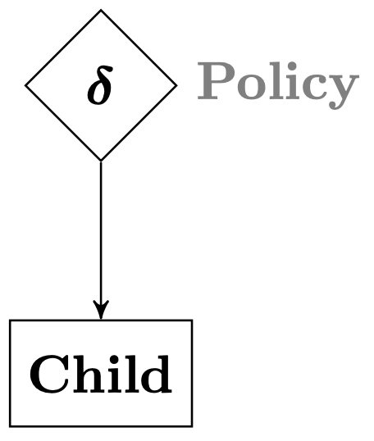
Decoder
A control flow node with a single child.
It manipulates the return status of its child according to a user-defined rule.
Selectively ticks the child according to some predefined rule.
For example:
  an invert decorator inverts the Success/Failure status of the child.
  a max-N-tries decorator only lets its child fail N times, then always returns Failure without ticking the child.
  a max-T- sec decorator lets the child run for T seconds then, if the child is still Running, the Decorator returns Failure without ticking the child.
The symbol of the Decorator is a rhombus.

Slide 12
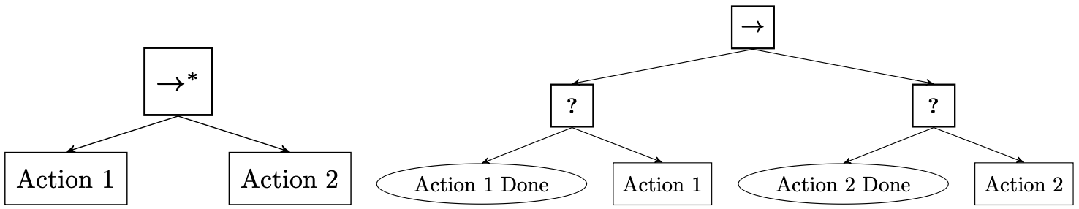
Control Flow nodes with Memory
Control flow nodes: sequence, fallbacks, parallel.
Introduced to avoid the unwanted re-execution of nodes with reiterated ticks.
Once the control flow node finishes its execution and returns success of failure, the memory is cleared. Can also be referred to as Blackboard.
A control flow with memory can be equivalent to one without memory and with additional control levels.

Slide 13
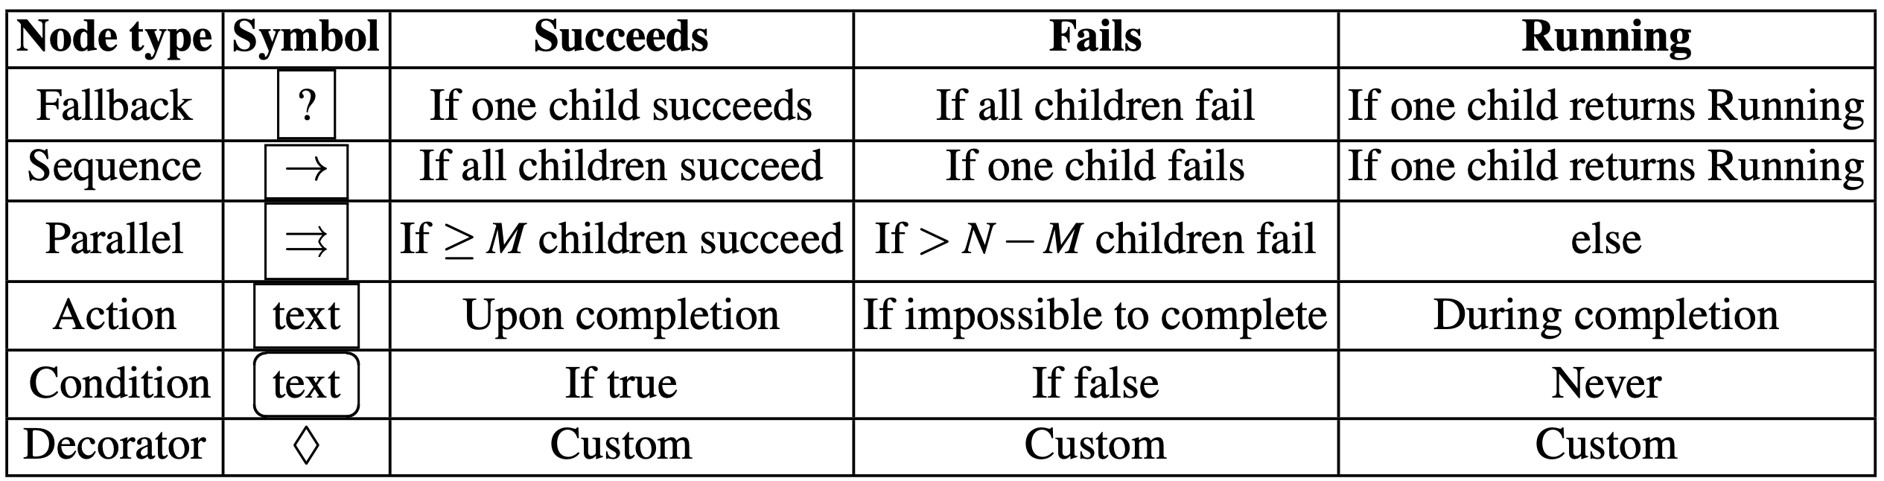
BTs and Reactivity
Reactivity: with the running state and cyclic ticking.
  Recurrent ticks allow to reevaluate the state of the nodes, and intervene if necessary (e.g. check the fire alarm).
  Having only success and failure would would prevent any reactions to unexpected high priority events.
Importance of conditions in sequences.
State transition logic organized in a hierarchical tree structure, with the states as leaves.
BTs without running state are refered to as non-reactive.

Slide 14
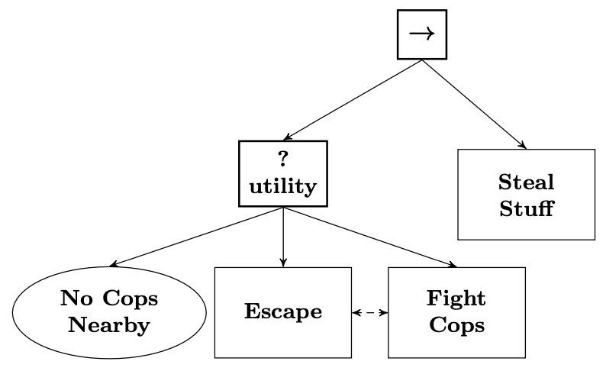
Utility BT
Utility Fallbacks:
  No fixed priority among children.
  Children return expected utility.
How?
  A Decorator between parent and each action child.
  Add utility estimates for every action in the tree.
Aggregate and propagate utility in the BT?
  Using max value utility in the control flow nodes.
  Can be tricky with Sequences.

Slide 15
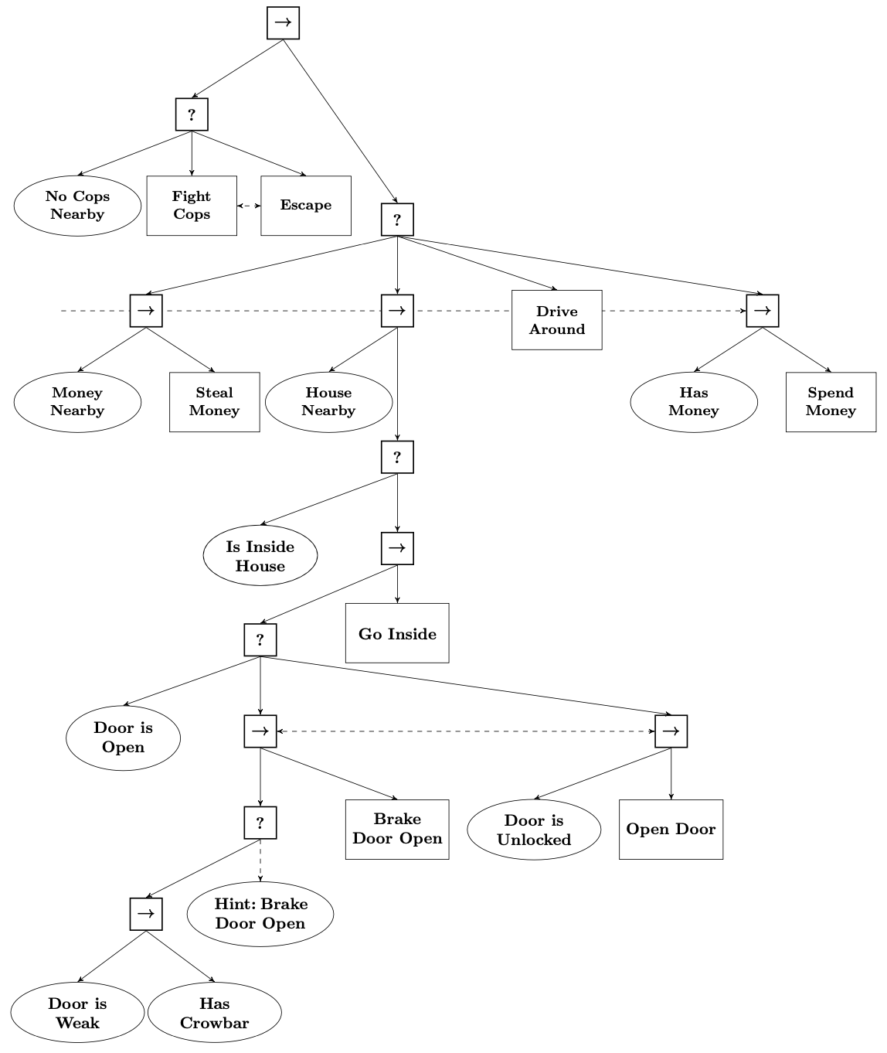
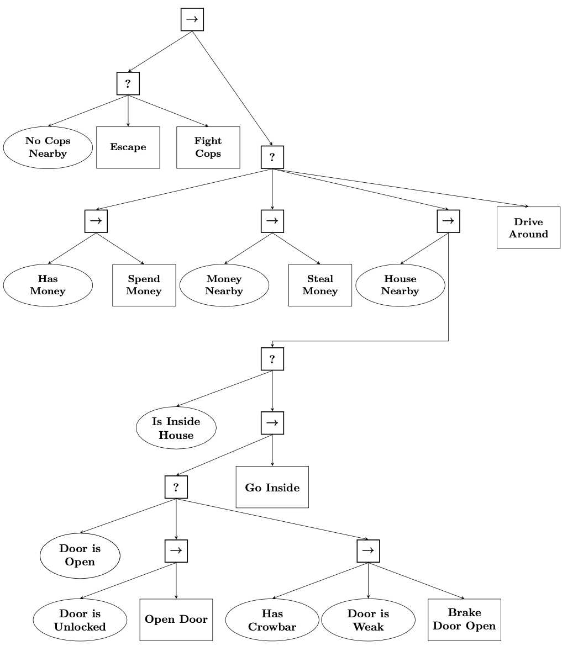
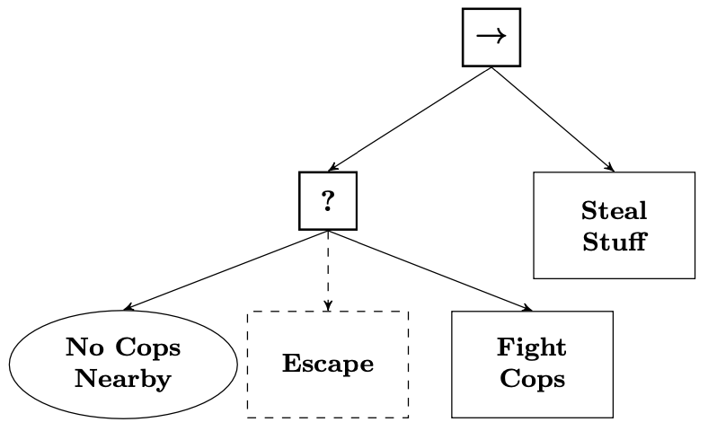
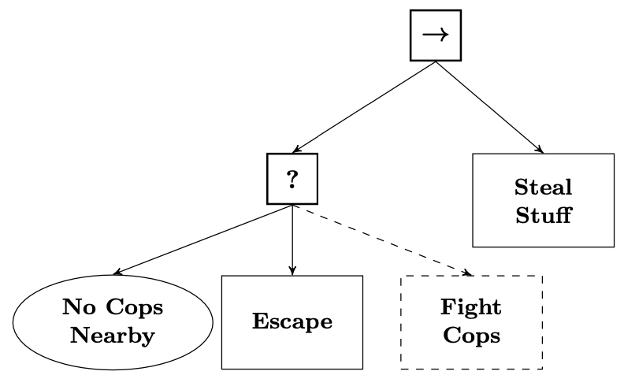
Hinted BT
Implementing styles:
  Disabling parts of the tree.
  E.g., aggressive or pacifist burglar.
Hinted BTs:
  External entity provides suggestions.
  Positive hints suggest to take an action.
  Negative hints suggest avoiding it.
  E.g., hint to fight first, then escape, to not spend money, to brake the door before checking if open.

Slide 16
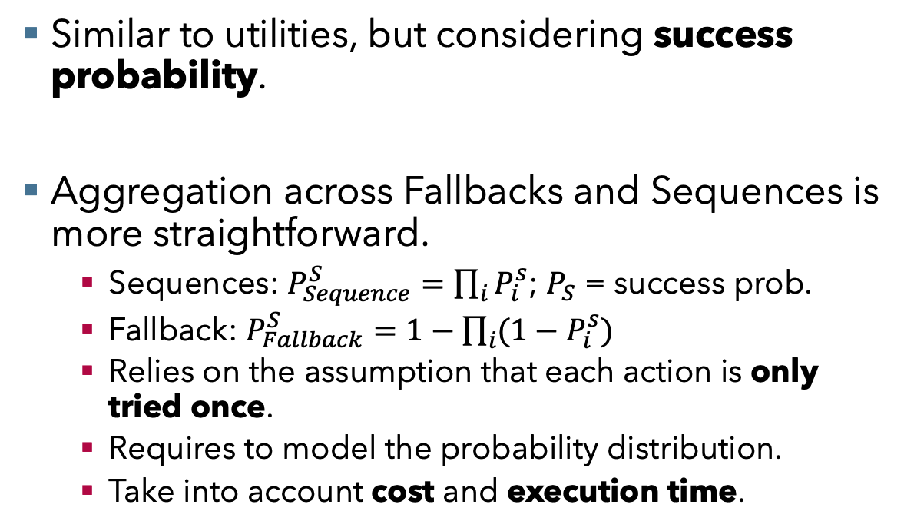
Stochastic BT
Similar to utilities, but considering success probability.
Aggregation across Fallbacks and Sequences is more straightforward.
  Sequences: $P_{Sequence}^{S}=\prod_{i}{P_{i}^{s}}$; $P_{S}$ = success prob.
  Fallback: $P_{Fallback}^{S}=1−\prod_{i}{{(1−P}_{i}^{s})}$
  Relies on the assumption that each action is only tried once.
  Requires to model the probability distribution.
  Take into account cost and execution time.

Slide 17
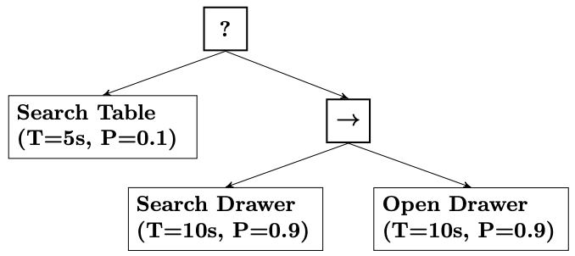
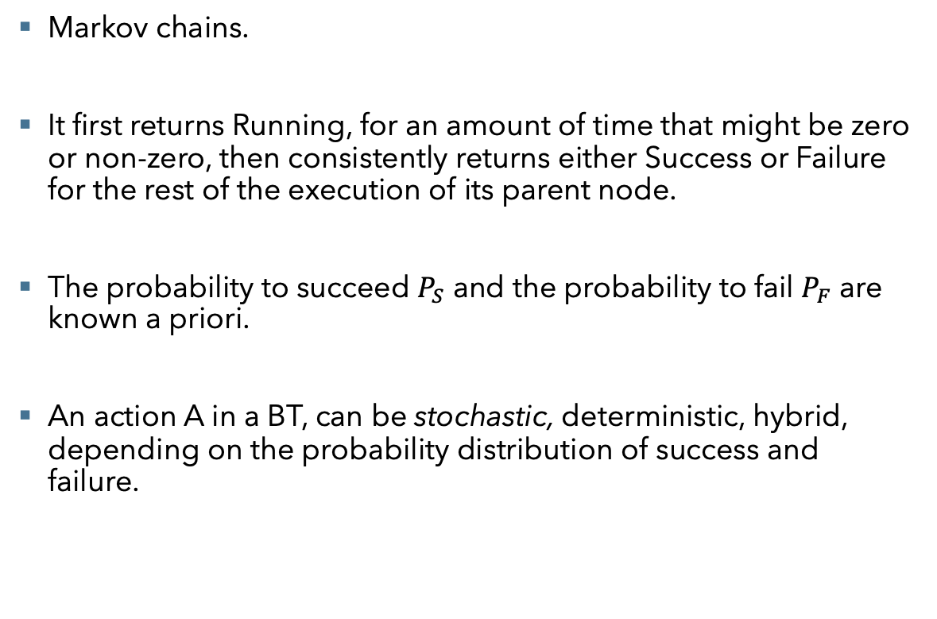
Stochastic BT
Markov chains.
It first returns Running, for an amount of time that might be zero or non-zero, then consistently returns either Success or Failure for the rest of the execution of its parent node.
The probability to succeed $P_{S}$ and the probability to fail $P_{F}$ are known a priori.
An action A in a BT, can be stochastic, deterministic, hybrid, depending on the probability distribution of success and failure.

Slide 18
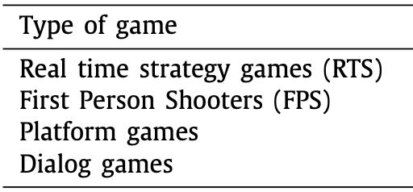
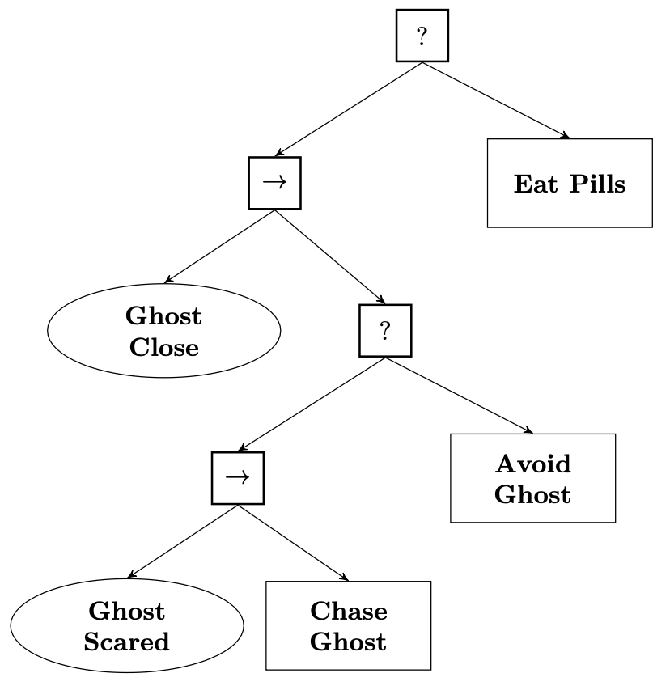
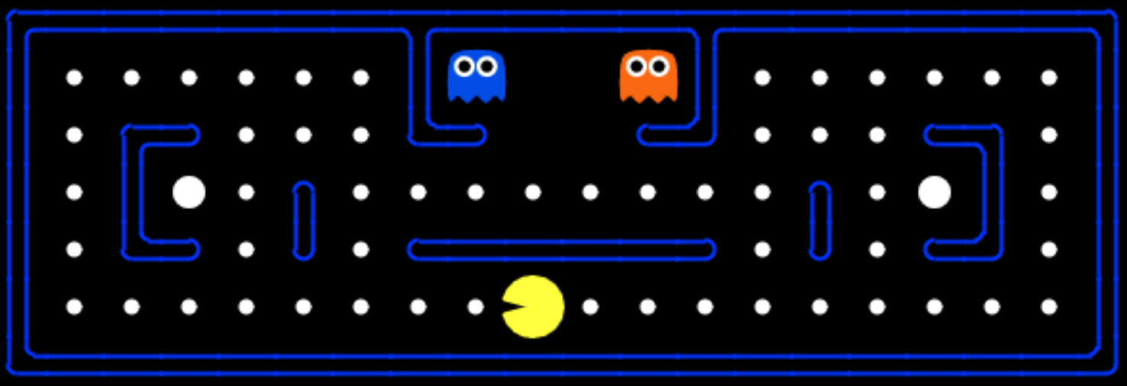
BTs in games
Fallbacks root ticks first child
  Sequence ticks first child
    Check if a Ghost is close
      Tick Sequence child:
        Check if Ghost is scared
          Chase
      Avoid Ghost
  Eat Pills

Slide 19
BTs in games
First Person Shooter.
Root (a Fallback node) ticks the children.
  Sequence1 checks if a player is attacking, in which case the action is to evade.
  Sequence2 targets the health level.
  Sequence3 checks the visibility of a non-attacking player, and ticks possible ways to engage.
  Wandering action.

Slide 20
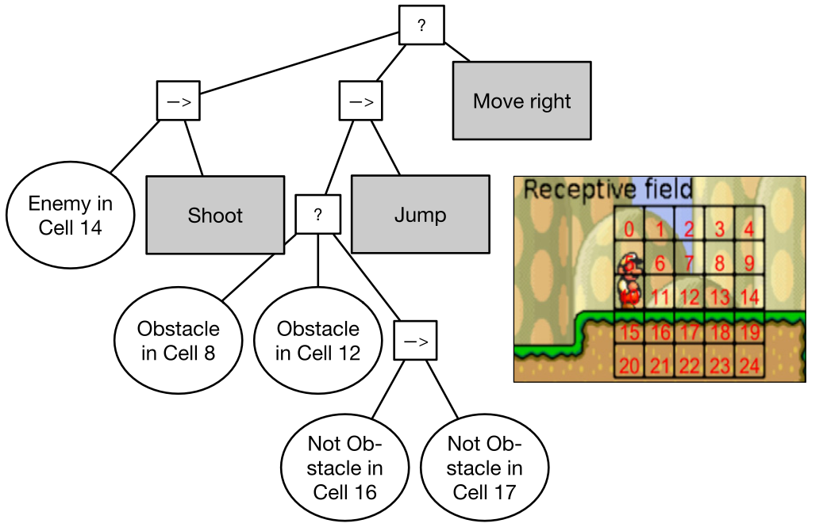
BTs in games
Platform games: the player controls a character in a 2D environment and moves between a set of platforms.
Super Mario.
  The Mario AI framework.

Slide 21
BTs in games

Slide 22
BTs in games
Root ticks children (fallbacks):
  Sequence: check enemy in c14
    Shoot.
  Sequence:
    Fallbacks, all leaf nodes are condition checks:
      Obstacle in c8
      Obstacle in c12
      Sequence with checks:
        No obstacle in c16
        No obstacle in c17
    If all checks return success, then jump.
  Move right.

Slide 23
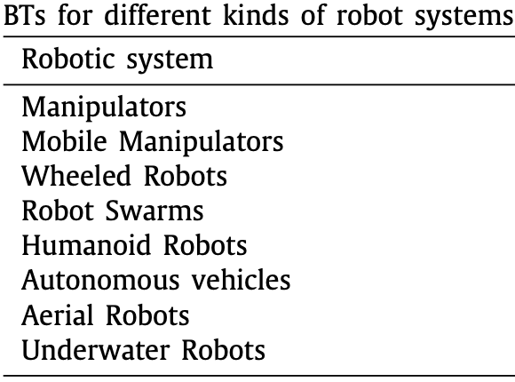

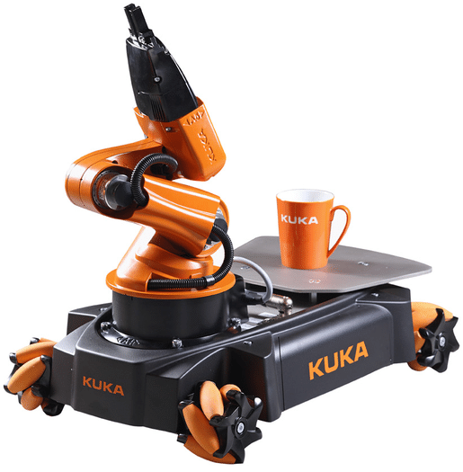
BTs in robotics
Manipulation and collaborative robots
  Advantages of transparency and modularity.
  E.g., Kuka and Franka Panda arms: reduction of execution time.
  E.g., Aldebaran/Softbank NAO: grasping and transporting objects.
Mobile ground robotics
  Reactivity and modularity while navigating,
  E.g., Kuka Youbot, moving to a collision free environment before performing manipulation.
  E.g., mobile robots detecting obstacles and faults.
  Autonomous driving?
Aerial and underwater robotics
  Unmaned Aeraial Vehicles: e.g., moving in proximity of obstacles, flying through a window.
  Autonomous Underwater Vehicles: e.g., fault handling, strict check to avoid losing the robot underwater.

Slide 24
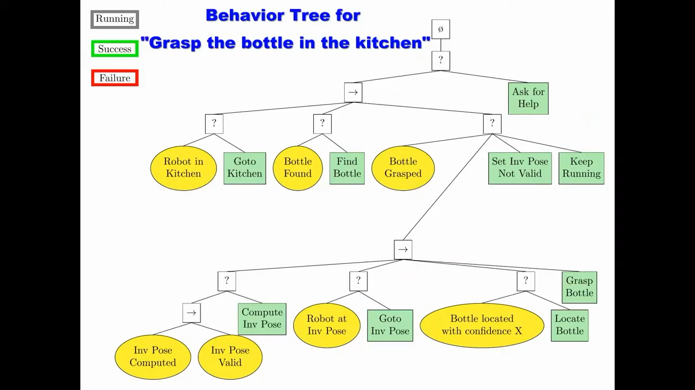
BTs in robotics

Slide 25
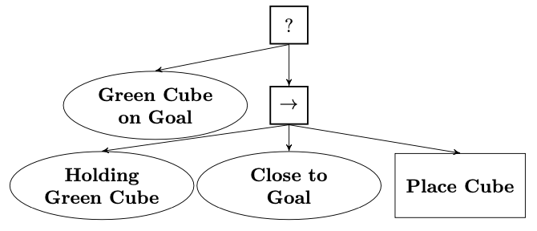
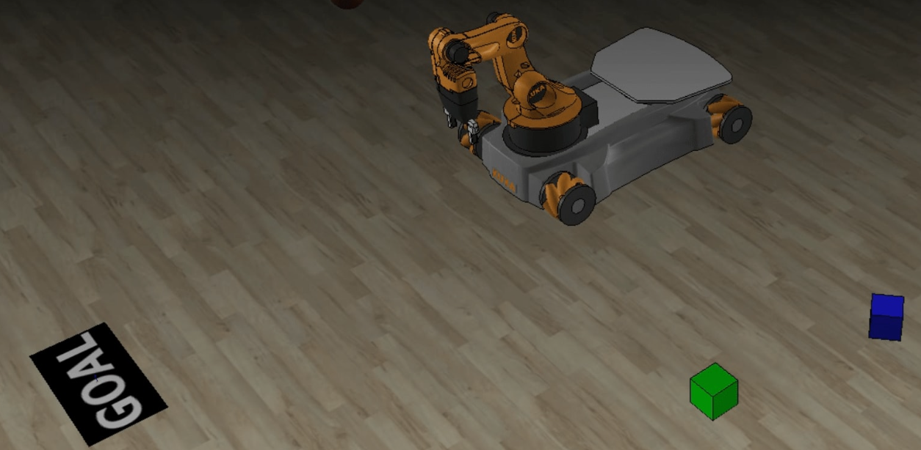
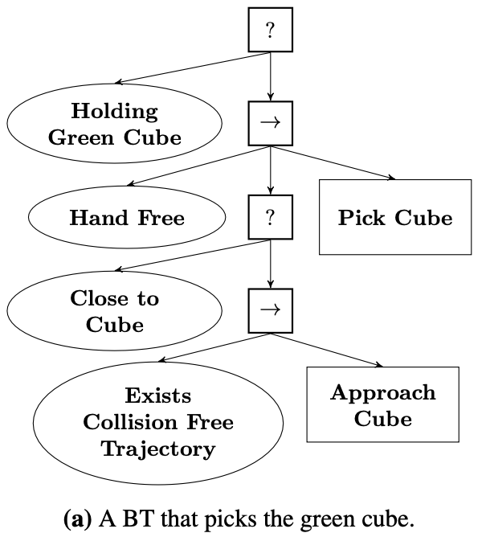
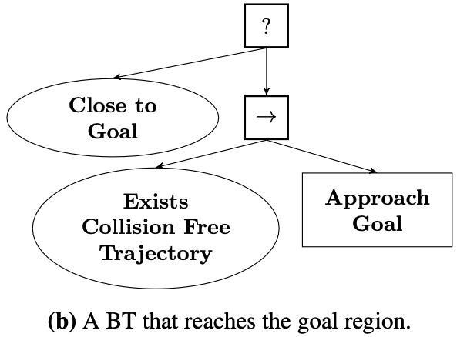
BTs in Robotics
Target behavior: Green Cube on Goal.

Slide 26
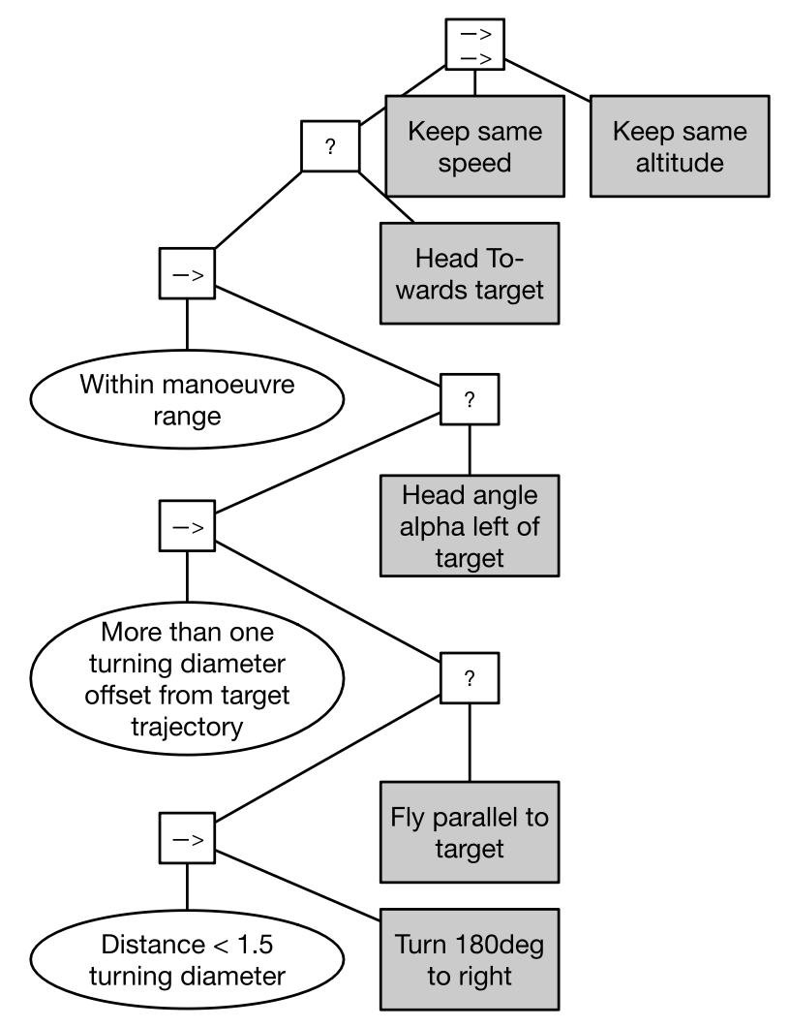
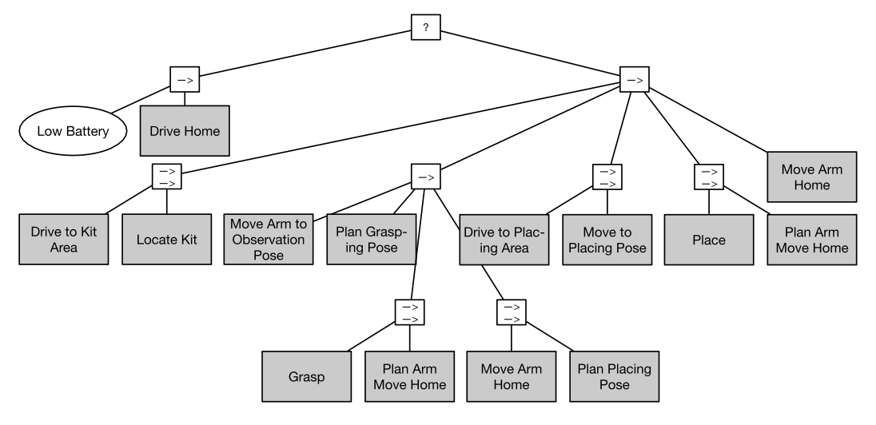
BTs in robotics
BT for a mobile manipulator to pick and place objects in a kitting task.
BT for UAVs to move towards and fly in behind another UAV.

Slide 27
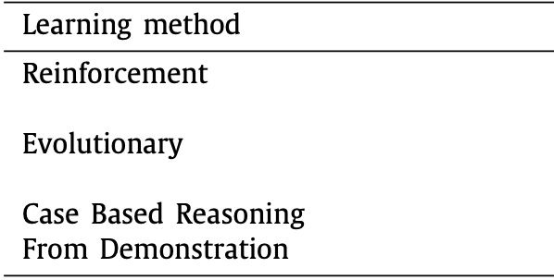
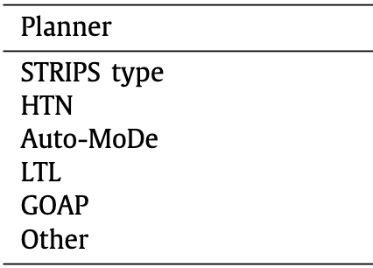
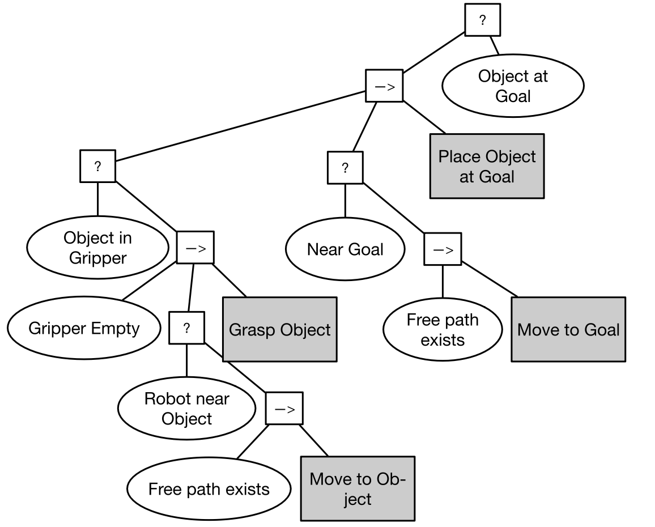
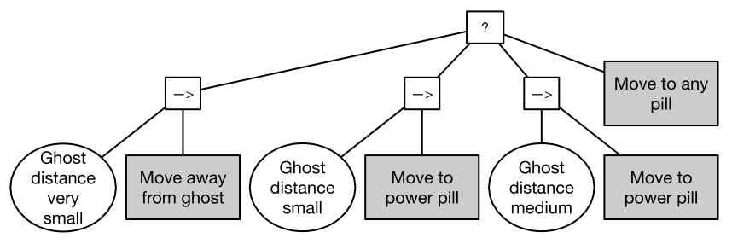
BTs as policy representation
BT for Pacman, learned using evolutionary methods.
BT for mobile manipulation, generated using a planning approach.

Slide 28
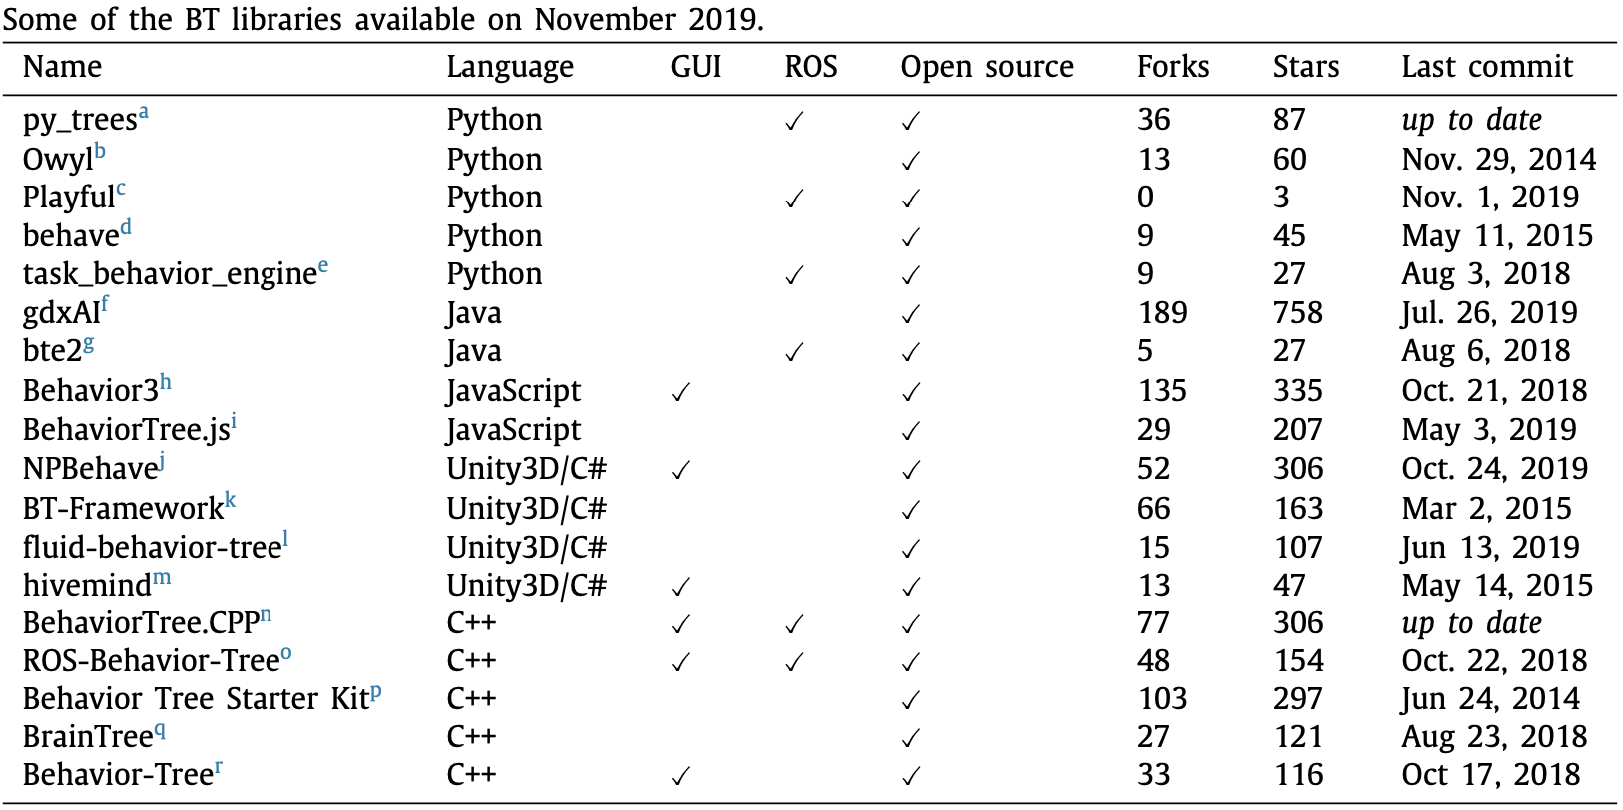
Implementations

