Slide 1




EEG Analysis with MNE Sample Dataset
Time-series,
Spring, 2026
Progress Report
Topic 10
Members: Tran Ngoc Mai, Nguyen Do Anh Duong, Bui Phuong Thao, Nguyen Ha Vy

Slide 2
Content
Problem Definition & Motivation
Methodology
Results & Future work
Time-series
Topic 10

Slide 3
Content
Problem Definition & Motivation
Methodology
Results & Future work
Time-series
Topic 10

Slide 4
Background
EEG records brain activity through electrodes placed on the scalp and is widely used in healthcare and neuroscience
Macro: reduces healthcare costs, improves research productivity, and lowers risks in clinical planning.
Societal: earlier diagnosis, safer patient monitoring
Practical: detect abnormalities faster, better experiments, brain–computer interfaces are more reliable.
Time-series
Topic 10

Slide 5
Challenges
EEG signals are complex to analyze.
Specialized technical complexity and multi-channel signals.
Transforming EEG data into suitable formats for predicting model training
Motivation
Applying systematic preprocessing and time‑series modeling to transform noisy EEG into reliable features for classification of brain states.
Time-series
Topic 10

Slide 6
Content
Problem Definition & Motivation
Methodology
Results & Future work
Time-series
Topic 10

Slide 7
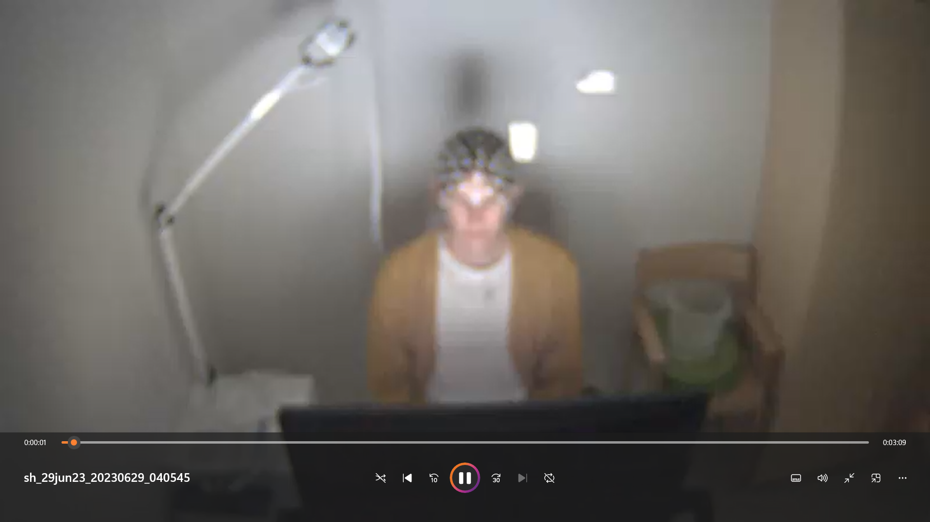
Dataset - MNE’s EYELINK
Duration/size: 192 seconds
Sampling frequency: 1000Hz
Target variable: “label”
0 = ‘normal’, 1 = ‘blink’
Train-test rate: 0.8-0.2
Time-series
Topic 10

Slide 8
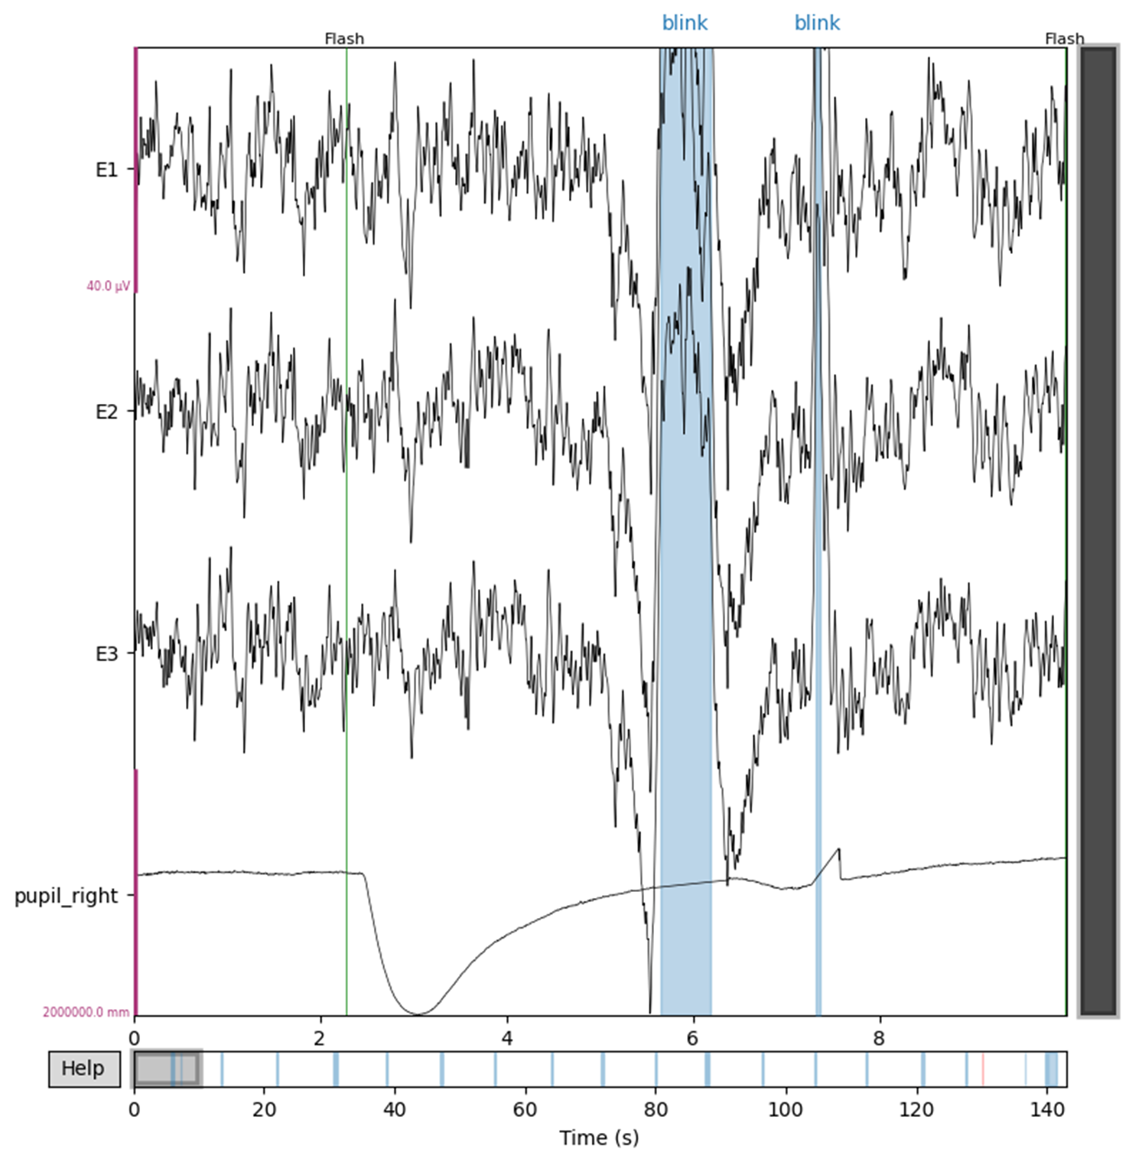
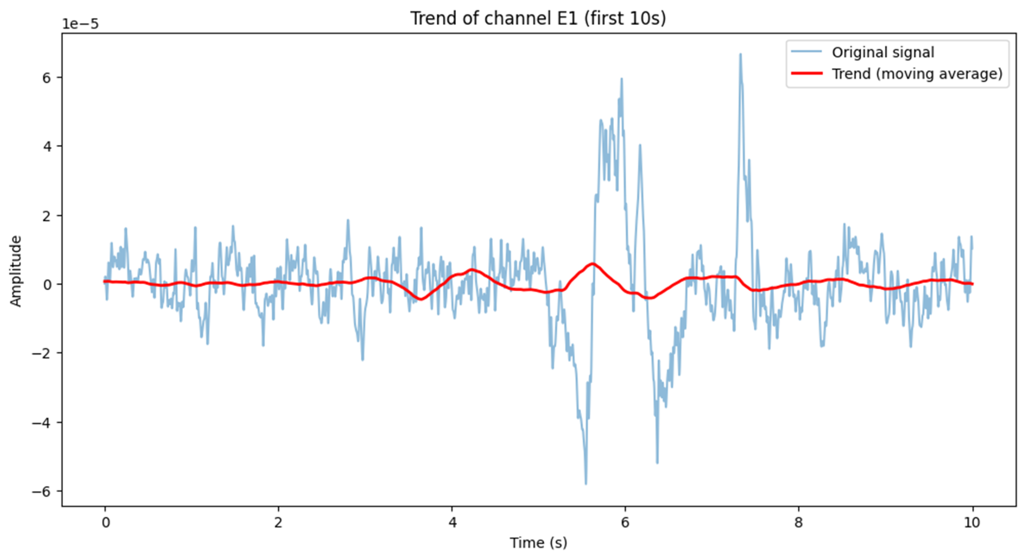
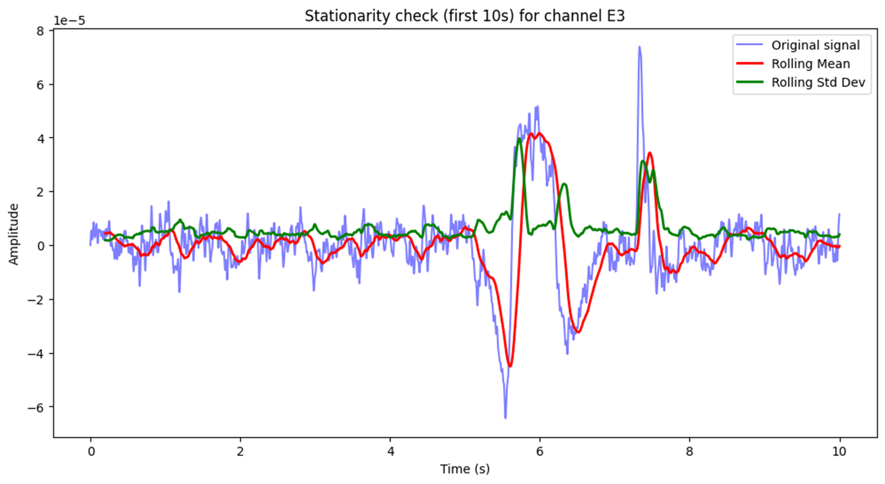
Data insights
Time-series
Topic 10

Slide 9
Training
Preparation for training
Duration: 175 seconds
Sampling frequency: 1000Hz
Filtered: 1-40Hz
Target variable: ‘labels’ 0: ‘normal’; 1: ‘blink’
Raw set; cleaned set
Create epochs in 2 seconds long and overlap = 0.5 seconds.
Train/test split: 8/2
Time-series
Topic 10

Slide 10
Training
Strategy
Train both clean and raw set with the same model variables to find the best model within: SVM, Logistic regression, Decision tree, Random forest
Comparing their metrics to figure the most suitable sets
Time-series
Topic 10

Slide 11
Content
Problem Definition & Motivation
Methodology
Results & Future work
Time-series
Topic 10

Slide 12
Results & Future work
Results: SVM
Dataset | Precision | Recall | F1-score
Raw | 0.71 | 0.56 | 0.62
Clean | 0.75 | 0.83 | 0.79
Time-series
Topic 10

Slide 13
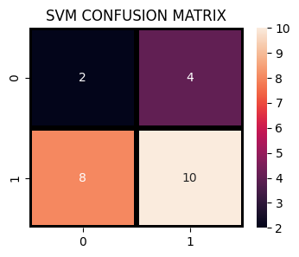
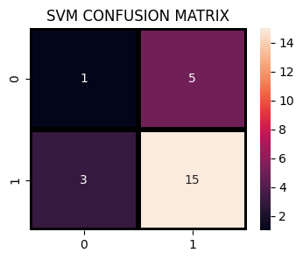
Results: SVM
Raw Data
Clean Data
Time-series
Topic 10

Slide 14
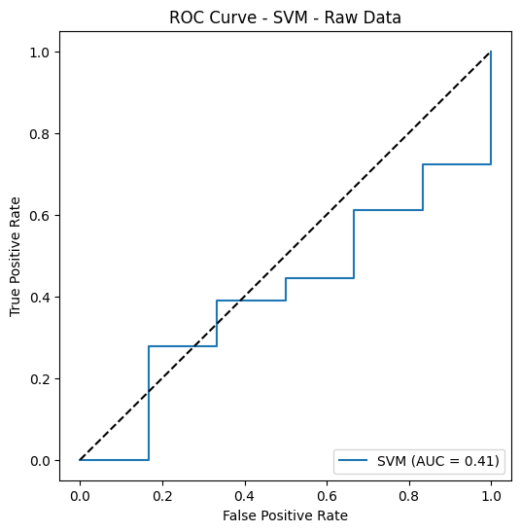
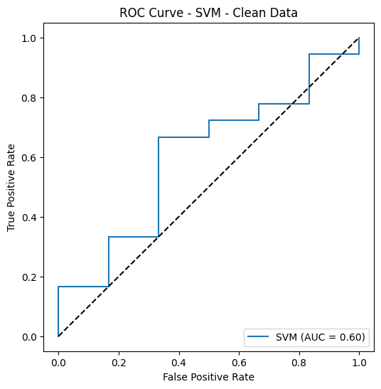
Results: SVM
Time-series
Topic 10

Slide 15
Results & Future work
Results: Logistic Regression
Dataset | Precision | Recall | F1-score
Raw | 0.59 | 0.50 | 0.58
Clean | 0.86 | 0.67 | 0.75
Time-series
Topic 10

Slide 16
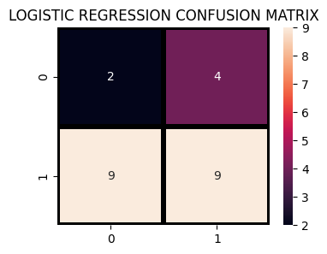
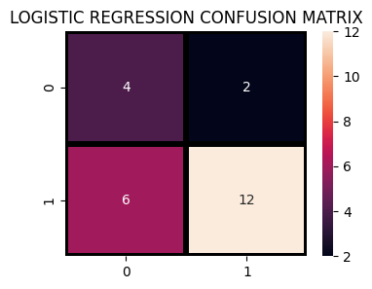
Results: Logistic regression
Raw Data
Clean Data
Time-series
Topic 10

Slide 17
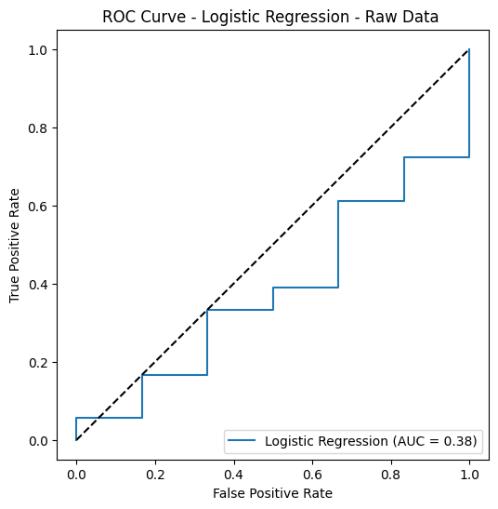
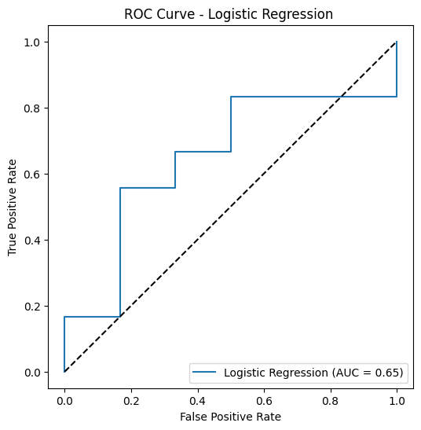
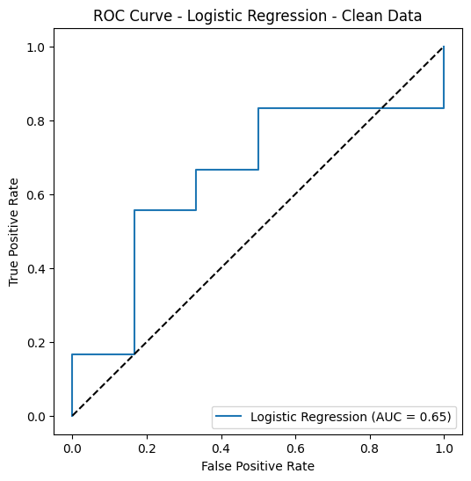
Results: Logistic regression
Time-series
Topic 10

Slide 18
Results & Future work
Results: Decision Tree Classifier
Dataset | Precision | Recall | F1-score
Raw | 0.70 | 0.70 | 0.70
Clean | 0.71 | 0.83 | 0.77
Time-series
Topic 10

Slide 19
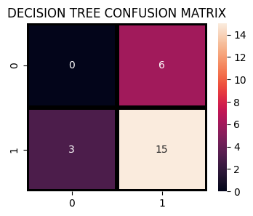

Results: Decision tree
Raw Data
Clean Data
Time-series
Topic 10

Slide 20
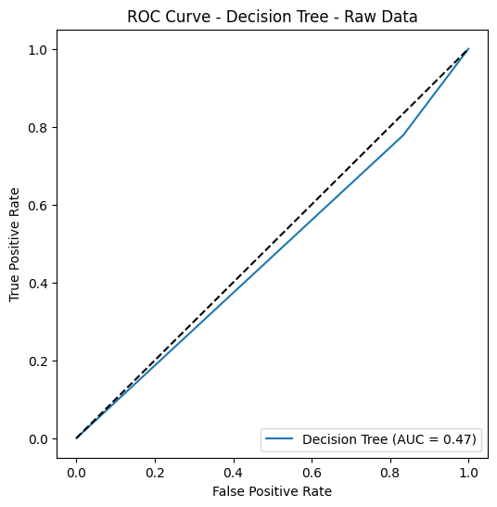
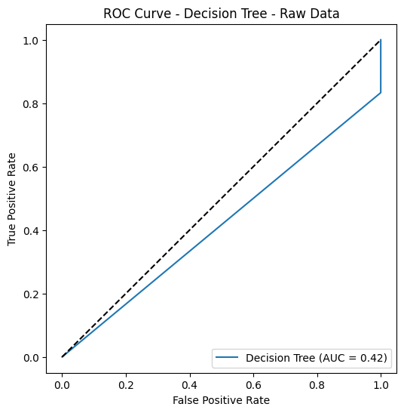
Results: Decision tree
Time-series
Topic 10

Slide 21
Results & Future work
Results: Random Forest Classifier
Dataset | Precision | Recall | F1-score
Raw | 0.75 | 1.00 | 0.86
Clean | 0.73 | 0.89 | 0.80
Time-series
Topic 10

Slide 22
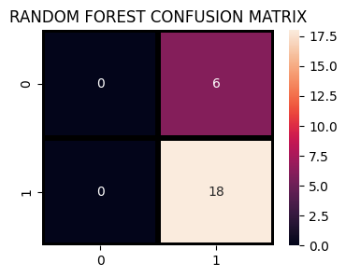

Results: Random forest
Raw Data
Clean Data
Time-series
Topic 10

Slide 23
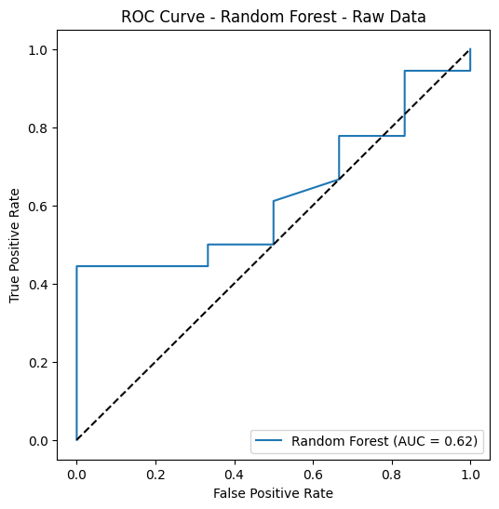
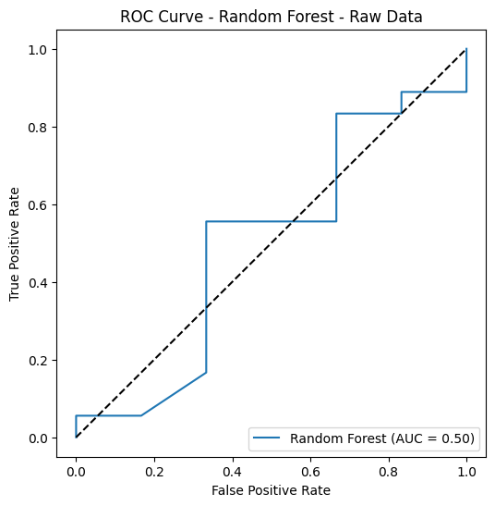
Results: Random forest
Time-series
Topic 10

Slide 24
Results: Winning model
SVM / Decision tree for cleaned dataset !!!!
Model | Precision | Recall | F1-score
SVM | 0.75 | 0.83 | 0.79
Decision tree | 0.71 | 0.83 | 0.77
Time-series
Topic 10

Slide 25
Limitation
Data preprocessing was the most challenging task
Struggled with cleaning EEG datasets (risk of losing important signals, noise not fully removed)
Models used were simple, mainly traditional machine learning methods.
Overfit and not so reliable accuracy
Time-series
Topic 10

Slide 26
Future work
Try deep learning methods to improve prediction accuracy.
Deepen understanding of EEG medical terms to enhance preprocessing and data interpretation.
Time-series
Topic 10

Slide 27
Thank you!
Link GitHub
Intro to A
Trong-Nghia Nguyen
Time-series
Topic 10
‹#›

