Slide 1




EEG Analysis with
MNE’s EYELINK Dataset
Time-series,
Spring, 2026
Progress Report
Group 6 - Topic 10
Presenter: Tran Ngoc Mai
Members: Tran Ngoc Mai, Nguyen Do Anh Duong, Bui Phuong Thao, Nguyen Ha Vy

Slide 2
Content
Introduction
Data Cleaning
Model Training and Results
Conclusion and Future Work.
Time-series
Topic 10

Slide 3
Content
Introduction
Data Cleaning
Model Training and Results
Conclusion and Future Work.
Time-series
Topic 10

Slide 4
Last week
Cleaned the EEG dataset using the ICA (Independent Component Analysis) method.
Trained several models.
SVM and Decision Tree are the two best models.
Model | Precision | Recall | F1-score
SVM | 0.75 | 0.83 | 0.79
Decision tree | 0.71 | 0.83 | 0.77
Time-series
Topic 10

Slide 5
Content
Introduction
Data Cleaning
Model Training and Results
Conclusion and Future Work.
Time-series
Topic 10

Slide 6
Cleaning methods
ICA (Independent Component Analysis): separates signal components to remove artifacts like eye blinks and muscle noise.
REG (Regression‑based correction): models and subtracts artifact contributions (e.g., eye movements) from EEG channels.
SSP (Signal Space Projection): projects data into a subspace that minimizes artifact influence.
Combinations
ICA + REG | ICA + SSP
REG + SSP | ICA + REG + SSP
Time-series
Topic 10

Slide 7
Content
Introduction
Data Cleaning
Model Training and Results
Conclusion and Future Work.
Time-series
Topic 10

Slide 8
Results - single method
 | SVM | Decision Tree
ICA | Precision: 0.75 Recall: 0.83 F1-score: 0.79 | Precision: 0.71 Recall: 0.83 F1-score: 0.77
REG | Precision: 0.78 Recall: 0.78 F1-score: 0.78 | Precision: 0.78 Recall: 0.78 F1-score: 0.78
SSP | Precision: 0.69 Recall: 0.50 F1-score: 0.58 | Precision: 0.88 Recall: 0.78 F1-score: 0.82
Time-series
Topic 10

Slide 9
Results - combined methods
 | SVM | Decision Tree
ICA + REG | Precision: 0.76 Recall: 0.89 F1-score: 0.82 | Precision: 0.70 Recall: 0.78 F1-score: 0.74
ICA + SSP | Precision: 0.71 Recall: 0.67 F1-score: 0.69 | Precision: 0.74 Recall: 0.78 F1-score: 0.76
REG + SSP | Precision: 0.73 Recall: 0.61 F1-score: 0.67 | Precision: 0.86 Recall: 0.67 F1-score: 0.75
ICA + REG + SSP | Precision: 0.73 Recall: 0.61 F1-score: 0.67 | Precision: 0.79 Recall: 0.83 F1-score: 0.81
Time-series
Topic 10

Slide 10
Content
Introduction
Data Cleaning
Model Training and Results
Conclusion and Future Work.
Time-series
Topic 10

Slide 11
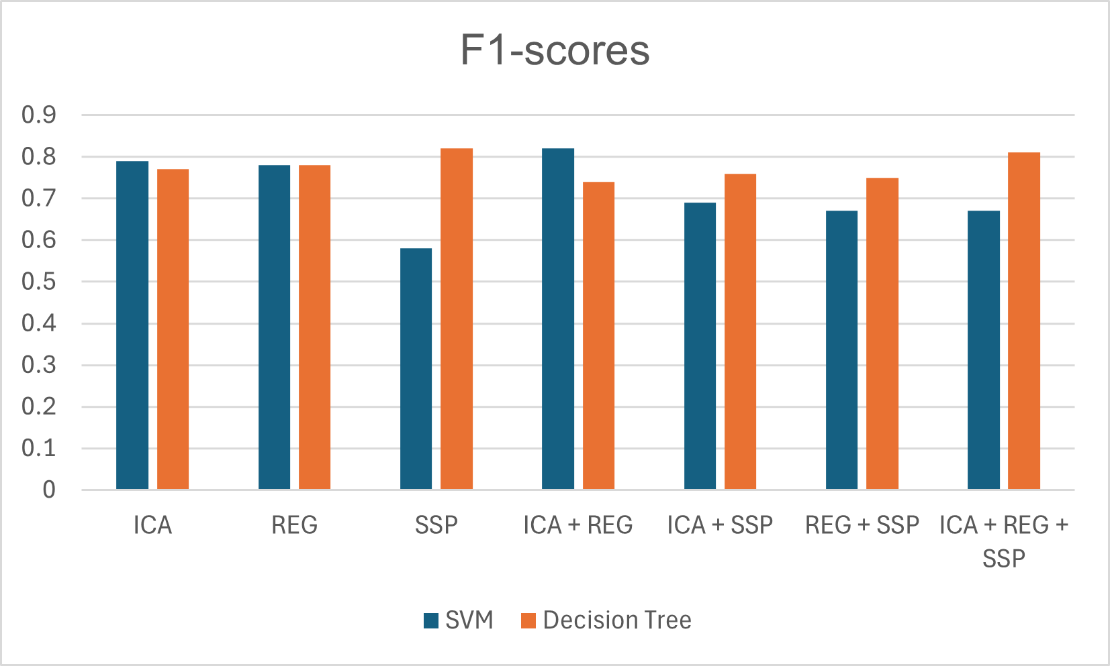
Winning models
Decision Tree with SSP
SVM with ICA + REG
Time-series
Topic 10

Slide 12
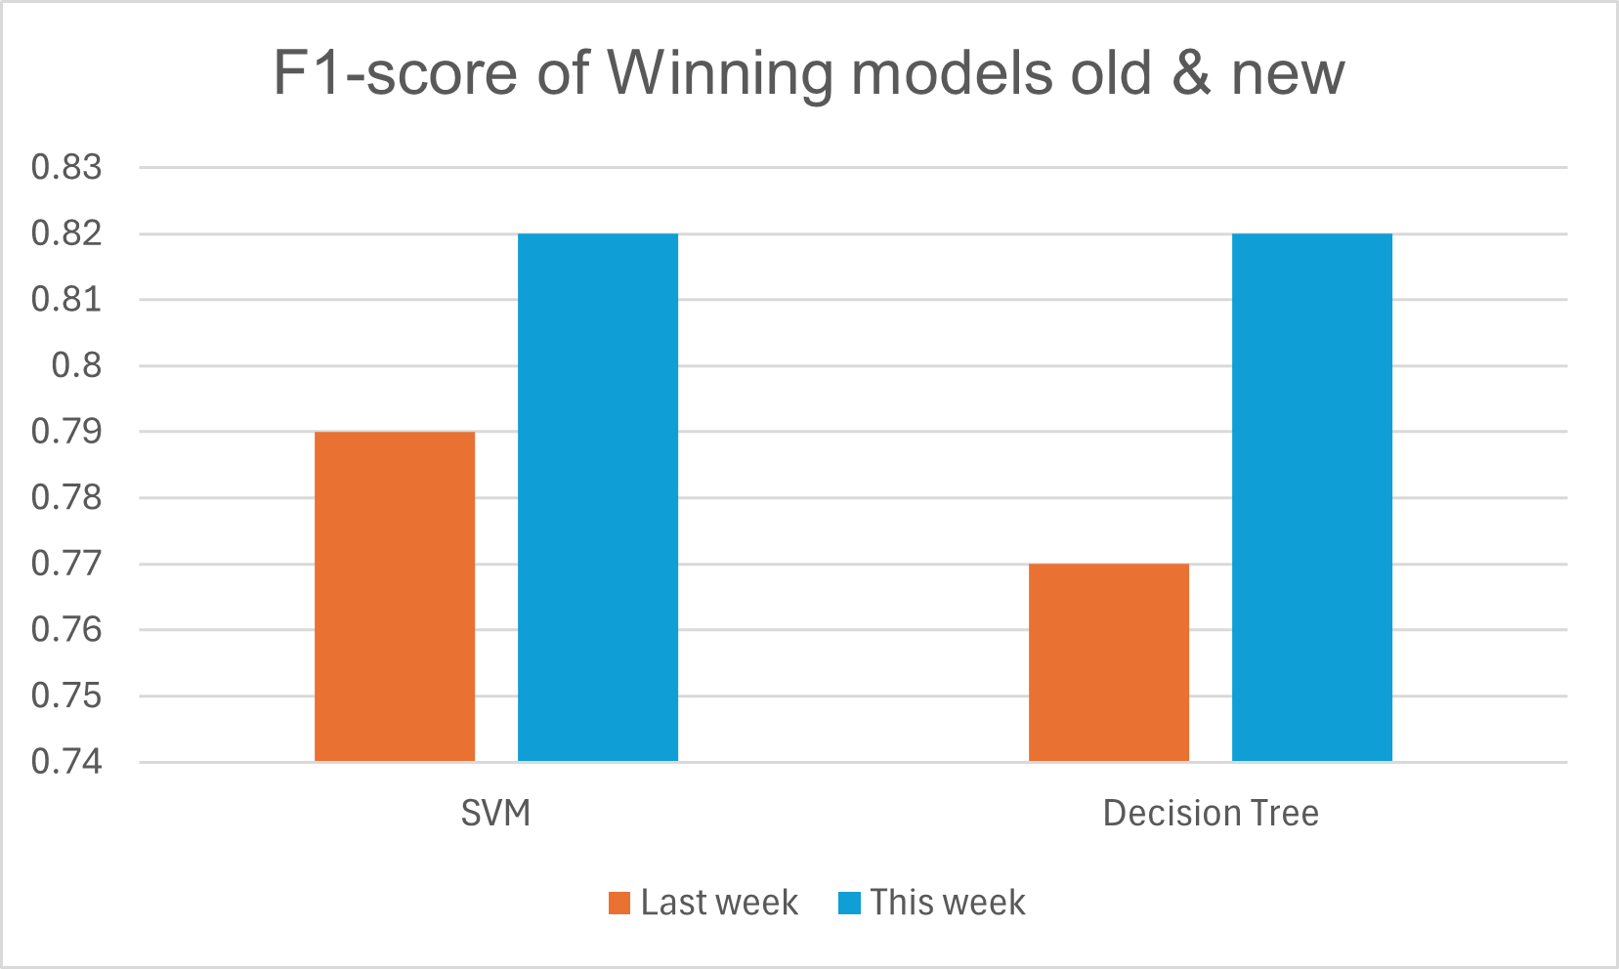
Winning models - compare to last week
Time-series
Topic 10

Slide 13

Future works
Advanced approaches: ensemble methods and deep learning.
Fine‑tune hyperparameters to further improve performance
Time-series
Topic 10

Slide 14
Thank you!
Link GitHub
Intro to A
Trong-Nghia Nguyen
Time-series
Topic 10
‹#›

