Slide 1



EEG Analysis with MNE Sample Dataset
Progress Report
Topic 10
Presenter: Nguyen Do Anh Duong
Members: Tran Ngoc Mai, Nguyen Do Anh Duong, Bui Phuong Thao, Nguyen Ha Vy
1

Slide 2
Table of content
A. Previous Week Summary
B. Progress
C. Conclusion
2

Slide 3
A
Previous Week Summary
What we did in the previous presentation
– Introduced the EEG-Eye Tracking dataset
– Explained the experimental setup
– Screen flash stimulation
– Eye-tracking (pupil size)
– EEG recording
– Demonstrated how to load and visualize the data using MNE-Python
– Showed basic raw signal plots
3

Slide 4
B
Progress
Data preprocessing
Noise Filtering
– Apply band-pass filter (1-40Hz)
Artifact removal
– Identify and remove artifacts (eye blinks, muscle activity)
– Use MNE's artifact detection methods
Channel selection
– Picked 3 channels (E1, E2 ,E3) - including EEG channel
4

Slide 5
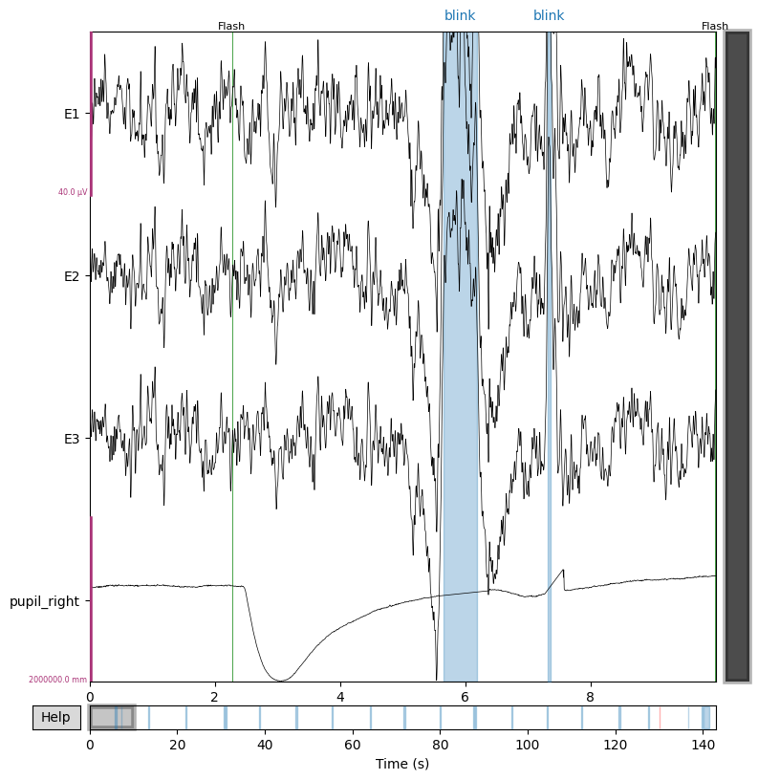
5

Slide 6
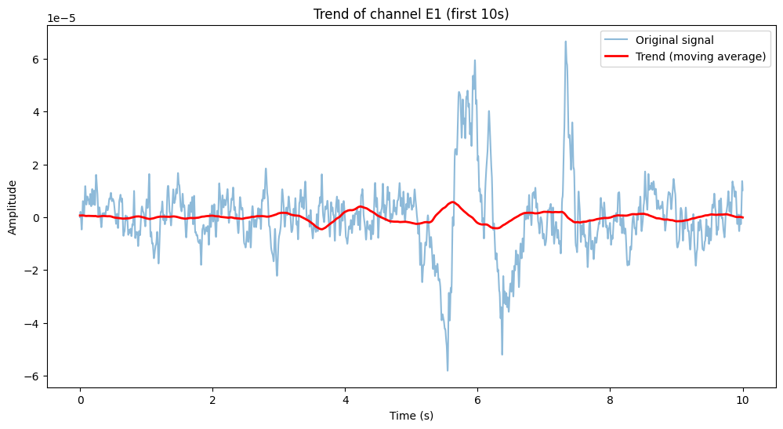
Trend
6

Slide 7
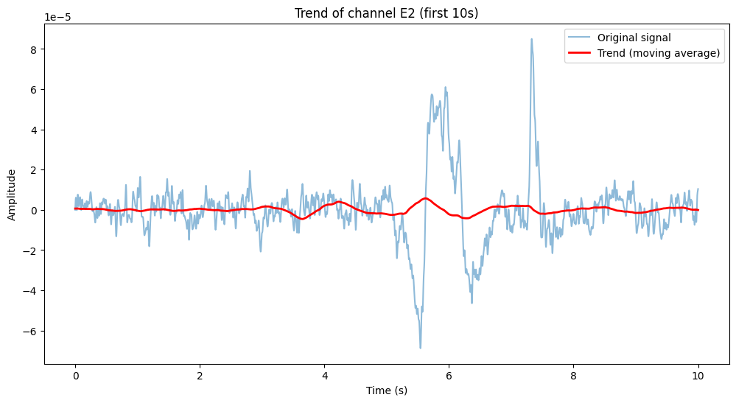
Trend
7

Slide 8
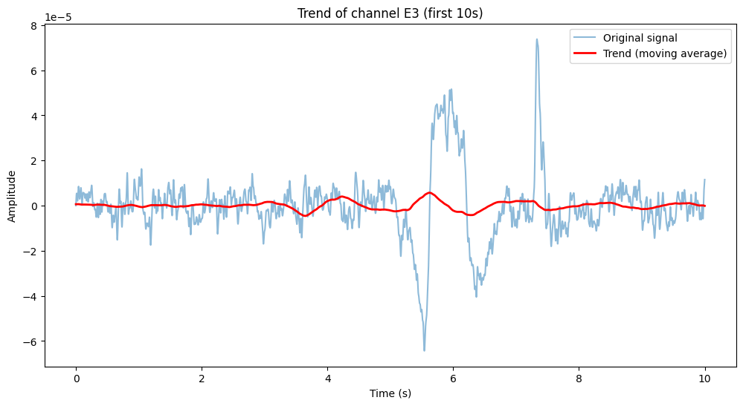
Trend
8

Slide 9
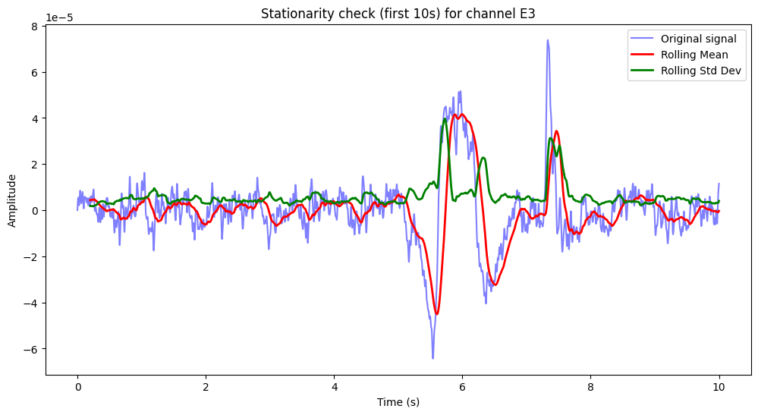
ADF Statistic: -21.631094039392178
p-value: 0.0
Critical Value 1%: -3.4303957862246266
Critical Value 5%: -2.86156023686082
Critical Value 10%: -2.5667807713612283
Stationary
9

Slide 10
C. Conclusion
10

Slide 11
Thank you!
11

Slide 12
12

