Slide 1




EEG Analysis with MNE Sample Dataset
Time-series,
Spring, 2026
Progress Report
Topic 10
Presenter: Nguyen Ha Vy
Members: Tran Ngoc Mai, Nguyen Do Anh Duong, Bui Phuong Thao, Nguyen Ha Vy

Slide 2
Content
Introduction & Dataset description
Analysis & Findings
Issues
Summary
Time-series
Topic 10

Slide 3
Content
Introduction & Dataset description
Analysis & Findings
Issues
Summary
Time-series
Topic 10

Slide 4
Introduction & Dataset description
Introduction
Goal: Explore EEG + eye‑tracking dataset
Understand structure, detect patterns, highlight issues
Dataset description
EyeLink dataset: 129‑channel EEG (EGI) + ASCII eye‑tracking
Task: Pupillary light reflex (fixation + light flashes)
Events recorded simultaneously by both systems
Time-series
Topic 10

Slide 5
Time-series
Topic 10

Slide 6
Content
Introduction & Dataset description
Analysis & Findings
Issues
Summary
Time-series
Topic 10

Slide 7
Analysis steps:
Load dataset with MNE
Inspect metadata (duration, sampling rate, channels, events)
Band‑pass filter EEG (1–30 Hz)
Segment the data into epochs around the light flash events
Compute ERPs (average brain response)
Analyze gaze + pupil size vs EEG
Time-series
Topic 10

Slide 8
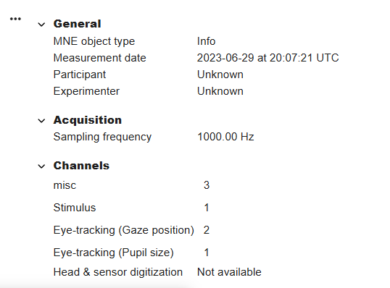

Findings:
Channels overview:
3 extra channels, 1 stimulus channel, 2 channels for eye position, and 1 channel for pupil size
No digitization → limits source localization.
Filter applied:
Acquisition: 0 Hz high‑pass, 500 Hz low‑pass.
Raw signal wide range → preprocessing needed.
Time-series
Topic 10

Slide 9
Content
Introduction & Dataset description
Analysis & Findings
Issues
Summary
Time-series
Topic 10
Time-series

Slide 10
Issues:
No participant information, so we cannot do subject‑specific analysis.
No head or sensor position data, so we cannot locate brain sources.
The wide frequency range means noise and artifacts are present, so careful filtering is needed
Time-series
Topic 10

Slide 11
Content
Introduction & Dataset description
Analysis & Findings
Issues
Summary
Time-series
Topic 10
Time-series

Slide 12
Summary:
Dataset rich in EEG + eye‑tracking, high resolution
Preprocessing needed to address metadata gaps & noise
Next: detailed event‑related analysis
Time-series
Topic 10

Slide 13
Thank you!
Intro to A
Trong-Nghia Nguyen
Time-series
Topic 10
13

