Slide 1
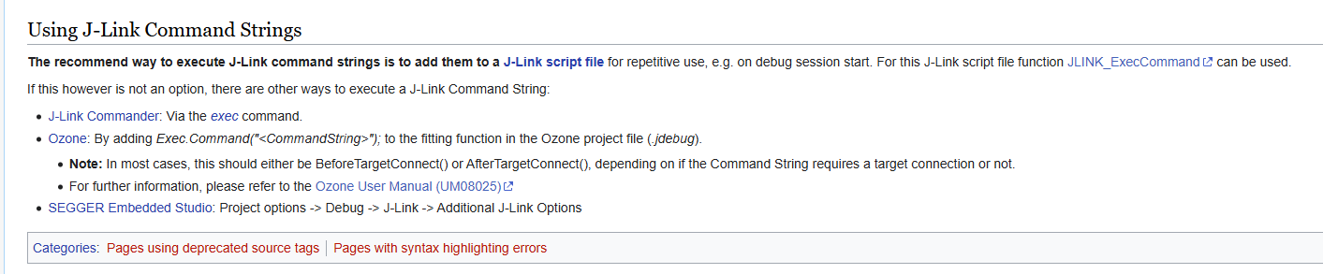
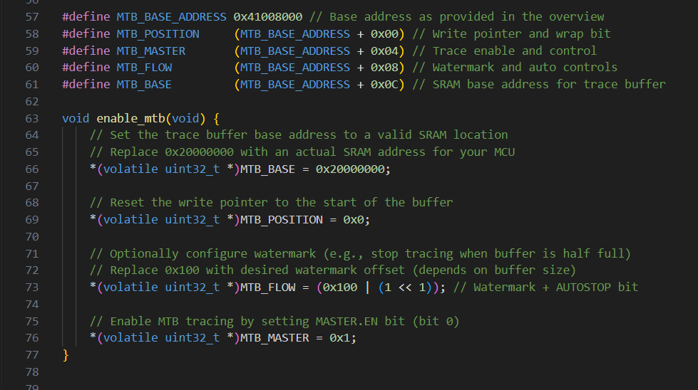
I want to enable tracing on Jlink to trace operations on the PIC32cm but for some reason the MTB is not working correctly
Here are the resources that I used:
https://kb.segger.com/How_to_configure_JLinkScript_files_to_enable_tracing
https://kb.segger.com/J-Link_script_files#Adding_missing_ROM_table_entries
Here are the MTB commands for Jlink:
https://kb.segger.com/J-Link_Command_Strings#CORESIGHT_SetMTBBaseAddr
To run these command from Ozone, I need to use this command: Jlink.Exec(“[Command]”)
Examples to run Jtrace:
https://kb.segger.com/Debug_Probes_-_J-Link_%26_J-Trace#Core_specifics
MTB specifics according to Jlink:
https://kb.segger.com/MTB_specifics#Command_strings_for_MTB_configuration
Ozone manual guides:
https://www.segger.com/downloads/jlink/UM08025_Ozone.pdf
Guide to set up trace with Ozone:
https://kb.segger.com/Setting_Up_Trace_with_Ozone
Add these commands at the top of main.c to enable the MTB tracer:
This is generated by ChatGPT.
Microchip description of MTB based on SAMD21:
https://developerhelp.microchip.com/xwiki/bin/view/products/mcu-mpu/32bit-mcu/sam/samd21-mcu-overview/samd21-processor-overview/mtb/
I can see the MTB options in MPLab X Ide but currently I cant access it, need to get it working first in Mplab X Ide before getting to work on Ozone.

Slide 2
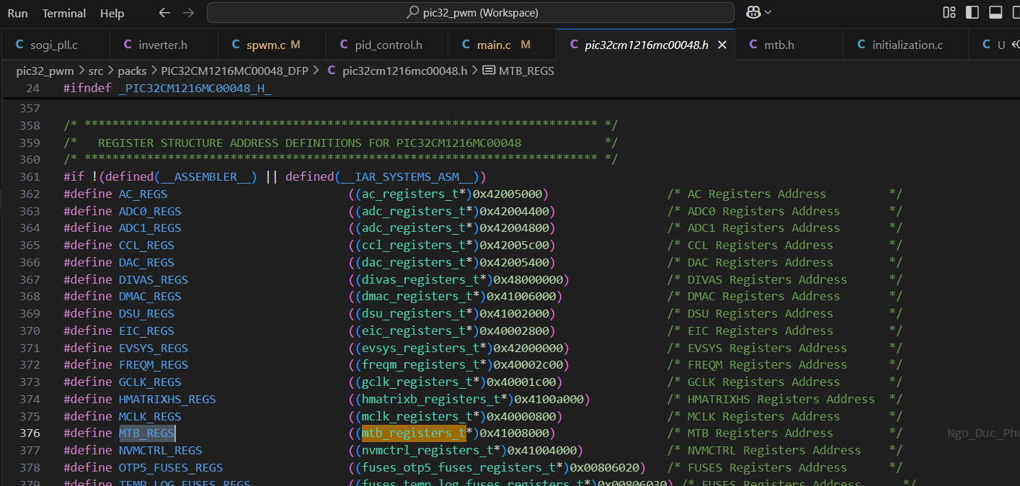
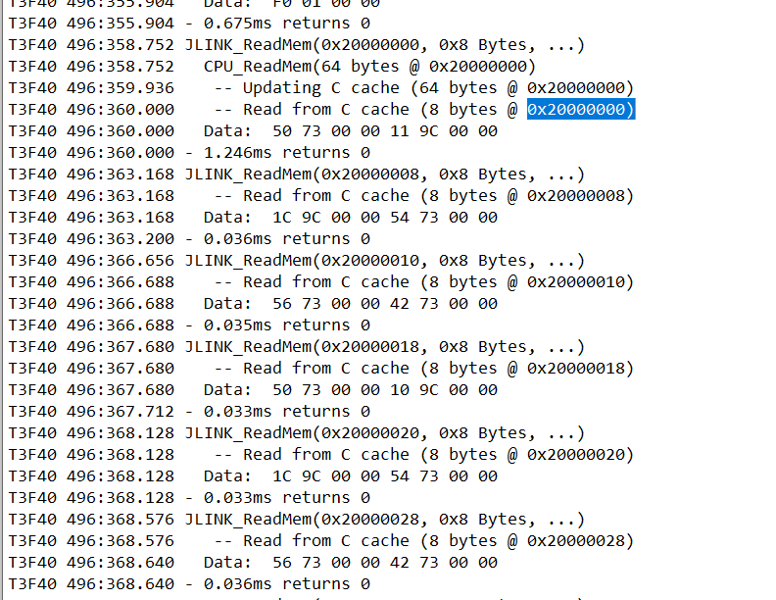
Found the defition for MTB on PIC32CM in the definition files here:
I found out the MTB implementation in MPLab X Ide is just… continuously read that same memory section, like this:
After checking the log, there is not initialization for MTB in the traditional sense like in Ozone, specifically, the Base address needs to be set and then the location of the buffer should be set too.
Halting action is performed semi-automatically by MPLAB IDE, not by the Jlink.

