Slide 1
PROJECT WORK
ComicCraft
AI Comic Story Creator using Gemini Models
An end-to-end web application that transforms a simple story prompt into a multi-panel illustrated comic and downloadable PDF.
AI Storytelling
Visual Generation
Web Backend
Gemini Flash / Pro
Stable Diffusion
FastAPI + Jinja2
ComicCraft • AI Comic Story Creator using Gemini Models | 1

Slide 2
Project Overview
What ComicCraft does
• Generates personalized comic stories from user-provided prompts.
• Creates a structured panel-by-panel outline with narration and dialogue.
• Generates matching comic-style illustrations automatically.
• Shows the complete comic in a browser preview.
• Exports the finished story as a professionally formatted PDF.
Input
Story prompt • character • setting • tone • art style
Processing
Gemini → image generation → layout → PDF
Output
Comic preview + downloadable PDF
ComicCraft • AI Comic Story Creator using Gemini Models | 2

Slide 3
Objectives
Key goals of the project
Automate storytelling
Generate visuals
01
02
Turn a short idea into a coherent comic narrative.
Create scene illustrations from AI-generated image prompts.
Simplify creation
Export results
03
04
Provide a beginner-friendly form and preview workflow.
Compile panels, captions and narration into a PDF.
ComicCraft • AI Comic Story Creator using Gemini Models | 3

Slide 4
Technical Architecture
High-level system flow
User Input
index.html
Story + preferences
FastAPI
routes.py
Request handling
Gemini
generate_outline()
generate_story()
Image AI
Stable Diffusion
panel illustrations
Layout
build_comic_layout()
structured panels
Export
save_pdf()
FPDF → PDF
The architecture separates user interaction, AI generation, image creation, layout assembly and document export into focused modules.
ComicCraft • AI Comic Story Creator using Gemini Models | 4

Slide 5
Technology Stack
Tools and libraries used
Frontend
HTML • CSS • Jinja2
Responsive forms and comic preview
Backend
Python • FastAPI
Routing, validation and workflow orchestration
Story AI
Google Gemini Flash / Pro
Outline, narration and dialogue generation
Image AI
Stable Diffusion / Diffusers
Comic-style panel illustration
Export
FPDF
Multi-page PDF generation
Validation
Pydantic
Structured JSON request validation
ComicCraft • AI Comic Story Creator using Gemini Models | 5

Slide 6
Application Workflow
From idea to downloadable comic
1
Enter prompt
2
Generate outline
3
Generate story
Story idea, character, setting, tone, art style
Gemini creates a structured 5-panel plan
Narration and dialogue are produced
4
Generate images
5
Build layout
6
Export PDF
Each panel receives a matching illustration
Images + text are organized into panel data
FPDF compiles the final comic
ComicCraft • AI Comic Story Creator using Gemini Models | 6

Slide 7
Core Backend Modules
Main Python functions
gemini_flash.py
gemini_pro.py
generate_outline() — Creates a structured 5-panel comic outline.
generate_story() — Expands panels into narration and dialogue.
image_generator.py
layout_builder.py
generate_image() — Generates and saves panel illustrations.
build_comic_layout() — Matches images with panel text and metadata.
exporters.py
routes.py
save_pdf() — Compiles the full comic into a multi-page PDF.
FastAPI routes — Connects forms/API requests to the workflow.
ComicCraft • AI Comic Story Creator using Gemini Models | 7

Slide 8
FastAPI Routes
How the backend handles requests
/
Loads the homepage and comic creation form.
/generate
Accepts form fields and runs the complete generation workflow.
/generate-comic/json
Accepts JSON payloads for API-based comic generation.
/export-success
Shows confirmation after a successful export.
/test-image
Developer utility for testing image generation.
ComicCraft • AI Comic Story Creator using Gemini Models | 8

Slide 9
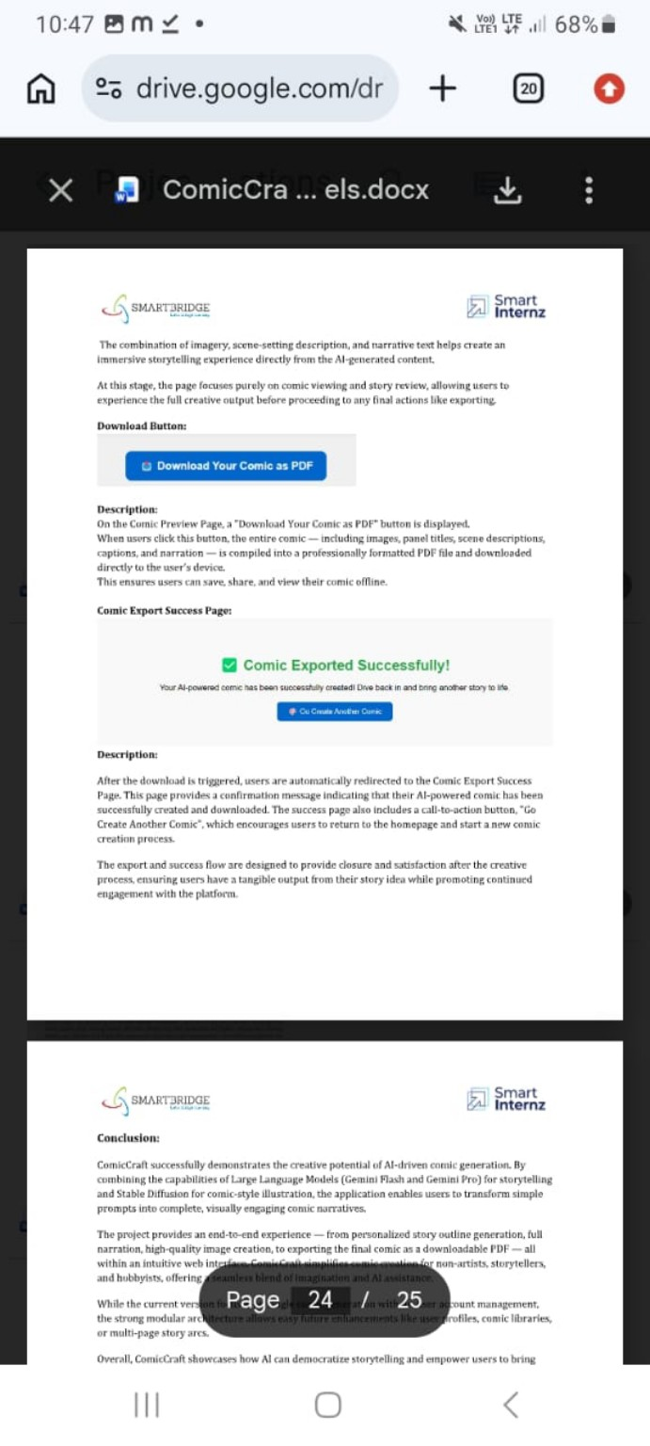
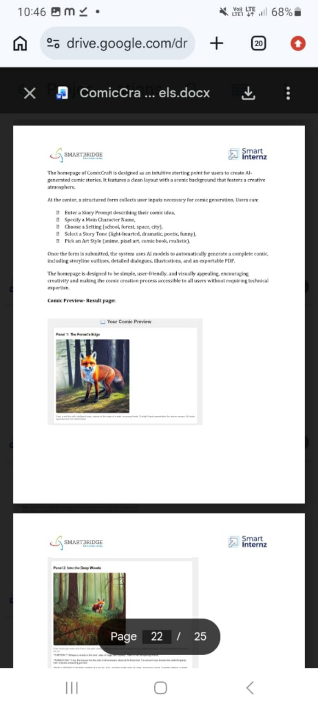
User Interface
Simple input form and comic preview
INPUT + PREVIEW
ComicCraft • AI Comic Story Creator using Gemini Models | 9

Slide 10
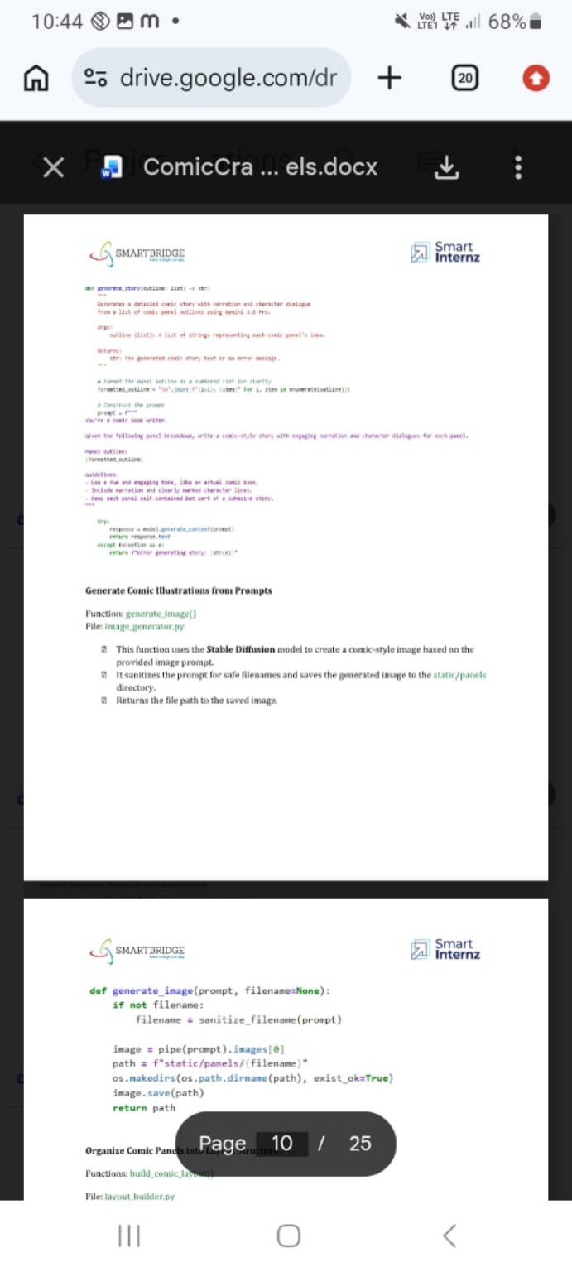
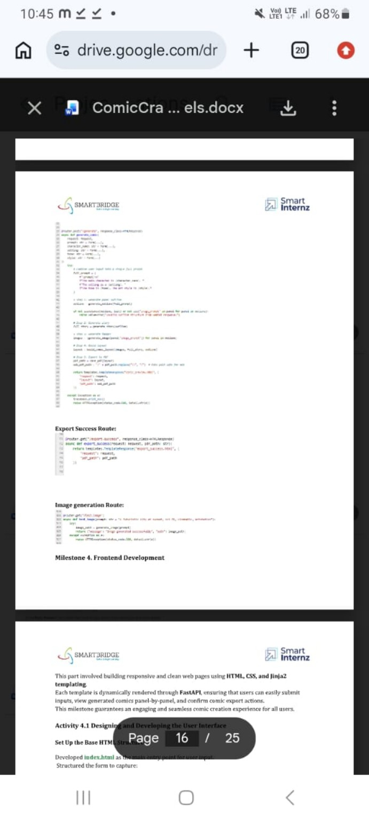
Generated Comic Panels
Example AI-generated visual storytelling
Each panel combines an AI-generated image with scene description, narration and dialogue.
ComicCraft • AI Comic Story Creator using Gemini Models | 10

Slide 11
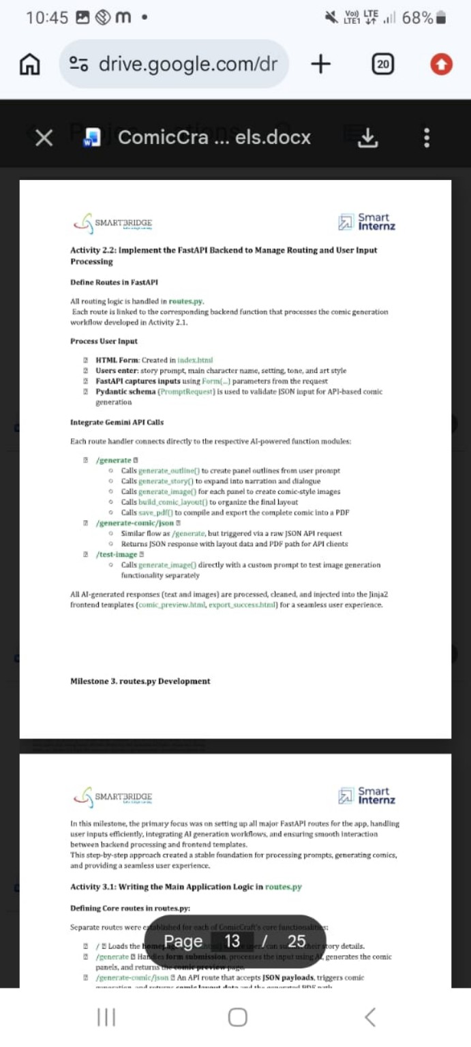
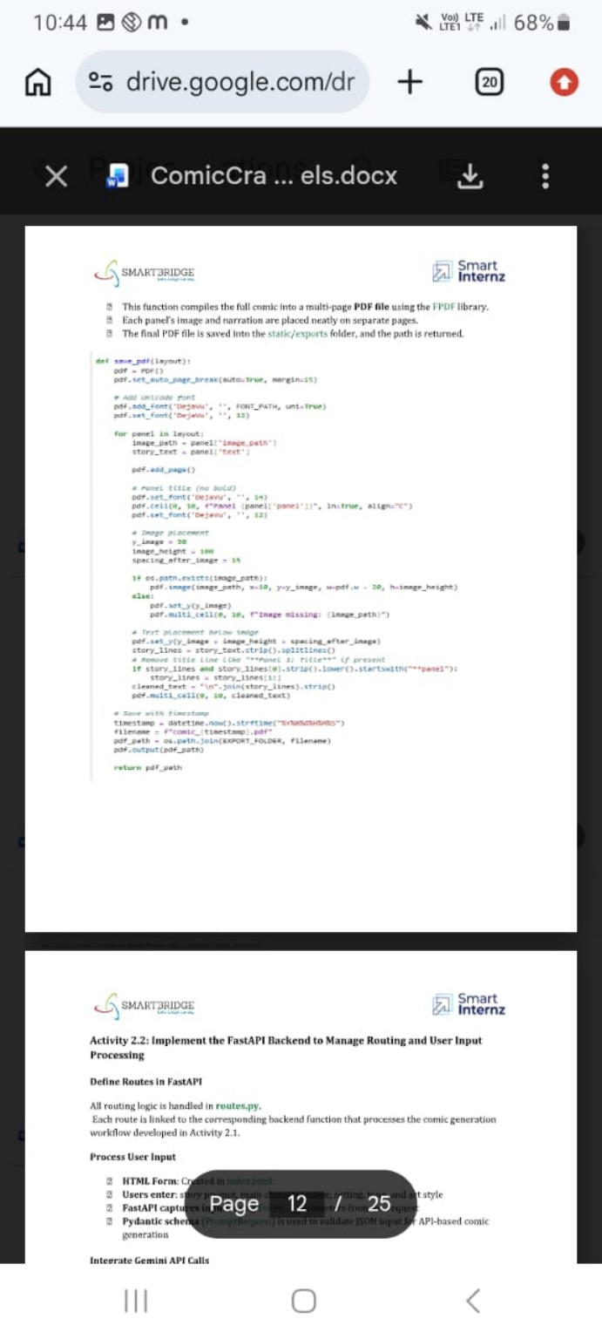
PDF Export & Success Flow
Turning the comic into a shareable document
Layout Builder
FPDF Export
Success Page
Creates structured panel records containing panel number, title, image path and text.
Places each panel image and narrative content on consecutive PDF pages.
Confirms the export and lets the user start another comic.
ComicCraft • AI Comic Story Creator using Gemini Models | 11

Slide 12
Project Results
What the completed prototype demonstrates
• End-to-end AI comic generation from a single user prompt.
• Structured storytelling with consistent panel sequencing.
• Automated image generation for each comic scene.
• Clean web preview for reviewing the generated story.
• PDF export for offline saving, sharing and printing.
Input
One creative idea
AI Pipeline
Story + images + layout
Final Output
Complete comic + PDF
ComicCraft • AI Comic Story Creator using Gemini Models | 12

Slide 13
Future Enhancements
Possible next steps
• User accounts and saved comic libraries.
• Multiple-page story arcs and larger panel counts.
• More art styles and stronger visual consistency controls.
• Editing tools for individual panels before export.
• Cloud storage and sharing links for finished comics.
Scalability Vision
ComicCraft can evolve from a prototype into a full creative platform by adding persistence, richer editing and reusable character/story settings.
ComicCraft • AI Comic Story Creator using Gemini Models | 13

Slide 14
CONCLUSION
ComicCraft turns imagination into a finished comic.
By combining Gemini-based storytelling, AI image generation, FastAPI backend processing, structured layout and PDF export, the project provides an end-to-end workflow for creating personalized comics.
Creative
Visual
Deliverable
Prompt → story
Story → panels
Panels → PDF
ComicCraft • AI Comic Story Creator using Gemini Models | 14

