Slide 1

KIE4033 Data Analytics 2025/2026
Assignment 2
Developing AI-driven framework that automates both detection and clinical stratification of DFU classification and severity mapping
Name | Matric Number
Muhammad Rashidul Bukhari Bin Asan Mohamed | 22004502/1
PREPARED FOR: ASSOCIATE PROF. IR. DR. CHOW CHEE ONN

Slide 2
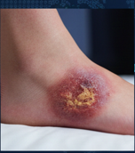


Abstract
Diabetic foot ulcers (DFUs) require precise monitoring to prevent life-threatening amputations.
Previous RM-2 monitoring device relied on geometric data (area, perimeter), failing to capture biological states like infection or necrosis.
An AI-driven framework that automates detection and clinical stratification using bio-medical feature engineering
Results:
Optimized Random Forest achieved 94% accuracy (0.99 AUC)
K-Means clustering (K=6) programmatically maps wounds to the clinical Wagner Classification System.

Slide 3
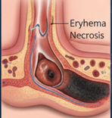
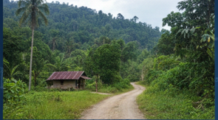
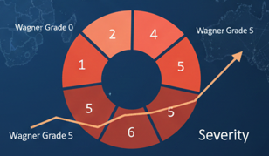

Introduction
Uses CIE LAB colour space to assess Erythema (inflammation) and Necrosis (tissue death) independently of lighting conditions.
Enable remote specialist triage by distinguishing healthy skin from ulcers and defining six stages of clinical severity.
Patients in rural areas (e.g., Sabah) often delay treatment due to travel distances and financial costs.
Transitions the RM-2 tool from a "reactive wound tracker" to a proactive medical companion.

Slide 4



Problem Definition
Pillar 1: Geometric Limitations
Pillar 2: Triage Bottleneck
Pillar 3: User Variability
Size alone does not represent biological status, infection and necrosis can develop internally without changing wound dimensions
High patient volume and low specialist availability in rural areas create decision-making delays
Variations in lighting and skin tones make simple pixel measurements inconsistent.
Core Objectives
Automate detection (Supervised ML) of ulcer
Automated severity strategy (Unsupervised ML)
Mapped Severity to the Wagner Scale to be used by doctors (no ambiguity)

Slide 5


Data Description & Preprocessing
Dataset: Medically validated Kaggle DFU dataset
Internal Set: 1,055 images (512 Ulcer + 543 Healthy) for training and testing
External Set: 167 ulcer-only images for independent validation
Group | Features | Purpose
Geometric Features | Area, Perimeter, Solidity & Eccentricity | Calculated to refine the basic metrics used by Group RM-2
Bio-Medical Features | Erythema Index (mean A-channel) Necrosis Index (mean L-channel) | Calculated to provide the biological context
Tissue Complexity | Colour Variance (standard deviation of the image) | Used as digital fingerprint for the heterogeneity of complex ulcerous tissue
Target Feature | Presence of Ulcer | Binary value indicating ulcer present: 1 and ulcer absent: 0
Preprocessing Pipeline
Images Standardization & Denoising: 256 x 256 pixels with Median Filtering
Clinical Colour Space Transformation: Transformation to CIE LAB colour space for lighting invariance
Morphological Segmentation : Otsu’s Thresholding for automated wound region extraction
Dealing with Missing Values in Outlier Data: Avoid any image where it is not possible to segment out the main affected area

Slide 6
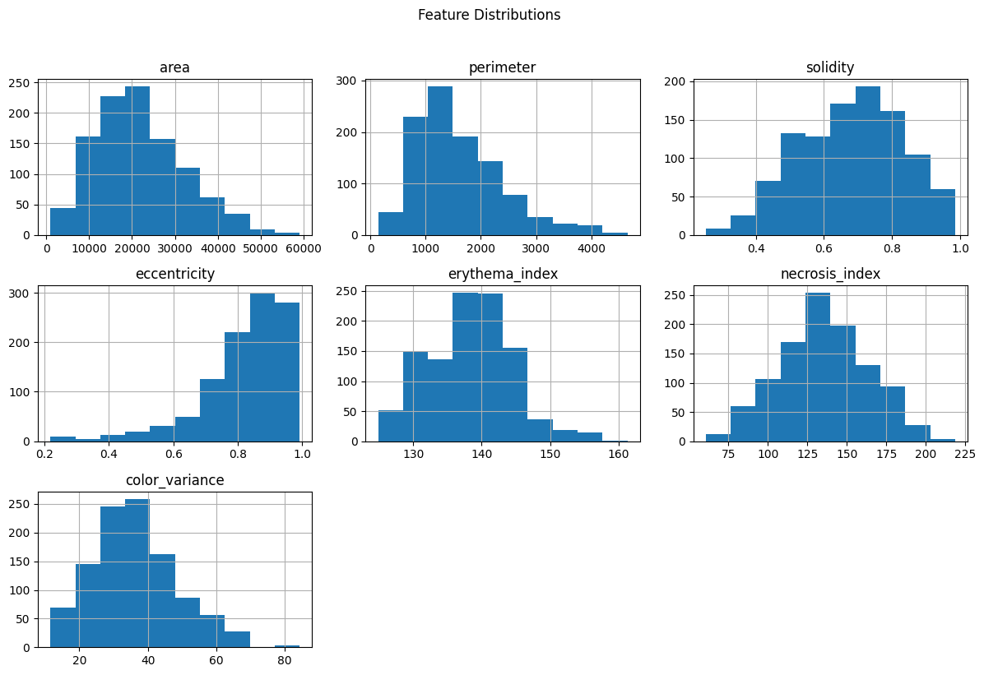
EDA

Slide 7
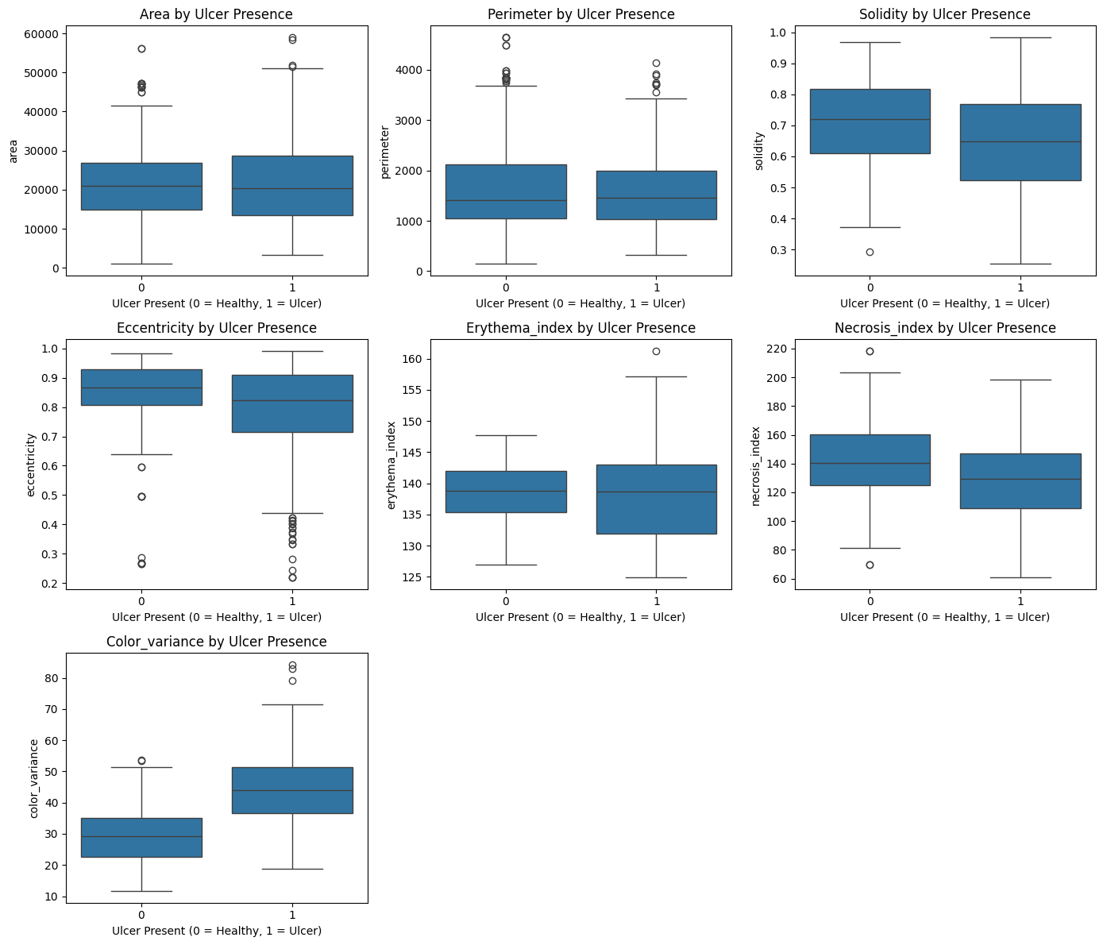
EDA

Slide 8
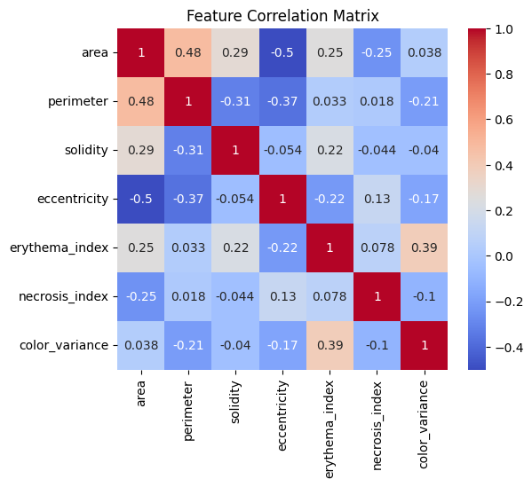
EDA

Slide 9
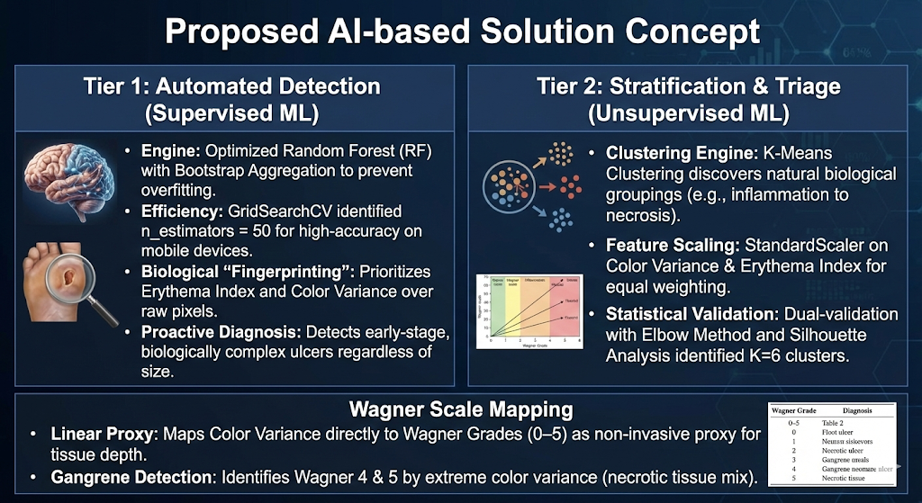
Proposed AI-based Solution Concept

Slide 10
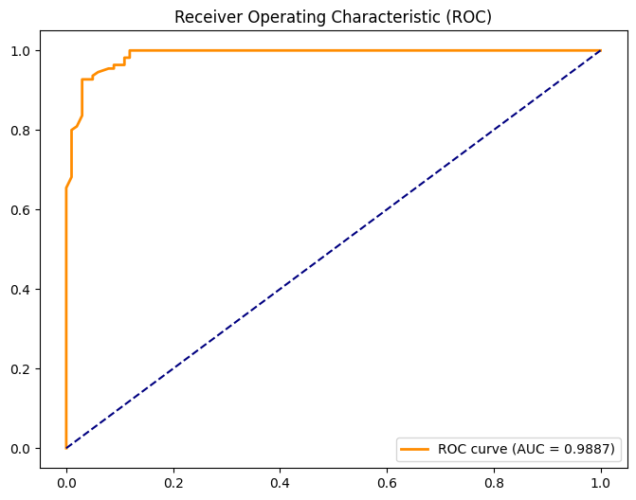
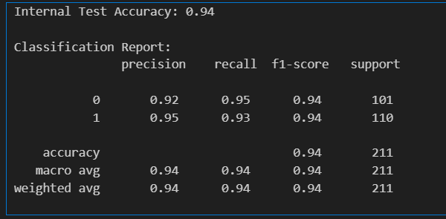
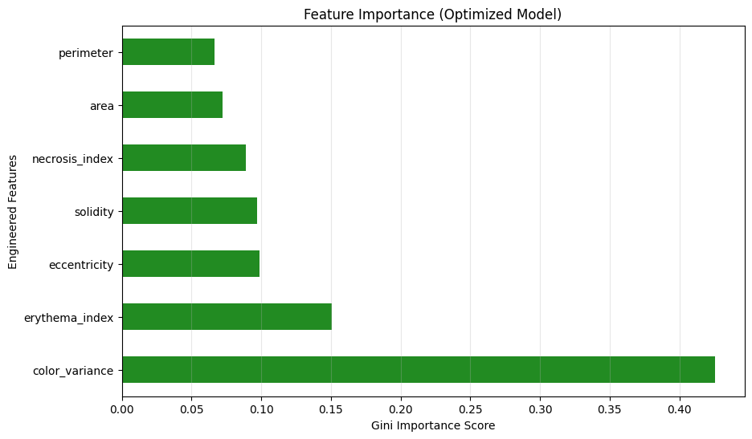
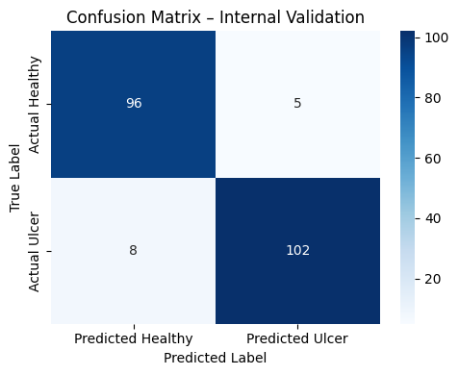
Result and Discussion
Automated Ulcer Detection (Supervised Learning)

Slide 11
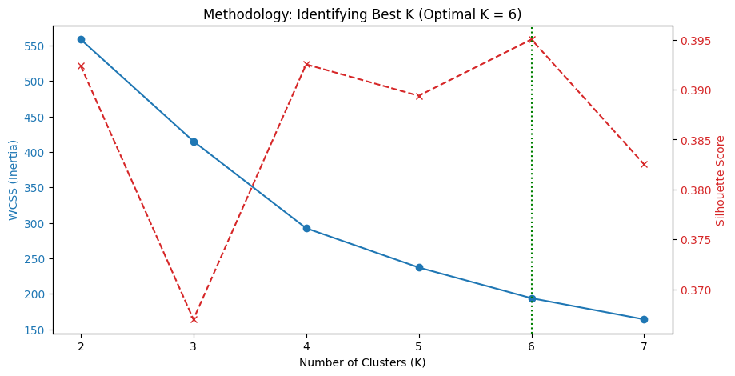
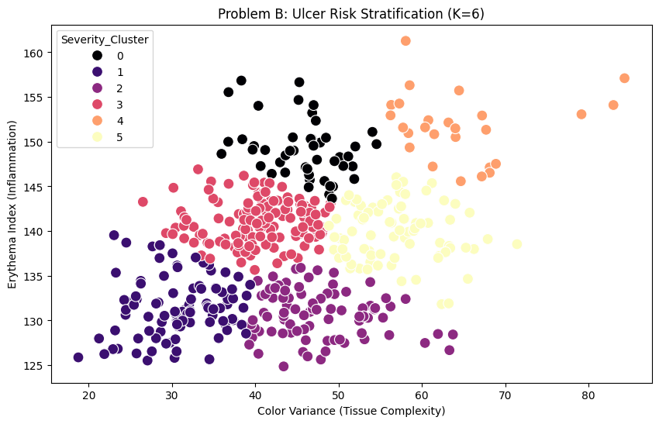
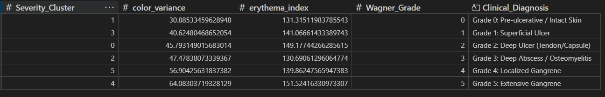
Result and Discussion
Severity based Triage and Wagner Mapping (Unsupervised Learning)

Slide 12
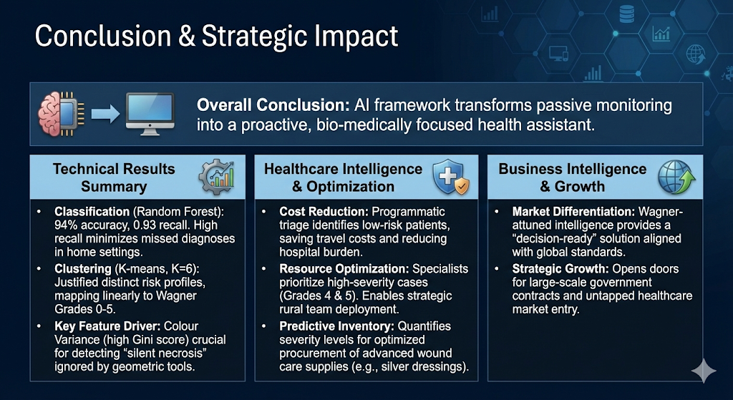
Conclusion
Overall Conclusion
Al framework transforms passive monitoring into a proactive, bio-medically focused health assistant.

