Slide 1
KIE4031
MACHINE LEARNING
AI-DRIVEN TRAFFIC MANAGEMENT: A MACHINE LEARNING FRAMEWORK FOR SMART CITY CONGESTION
PRESENTED BY:
Name | Matrics Number
Muhamad Rashidul Bukhari Bin Asan Mohamed | 22004502/1
Zul Arif Nael Bin Zul Adenan | U2101223/2

Slide 2
BACKGROUND & CASE STUDY
INTRODUCTION
PROBLEM STATEMENT
ROLE OF ML
CASE STUDY & DATASET
Rapid urbanization is straining municipal infrastructure, making congestion a primary concern for modern city planners.
Intelligent Transport Systems (ITS): A core pillar of smart cities focused on Dynamic traffic management, congestion mitigation and enhancing road safety for all citizens.
Static & Reactive Systems: Fixed, pre-set time cycles
Manual Intervention Inefficiency: Heavy human labor during peak hours.
Environmental Risks: Unexpected weather causes traffic spikes and accidents.
Cost: Increased travel times, fuel wastage, and severe carbon emissions.
Enables systems to forecast traffic flow before congestion actually forms.
Random Forest is chosen due to ensemble power, big data capability and robustness.
Goal: Optimize signal timings and support long-term urban infrastructure planning.
Dataset: "Metro Interstate Traffic Volume" (UCI Machine Learning Repository).
Temporal: date_time,
Environmental: Temperature, hourly rainfall & cloud coverage.
Target Variable: Total hourly traffic volume.
Innovation: Combines diverse & heterogeneous atmospheric data with human activity patterns into a single model.

Slide 3
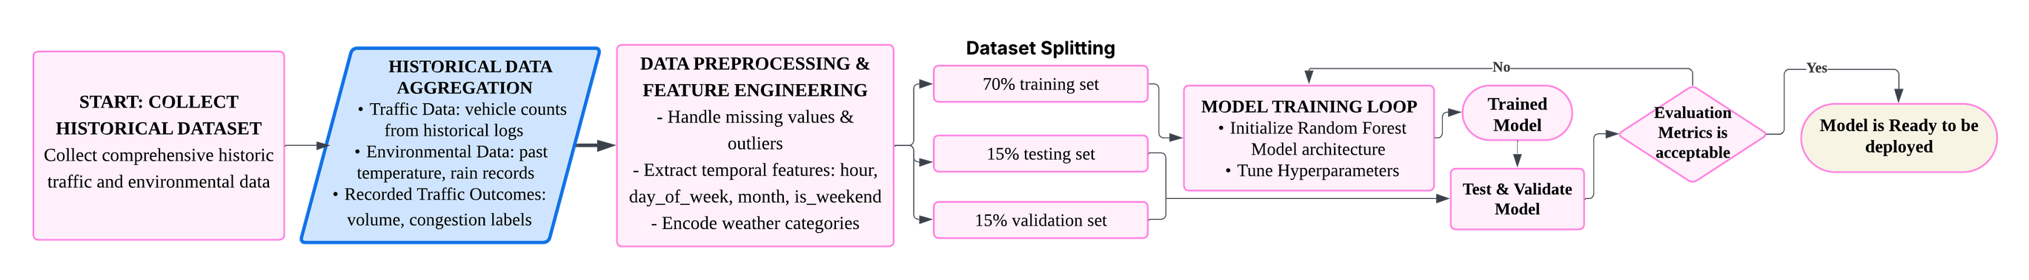
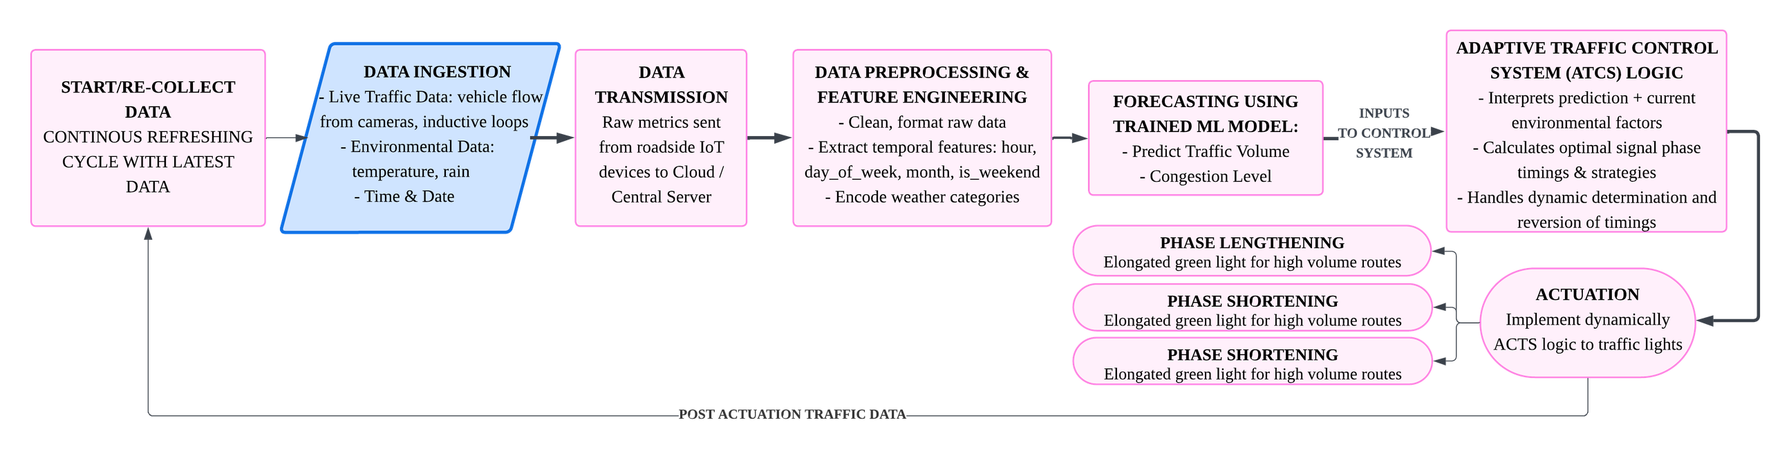
TRAINING RANDOM FOREST MODEL
POST TRAINING

Slide 4
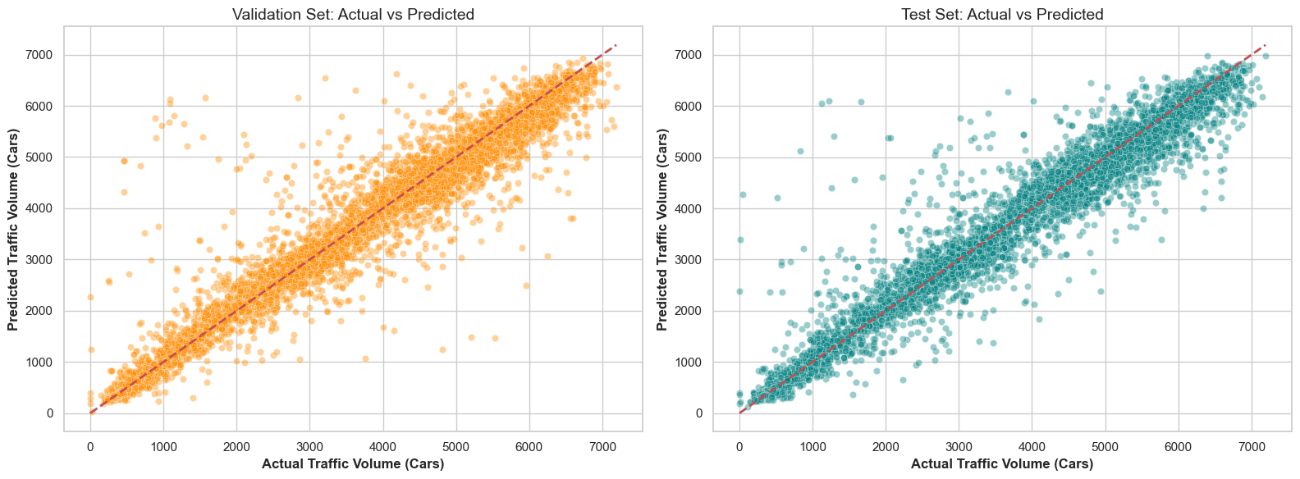
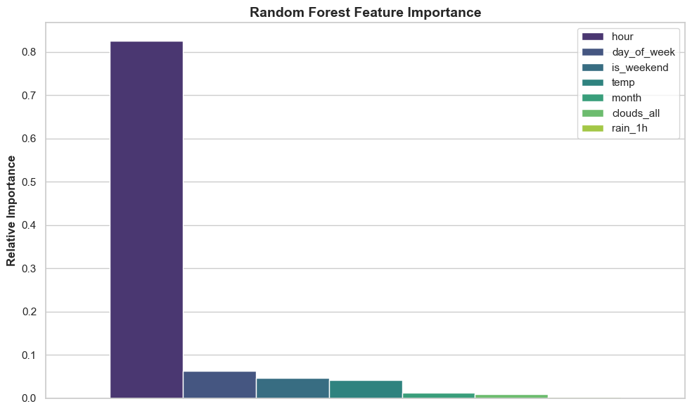
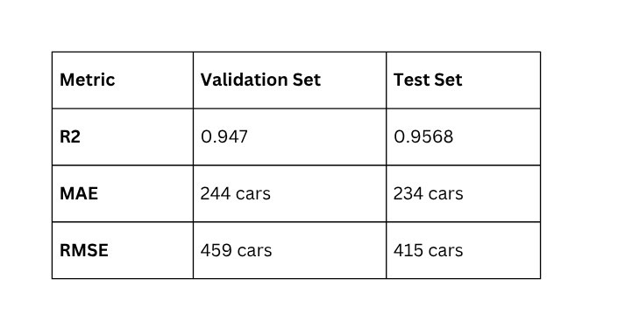
RESULTS

Slide 5

CASE STUDY EXAMPLES
MORNING RUSH
RAINY AFTERNOON
OFF-PEAK NIGHT
8 AM, Weekday
Temp: 280K
3 PM, Weekday
Rain: 5mm
11 PM, Weekday
Clear Weather
Predicted Traffic:
5420 cars
Predicted Traffic:
4150 cars
Predicted Traffic:
840 cars
Phase Lengthening
(Green +30s)
Phase Lengthening
(Green +15s)
Dynamic Reversion
(Baseline)

Slide 6

RESPONSE AND REFLECTION
01
02
03
IMPACT OF AI INTEGRATION
PRIVACY TRADE-OFF
CAUTIOUS OPTIMISM & RESILIENCE
Machine learning successfully shifts urban traffic management from reactive to highly proactive, but the deep integration turns the critical physical infrastructure into prime targets for cyberattacks and data poisoning.
Seamless urban mobility requires continuous, heavy data collection from IoT sensors and cameras. Strict adherence to guidelines like the MHLG Smart City Framework is important to protect personal data and prevent mass surveillance.
The potential to solve urban congestion is endless but complicated by the legal liability of AI routing errors. Future projects must prioritize building fail-safe and highly resilient systems instead of pure algorithmic innovation.

