Slide 1

Optimization of Medical Resource Allocation Using Python and PgRouting
By
Daniel Erickson, m20210194
Oluwabukola Olufunke Akanbi, m20210934
Supervisor: Professor Alexandre Neto

Slide 2
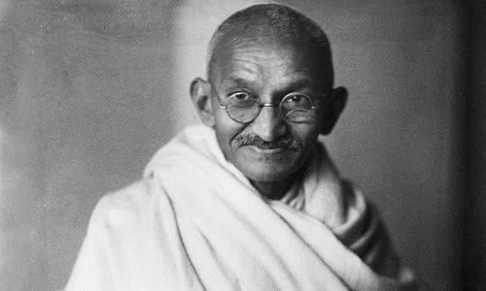
Introduction
Presenter: Bukky
Health is wealth, said Ghandi a long time ago, and that is still the reality today. A healthy nation has a possibility of experiencing sustained growth.
Mahatma Ghandi
Which ever way you choose to define medical resources, either in terms of material, human, or medical facility, the reality is they are always limited.
Eike-Henner W. Kluge, 2007

Slide 3

Presenter: Bukky
Aim and Objectives
The aim of this project is to implement Python and PgRouting to manage and optimize the allocation of medical resources in Goa State India. This tool uses several data inputs, namely: population, OSM (road network), and existing medical centers.
Plot and show the spatial distribution of existing medical facilities and population in the study area.
Create isochrones/buffers with specified distances around medical facilities to estimate population served
Create a web-based solution that allows planners to click/enter the coordinates of an existing medical center and retrieve its service area and also the served population estimation based on specified buffer radius.

Slide 4
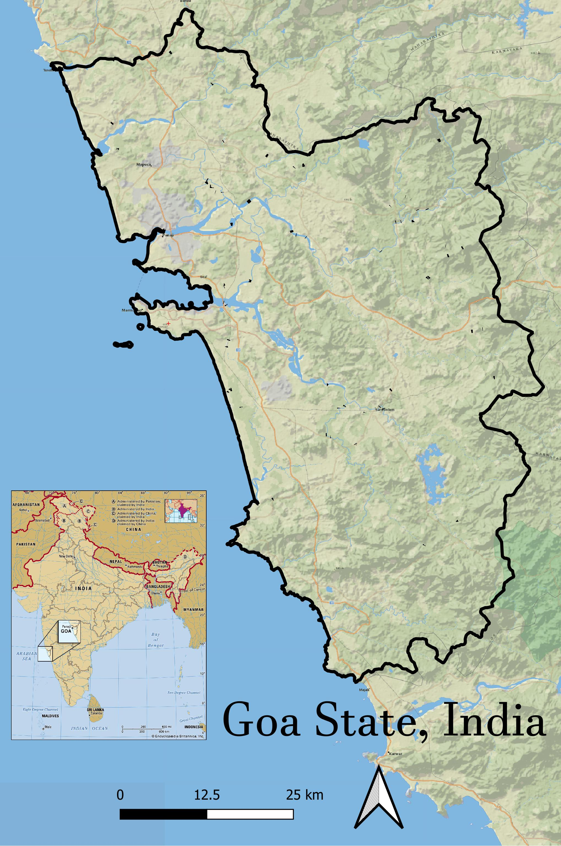
Presenter: Daniel
Study Area and Data
Goa is a small emerald land on the west coast of India, the 25th state of the union states of India. The population is about 1.82m. Goa covers an area of 3702 square kilometers and comprises two revenue district, North Goa and South Goa. Major business industries.
Agriculture
Mining
Tourism
S/N | Data | Year | Source
1 | Census | 2001 | https://censusindia.gov.in/pca/pcadata/Houselisting-housing-Goa.html
2 | Medical Facilities | 2011 | https://nhm.goa.gov.in/list-of-health-centres/
3 | OSM(road network) | 2021 | Geofabrik (Open Street map)
The Medical Facility data was divided into 3 tiers.
Tier 1 represents hospitals
Tier 2 represents health centers
Tier 3 represents clinics

Slide 5
Presenter: Daniel
Scope and Limitations
Limitation
Some of the limitations we encountered during the project are as follows
Stata data
Dataset are not consistent
Routing issues, especially for rural areas
Lack of adequate information about the study area
Time!!
Scope
Viewing the medical facilities and creating isochrones around them
Calculating intersections of census tracts and the isochrones to arrive at population served
Population estimations are based on area percentages

Slide 6
Conclusion
The problem of allocating healthcare resources in a fair and equitable way has been a focus of concreted discussion and analysis for decades.
The health of a nation is an important criterion of a country’s advancement; when the population in a particular nation is healthy, there is a possibility of experiencing sustained growth.
This project helps in the optimization of medical resource allocation by estimating the population served in Goa state based on a specific distances, it also estimates the population that is not served.

Slide 7

Daniel and Bukky, please move on to visualization and app presentation!!
Thank you!!

