Slide 1
ACUTE LYMPHOBLASTIC LEUKEMIA DETECTIONG USING CONVOLUTIONAL NEURAL NETWORKS
Supervised by:
Mr. Umar Farooq
Ms. Aleena
Presented by:
Muhammad Luqman (FA20-BSAI-005)
Farhan Shoukat (FA20-BSAI-048)
Wafiya Sohail (FA20-BSAI-027)

Slide 2
Introduction

Slide 3
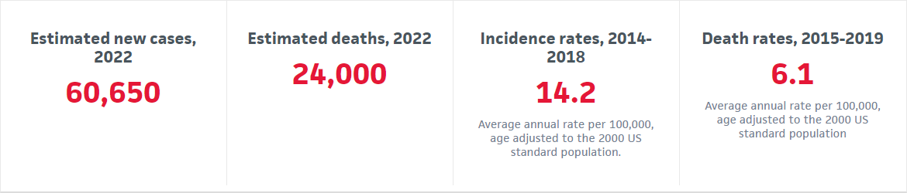
Statistics for Leukemia

Slide 4
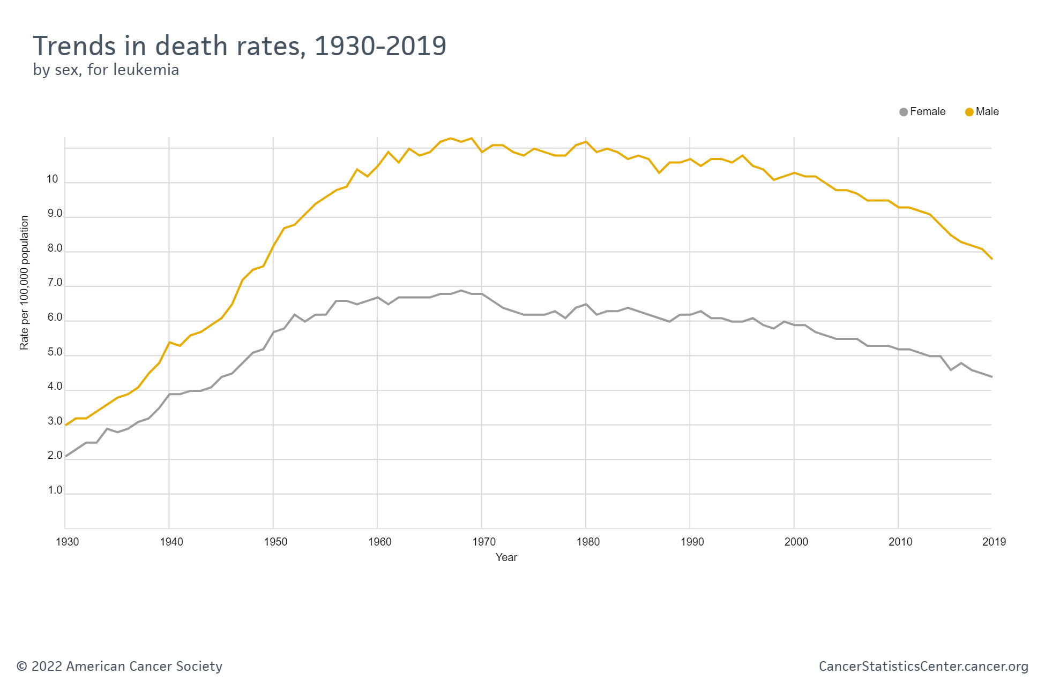
Leukemia Death Rate

Slide 5
OUR CONTRIBUTION

Slide 6



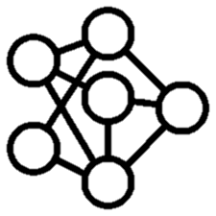

Contents for our Project
Datasets
Cell Extraction
Web Application
Image Pre Processing
CNNs

Slide 7
DATASETS
Two DataSets ALL IDB and ALL IDB 2 were acquired from researchers at University of Milan, spain.
ALL IDB 1 contain 100+ blood sample images containing a mix of labled cancerous and normal cells.
ALL IDB 2 contains isolated labled blood cells.

Slide 8
Image Processing

Slide 9
Steps for Image-Processing
Original Image
RGB to Lab Colors pace Transformation
K-Means Clustering
Image to Gray Scale
Find Contours
Erosion
Bitwise Masking onto the original Image
Thresholding
Dividing into Cell Sub-images
Data Augmentation

Slide 10
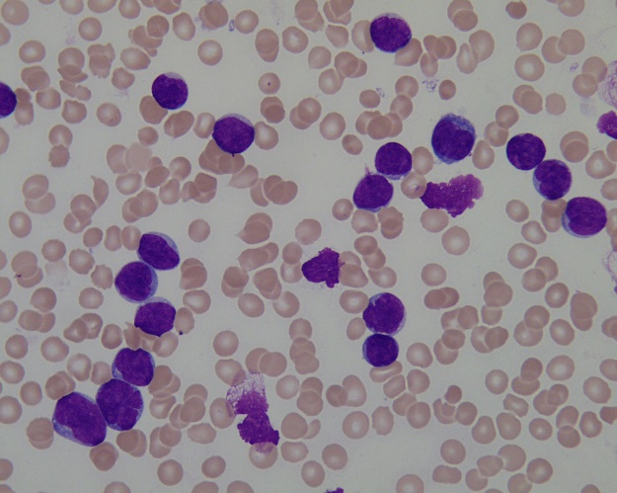
Original Image

Slide 11
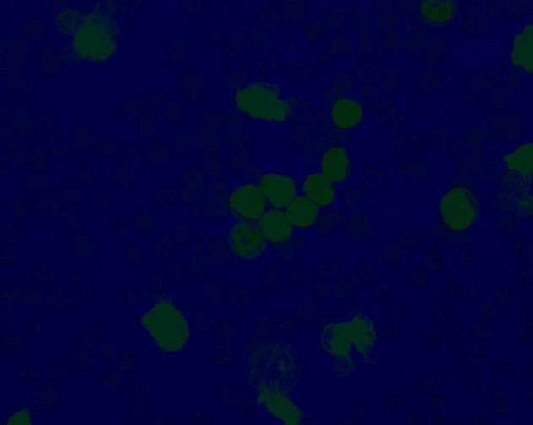
RGB to LAB Color Space Transformation

Slide 12
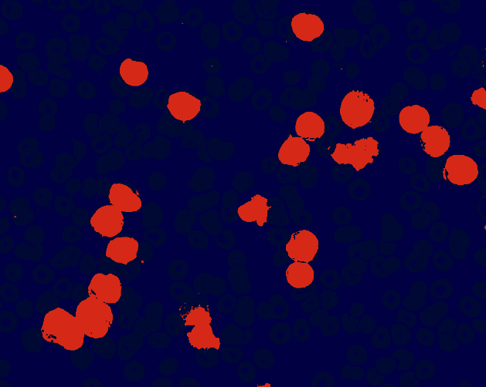
K-Means Clustering

Slide 13
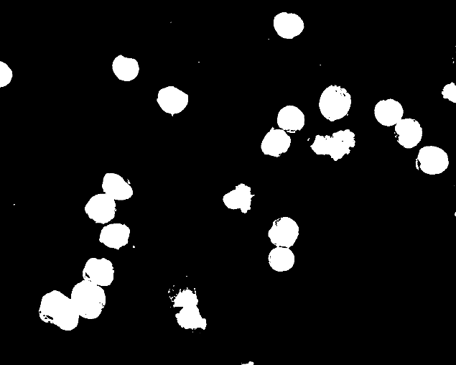
Thresholding

Slide 14
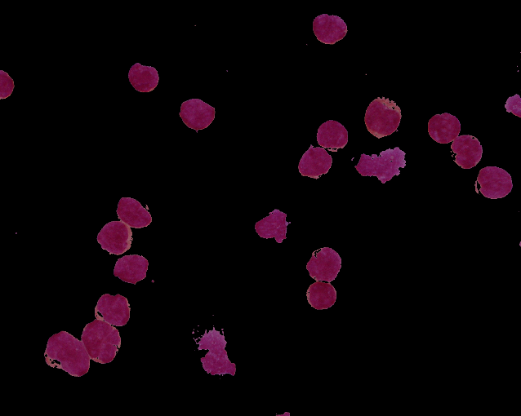
Bitwise Masking

Slide 15
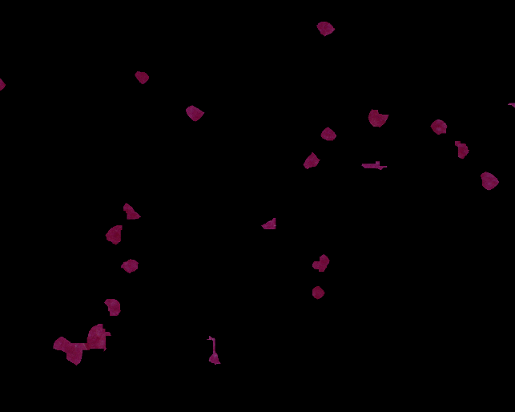
Erosion

Slide 16

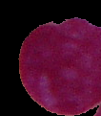
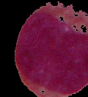
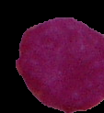

Sub-Image extraction Using Find Contour

Slide 17
Convolutional Neural Networks

Slide 18
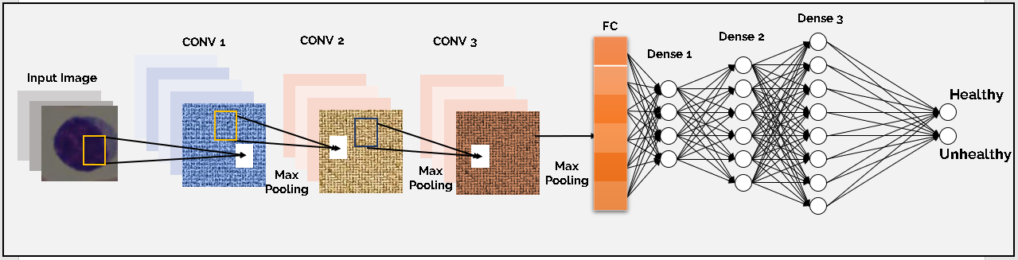

Slide 19
Working of a Convolutional Layer
Filter 1
Feature Map 1
Max Pooling
Original Image
Filter 2
Feature Map 2
Combined Feature Map
Output
Filter 3
Feature Map 3

Slide 20
Our Convolutional Layers
Output
Flatten
Original Image
Convolutional Layer 1 (32 features)
Convolutional Layer 2 (64 features)
Convolutional Layer 3 (128 features)

Slide 21
Flattened Input Layer
Layer 3
(128 Neurons)
Input
Layer 2
(64 Neurons)
Layer 1
(32 Neurons)
Output Layer
0
1

Slide 23
Web Application User Interface

Slide 24
FLASK Framework
HTML + CSS Front End
Python Back End
Trained CNN

Slide 25
Demonstration

Slide 26
Q/A

