Slide 1
BolPay
Freelance contracts & payroll with on-chain escrow on Stellar
1

Slide 2
THE PROBLEM
Remote work is paid with trust, not guarantees
1
Informal agreements
2
Manual, slow payments
3
Payroll without automation
Companies and freelancers make deals over email, WhatsApp or Telegram, with nothing enforcing what was agreed.
International payments are processed manually through PayPal or bank transfers: delays, high fees and no traceability.
Remote employees are paid manually and periodically, without auditability or real transparency.
Real-world case
Capa Zero manages global freelancers through this same informal model, with payment delays and limited transaction traceability.
◈ BolPay
2

Slide 3
THE SOLUTION
A guarantee infrastructure for contracts and payroll
1
Milestone contracts
2
On-chain payroll
3
Fair disputes
Each milestone is released only after the deliverable is approved. Funds are locked in escrow once the contract is accepted.
Weekly, biweekly or monthly cycles automatically distribute USDC to each contributor, with a verifiable payment history.
If an agreement is not fulfilled, payment remains paused until both parties agree on the split. Neither side can release funds unilaterally.
All value moves in USDC, a Stellar-native stablecoin: no volatility and on-chain traceability for every transaction.
◈ BolPay
3

Slide 4
HOW IT WORKS
From agreement to payment, everything stays on-chain
MILESTONE CONTRACTS
1
Contract accepted
2
Escrow funded
3
Milestone approved
4
On-chain release
The multi-release escrow is deployed.
The company funds the escrow with the full amount in USDC.
The freelancer delivers and the company approves the milestone.
Payment is released on-chain and the transaction hash is recorded.
RECURRING PAYROLL
1
Define the cycle
2
Fund escrow
3
Automatic distribution
4
Verifiable payment
Set the payroll cycle and recipients.
The company funds the payroll escrow.
On the scheduled date, each recipient is paid.
Each payment generates its own transaction hash.
◈ BolPay
4

Slide 5
TARGET USERS
Who we are building BolPay for
Companies & remote teams
Freelancers & contributors
Startups and tech/Web3 agencies that hire international freelancers and pay fixed remote contributors, such as Capa Zero.
Professionals who invoice in USD/USDC and want certainty that approved work translates into immediate payment.
EARLY ADOPTERS
Blockchain startups and development agencies already operating with stablecoins that need to formalize remote contracts and payroll without friction.
◈ BolPay
5

Slide 6
VALUE PROPOSITION
What makes BolPay different
Truly non-custodial escrow
Contracts + payroll in one place
Stellar speed & cost
Unlike traditional intermediaries, BolPay never holds funds or private keys. Every action is signed from the user's own wallet.
One guarantee infrastructure covers both project-based payments and recurring payroll — together in one platform.
Settlement in 3–5 seconds with minimal network fees, suited to frequent and international low-value payments.
◈ BolPay
6

Slide 7
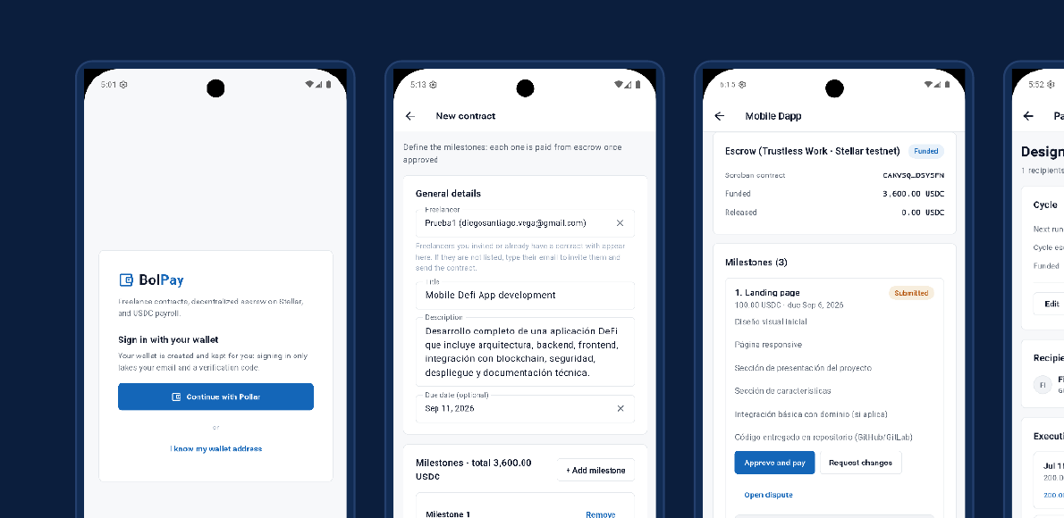
PROTOTYPE
A real product, not a mockup
Stellar wallet access (Pollar)
Milestone contract creation
Funded escrow & payment approval
Automatic payroll distribution
◈ BolPay
7

Slide 8
COMPETITION
How BolPay compares
Upwork
Deel
ArcusX
BolPay
On-chain escrow
No
No
Yes
Yes
Integrated payroll
No
Yes
No
Yes
Stablecoin payments
No
No
Yes (USDC)
Yes (USDC)
Structured disputes
Partial
Partial
No
Yes
Typical fee
Up to 20%
High fixed fee
Not specified
1.5%
◈ BolPay
8

Slide 9
IMPACT & SCALABILITY
From a real case to scalable infrastructure
IMPACT
SCALABILITY
• Reduces friction and distrust in remote work between companies and freelancers.
• Gives freelancers payment certainty: approved work is paid without relying on an intermediary.
• Gives companies full traceability for each payment and agreement.
• The same escrow infrastructure can serve more companies and freelancers without structural changes.
• Monorepo architecture with a shared types package across web, mobile and backend.
• Simulated mode enables full-flow demos and testing before scaling to Mainnet.
3–5s
0.3%
100%
3
Settlement per transaction
Trustless Work protocol fee
Non-custodial model
Clients: web, mobile & backend
◈ BolPay
9

Slide 10
BUSINESS MODEL
How BolPay generates revenue
1
Transaction fee
2
BolPay Teams
1.5% on every released payment (milestone or payroll cycle), well below platforms such as Upwork.
Primary revenue is directly tied to the volume of contracts and payroll processed by the platform.
• Fixed monthly fee for companies with high-volume payroll.
• Reduced transaction fee above a defined volume threshold.
• Recurring, predictable MRR that complements transaction revenue.
COST STRUCTURE
Platform development & maintenance · Infrastructure & monitoring · Trustless Work protocol fee (0.3%) · Support & customer acquisition
◈ BolPay
10

Slide 11
VIABILITY
An MVP built, tested and in production
TECH STACK
CURRENT STATUS
Web — React (Vite) + TanStack Query
Mobile — Flutter
Backend — NestJS (Node.js + TypeScript) + Prisma
Database — PostgreSQL (Supabase)
Blockchain — Stellar + Soroban
Escrow — Trustless Work (Escrow-as-a-Service)
Auth & wallets — Pollar (social login + custodial wallet)
Transactional email — Resend
• All modules implemented: authentication, contracts, milestones, escrow, disputes, payroll, notifications and audit.
• Functional tests validated on Stellar Testnet across the three payment flows.
• Backend in production on a hardened Linux server with systemd and monitoring.
• Web continuously integrated and deployed on Vercel.
• Android APK compiled and distributed.
◈ BolPay
11

Slide 12
NEXT STEP
Bring freelance payments on-chain
1
Move to Stellar Mainnet
2
Add fiat rails
3
Run pilots
4
Expand beyond Capa Zero
Migrate the operation from Testnet to Stellar Mainnet.
Add fiat on/off-ramp entry and exit rails.
Pilot with more Web3 studios and remote agencies.
Open BolPay to additional companies.
BolPay
◈ BolPay
12

