Slide 1


Slide 2

BLING BLING
:LIGHT
GROUP 5

Slide 3
TABLE OF CONTENTS
01
LASCR
02
OPTICAL ISOLATORS
03
OPTICAL MODULATORS
Light-Activated Silicon-Controlled Rectifier
Light Rectifier
Light Manipulator

Slide 4
01
LASCR
DEFINITION – CONSTRUCTION – OPERATION - APPLICATION

Slide 5
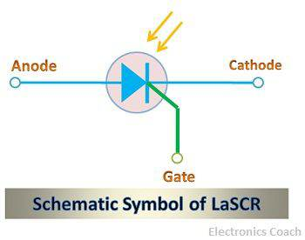
DEFINITION
A LASCR or Light Activated Silicon Controlled Rectifier is a semiconductor device that turns on when exposed to light. LASCR is a type of thyristor triggered by photons present in a light beam.
It is a three-terminal device consisting of a cathode terminal, an anode terminal, and a gate terminal. The Gate terminal is used when an electrical trigger is fed to the LASCR. The advantage of light triggering the thyristor is that it prevents interference from electrical noise. Therefore, LASCR is considered his one of the best devices.

Slide 6
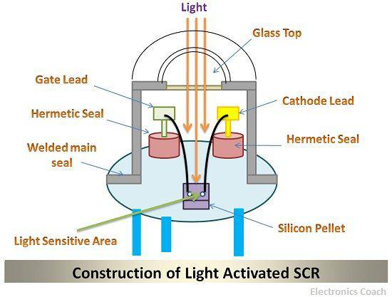
CONSTRUCTION
LASCRs are made of silicon material and use the LASCR's glass lens to focus light from an external light source onto the semiconductor material. A silicon pellet is used at the bottom of the device, and the light intensity releases electrons in the semiconductor crystal, contributing to conduction.

Slide 7
OPERATION
LASCR works on the principle of photoconduction that is conduction due to photon striking the semiconductor surface. The LASCR is basically a thyristor; it is made up of semiconductor material. The more the intensity of light, the more will be the current through the LASCR. The internal architecture of LASCR consists of two transistors in such a way that the collector of one transistor is connected to the base of another transistor. The light falling on the light activated SCR generates the electron from the valence band, and these electrons will enter conduction band. The best thing about Light Activated SCR is that they do not turn off even when the supply of external light is ceased. The light-activated SCR (Silicon Controlled Rectifier) is also termed as light triggered thyristor (LTT). This is because the thyristor is triggered by the supply of light from the external source. Although, the combination of light source and the electrical signal is also used sometimes to trigger the thyristor. And the light is incident directly to semiconductor crystal.
When a weaker electrical signal is delivered to the gate terminal, the intensity of the light required to dislodge electrons from the semiconductor crystal is high.
When a stronger electrical signal is given to the gate terminal, the intensity of the light required to dislodge electrons from the semiconductor crystal is low.

Slide 8
APPLICATION
Used in high voltage and high current application
Used in HVDC transmission and VAR compensation
Used in light activated flash units, logic circuits, and etc.
Used in alarm circuits
Used in large computer applications
Used in optical light control, phase control, and motor control.

Slide 9
02
OPTICAL ISOLATORS
DEFINITION – CONSTRUCTION – OPERATION - APPLICATION

Slide 10
DEFINITION
An optical Isolator is a passive magneto-optic device used in optical systems to permit only a unidirectional signal in optical transmission. Due to the sensitivity of optical oscillators to external optical feedback, optical isolators are usually applied at the output of each laser for systems requiring low optical noise and stable optical frequency as it can reduce or eliminate unnecessary optical reflections and feedbacks during transmission.

Slide 11
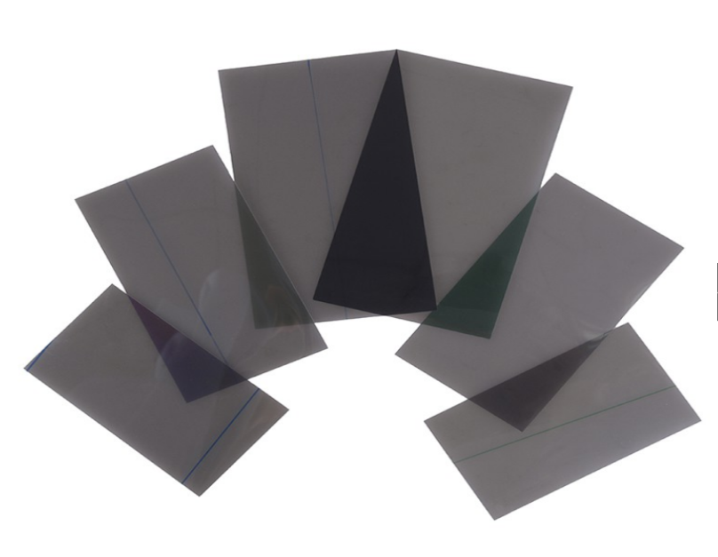
CONSTRUCTION
An optical isolator consists of faraday rotor and either a polarizer (Polarization Dependent) or birefringent wedge (Polarization Independent) as input and output filter.
Polarizer
- A polarizer is a purely optical device that can convert a beam of unpolarized light into one that is appreciably polarized in some form.
- A Polarization dependent isolator consists of an input polarizer, a Faraday rotator with magnet, and an output polarizer. The input polarizer works as a filter to allow only linearly polarized light into the Faraday rotator. One of the benefits of polarizer is make the

Slide 12
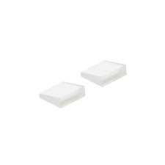
CONSTRUCTION
Birefringent Wedge
-Birefringence is the phenomenon exhibited by certain materials in which an incident ray of light is split into two rays, called an ordinary ray and an extraordinary ray, which are plane-(linear) polarized in mutually orthogonal planes, or circular-polarized in opposite directions (left and right). O-ray (Ordinary ray) travels at the same speed in all direction inside the crystal. E-ray (Extraordinary ray) travels at different speeds in different directions within the crystal. However, the speed of Ordinary and extraordinary ray is the same along its optic axis.
-A birefringent wedge divides a light beam into two orthogonally polarized beams with polarization parallel to the optical axis by a larger angle. Birefringent wedge used to separate and combine the polarized light.

Slide 13
CONSTRUCTION
-Birefringent wedges are often made of YVO4 (Yttrium orthovanadate) or LiNbO3 (Lithium niobate) and are widely used in fiber-optics devices such as isolators and circulators.
-The Polarization independent isolator consist of an input birefringent wedge (with its ordinary polarization direction vertical and its extraordinary polarization direction horizontal), a Faraday rotator, and an output birefringent wedge (with its ordinary polarization direction at 45°, and its extraordinary polarization direction at −45°).
Faraday Rotator
- A Faraday rotator is a magneto-optic device, where light is transmitted through a transparent medium which is exposed to a magnetic field. The magnetic field lines have approximately the same direction as the beam direction, or the opposite direction. If the light is linearly polarized in some direction, this polarization direction is continuously rotated during the passage through the medium.

Slide 14
OPERATION
POLARIZATION DEPENDENT ISOLATOR
POLARIZATION INDEPENTENT ISOLATOR

Slide 15
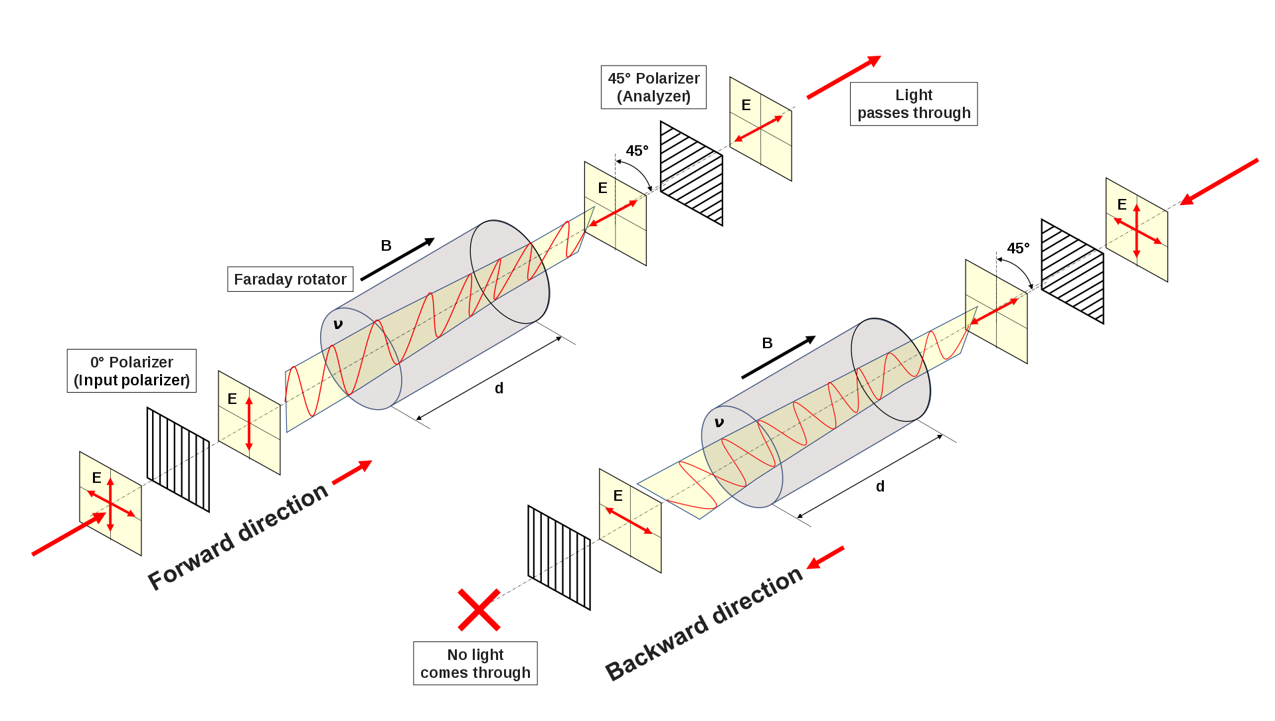
OPERATION:POLARIZATION DEPENDENT ISOLATOR
When light passes through the input polarizer in a forward direction, the light beam is then polarized vertically (90°). The beam then goes to the Faraday rotor, and the rotor rotates 45°, producing a light beam oscillating at 45°. The analyzer, a lens polarized at 45°, allows the traveling light from the rotor to pass through. When light travels backward work similarly, the difference is that the light passing through the analyzer polarizes the beam at 45°. The light beam initially at 45° then goes through the Faraday rotor and rotates at 45° in a similar direction, resulting in a polarized light deflected at 90°. Since the light is at 90°, the light beam would not be able to pass through the input polarizer and hence be reflected.

Slide 16
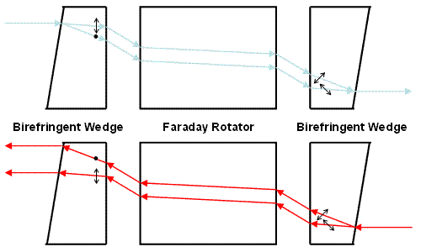
OPERATION:POLARIZATION INDEPENDENT ISOLATOR
When light travels forward and goes through the input birefringent wedge, it divides the light into two components: the ordinary ray (o-ray) and the extraordinary ray (e-ray). The o-ray is light at 0° while the e-ray is polarized at 90°. When both light components travel through the Faraday rotor, the rotor then turns 45° together with the light rays which makes the o-ray at 45° and e-ray at -45°. Lastly, the two rays go through the output birefringent wedge and recombine the rays together. When light travels in a backward direction is divided at 45° and -45° light rays by the output birefringent wedge. It is then rotated to 0° and 90° via the Faraday rotor. Instead of being converged together, the input birefringent wedge diverges the rays.

Slide 17
APPLICATION
Optical isolators are used in many optical applications in corporate, industrial, and laboratory settings. They are reliable devices when used in conjunction with fiber-optic amplifiers, fiber-optic ring lasers, fiber-optic links in CATV applications, and high-speed and coherent fiber-optic communication systems. Single polarization fiber-optic isolators are also used with laser diodes, gyroscopic systems, optical modular interfaces, and a variety of other mechanical control and testing applications.
In the optical communication system: These finds wide applications in optical fiber communication system. As at the time of signal transmission, these devices reduce the chances of signal losses due to reflection.
In the optical amplification unit: An amplifier boosts the signal level so if we use an isolator along with an amplifier then it will result in better amplification of the transmitted signal.
In laser diodes: The laser light source is used to provide a highly coherent light wave. So, when it will be used with an isolator then the chances of having highly coherent radiation will become more.

Slide 18
03
OPTICAL MODULATORS
DEFINITION – CONSTRUCTION – OPERATION - APPLICATION

Slide 19
DEFINITION
Optical Modulator
An optical modulator is a device that can be used to manipulate a property of light, most commonly that of an optical beam, such as a laser beam. Modulators are classified as intensity modulators, phase modulators, modulators, spatial light modulators, and so on, depending on which attribute of light is regulated.
Optical modulators are employed in a variety of applications, including optical fiber communications, displays, active Q switching or mode locking of lasers, and optical metrology.
Optical Modulation
Optical modulation is the method by which a light wave is modulated by a high-frequency electrical signal containing information. These modified light waves are then delivered over a transparent medium or an optical fiber connection.
MODULATION TECHNIQUES
Direct Modulation – is a modulation technique that uses a high-frequency carrier wave to directly modulate the amplitude, frequency, or phase of a message signal. The message signal is applied directly to the modulation input of the transmitter in this technology, which modulates the carrier wave accordingly.
External Modulation – is a technique for modulating the amplitude, frequency, or phase of a high-frequency carrier wave using an external device. An external device, such as an oscillator or signal generator, generates the modulating signal, which is then applied to a modulator circuit, which modulates the carrier wave accordingly.

Slide 20
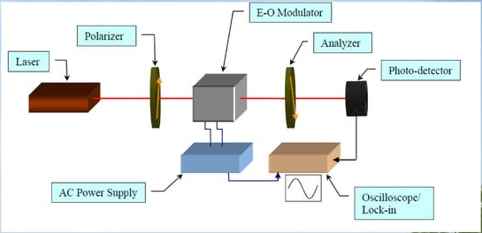
CONSTRUCTION

Slide 21
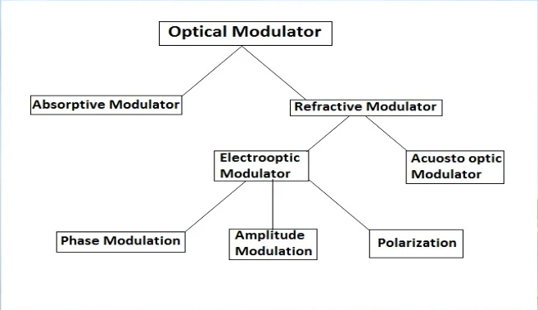
OPERATION
Types of Optical Modulators

Slide 22
OPERATION
Absorptive Modulator
An absorptive modulator is a type of optical modulator that works by changing the absorption properties of a material in response to an external signal or input.
Operation: an absorptive modulator alters the absorption properties of a material in response to an external signal or input, affecting how the light wave is absorbed as it passes through the substance. This variation in absorption can be utilized to alter the strength of the light wave, allowing data to be encoded onto it.
Refractive Modulator
A refractive modulator is a type of optical modulator that operates by changing the refractive index of a material in response to an external signal or input.
Operation: a refractive modulator alters the refractive index of a material in response to an external signal or input, affecting how the light wave bends or refracted as it passes through the substance. This change in refractive index can be utilized to modify the phase or polarization of a light wave, allowing data to be encoded onto it.

Slide 23
OPERATION
Types of Refractive Modulator
Acousto-Optic Modulator
Acousto-Optic modulators are devices that use sound waves to change the amplitude, frequency, or phase of light travelling through an acousto-optic material. The Acousto-Optic Modulator is based on the elasto-optic phenomenon, in which material strain induces a change in the refraction index of the material.
Electro-optic Modulator
Electro optic modulator (EOM) Is a device which can be used for controlling the power base or polarization of a laser beam with an electrical control signal. The effect of Electro optic is the modification of refractive index of nonlinear crystal by an external voltage.
Two types of effect of an Electro optic
Pockels effect Is a linear Electro optic effect where the refractive index of medium is modified in proportion to the applied electric field strength
Kerr effect or called quadratic Electro optic effect is a change in refractive index of material refractive index with an electric field.

Slide 24
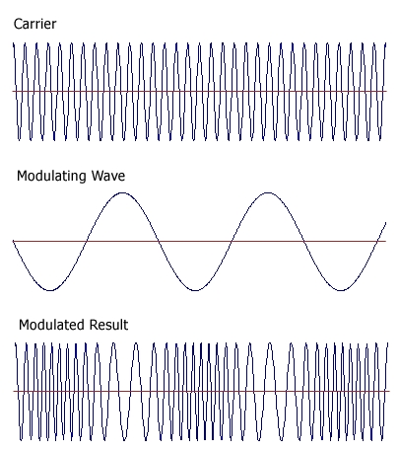
OPERATION
Two types of effect of an Electro-Optic Modulator
Pockels effect Is a linear Electro optic effect where the refractive index of medium is modified in proportion to the applied electric field strength
Kerr effect or called Quadratic Electro optic effect is a change in refractive index of material refractive index with an electric field.
Types of Electro-Optic Modulator
Phase Modulator
Simplest as type of Electro-optic modulator is phase modulator containing only a pockel cells where an electric field applied to crystal via electrodes) changes the phase delay of laser beam sent through the crystal. The polarization of the input beam often has to be aligned with one of the optical axis of the crystal.

Slide 25
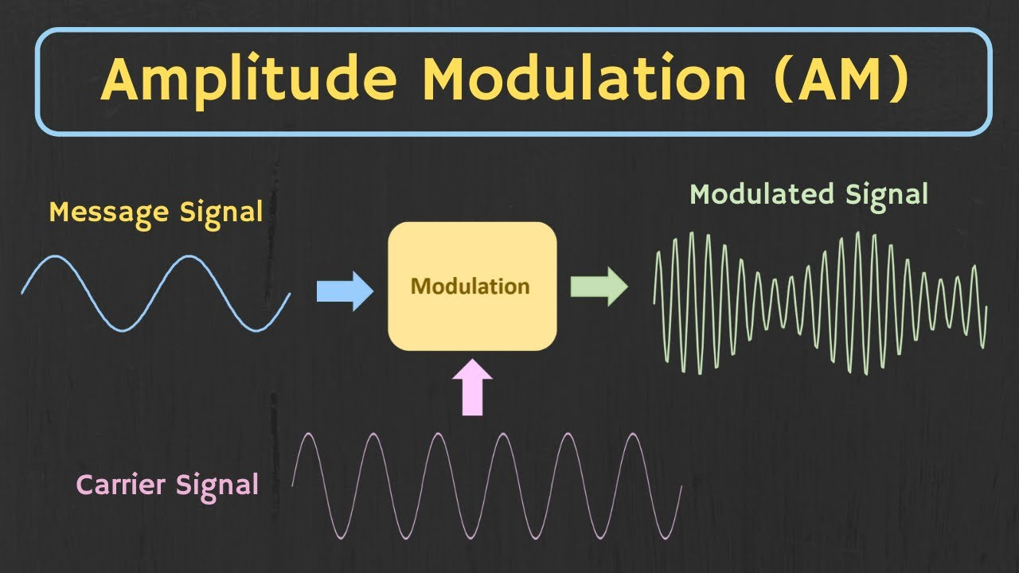
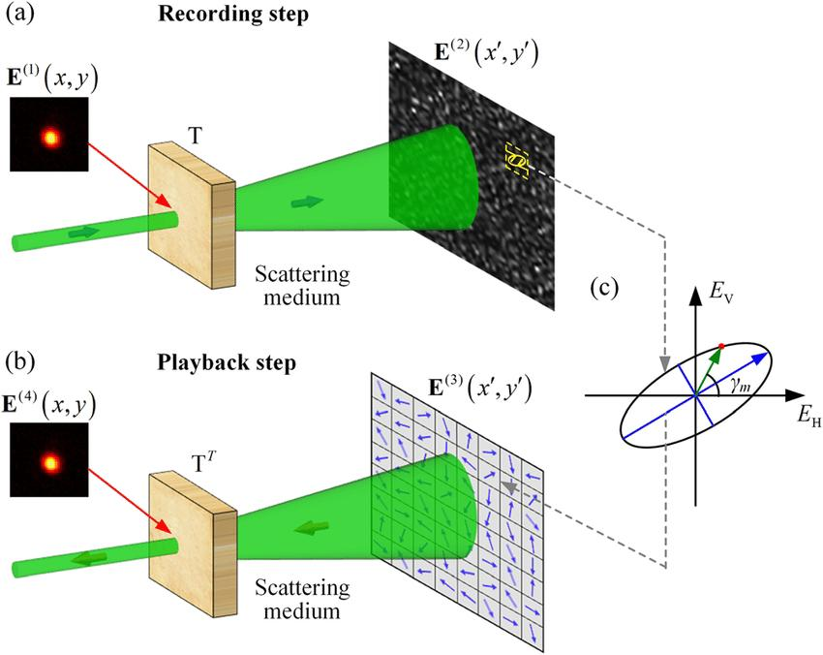
OPERATION
Types of Electro-Optic Modulator
Amplitude Modulator
Modulation of the amplitude of a radio carrier wave in accordance with the strength of the audio or other signal. Combination with other optical elements particularly pockels cells, polarizers. An amplitude modulator is based on a pockels cell to modify the polarization state and polarizer for subsequently converting this into a change in transmitted optical power and amplitude.
Polarization Modulator
Gives a new degree of freedom in the modulation adding to the phase, amplitude, and frequency. This polarization modulator is depending on the type and orientation of the nonlinear crystal also on the direction of applied electric field the phase delay can depend on the polarization direction.

Slide 26
APPLICATION
Telecommunications
Data Communications
Sensors
Biomedical Imaging.

Slide 27
SALAMAT!

