Slide 1

Leveraging Advanced Analytics to enhance pharmaceutical sales forecasting
Team 46: Zixiao Chen & Alejandro Sáez
November 2021

Slide 2

Agenda
A
Provide context of the forecasting problem at a macro and Novartis-specific level
B
Present our approach to solve the case-study by predicting sales for every pharmaceutical brand at a monthly and regional level
C
Showcase the details of the model developed and illustrate examples of the predictive effort
D
Summarize findings and outline steps forward to directly extract value from the study

Slide 3





A: Context and objectives of the forecasting case-study
Context of the relevance of sales forecasting
Objectives of the challenge
Accurate sales forecasting is a top priority for pharmaceutical firms…
XXX
XXX
The objective of our study is to forecast sales at a brand-month-region level…
2
201
Global investment in pharmaceutical supply chain
XXX
Brands of respiratory pharmaceuticals
Anonymized regions where pharmaceuticals are sold
…increasing goodness of fit of predictive models by 1 p.p. can unlock significant value…
~XXX
XXX
Out of stock
XXX
…with the objective to minimize two metrics…
XXX
XXX
…the global breadth of Novartis makes it necessary to use analytic approaches…
>150
>1000
Accuracy metric
Confidence interval metric
# countries where Novartis has presence
Product types in different therapeutic areas
…solving the forecasting challenge is a humanitarian concern during the pandemic
XXX
XXX
…and unveil key business insights
XXX
XXX
Understand regional sales disparities
Influence key business decisions

Slide 4






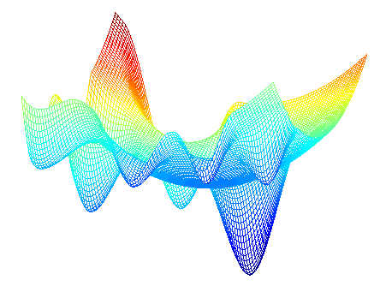


B: We have followed a 5-step approach to solve the sales forecasting challenge
Detail of the steps followed to solve the challenge
Detail next
Data gathering
Feature extraction
Parameter optimization
Model development
Result analysis
Description
Gathered and cleansed 7 data sources from 2 brands and 201 regions
Downloaded external public data on monthly COVID cases, hospitalizations and deaths to complement the existing internal data and improve model accuracy
Extracted >400 synthetic features from 5 different data blocks which are related with pharmaceutical sales
Analyzed descriptive relation between features and the target being predicted
Searched for the best model parameter configuration using Bayesian Optimization with 6-fold cross-validation
Trained >250 machine learning models to find an error-minimizing set of parameters
Trained a Gradient Boosting Machine to learn relations between the synthetic features created and the target to be predicted
Accomplished a strong predictive power – accuracy score of XXX and a confidence metric of XXX
Retrieved sales forecast and confidence intervals at a monthly-regional-brand level
Studied the regions of most certainty and heterogeneous goodness of fit of the model
Output
Data sources leveraged
Data blocks extracted
Parameter search
Predictive power
Model results
Internal Novartis data sources
Historical data for every month-region-brand…
XXX
Month | Region | Brand | Forecast | Lower | Upper
2021-05 | region_1 | brand_1 | 221,2 | 168,7 | 254,2
2021-05 | region_1 | brand_2 | 105,6 | 98,7 | 123,4
2021-05 | region_2 | brand_1 | 23,4 | 14,5 | 43,3
2021-05 | region_2 | brand_2 | 34,6 | 44,3 | 21,5
2021-05 | region_3 | brand_1 | 10,5 | 1,4 | 5,5
2021-05 | region_3 | brand_2 | 15,6 | 12,3 | 24,5
Accuracy score
External publicly available data
Regional sales
Region characteristics
COVID indicators
Activity movements
Interactions
XXX
Bayesian parameter optimization
Confidence metric

Slide 5
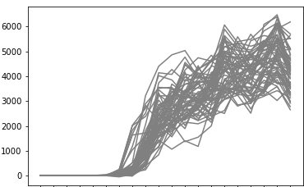
C: We have analyzed the results of the forecasting model in detail to granularly cluster all the geographies
Actual sales
10%
Cluster analysis of all the geographies
Illustration of 4 out of XXX clusters
Individual sales time series
Predicted sales
90%
Sales and forecasts for region 0 and brand 1
Time series of sales per cluster
Avg sales per month
Forecast uncertainty
# of regions
Jul
Aug
Sep
Oct
Nov
Dec
Jan
Feb
Mar
Apr
May
Jun
Jul
Aug
Sales and forecasts for region 118 and brand 2
Jul
Aug
Sep
Oct
Nov
Dec
Jan
Feb
Mar
Apr
May
Jun
Jul
Aug
Sales and forecasts for region 145 and brand 2
Jul
Aug
Sep
Oct
Nov
Dec
Jan
Feb
Mar
Apr
May
Jun
Jul
Aug

Slide 6








D: In order to better influence key business decisions we have identified a set of potential steps
Detail of steps forward
Enhancements to our solution
Applications of our study
Consider all countries and pharmaceuticals launched to capture further interdependencies and improve model accuracy
Optimize resource and budget allocation at a regional-brand level to prioritize areas with high potential and significant uncertainty
Include pharmaceutical-specific characteristics to add granularity and get a more refined set of predictions
Influence supply chain management XXX
Align variables utilized and model results with industry experts and geographical stakeholders to validate assumptions and forecasts
Updating empirical evidence/ estimations XXX
Translate accuracy estimates to monetary quantities to better understand which regions and brands are more critical to predict correctly
Recommend salesforce activities to

Slide 7

Q&A
Thank you for giving us the opportunity to be a part of this experience and present our solution, we really enjoyed the ride!

