Slide 1
assignment
ON
SEARCHING AND SORTING

Slide 2
SEARCHING
Searching Algorithms are designed to check for an element or retrieve an element from any data structure where it is stored.
It is of two types
linear search
Binary search

Slide 3
Linear search
Linear search is a very simple search algorithm. In this type of search, a sequential search is made over all items one by one. Every item is checked and if a match is found then that particular item is returned, otherwise the search continues till the end of the data collection.

Slide 4
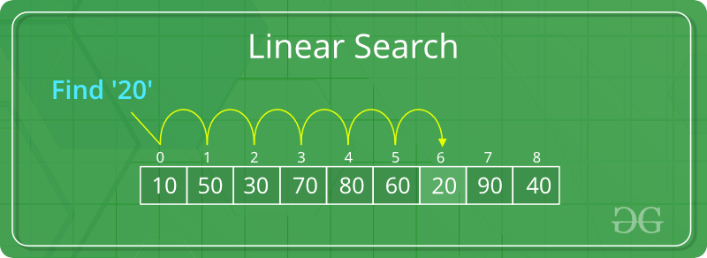
Linear search
Linear Search to find the element “20” in a given list of numbers

Slide 5
Binary search
Search a sorted array by repeatedly dividing the search interval in half. Begin with an interval covering the whole array. If the value of the search key is less than the item in the middle of the interval, narrow the interval to the lower half. Otherwise narrow it to the upper half. Repeatedly check until the value is found or the interval is empty.

Slide 6
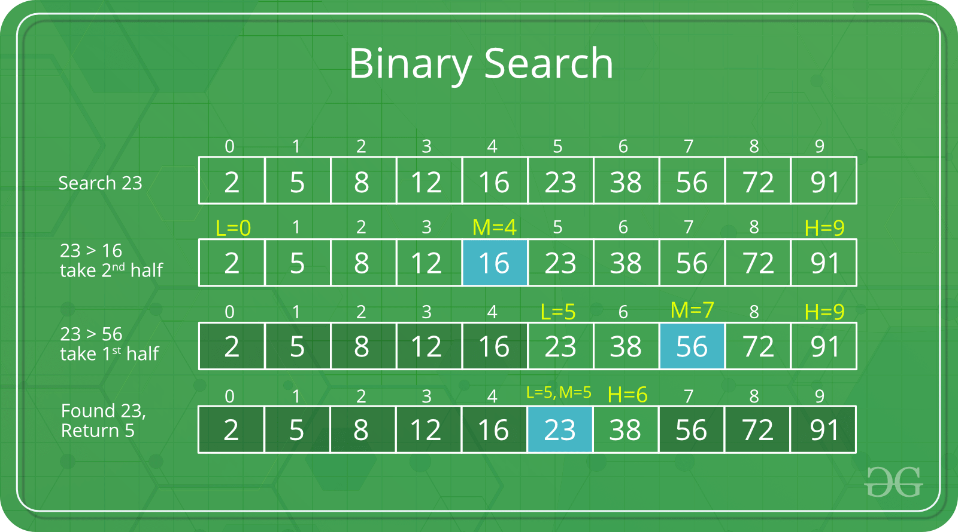
Binary search

Slide 7
sorting
Sorting is a process of ordering or placing a list of elements from a collection in some kind of order. It is nothing but storage of data in sorted order. Sorting can be done in ascending and descending order. It arranges the data in a sequence which makes searching easier.

Slide 8
Types of sorting
Types of sorting are
1. Bubble Sort 2. Insertion Sort 3. Selection Sort 4. Quick Sort 5. Heap Sort

Slide 9
Bubble sort
Bubble sort is a type of sorting.
It is used for sorting 'n' (number of items) elements.
It compares all the elements one by one and sorts them based on their values.

Slide 10
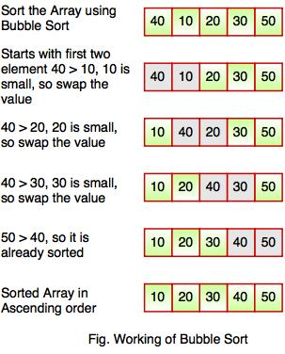
Bubble sort

Slide 11
Insertion sort
Insertion sort is a sorting algorithm that places an unsorted element at its suitable place in each iteration

Slide 12
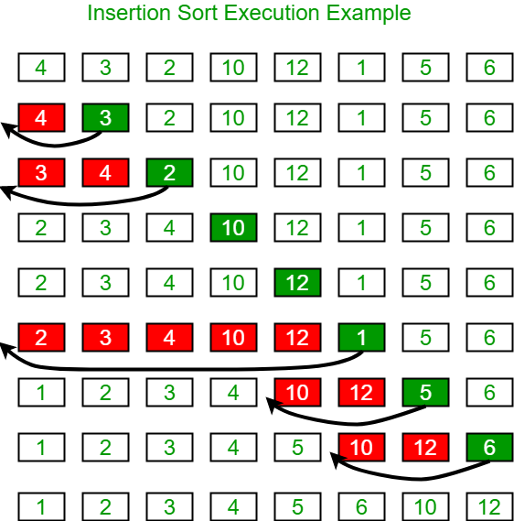
Insertion sort

Slide 13
Selection sort
The selection sort algorithm sorts an array by repeatedly finding the minimum element (considering ascending order) from unsorted part and putting it at the beginning. The algorithm maintains two sub arrays in a given array.
1) The sub array which is already sorted. 2) Remaining sub array which is unsorted.
In every iteration of selection sort, the minimum element (considering ascending order) from the unsorted sub array is picked and moved to the sorted sub array.

Slide 14
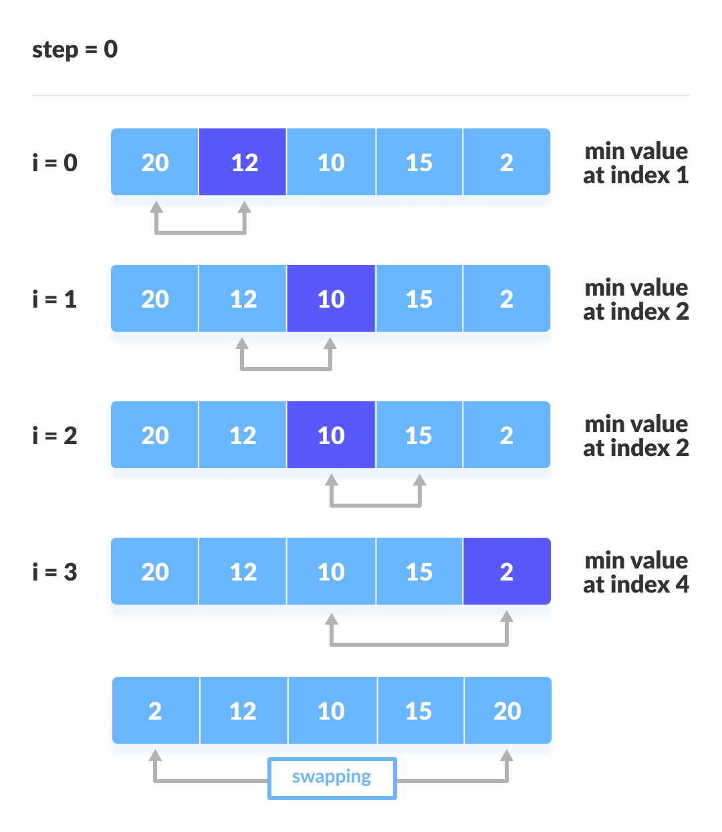
Selection sort

Slide 15
Quick sort
Quick sort is a highly efficient sorting algorithm and is based on partitioning of array of data into smaller arrays. A large array is partitioned into two arrays one of which holds values smaller than the specified value, say pivot, based on which the partition is made and another array holds values greater than the pivot value.

Slide 16
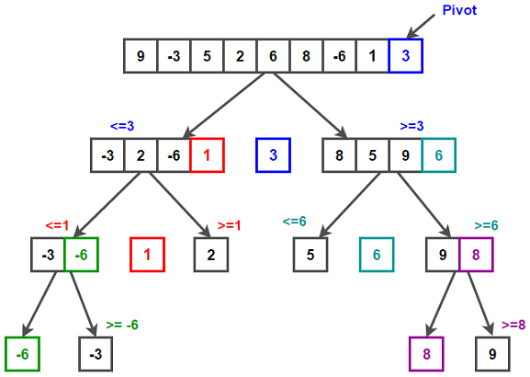
Quick sort

Slide 17
Heap sort
Heaps can be used in sorting an array. In max-heaps, maximum element will always be at the root. Heap Sort uses this property of heap to sort the array.
Consider an array Arr which is to be sorted using Heap Sort.
1.Initially build a max heap of elements in Arr.
2.The root element, that is Arr[1], will contain maximum element of Arr. After that, swap this element with the last element of Arr and heapify the max heap excluding the last element which is already in its correct position and then decrease the length of heap by one.
3.Repeat the step 2, until all the elements are in their correct position.

Slide 18
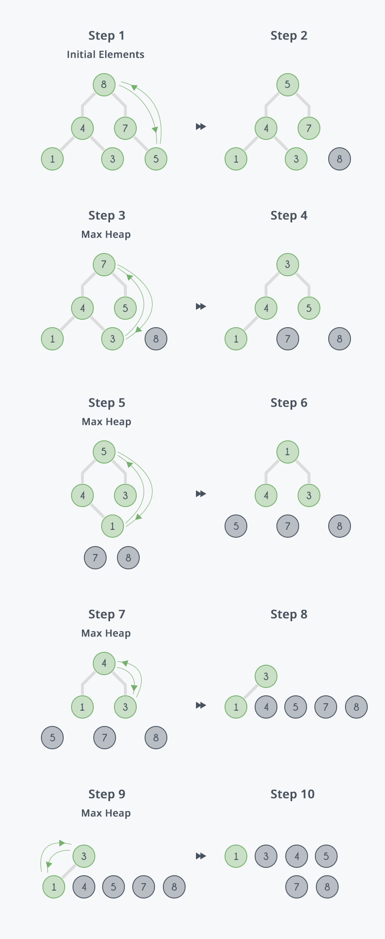
Heap sort

Slide 19
Thank you

