Slide 1
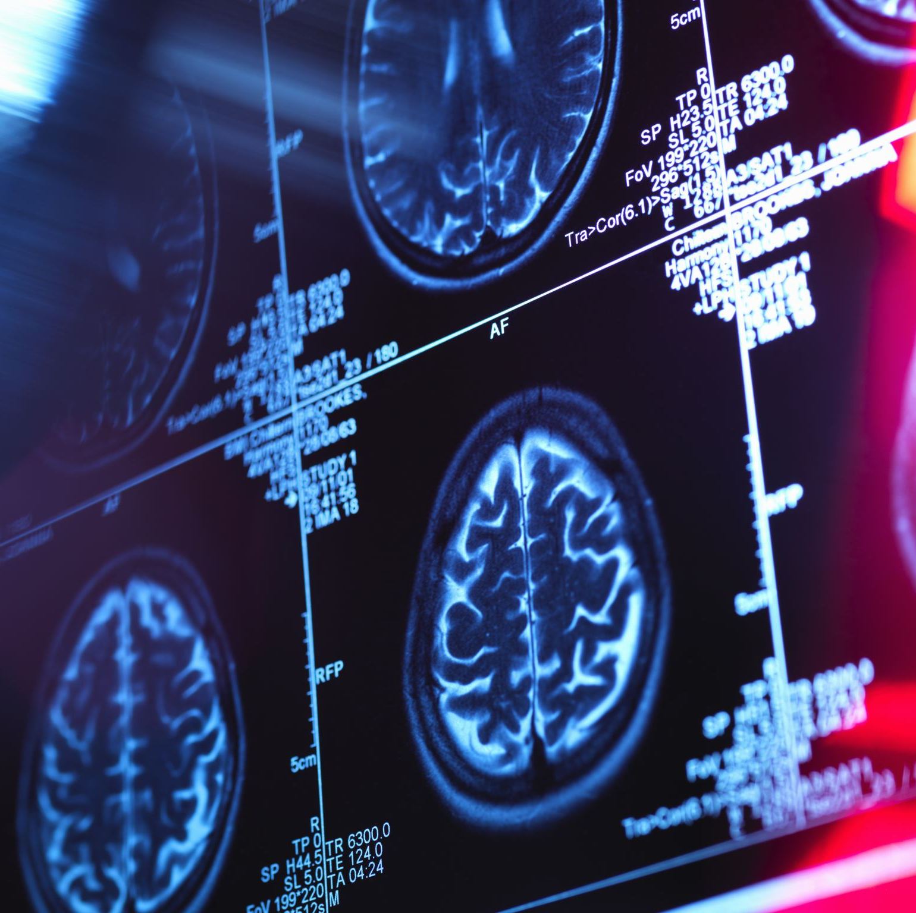
Convolutional Neural Networks in Pulmonary Embolism detection on ComputeD TomographY Pulmonary Angiogram Scans
Student: George Ionut Buleandra
Supervisor: Dr Hossein Malekmohamadi

Slide 2
Presentation Aims
Topic. Importance. Relevance
Aims of the project
Training
Dataset
Graphic User Interface
Critical Analysis
Conclusion
Questions

Slide 3
1. Topic, Importance and Relevance
Why is worth investing the time in developing a model which can predict Pulmonary Embolism in Computed Tomograph Scans?

Slide 4
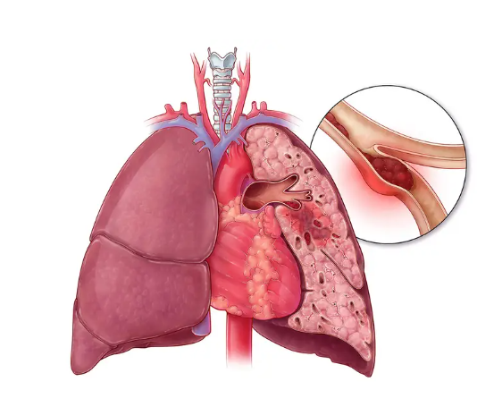
1. Topic, Importance and Relevance
PE is the third most common cardiovascular disorder where a blood clot, typically formed in the leg, travels to the lungs and blocks one or more pulmonary arteries (Bĕlohlávek et al. 2013).
Figure 1. Pulmonary Embolism

Slide 5
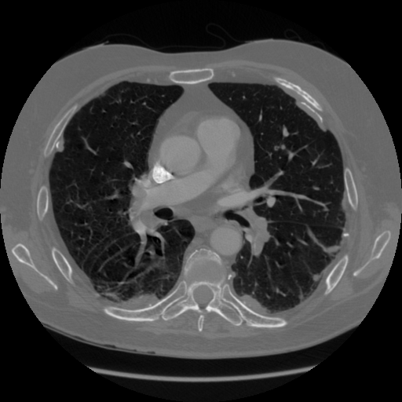
1. Topic, Importance and Relevance
Two out of three patients die within 2 hours of the presentation (Bĕlohlávek et al. 2013) .
Figure 2. Computer Tomography Pulmonary Angiogram Scan
The most exact way of diagnosis is the Computer Tomography Pulmonary Angiogram (CTPA) scan (Bĕlohlávek et al. 2013) .
Figure 3. Ratio mortality

Slide 6



1. Topic, Importance and Relevance
A major disadvantage of the CTPA is that experts are necessary for diagnosis, and it is a time-consuming activity (Sofer, 2021).
A radiologist must assess a CTPA every 3 seconds which leads to a considerable number of false negatives, and it is an increased workload (Buls et al. 2021).

Slide 7
1. Topic, Importance and Relevance
Convolutional Neural Networks showed competitive performances with the radiologists one as much theoretically as practically.
* Pooled performance based on Sofer et al.’s 2021 study
** AIDOC performance based on Buls et al.’s 2021 study
*** Performance based on Sofer et al.’s 2021 study

Slide 8
2. Aims of the project
1. Train and compare the performances of three models in PE Detection
2. Create a graphical user interface to facilitate the use of the champion model.

Slide 9
3. Training

Slide 10
3. Training

Slide 11
3. Training

Slide 12
3. Training
* Pooled performance based on Sofer et al.’s 2021 study
*** Left side and right side of the intervals based on Sofer et al.’s 2021 study

Slide 13

4. Dataset
Characteristics
A sample out of The RSNA Pulmonary Embolism CT Dataset
Balanced: 87000 records for positive case vs 87 000 records for negative case
Diverse sources, population and imaging equipment: 5 different radiologic centres, 7279 different patients
Significant size: sums up 174 000 of records

Slide 14
4. Dataset

Slide 15
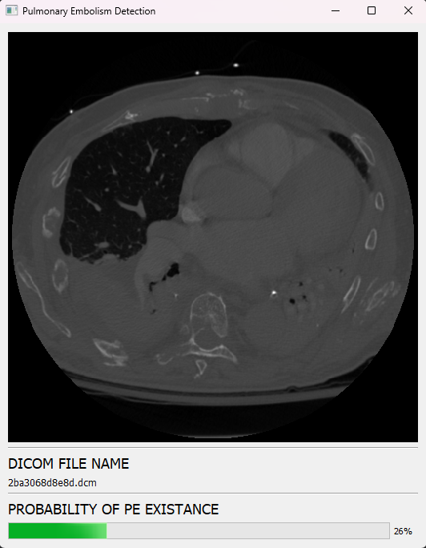
5. Graphic User Interface
Characteristics:
Simple and intuitive
Displays the CTPA, File name, Probability of existence
Re-sizeable
Drag and drop feature
Figure 4. Prediction

Slide 16
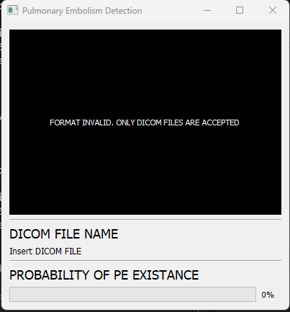
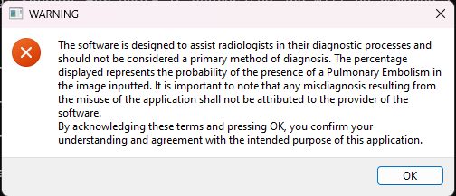
5. Graphic User Interface
Characteristics:
Purpose of Use
File Verification
Figure 5. Purposes
Figure 6. Invalid File Format

Slide 17
6. Critical Analysis
Strengths
Weaknesses
Three models trained
Complex dataset
Simple and intuitive GUI
Performant model
Relative small dataset
Few training epochs
Binary classification
Improvements
Mix together more datasets
A better setup for training
More Models and architectures
Testing in a real environment
Segmentation

Slide 18
7. Conclusion
Deep learning has the potential of at least comforting the radiologists in their predictions
The project achieves the main aims of the contract
The Champion Model has a competitive performance

Slide 19
8. Questions

Slide 20
References
E Colak, FC Kitamura, SB Hobbs, et al. The RSNA Pulmonary Embolism CT Dataset [https://pubs.rsna.org/doi/full/10.1148/ryai.2021200254]. Radiology: Artificial Intelligence 2021;3:2.
SOFER S. et al. (2021) Deep learning for pulmonary embolism detection on computed tomography pulmonary angiogram: a systematic review and meta‑analysis. Sci Rep. [Online] 11. Available from: https://doi.org/10.1038/s41598-021-95249-3 [Accessed 27/12/22].
BĔLOHLÁVEK, J. et al. (2013) Pulmonary embolism, part I: Epidemiology, risk factors and risk stratification, pathophysiology, clinical presentation, diagnosis and nonthrombotic pulmonary embolism. Experimental and clinical cardiology. [Online] 18(2). Available from: https://www.ncbi.nlm.nih.gov/pmc/articles/PMC3718593/ [Accessed 27/12/22].
BULS, N. et al. (2021) Performance of an artificial intelligence tool with real-time clinical workflow integration – Detection of intracranial hemorrhage and pulmonary embolism.Physica Medica. [Online] 83.Available from: 10.1016/j.ejmp.2021.03.015.[Accessed 27/12/22]
Figure 1. Pulmonary Embolism. https://www.medpagetoday.com/emergencymedicine/emergencymedicine/96046
Figure 2.COLAK,E. et al. (2021) The RSNA Pulmonary Embolism CT Dataset.Radiology: Artificial Intelligence. [Online] 3(2). Available from: 10.1148/ryai.2021200254. [Accessed 28/12/2022]

