Slide 1
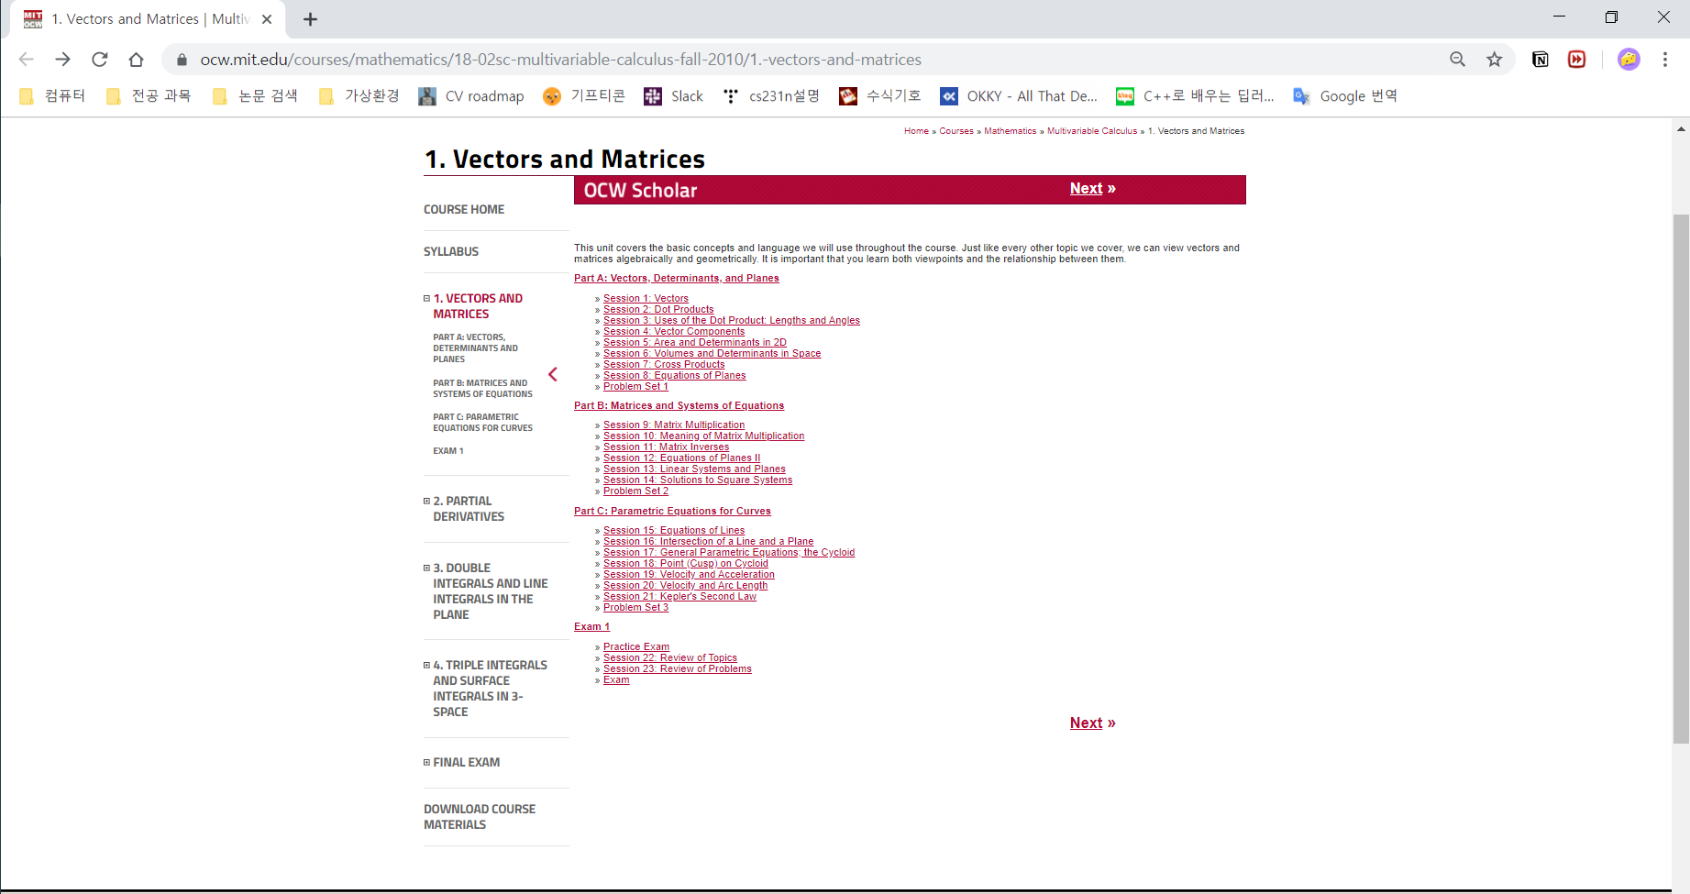
extracting & getting in step by step

Slide 2
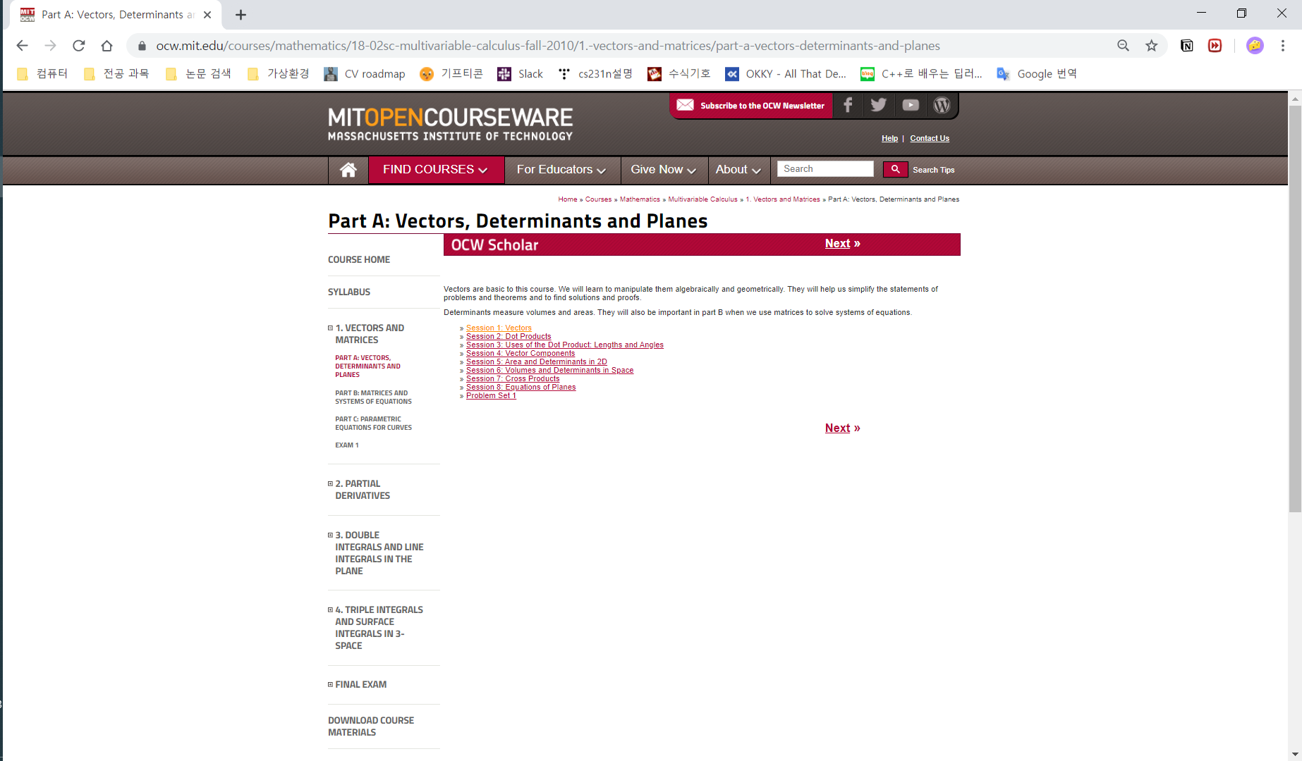
extracting & getting in step by step

Slide 3
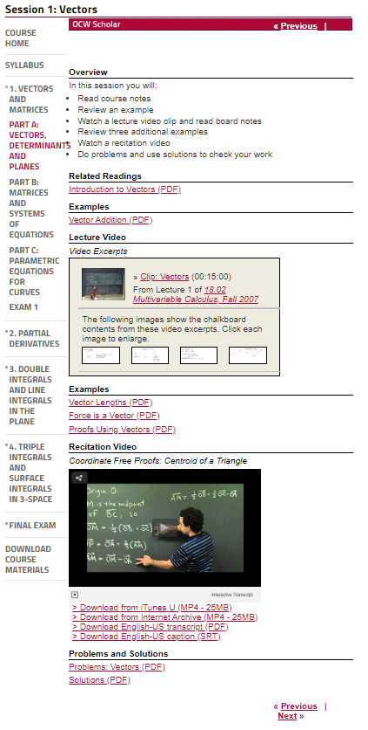
extracting & downloading in each dir

