Slide 1
Anytime RRTs
Dave Fergusson and Antony Stentz

Slide 2
RRT – Rapidly Exploring Random Trees
Good at complex configuration spaces
Efficient at providing “feasible” solutions
No control over solution quality
Does not pay attention to solution cost

Slide 3
Earlier Improvements
Can add a goal bias – makes it a best-first search
Nearest Neighbor could look for k-nearest neighbors (Urmson and Simmons) and select:
Qnearest to Qtarget where path-cost< r
First of k-nodes ordered by estimated path-cost whose current path-cost < r
Node with minimum estimated path cost where cost < r

Slide 4
An idea from ARA*
Get an initial suboptimal solution to an inflated A* search with a highly suboptimality bound ε
Repeat running new searches with decreasing values of ε
After each search, cost of most recent solution is guaranteed to be at most ε times the cost of an optimal solution

Slide 5
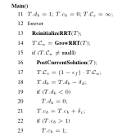
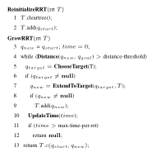
Anytime RRT algorithm

Slide 6
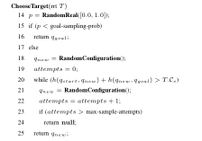
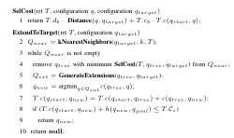
Algorithm contd…

Slide 7

Anytime RRT planning
RRT being grown from initial configuration to goal configuration

Slide 8

Node Sampling
Only areas that can potentially lead to an improved solution are considered
Uses a heuristic function to restrict search

Slide 9

Node Selection
Order by distance from the sample point and cost of their path from start node
Select node with path cost lower than others

Slide 10

Extending tree
Generate a set of possible extensions
Choose extension which is cheapest among these

Slide 11

Accepting new elements
Check if sum of cost of path from start node through tree to new element and heuristic cost of path to goal is less than solution bound
If “yes” add element to the tree

Slide 12
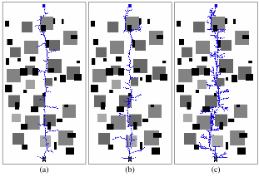
Single Robot planning with Anytime RRTs

Slide 13
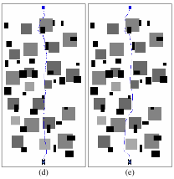
Resulting Paths
On avg 3.6 times better

Slide 14
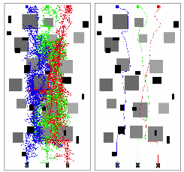
Multi-robot Constrained exploration
On avg 2.8 times better

Slide 15
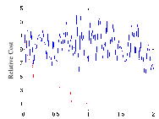
Comparison of Relative Cost vs. Time

Slide 16
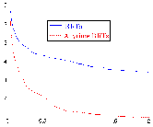
Average relative solution cost for single robot

Slide 17
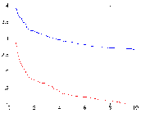
Average relative solution cost for multiple robots

