Slide 1
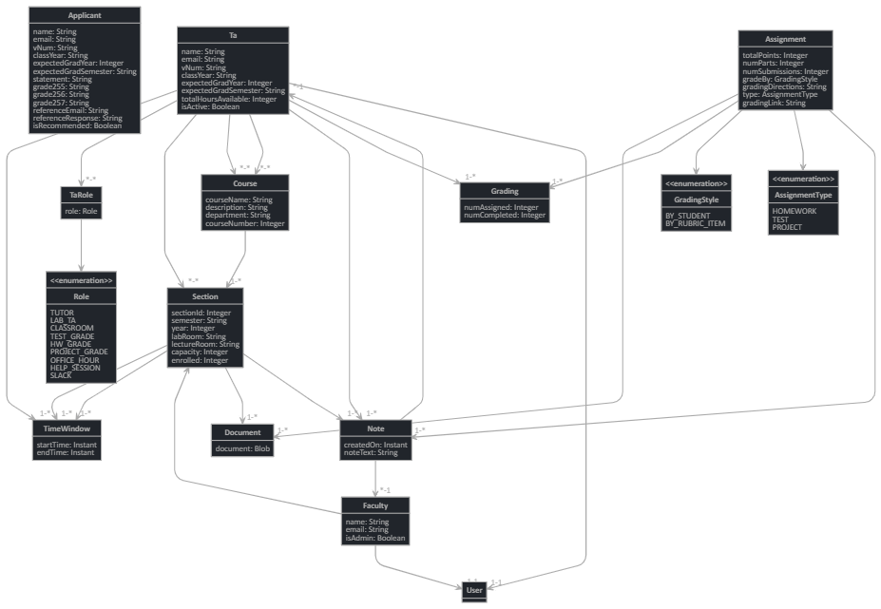




313
Teaching Assistant Management System
Team members: Abigail Byram, Neil Watson, Matthew Pointer, Matthew Tran | Faculty adviser: Caroline Budwell | Sponsor: VCU Dept of Computer Science | Mentor: Debra Duke
Objective
Utilize the resources provided by the Department
Emphasis on TA recruitment and evaluation
TA training: guidelines and expectations
Course management
Communication between faculty and TAs
Design
Data storage system
Current/past/potential TAs
Courses and sections
TA Application
TA Handbook
Header
Summary
Header
Summary

