Slide 1

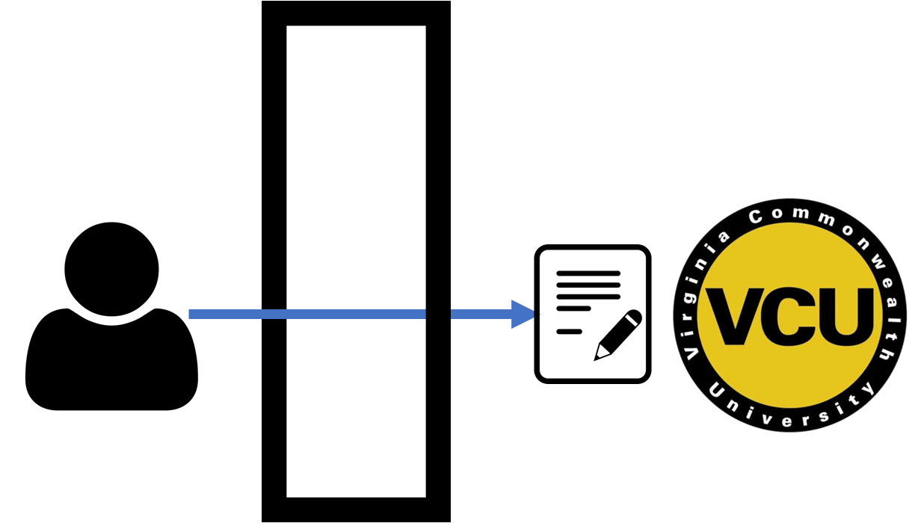

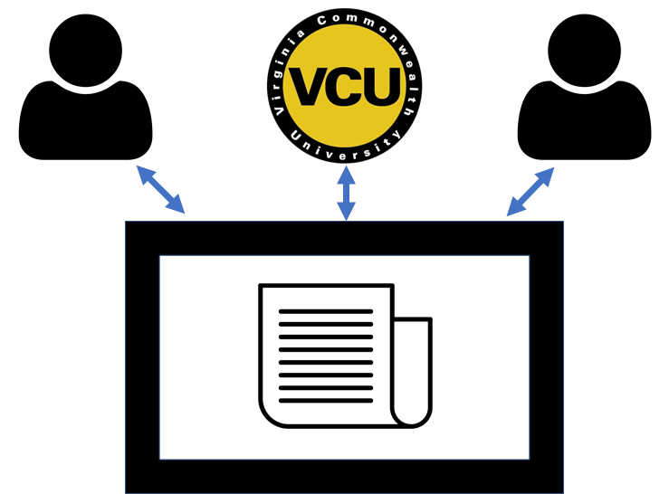




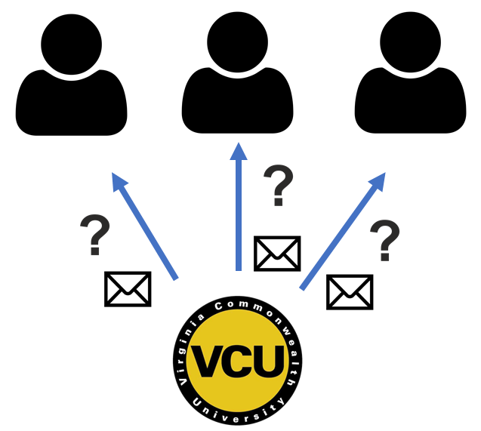
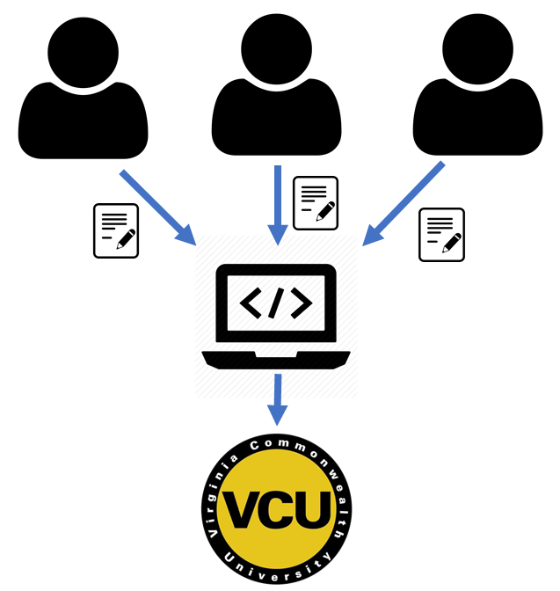

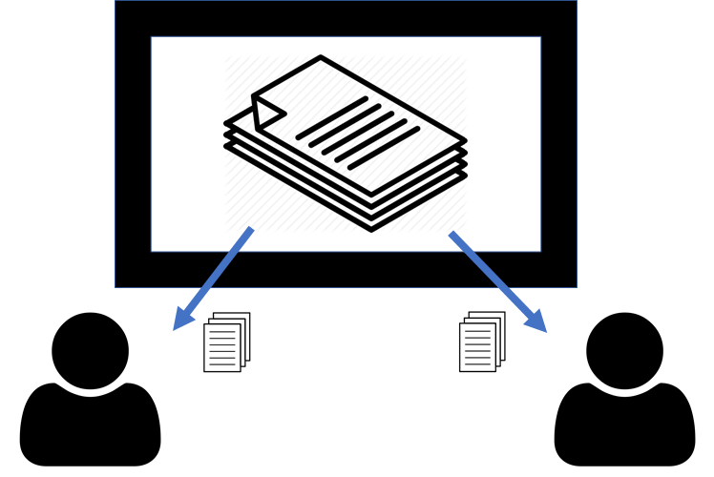






313
Teaching Assistant Management System
Team members: Abigail Byram, Neil Watson, Matthew Pointer, Matthew Tran | Faculty adviser: Caroline Budwell | Sponsor: VCU Dept of Computer Science | Mentor: Debra Duke
Old Process
New Process
Problem Statement
Utilize the resources provided by the Department
Emphasis on TA recruitment and evaluation
TA training: guidelines and expectations
Course management
Communication between faculty and TAs
TA Recruitment
Application available through web portal
Qualifications gathered and stored
Enables easy evaluation by VCU administrator
Recruitment by word of mouth
Students do not know how to apply
Applicant information obtained through conversation
Solution Outline
Data storage system
Current/past/potential TAs
Courses and sections
TA Application
TA Handbook
Training and Information Sharing
TA Handbook available in web application
Acts as a contract of TA responsibilities and expectations
TA onboarding and training information available in a centralized location
TAs trained individually without a centralized standard
TAs often are unsure of their duties
TA – Class Matching
TAs prompted each semester for updates
Professors can assign qualified TAs to their course within the app
TAs are notified by email when selected
Manual emails required to check TA availability
No long-term record of TA experience or qualifications
No consistent method to update TA qualifications
TA Grading Supervision
Grading can be assigned in the web application and progress is recorded
TAs are notified when assigned grading and given a link to Gradescope
Grading directions and rubric notes can be added to assignments
Professors may assign grading to a TA, but it is difficult to record progress
TAs often find it difficult to know specific directions for grading
Multiple graders causes inconsistency

