Slide 1

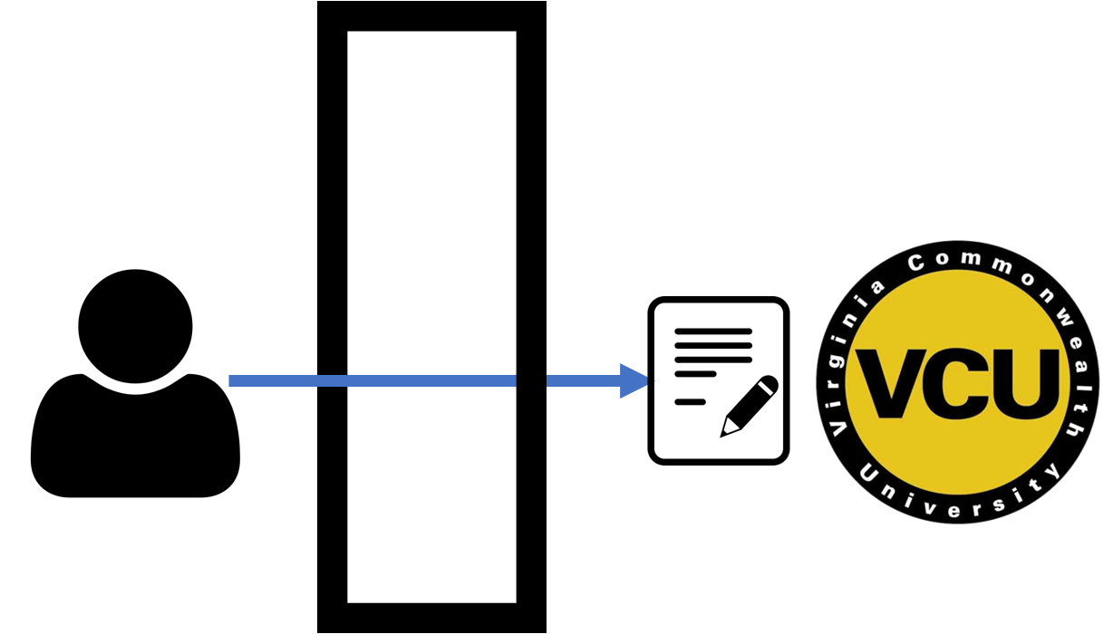
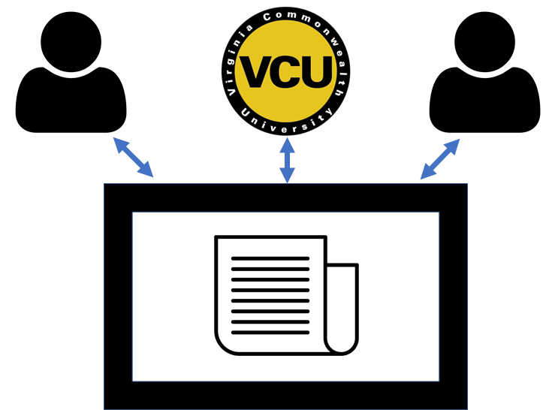



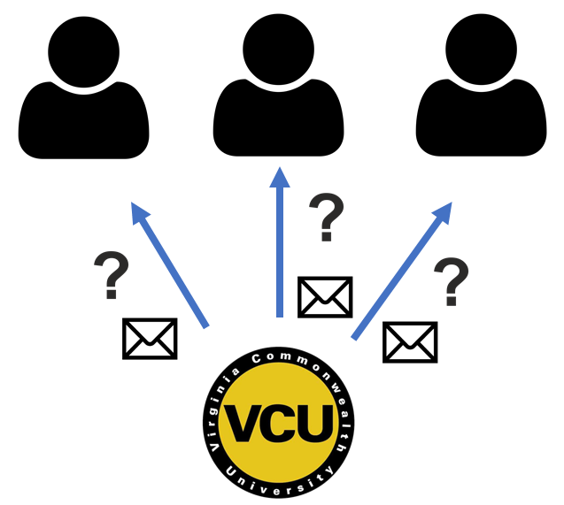
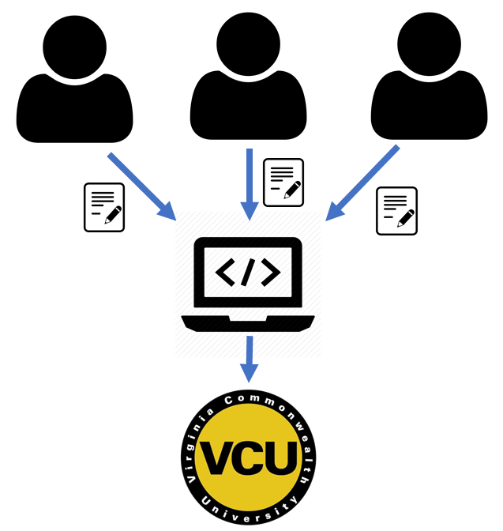


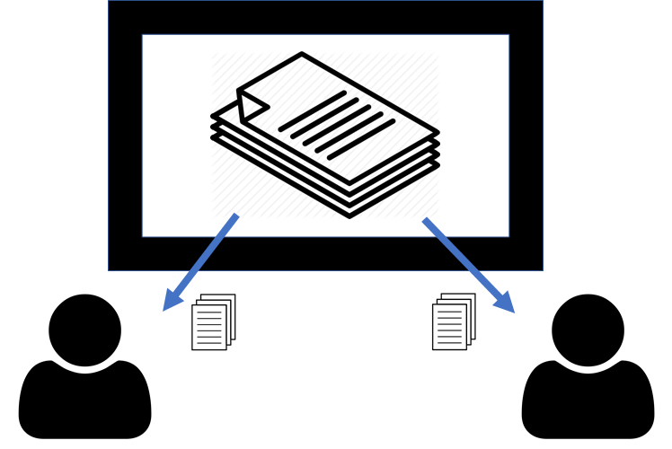






313
Teaching Assistant Management System
Team members: Abigail Byram, Neil Watson, Matthew Pointer, Matthew Tran | Faculty adviser: Caroline Budwell | Sponsor: VCU Dept of Computer Science | Mentor: Debra Duke
Old Process
New Process
Problem Statement
Undergraduate teaching assistants (TAs) are a major resource in courses, but TA management is currently handled manually and is not scalable. A management system is needed to most effectively utilize TAs and allow courses to function smoothly.
TA Recruitment
Application available through web portal
Qualifications gathered and stored
Enables easy evaluation by VCU administrator
Recruitment by word of mouth
Students do not know how to apply
Applicant information obtained through conversation
Objectives
Automate the manual processes for TA recruitment, scheduling, and overseeing grading
Enable communication between TAs and Professors
Improve the scalability and quality of CS education
Training and Information Sharing
TA Handbook available in web application
Acts as a contract of TA responsibilities and expectations
TA onboarding and training information available in a centralized location
TAs trained individually without a centralized standard
TAs often are unsure of their duties
Solution Outline
Web interface: a centralized portal for TAs, professors, and administrators
TA Handbook: information and policy for the duties and expectations of TAs
TA – Class Matching
TAs prompted each semester for updates
Professors can assign qualified TAs to their course within the app
TAs are notified by email when selected
Manual emails required to check TA availability
No long-term record of TA experience or qualifications
No consistent method to update TA qualifications
TA Grading Supervision
Grading can be assigned in the web application and progress is recorded
TAs are notified when assigned grading and given a link to Gradescope
Grading directions and rubric notes can be added to assignments
Professors may assign grading to a TA, but it is difficult to record progress
TAs often find it difficult to know specific directions for grading
Multiple graders causes inconsistency
Storage system: stores long term TA and course information
Automated Notifications: notifies and requests information updates

