Slide 1
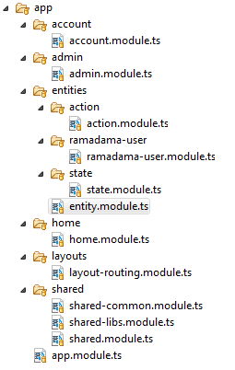
Modules

Slide 2
BrowserModule
Ng2Webstorage.for()
RamadamaUserModule
RamadamaAppModule
*
*
RamadamaActionModule
RamadamaEntityModule
*
*
RamadamaHomeModule
RamadamaStateModule
*
*
RamadamaAdminModule
*
RamadamaAccountModule
*
*
LayoutRoutingModule
RouterModule.forRoot()
*
RamadamaSharedModule

Slide 3
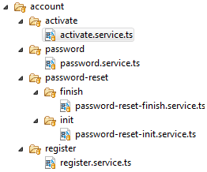
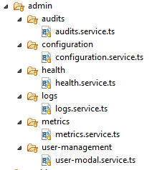
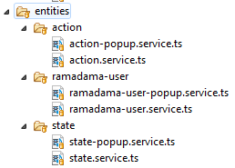
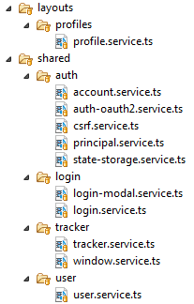
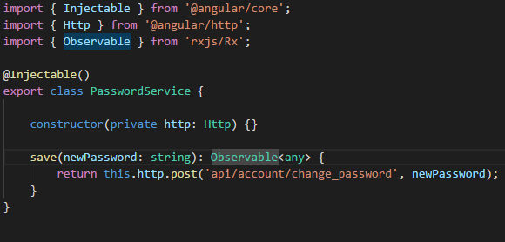
Services

Slide 4
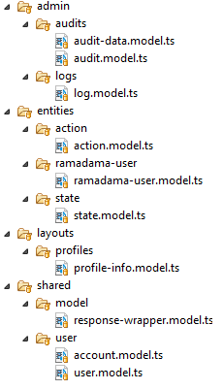
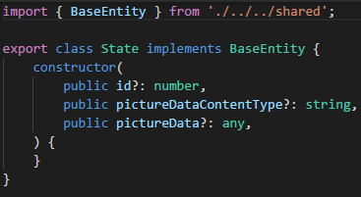
Modells

Slide 5
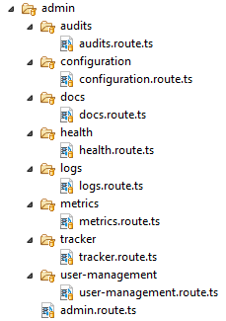
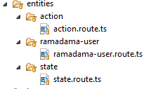
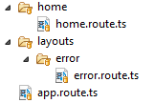
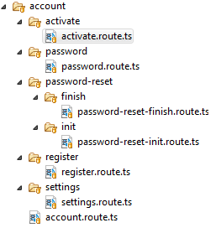
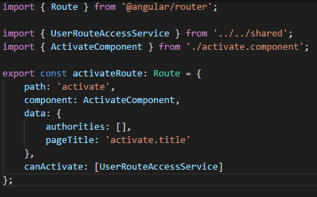
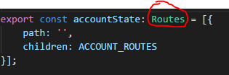
Routes

Slide 6
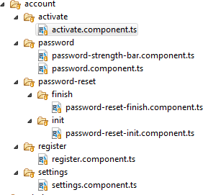
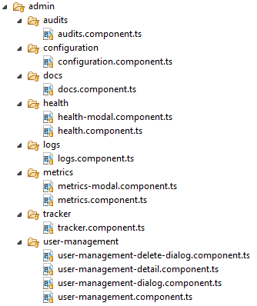
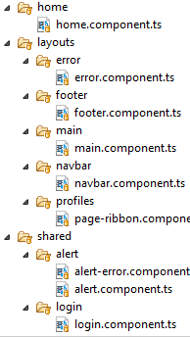
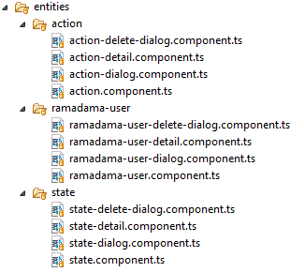
Components

Slide 7
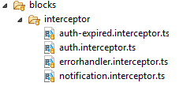
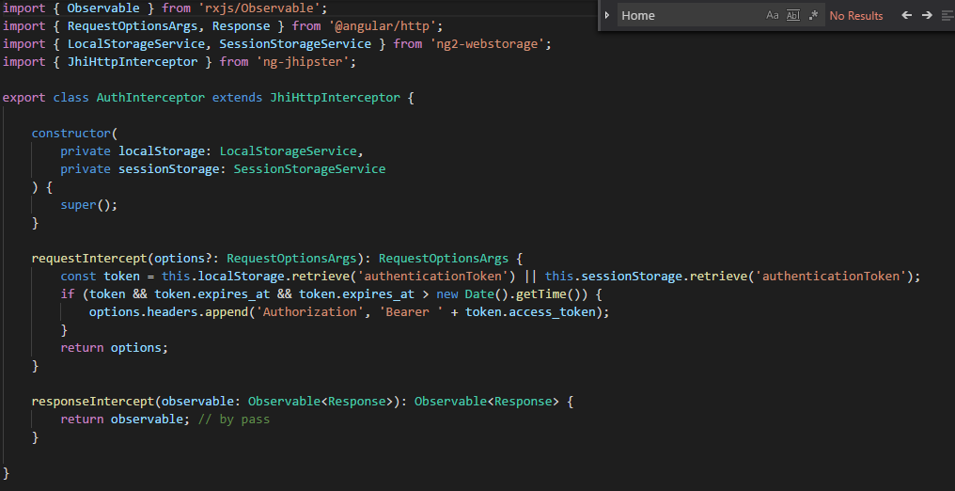
Interceptors

Slide 8
Notes

Slide 9

Vor dem Aufräumen:
Nach dem Aufräumen:
1
2
OK
3
1
Taking picture with camera, creating „before state“, saving id
2
Taking picture with camera, creating „after state“, saving id
3
Creating action, updating views

Slide 10
Form-Controls
Data-Model
Form-Model

