Slide 1


A Framework for Rapid Development and Scalability Using UIMA
Ryan Cornia, Thomas Ginter, Scott DuVall

Slide 2
The Basics
NLP Project Common Elements
Data to Process
Something to transfer the data into your application
A way to store the metadata your NLP generates
Bootstrap logic in steps
A way to transfer results out of your application for analysis

Slide 3

More Basics
Bootstrapping logic in steps
Common aspect of every big data system
Pipeline format
Continues Till Result
Algorithm1
Algorithm2
A1 Annotations
A1 Annotations
A2 Annotations

Slide 4
Where to Begin?
Every NLP Project needs infrastructure to support:
Reading in data
Processing data
Transferring data between logic modules
Storing metadata generated by logic
Writing Results

Slide 5

UIMA
Unstructured Information Management Architecture
Reusable logic modules (Annotation Engine or AE)
Easily convert modules to UIMA Annotation Engine
Form organized pipelines of modules (Aggregate AE)
Common infrastructure
Serialization and Transport of Data
Metadata Storage and Indexing
Community support
XML Descriptors

Slide 6
Core UIMA
Pipeline
CAS
Collection
Reader
Tokenizer
Sentence Detection
Chunker
NER
Listener

Slide 7
UIMA-AS
UIMA – Asynchronous Scaleout
Pipeline as a Service
Logic Modules
Replicate Service as a whole or Individual Logic Modules
Client
Reader for Input
Listener for Output
Third Party Broker
ActiveMQ
JMS Queues

Slide 8
UIMA-AS Overview
Top Aggregate
Descriptor
UIMA AS Service
Deployment
Descriptor
AE
JMX
Input Queue
Asynchronous
Messaging
Reply Queue
CAS
Collection
Reader
UIMA AS Client
Listener
UIMA AS Client

Slide 9
Goal
Rapid NLP Development
Scalable Architecture
Analysis code reuse – ours and theirs

Slide 10

Leo

Slide 11
Leo Framework Feature
Programmatically Generate:
UIMA Descriptors
Parameter and Type information for AE
Aggregate AE for a Service
Deployment Configuration
Standard and Custom CollectionReaders
Standard and Custom Listeners
Launch Services and Clients in UIMA-AS

Slide 12
Leo Framework Feature
Leo Aggregate Engine
Leo
Deployment
Descriptor
Token
Annotator
Sentence
Annotator
Chunker
Annotator
Regex
Annotator
Dictionary
Annotator
Leo Service
UIMA AS Service
Deployment
Descriptor
Top Aggregate
Descriptor
AE
JMX
Input Queue
Asynchronous
Messaging
Reply Queue
SubReader
UIMA AS Client
UIMA AS Client
Leo
SuperReader*
CAS
Listener(s)
Leo Client
*Can also use Standard UIMA CollectionReader

Slide 13
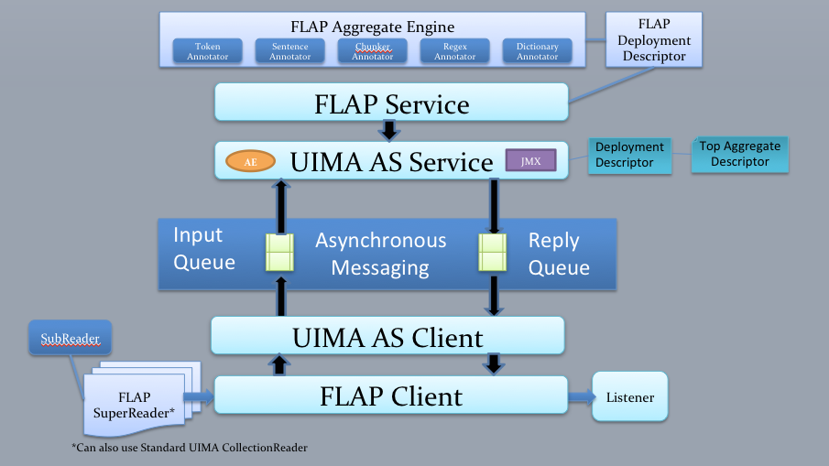
Leo Service Overview
Define Pipeline Programmatically
(Type System, Annotators)
Register with Analytics Module (optional)
Deploy
(Generates UIMA XML files, deploys to UIMA AS Broker)

Slide 14
Leo Client Overview
Define Client
(Broker URL and Service Name, Collection Reader, Listeners)
Run
(Standard UIMA AS send CAS and invoke Listeners on results)

Slide 15
Leo Readers
File
XMI
Simple Database
Batched Database
Knowtator
Siman
Third Party/Custom Listeners

Slide 16
Leo Listeners
CSV
XMI
Database
Siman
Knowtator
Third Party Listeners

Slide 17
AnnotationLibrarian
Annotation Utility Methods
Find, compare, overlap, contains, trim, modify…

Slide 18
LeoBaseAnnotator
Static inner class Param, includes input and output params pre-defined
Method to retrieve parameters in this and extending classes
Initialization
Output Annotations
Read Resource File into String
Default Descriptor Generation

Slide 19
LeoCachingAnnotator
Extends LeoBaseAnnotator
Provides caching through EHCache
Create cache
Access methods for adding/removing to/from the cache

Slide 20
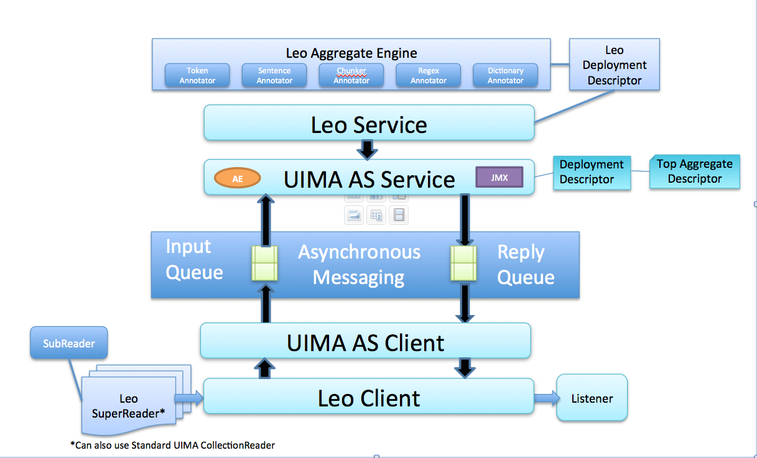
Leo Service
gov.va.vinci.leo.Service
- User Specified Path
- Defaults to conf/flap.properties
- Broker Information
- Existing deployment descriptor (Optional)
- Timeout Values (Optional)
Properties File
Constructor
- Create Aggregate if needed
- Create Service Deployment Descriptor
- Launch Service
init
init options
ArrayList<String> descriptors, boolean byName
List<LeoAEDescriptor> descriptors
LeoAEDescriptor

Slide 21
LeoAEDescriptor
gov.va.vinci.leo.descriptors.LeoAEDescriptor
Constructor
Constructor
options
String descriptor, boolean byName
String name, String implementation_class
List<LeoAEDescriptor> descriptors
AnalysisEngineDescription
Import Descriptor from file.
New Descriptor, no file import
Create Aggregate Descriptor from List
Use UIMA AE Descriptor Provided
Set Parameters
Add Annotation Types
Set Deployment Params
Serialize to XML

Slide 22
Leo Client
gov.va.vinci.leo.Client
- User Specified Path
- Defaults to conf/leo.properties
- Broker Information
Properties File
Constructor
Configure UIMA Client Engine
Register Listener with UIMA Client
init(Listener)
run
run options
CollectionReader
String documentText
UIMA CAS
CollectionReader Registered with UIMA Client, Processing Started
Create new CAS from Document Text, Send to Service for processing
Send CAS object to Service for Processing

Slide 23
Leo’s Universe
Chex
- Validation
Project AEs
- Applied project AEs
- Not-quite Enterprise AEs
JAM
- Performance monitoring
Any UIMA AS AEs
Marian
- Enterprise Quality AEs
Siman
- Simple Annotation Schema
Leo
- Framework
- Annotation
Any (non-AS) UIMA AEs
like cTAKES
eHOST
- Annotation and document classification
UIMA AS
Notes:
Set of libraries that provides easy access to UIMA AS functionality.
BONES: ws annotator, regex, annotation pattern
DERMA: hist, window annotator
PROJECTS: smoking, bcc, cvad, etc
Marian
ALSO ADD other UIMA annotators (FLAP can register automatically)

Slide 24

Current Release 2013.11.1

