Slide 1


Leo

Slide 2

UIMA
Reusable logic modules (Annotation Engine or AE)
Easily convert modules to UIMA Annotation Engine
Form organized pipelines of modules (Aggregate AE)
Common infrastructure
Serialization and Transport of Data
Metadata Storage and Indexing
Community support
Asynchronous Scale Out (UIMA-AS)
Notes:
Evaluated various platforms, including the possibility of writing our own, and eventually chose UIMA.
Benefits from our point of view

Slide 3
Goal
Rapid NLP Development
Scalable Architecture
Analysis code reuse – ours and theirs

Slide 4
Leo’s Universe
Chex
- Validation
Project AEs
- Applied project AEs
- Not-quite Enterprise AEs
JAM
- Performance monitoring
Any UIMA AS AEs
Marian
- Enterprise Quality AEs
Siman
- Simple Annotation Schema
Leo
- Framework
- Annotation
eHOST
- Annotation and document classification
Any (non-AS) UIMA AEs
like cTAKES
UIMA AS
Notes:
Set of libraries that provides easy access to UIMA AS functionality.
BONES: ws annotator, regex, annotation pattern
DERMA: hist, window annotator
PROJECTS: smoking, bcc, cvad, etc
Marian
ALSO ADD other UIMA annotators (FLAP can register automatically)

Slide 5
Framework Features
Programmatically Generate:
UIMA Descriptors
Parameter and Type information for AE
Aggregate AE for a Service
Deployment Configuration
Standard and Custom CollectionReaders
Standard and Custom Listeners
Launch Services and Clients in UIMA-AS

Slide 6
Framework Features
Leo Aggregate Engine
Leo
Deployment
Descriptor
Token
Annotator
Sentence
Annotator
Chunker
Annotator
Regex
Annotator
Dictionary
Annotator
Leo Service
UIMA AS Service
Deployment
Descriptor
Top Aggregate
Descriptor
AE
JMX
Input Queue
Asynchronous
Messaging
Reply Queue
SubReader
UIMA AS Client
UIMA AS Client
Leo
SuperReader*
Listener(s)
Leo Client
*Can also use Standard UIMA CollectionReader

Slide 7
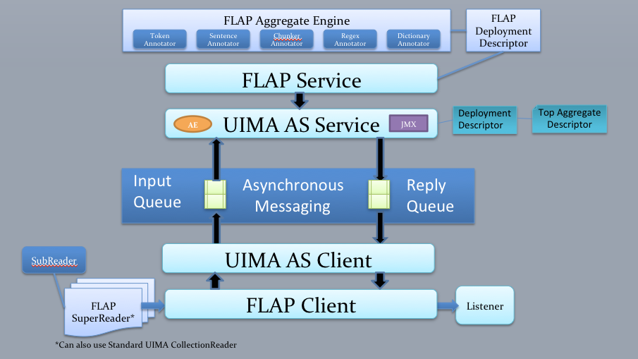
Leo Service Overview
Define Pipeline Programmatically
(Type System, Annotators)
Register with Analytics Module (optional)
Deploy
(Generates UIMA XML files, deploys to UIMA AS Broker)

Slide 8
Leo Client Overview
Define Client
(Broker URL and Service Name, Collection Reader, Listeners)
Run
(Standard UIMA AS send CAS and invoke Listeners on results)

Slide 9
Leo Readers
File
XMI
Simple Database
Batched Database
Knowtator
Siman
Third Party/Custom Listeners

Slide 10
Leo Listeners
CSV
XMI
Database
Siman
Knowtator
Third Party Listeners

Slide 11
Annotation Feature
Annotation Utilities
Find, compare, overlap, modify…
Annotator Functionality
Base structure for standard module implementation

Slide 12
JMX Monitoring
JMX Monitoring provides the missing piece to UIMA AS:
Easy collection of performance metrics for running UIMA pipelines
Aggregation of statistics from a distributed system
Presentation of statistics in an easy to interpret format

Slide 13
JAM Overview
JMX: Port
UIMA AS
Server 1
JAM Server
Statistics:
Aggregate
Individual
Real Time Gathering
Can Gather Over a Port Range
Compare Over Time (Future)
Standard WAR (Tomcat, Jetty, JBOSS, etc.)
Web User Interface
Service 1
Performance Metrics
DB
UIMA AS
Server 2
JMX: Port 1
Service 1
JMX: Port 2
Service 2

Slide 14
JAM Collection
Statistics are gathered from 1 to any number of running UIMA AS pipelines at specified intervals.
Adding and removing servers that are monitored happens automatically as servers are created and destroyed using the Leo project.
Statistics are gathered and saved at the individual node level, as well as the overall service level.

Slide 15
JAM Aggregation
Statistics can be gathered over a widely distributed network, and stored in a centralized database.
All statistics for a given service can be aggregated into a top level overview, or detailed view depending on need.
Aggregation allows viewing the performance of a pipeline as a whole, as well as the performance of each individual component.

Slide 16
JAM Value
JMX Monitoring provides a full end-to-end view of the running system that has never been available before.
Individual component throughput and service level throughput are visible and allow administrators to more effectively scale and tune the system.
A web interface allows easy access to view and graph the performance metrics

Slide 17
Analytics Tool
Design Goals
Gather statistics from various UIMA AS services
Aggregate the data into meaningful numbers
Give a both a broad and detailed view of system performance
Easy to use
Persist analytics
Compare analytics over time [Future work]
Allocate new resources as bottlenecks occur. [Future work]

Slide 18
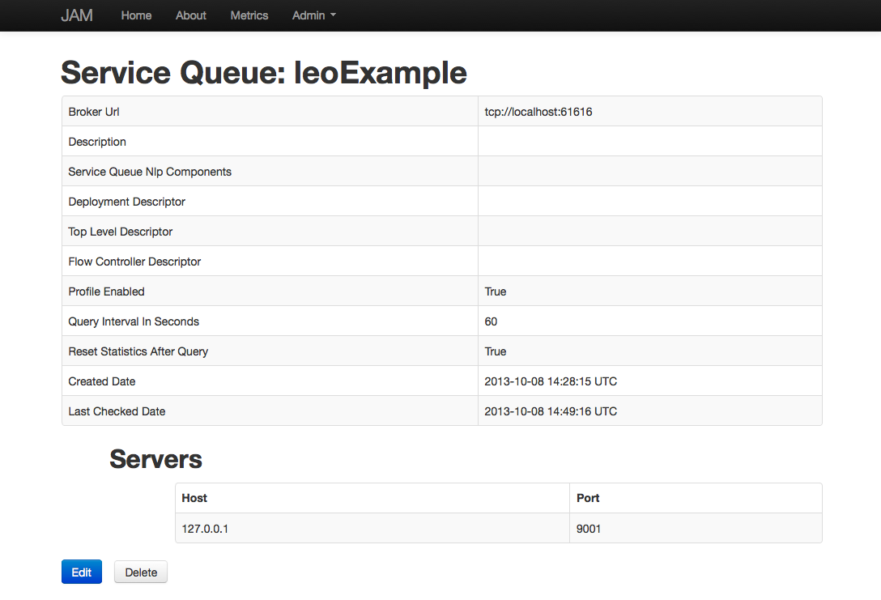
Service Details Screen

Slide 19
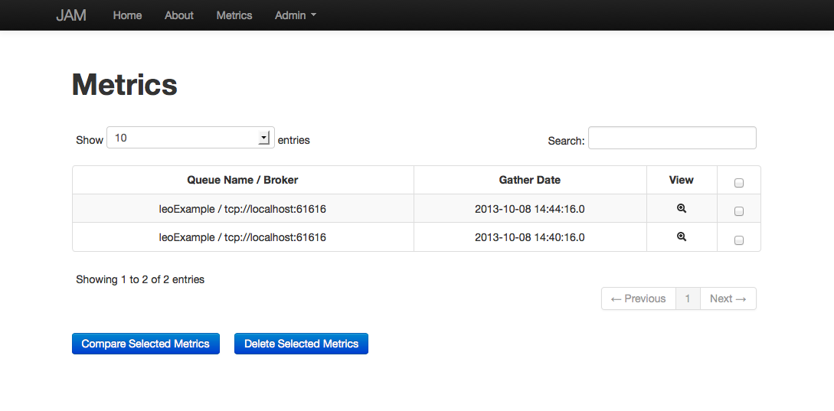
Metrics

Slide 20
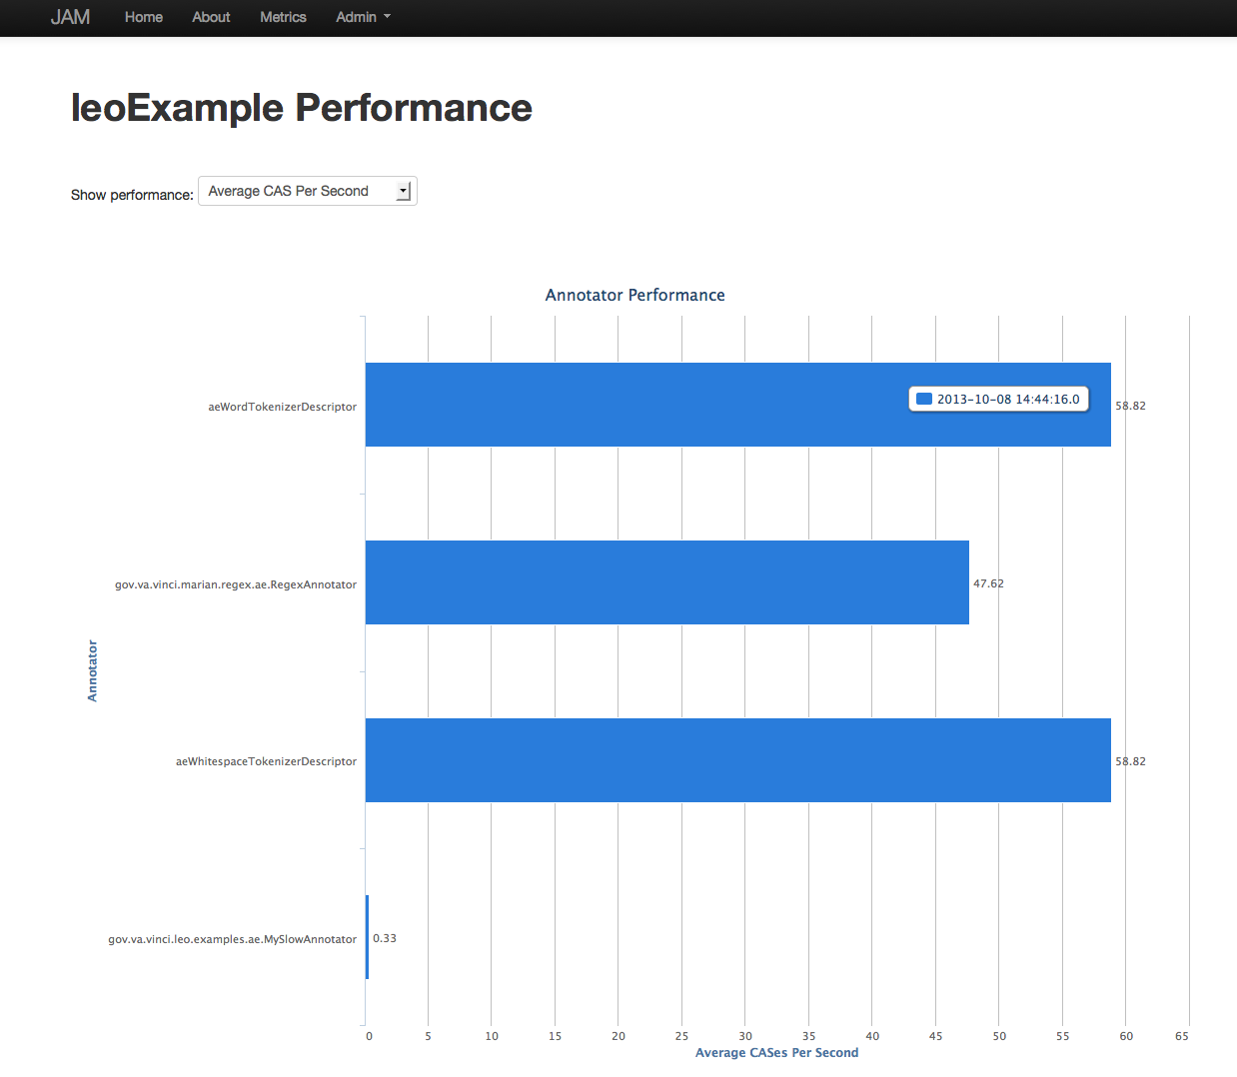
Service View

Slide 21
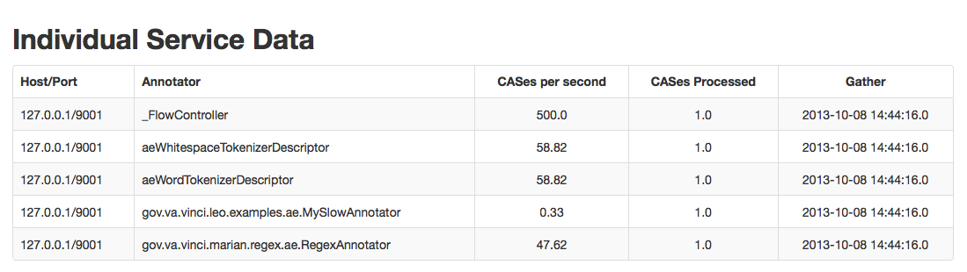
Service View Details

Slide 22
Chex: Validation Made Easy
Chex is a web application that allows for annotators to validate information.
Information is stored in the SIMAN format.
Reporting on validation status is built it.
Reads from project specific databases, not one single unified database.
Supports all major databases
Validation information can be read from SIMAN and added into a UIMA pipeline.

Slide 23
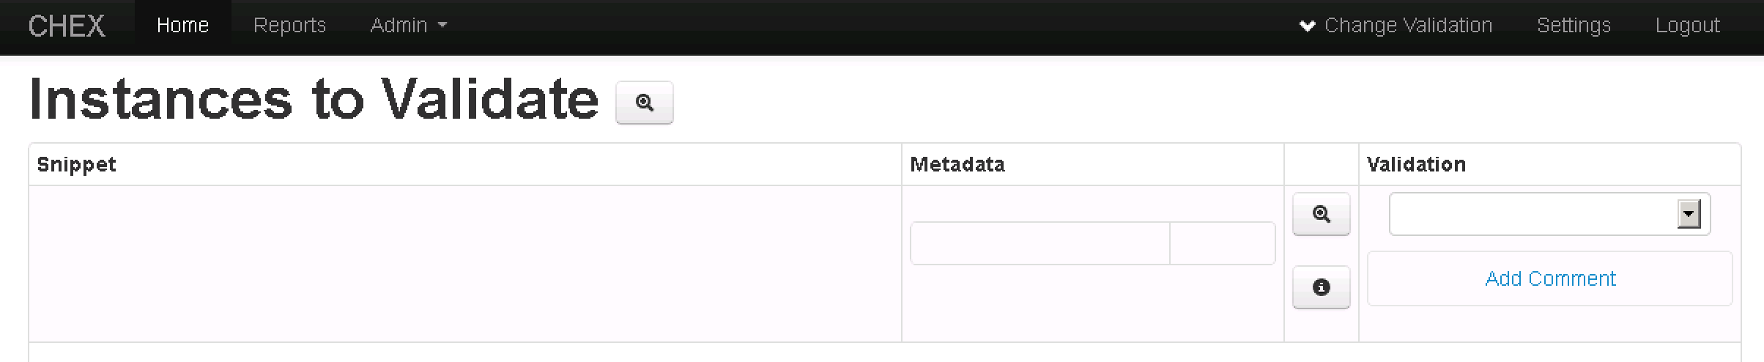
Chex: Validation Made Easy
Professional Diagnosis:
Axis I:
Major Depression, partial response to meds
Binge eating disorder
Axis II:
Relevant: TRUE
All Correct
Assertion: PRESENT
Relevant: TRUE
Assertion Incorrect
Patient does not meet criteria for binge eating disorder at this time due to purging behaviors.
Assertion: PRESENT

Slide 24
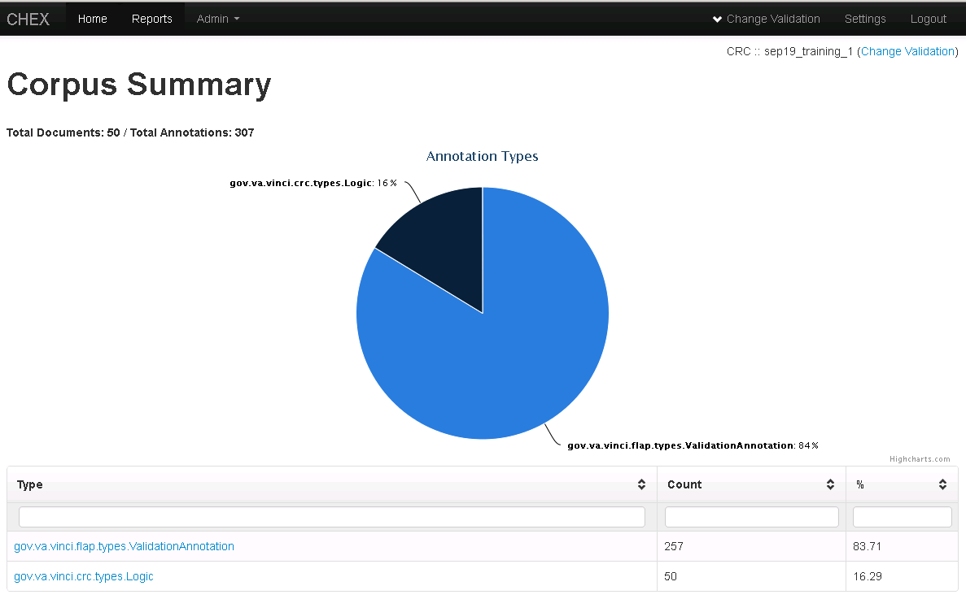
Chex: Validation Made Easy

Slide 25
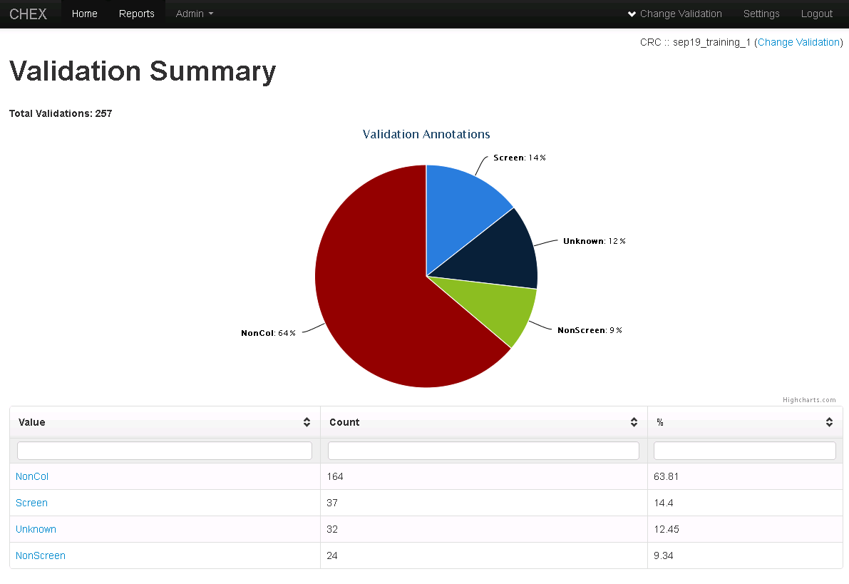
Chex: Validation Made Easy

Slide 26
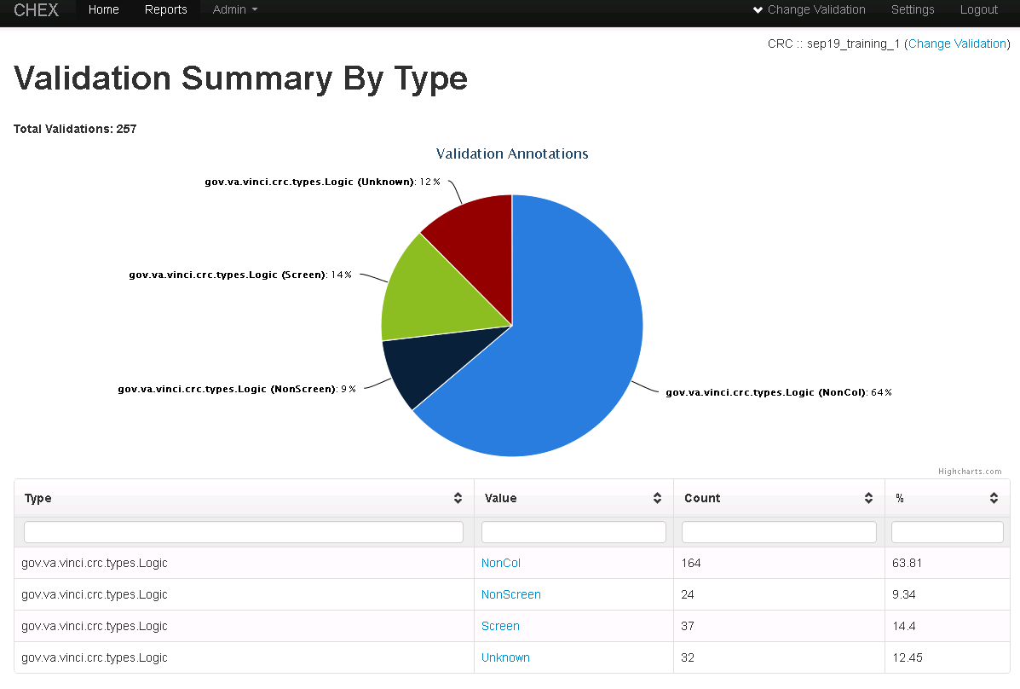
Chex: Validation Made Easy

Slide 27
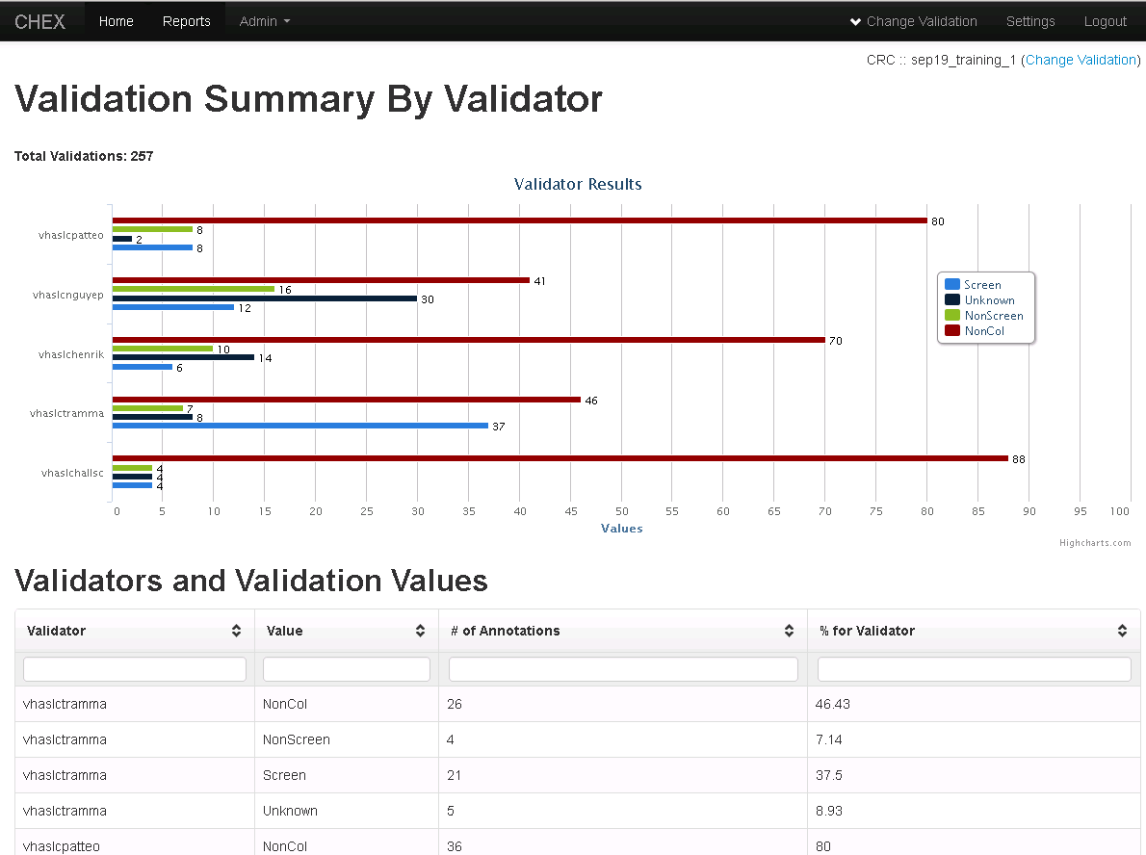
Chex: Validation Made Easy

