Slide 1

Harnessing Horsepower: Leo Architecture
Thomas Ginter

Slide 2

UIMA – The Brawn
Reusable logic modules (Annotation Engine or AE)
Easily convert modules to UIMA Annotation Engine
Form organized pipelines of modules (Aggregate AE)
Common infrastructure
Serialization and Transport of Data
Metadata Storage and Indexing
Community support
Asynchronous Scale Out (UIMA-AS)
Notes:
Evaluated various platforms, including the possibility of writing our own, and eventually chose UIMA.
Benefits from our point of view

Slide 3
UIMA-AS Overview
Top Aggregate
Descriptor
UIMA AS Service
Deployment
Descriptor
AE
JMX
Input Queue
Asynchronous
Messaging
Reply Queue
Collection
Reader
UIMA AS Client
Listener
UIMA AS Client

Slide 4
Leo
Rapid NLP Development
Programmatically Generate:
UIMA Descriptors
Parameter and Type information for AE
Aggregate AE for a Service
Configuration and Service Launch
Standard and Custom CollectionReaders
Plug and Play Algorithm Modules
Launch Services and Clients in UIMA-AS

Slide 5
Leo Overview
Leo Aggregate Engine
Leo
Deployment
Descriptor
Token
Annotator
Sentence
Annotator
Chunker
Annotator
Regex
Annotator
Dictionary
Annotator
Leo Service
UIMA AS Service
Deployment
Descriptor
Top Aggregate
Descriptor
AE
JMX
Input Queue
Asynchronous
Messaging
Reply Queue
SubReader
UIMA AS Client
UIMA AS Client
Leo
SuperReader*
Listener
Leo Client
*Can also use Standard UIMA CollectionReader

Slide 6
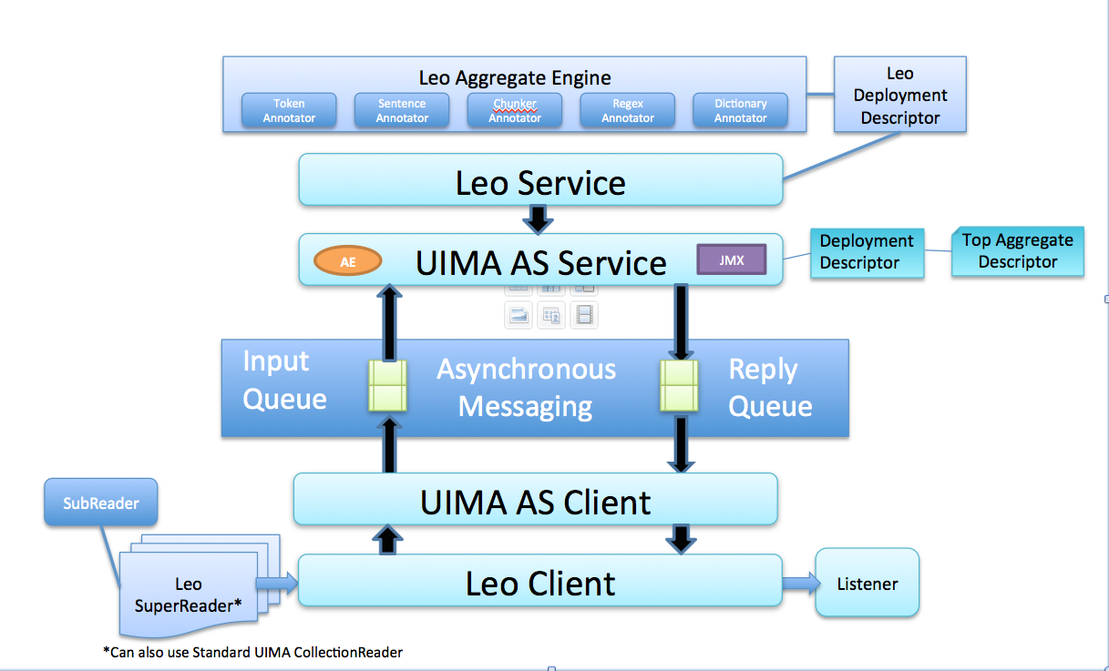
Leo Service
gov.va.vinci.leo.Service
- User Specified Path
- Defaults to conf/flap.properties
- Broker Information
- Existing deployment descriptor (Optional)
- Timeout Values (Optional)
Properties File
Constructor
- Create Aggregate if needed
- Create Service Deployment Descriptor
- Launch Service
init
init options
ArrayList<String> descriptors, boolean byName
List<LeoAEDescriptor> descriptors
LeoAEDescriptor

Slide 7
LeoAEDescriptor
gov.va.vinci.leo.descriptors.LeoAEDescriptor
Constructor
Constructor
options
String descriptor, boolean byName
String name, String implementation_class
List<LeoAEDescriptor> descriptors
AnalysisEngineDescription
Import Descriptor from file.
New Descriptor, no file import
Create Aggregate Descriptor from List
Use UIMA AE Descriptor Provided
Set Parameters
Add Annotation Types
Set Deployment Params
Serialize to XML

Slide 8
Leo Client
gov.va.vinci.leo.Client
- User Specified Path
- Defaults to conf/leo.properties
- Broker Information
Properties File
Constructor
Configure UIMA Client Engine
Register Listener with UIMA Client
init(Listener)
run
run options
CollectionReader
String documentText
UIMA CAS
CollectionReader Registered with UIMA Client, Processing Started
Create new CAS from Document Text, Send to Service for processing
Send CAS object to Service for Processing

Slide 9
Collection Readers
gov.va.vinci.leo.descriptors.CollectionReaderFactory
generateCollectionReader
Generate
options
String descriptor, boolean byName
DatabaseSubReader – DB Params
Import Descriptor from file.
Create new Database CollectionReader
FileSubReader – inputDir, boolean recurse
XmiSubReader – inputDir, boolean recurse
Create new File CollectionReader
Create new XMI CollectionReader
SubReader – HashMap<String, String> Params, String className
Create new CollectionReader from SubReader implementation

Slide 10
Listeners
UimaAsBaseListener abstract class
Listener Events:
Collection processing starts
CAS is being sent up to the service
CAS is returned from the service
Collection processing complete
Leo Listeners
XmiUABListener,
Serializes CAS files to XMI output
Launches UIMA Annotation Viewer for collection processing complete event
DatabaseUABListener,
Output annotations to an annotation db
Internally developed schema

Slide 11
Comments / Questions

