Slide 1

New System Instructions

Slide 2
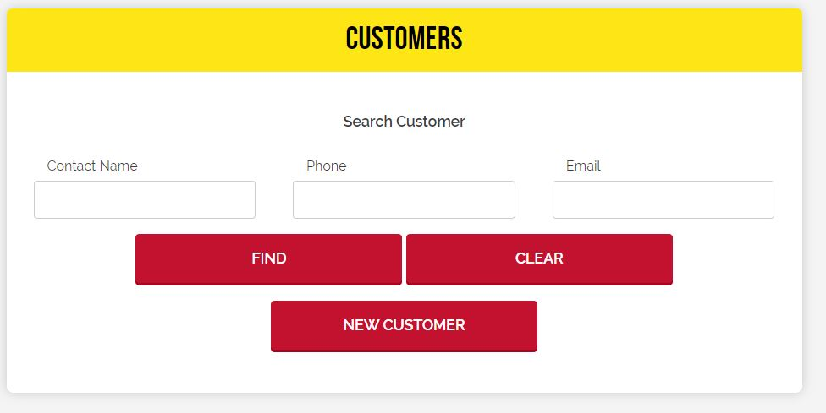
There are three different ways you can search for clients or returning customers by Contact Name, Phone Number or Email Address.

Slide 3
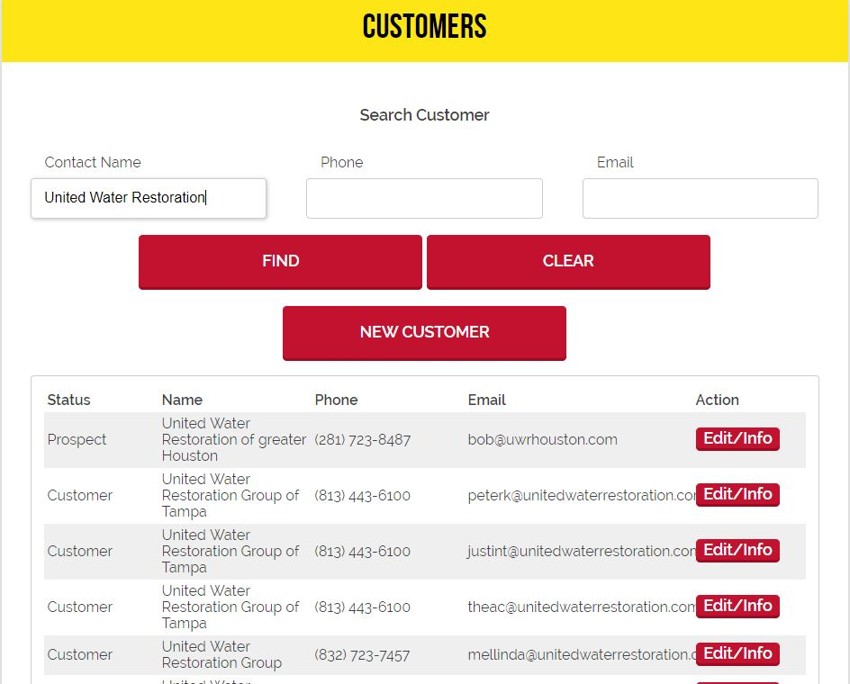
First way you can look up an account is by the Contact Name (For example: United Water Restoration)
Once you type the company name in it is going to pull up every “United Water Restoration” in our system.
From there you would have to look for the persons email address or phone number to place the order under who called it in.

Slide 4
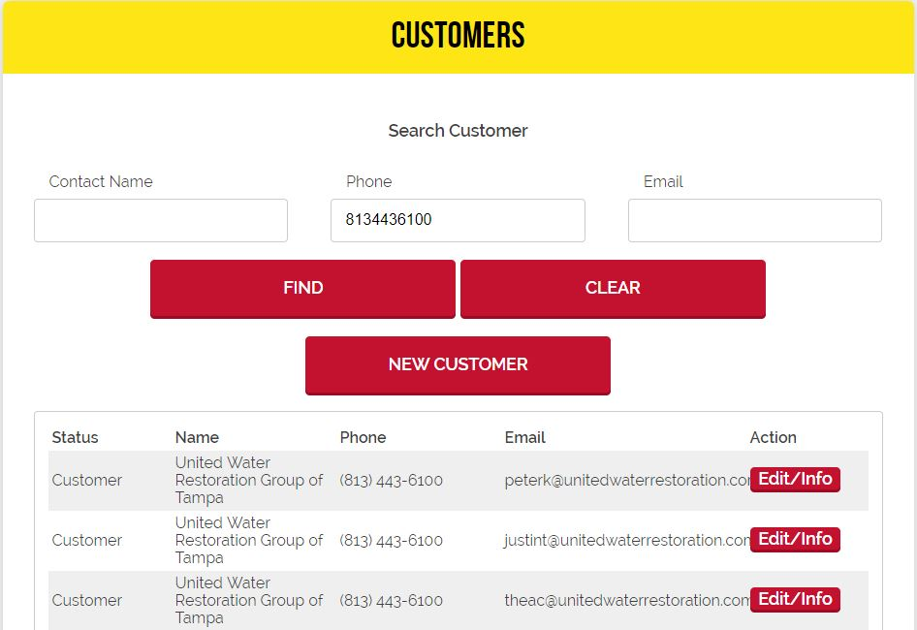
Second way you can look up a client is by there phone number (For example: 8134436100(DO NOT PUT ANY DASHES)
Once you type the company phone number in it is going to pull up every United Water Restoration that is attached to that phone number(As you can see this is for the Tampa location)
From there just look for the persons email address that is calling in the order.

Slide 5
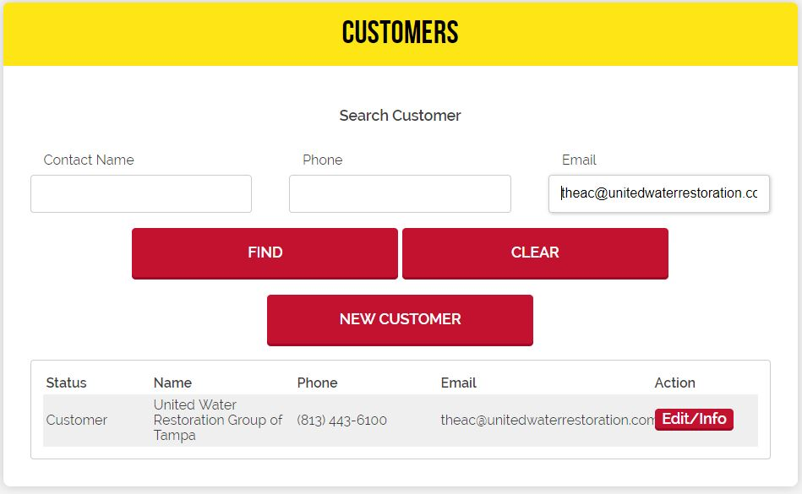
Third way you can look up an account & directly find the contact is by email address (For example: theac@unitedwaterrestoration.com.)
Once you type in the email address the only thing that will and should pop up is the client & the company name(Please verify). Some clients from the same company might have the same email address.

Slide 6


Once you have located your point of contact click on Edit/Info(Located by the yellow arrow)
Scroll all the way to the bottom to where you see “Buy a Bag” or “Schedule Disposal”(for our clients they will never call in to buy a bag) but our residential customers will.
Click on “Schedule Disposal”

Slide 7
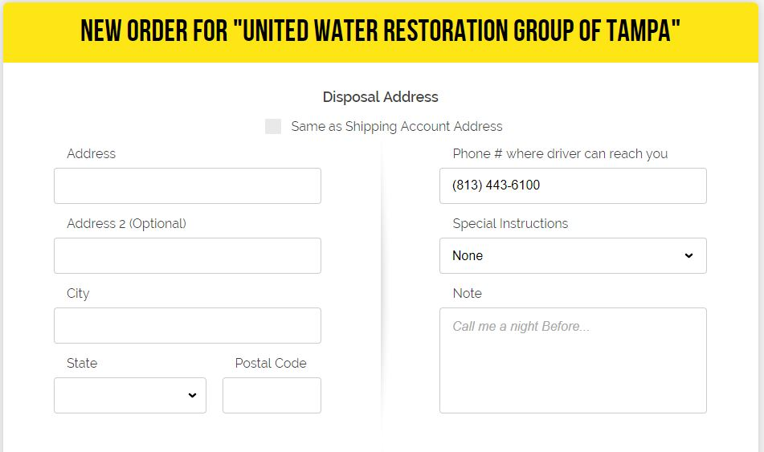
To ensure you are in the right account always look at the yellow bar & it will tell you what account you are putting the order in.
This is where you would enter the disposal address, city, state & zip code & phone number(you have to remove any dashes)
In the note section this is where you would enter weather the customer would like the bag rolled or reset(MANDATORY), job name or number(OPTIONAL) not all clients will have this) & any special notes the clients would like to add(OPTIONAL).

Slide 8
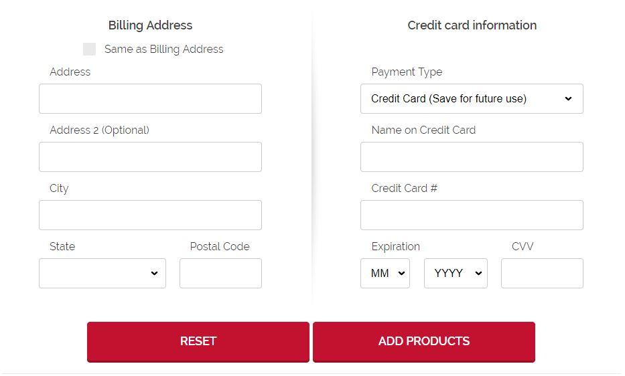
For clients just click on “Same as Billing Address” for residential just asked if the billing address is the same as the disposal address if not then enter it. If it is the same just click the check box.
If it is a client majority of our clients are on “Pay by Terms” so where you see Payment Type just click on the drop down box and you will see it. If “Pay by Terms” is not there then you would have to get a credit card from the customer or client. Some accounts or customers already have a credit card in the system if this is the case please verify the last 4 digits. If different then add a new one.
Once Billing Address and Credit Card Information is completed click on “Add Products”
At this point if anything is wrong it will give you an error message. If everything is correct then the selection of bags will pop up.

Slide 9
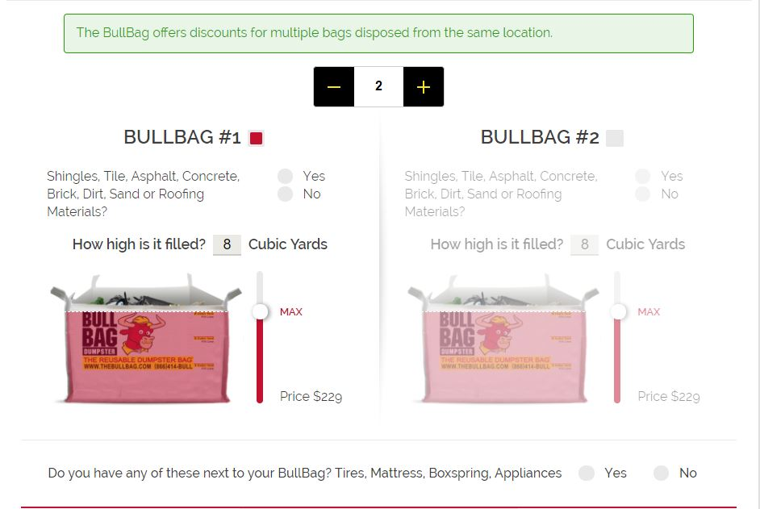




Where the red arrow is this is where you can increase the bag amount it will only go up to 10 bags per order so if the customer has more then 10 bags you will have to do a separate order to accommodate the remaining.
Where the yellow arrow is please ask customer this question. It makes a difference in how full the bag can be. If these materials are in it that means it can only be filled to 4 cubic yards and the system will automictically change it to that with the correct pricing.
Where the black arrow is that’s where you can change the yardage from 4 yards, 6 yards & 8 yards. Just move white bubble up and down.
Where the blue arrow is please ask if they have any miscellaneous items on the side of the bag. It will require an additional charge.
This Photo by Unknown Author is licensed under CC BY-SA

Slide 10
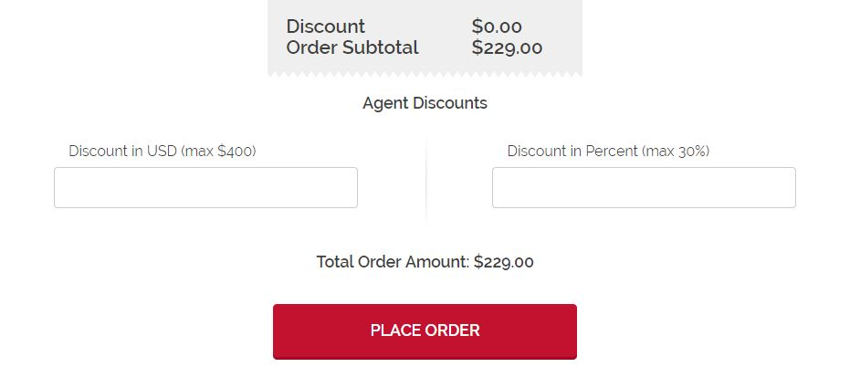

Once you have checked off how many bags the client/customer has. The next set is discounts.
Where the green arrow is that’s where the $40.00 discount can go ONLY if they mention (BBTEXAS or BBFLORIDA)(THIS IS ONLY FOR RESIDENTIAL CUSTOMERS)
Simply just put 40.00 & it will provide the discount.
Then you can click on “Place Order”
A pop up should appear that lets you know you have completed the transaction successfully.

