Slide 1
Optimization
Prescriptive Techniques – What should we do?

Slide 2
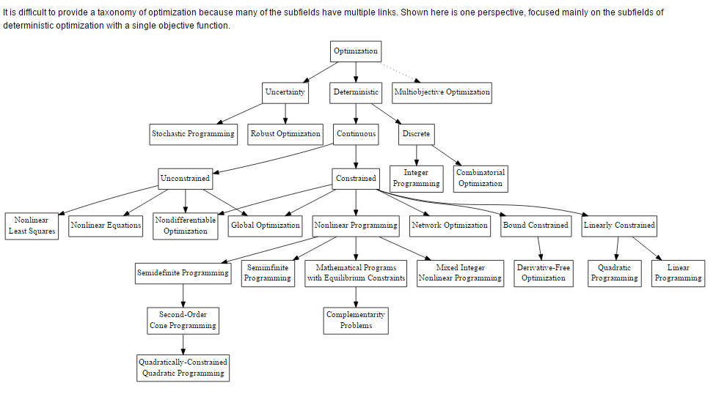
Taxonomy

Slide 3
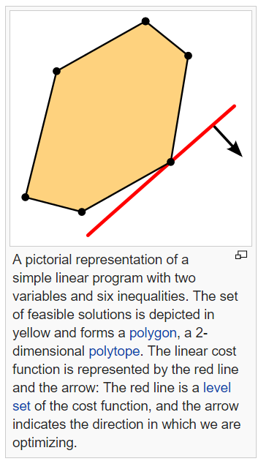
Linear Programming
Definition – a mathematical technique for maximizing or minimizing a linear function of several variables, such as output or cost.
Details – Linear programming (LP; also called linear optimization) is a method to achieve the best outcome (such as maximum profit or lowest cost) in a mathematical model whose requirements are represented by linear relationships. Linear programming is a special case of mathematical programming (mathematical optimization).
More formally, linear programming is a technique for the optimization of a linear objective function, subject to linear equality andlinear inequality constraints. Its feasible region is a convex polytope, which is a set defined as the intersection of finitely manyhalf spaces, each of which is defined by a linear inequality. Its objective function is a real-valued affine (linear) function defined on this polyhedron. A linear programming algorithm finds a point in the polyhedron where this function has the smallest (or largest) value if such a point exists.
How Used – Usually when you are seeking to minimize or maximize the objective function (or set it to a value)
Example – The Wyndor Glass Co. – has three workshops and two products each costing a certain amount of time and generating a certain profit. What is the optimal mix of production to maximize profits?
Links –

Slide 4
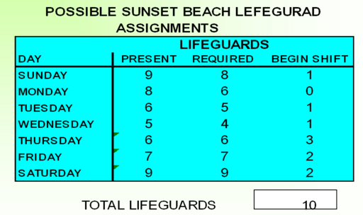
Integer Programming, Mixed Integer Programming, Binary Programming
Definition – a mathematical technique for maximizing or minimizing a linear function of several variables, such as output or cost.
Details – An integer programming problem is a mathematical optimization or feasibility program in which some or all of the variables are restricted to be integers. In many settings the term refers to integer linear programming (ILP), in which the objective function and the constraints (other than the integer constraints) are linear.
- Mixed integer linear programming (MILP) or Mixed integer programming (MIP) involves problems in which only some of the variables, x_i, are constrained to be integers, while other variables are allowed to be non-integers.
- Zero-One (or Binary) linear (or integer) programming involves problems in which the variables are restricted to be either 0 or 1. Note that any bounded integer variable can be expressed as a combination of binary variables.
How Used – There are two main reasons for using integer variables when modeling problems as a linear program:
The integer variables represent quantities that can only be integer. For example, it is not possible to build 3.7 cars.
The integer variables represent decisions and so should only take on the value 0 or 1 .
Example – Used for personnel scheduling. You can’t assign .5 persons to a shift; for BIP, typically used for Yes/No decisions
Links – http://slideplayer.com/slide/4278930/

Slide 5
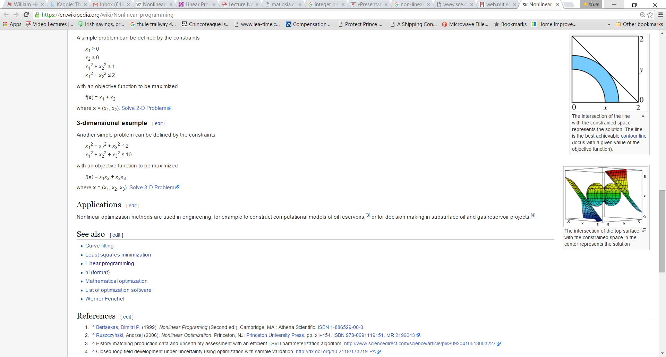
Non-Linear Programming (NLP)
Definition – nonlinear programming is the process of solving an optimization problem defined by a system of equalities and inequalities, collectively termed constraints, over a set of unknown real variables, along with an objective function to be maximized or minimized, where some of the constraints or the objective function are nonlinear.
Details – The difference between a linear program and non-linear program is that the non-linear program includes at least one nonlinear function, which could be the objective function, or some or all of the constraints. Many real systems are inherently nonlinear, e.g. modelling the drop in signal power with distance from a transmitting antenna.
It’s pretty d*mn hard to do. In contrast to the case of the simplex method for linear programming, there is no efficient all-purpose algorithm that can be used to solve all nonlinear programming problems
How Used – Dealing with price elasticity-the amount of a product that can be sold has an inverse relationship to the price charged. Formulates a price/demand curve. Marginal costs of production or shipping is another use.
Example – Previous examples fix shipping costs, but these are routinely not fixed, but variable. Volume discounts result in a cost of shipping that follows a nonlinear function. Also used to build a portfolio that balances risk and expected return.
Links – http://www.sce.carleton.ca/faculty/chinneck/po/Chapter16.pdf
http://web.mit.edu/15.053/www/AMP-Chapter-13.pdf

Slide 6
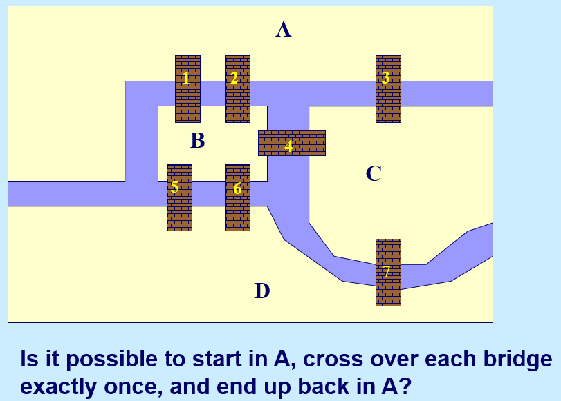
Network Optimization
Definition – Network optimization is a special type of linear programming model.
Details – Network models have three main advantages over linear programming:
1. They can be solved very quickly. Problems whose linear program would have 1000 rows and 30,000 columns can be solved in a matter of seconds. This allows network models to be used in many applications (such as real-time decision making) for which linear programming would be inappropriate.
2. They have naturally integer solutions. By recognizing that a problem can be formulated as a network program, it is possible to solve special types of integer programs without resorting to the ineffective and time consuming integer programming algorithms.
3. They are intuitive. Network models provide a language for talking about problems that is much more intuitive than the variables, objective, and constraints" language of linear and integer programming.
Of course these advantages come with a drawback: network models cannot formulate the wide range of models that linear and integer programs can. However, they occur often enough that they form an important tool for real decision making.
How Used – Commonly used to compute shortest paths, maximum flows, and transportation problems
Example – People wondered whether it is possible to take a walk, end up where you started from, and cross each bridge in Koenigsberg exactly once. Generally it was believed to be impossible, but
Links – http://mat.gsia.cmu.edu/classes/QUANT/NOTES/chap11.pdf
http://ocw.mit.edu/courses/sloan-school-of-management/15-082j-network-optimization-fall-2010/lecture-notes/

Slide 7
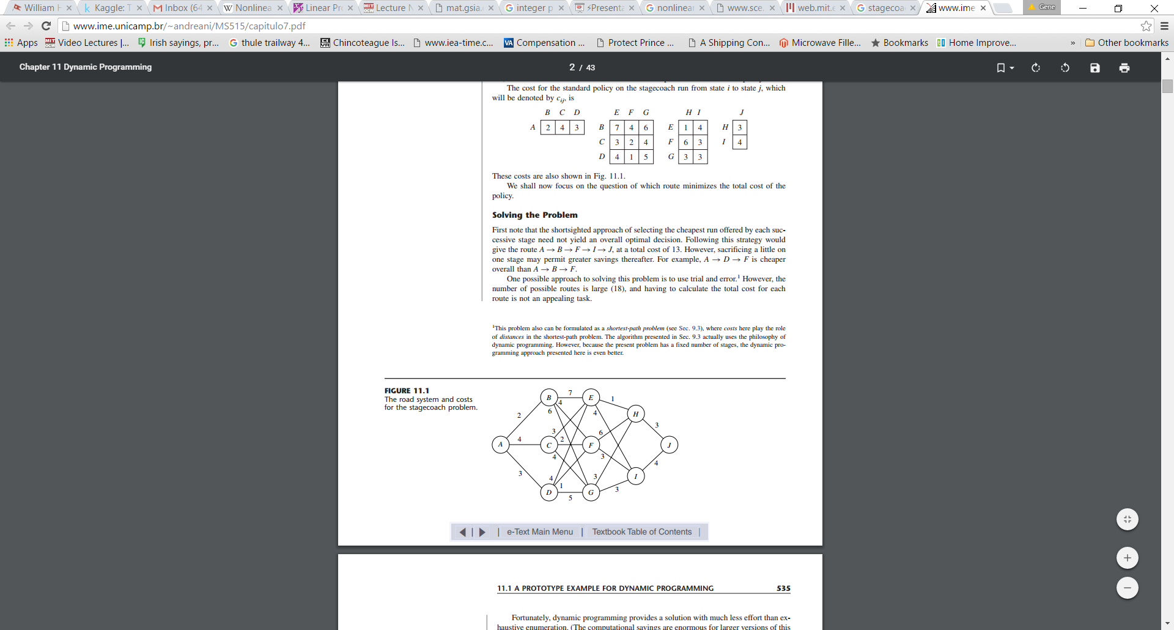
Dynamic Programming
Definition – a useful mathematical technique for making a sequence of interrelated decisions. It provides a systematic procedure for determining the optimal combination of decisions
Details – In contrast to linear programming, there does not exist a standard mathematical formulation of “the” dynamic programming problem. Rather, dynamic programming is a general type of approach to problem solving, and the particular equations must be developed to fit each situation.
Basic features: problem can be divided into stages, decisions required at each stage.
Each stage has a number of states associated with the beginning of that stage
The effect of the decision is to transform the current state to a state associated with the beginning of the next stage
Solution is to find the overall optimal policy vice each stage optimal policy
How Used – Stagecoach problem ca be formulated as a shortest path problem, with cost as distance.
Example – The Stagecoach Problem. Journey by stagecoach through unsettled country where there was serious danger of attack by marauders. Although his starting point and destination were fixed, he had considerable choice as to which states (or territories that subsequently became states) to travel through en route. After some thought, he came up with a rather clever way of determining the safest route. Life insurance policies were offered to stagecoach passengers. Because the cost of the policy for taking any given stagecoach run was based on a careful evaluation of the safety of that run, the safest route should be the one with the cheapest total life insurance policy.
Links – http://www.ime.unicamp.br/~andreani/MS515/capitulo7.pdf

Slide 8
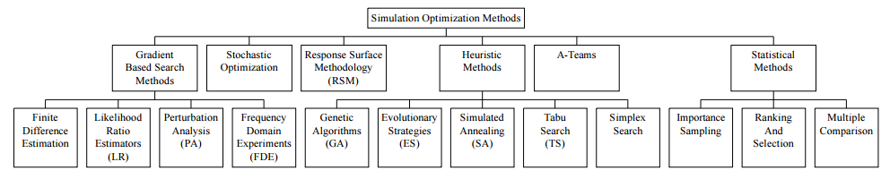
Simulation-Optimization
Definition – Simulation optimization can be defined as the process of finding the best input variable values from among all possibilities without explicitly evaluating each possibility. The process of finding the best input variable values from among all possibilities without explicitly evaluating each possibility is simulation optimization.
Details –A system is modeled as if the random variables were known. Then values for the variables are drawn randomly from their known probability distributions. Each replication gives one observation of the system response. By simulating a system in this fashion, one can compute statistics concerning the results. The statistics are used for evaluation and design.
How Used – The objective of simulation optimization is minimizing the resources spent while maximizing the information obtained in a simulation experiment
Example –Consider an intersection with four-way stop signs. Suppose that it has been determined to be a bottleneck for traffic during rush hours and a decision has been made to replace it with traffic lights in all four directions. The problem is to determine the optimal greentimes in all directions in order to ensure the least waittime for cars arriving from all directions. The greentimes must allow for the flow of traffic in all the pre-specified directions. Given the rates at which cars arrive from every direction, and picking reasonable green-time values, a simulation model of the intersection can be developed and run to determine the wait-time statistics.
Running of this simulation model can only provide the answer to a “what if” question (e.g. What if the greentime in all four directions is 2 minutes ... what is the resulting wait-time for cars arriving at the intersection?). But how do we find the optimal values for the various green-times? This is an instance of a simulation optimization problem.
Links – http://www.simopt.org/
http://www.informs-sim.org/wsc97papers/0118.PDF

Slide 9
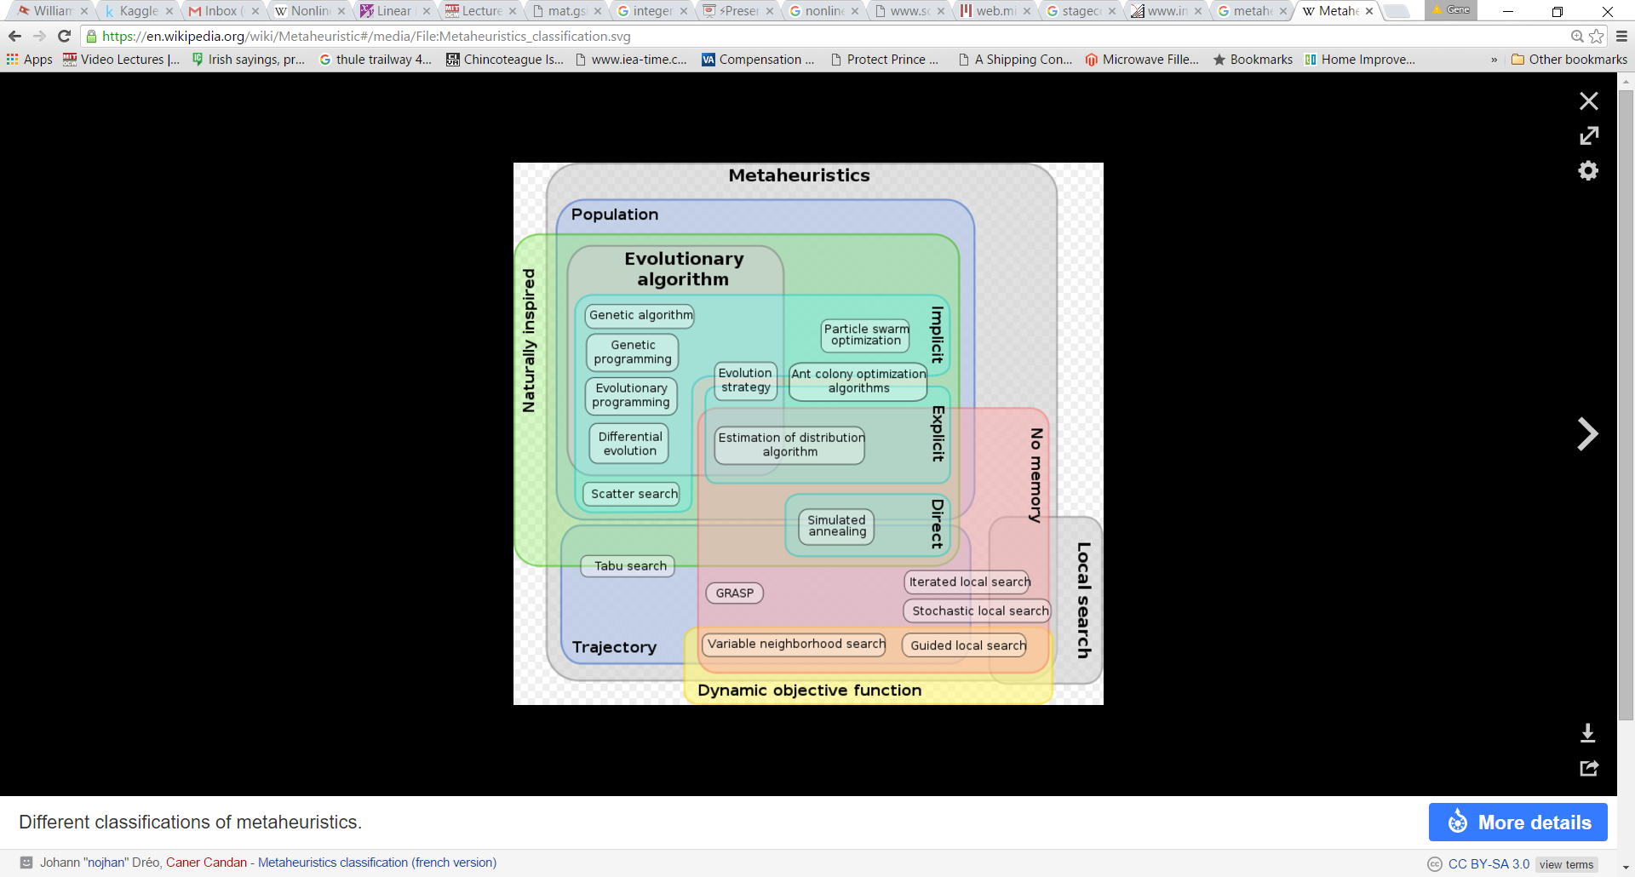
Metaheuristics
Definition – In computer science and mathematical optimization, a metaheuristic is a higher-level procedure or heuristic designed to find, generate, or select a heuristic (partial search algorithm) that may provide a sufficiently good solution to an optimization problem, especially with incomplete or imperfect information or limited computation capacity. Metaheuristics sample a set of solutions which is too large to be completely sampled. Metaheuristics may make few assumptions about the optimization problem being solved, and so they may be usable for a variety of problems.
Details – A heuristic method is a procedure that is likely to discover a very good feasible solution, but not necessarily an optimal one. In the past, an OR team would need to start from scratch to develop a heuristic method to fit a problem that did not have an algorithm based optimal solution. A metaheuristic is a general solution method that provides both a general structure and strategy guidelines for developing a specific heuristic method to fit a particular kind of problem.
How Used – Properties that characterize most metaheuristics:^{[2]}
Metaheuristics are strategies that guide the search process.
The goal is to efficiently explore the search space in order to find near–optimal solutions.
Techniques which constitute metaheuristic algorithms range from simple local search procedures to complex learning processes.
Metaheuristic algorithms are approximate and usually non-deterministic.
Metaheuristics are not problem-specific.
Three popular types: tabu search, simulated annealing, genetic algorithms
Example – Traveling Salesman Problem (TSP). NP-hard - New solutions are created until some stopping criterion, such as an arbitrary number of iterations, is met. Once the simple tabu search stops, it returns the best solution found during its execution.
Links – https://en.wikipedia.org/wiki/Metaheuristic

Slide 10
Stochastic Optimization
Definition – Stochastic optimization refers to the minimization (or maximization) of a function in the presence of randomness in the optimization process. The randomness may be present as either noise in measurements or Monte Carlo randomness in the search procedure, or both.
Details –Partly random input data arise in such areas as real-time estimation and control, simulation-based optimization where Monte Carlo simulations are run as estimates of an actual system,[2] [3] and problems where there is experimental (random) error in the measurements of the criterion. In such cases, knowledge that the function values are contaminated by random "noise" leads naturally to algorithms that use statistical inference tools to estimate the "true" values of the function and/or make statistically optimal decisions about the next steps.
The study of stochastic optimization problems dates back to the 1950’s and the work of Dantzig [3] (among others) and attempts to model uncertainty in the data by assuming that (part of) the input is specified in terms of a probability distribution, rather than by deterministic data given in advance
A game of chutes and ladders or any other game whose moves are determined entirely by dice is a Markov chain, indeed, an absorbing Markov chain. This is in contrast to card games such as blackjack, where the cards represent a 'memory' of the past moves.
How Used – When your inputs are probabilistic vice deterministic (deals with uncertainty)
Example – Markov Chains have the special property that probabilities involving how the process will evolve depend only on the present state and are independent of past events.
Links – http://www.jhuapl.edu/spsa/PDFSPSA/Handbook04_StochasticOptimization.pdf
https://www.math.uwaterloo.ca/~cswamy/papers/stochfnl.pdf
http://www.stat.columbia.edu/~liam/teaching/compstat-spr15/lauren-notes.pdf
https://en.wikipedia.org/wiki/Examples_of_Markov_chains

