Slide 1
Regression, Modeling and Simulation
Predictive Techniques – What could happen?

Slide 2
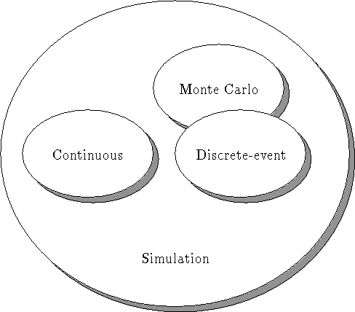
Taxonomy
http://www.cs.mun.ca/~donald/msc/node11.html

Slide 3
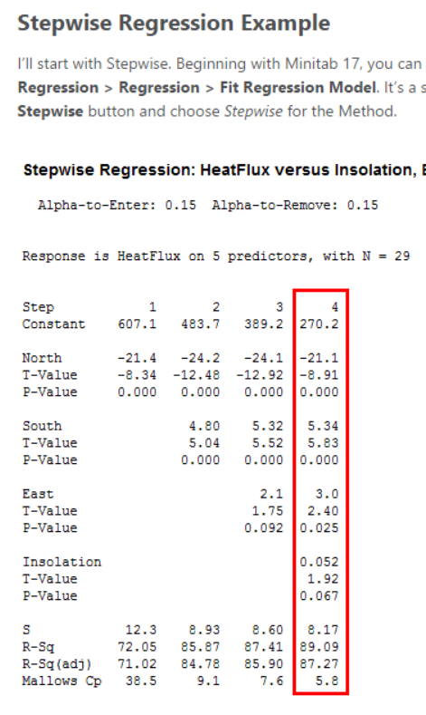
Step-wise Regression
Definition – A regression technique to select the best predictor variable from among many.
Details – Imagine a scenario where you have many predictor variables and a response variable. Because there are so many predictor variables, you’d like some help in creating a good regression model. You could try a lot of combinations on your own. But there are two automatic tools that will help you pick a regression model. These tools are Stepwise Regression and Best Subsets Regression. They both identify useful predictors during the exploratory stages of model building for ordinary least squares regression.
How Used – Stepwise regression selects a model by automatically adding or removing individual predictors, a step at a time, based on their statistical significance(according to their statistical contribution in explaining the variance in the dependent variable). The end result of this process is a single regression model, which makes it nice and simple. You can control the details of the process, including the significance level and whether the process can only add terms, remove terms, or both.
Best Subsets compares all possible models using a specified set of predictors, and displays the best-fitting models that contain one predictor, two predictors, and so on. The end result is a number of models and their summary statistics. It is up to you to compare and choose one. Sometimes the results do not point to one best model and your judgment is required.
Both procedures build models from a set of predictors that you specify. Stepwise does not assess all models but constructs a model by adding or removing one predictor at a time. Best Subsets does assess all possible models and it presents you with the best candidates. Best subsets provides more information by including more models, but it can be more complex to choose one. Because Best Subsets assesses all possible models, large models may take a long time to process.
Example – See example at link below and Solving Regression in SPSS PDF (on Google Drive)
Links – http://blog.minitab.com/blog/adventures-in-statistics/regression-smackdown-stepwise-versus-best-subsets
http://www.spiderfinancial.com/support/documentation/numxl/users-guide/factor-analysis/regression-analysis-mlr/stepwise-regression-excel
The four steps run horizontally across the output. For each step, the procedure added these predictors: North, South, East, and Insolation. At this point, no more variables could enter or leave, so the procedure stopped. I’ve highlighted the final model, which has an R² of 89.09%.

Slide 4
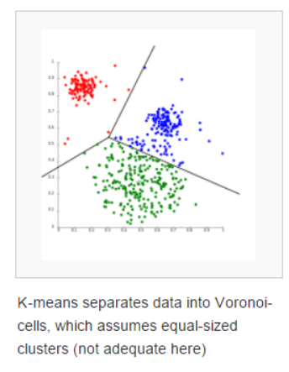
Clustering
Definition – Cluster analysis or clustering is the task of grouping a set of objects in such a way that objects in the same group (called a cluster) are more similar (in some sense or another) to each other than to those in other groups (clusters). It is a main task of exploratory data mining, and a common technique for statistical data analysis, used in many fields, including machine learning, pattern recognition, image analysis, information retrieval, and bioinformatics..
Details – Cluster analysis itself is not one specific algorithm, but the general task to be solved. It can be achieved by various algorithms that differ significantly in their notion of what constitutes a cluster and how to efficiently find them. Popular notions of clusters include groups with small distances among the cluster members, dense areas of the data space, intervals or particular statistical distributions. Clustering can therefore be formulated as a multi-objective optimization problem.
Algorithm Types –
Hierarchical procedures
– Agglomerative (start from n clusters, to get to 1 cluster)
– Divisive (start from 1 cluster, to get to n cluster)
Non hierarchical procedures – K-means clustering
How Used – Data mining and analysis software usually has various clustering and classification algorithms and the programming to run them through data sets.
Example – Used to describe complicated populations in almost every field: genetics, networks, biology, medicine, social networks, science
Links – https://en.wikipedia.org/wiki/Cluster_analysis
https://web.stanford.edu/class/cs345a/slides/12-clustering.pdf
http://www.mvsolution.com/wp-content/uploads/SPSS-Tutorial-Cluster-Analysis.pdf

Slide 5

Queuing Models
Definition – Queuing theory deals with problems which involve queuing (or waiting). Typical examples: banks/supermarkets - waiting for service, computers - waiting for a response, failure situations - waiting for a failure to occur e.g. in a piece of machinery, public transport - waiting for a train or a bus.
Details – In designing queueing systems we need to aim for a balance between service to customers (short queues implying many servers) and economic considerations (not too many servers).
How Used – The first queueing theory problem was considered by Erlang in 1908 who looked at how large a telephone exchange needed to be in order to keep to a reasonable value the number of telephone calls not connected because the exchange was busy (lost calls). Within ten years he had developed a (complex) formula to solve the problem.
Components:
arrival process: how customers arrive e.g. singly or in groups (batch or bulk arrivals), how the arrivals are distributed in time (e.g. what is the probability distribution of time between successive arrivals (the interarrival time distribution)), whether there is a finite population of customers or (effectively) an infinite number. The simplest arrival process is one where we have completely regular arrivals (i.e. the same constant time interval between successive arrivals). A Poisson stream of arrivals corresponds to arrivals at random. In a Poisson stream successive customers arrive after intervals which independently are exponentially distributed. The Poisson stream is important as it is a convenient mathematical model of many real life queuing systems and is described by a single parameter - the average arrival rate. Other important arrival processes are scheduled arrivals; batch arrivals; and time dependent arrival rates (i.e. the arrival rate varies according to the time of day).
service mechanism: a description of the resources needed for service to begin, how long the service will take (the service time distribution), the number of servers available, whether the servers are in series (each server has a separate queue) or in parallel (one queue for all servers), whether preemption is allowed (a server can stop processing a customer to deal with another "emergency" customer). Assuming that the service times for customers are independent and do not depend upon the arrival process is common. Another common assumption is that service times are exponentially distributed.
queue characteristics: how, from the set of customers waiting for service, do we choose the one to be served next (e.g. FIFO (first-in first-out) - also known as FCFS (first-come first served); LIFO (last-in first-out); randomly) (this is often called the queue discipline). do we have: balking (customers deciding not to join the queue if it is too long) reneging (customers leave the queue if they have waited too long for service). jockeying (customers switch between queues if they think they will get served faster by so doing)
Note here that integral to queuing situations is the idea of uncertainty in, for example, interarrival times and service times. This means that probability and statistics are needed to analyse queuing situations. It is common to use to use the symbols: lamda to be the mean (or average) number of arrivals per time period, i.e. the mean arrival rate and µ to be the mean (or average) number of customers served per time period, i.e. the mean service rate
Links – http://people.brunel.ac.uk/~mastjjb/jeb/or/queue.html

Slide 6
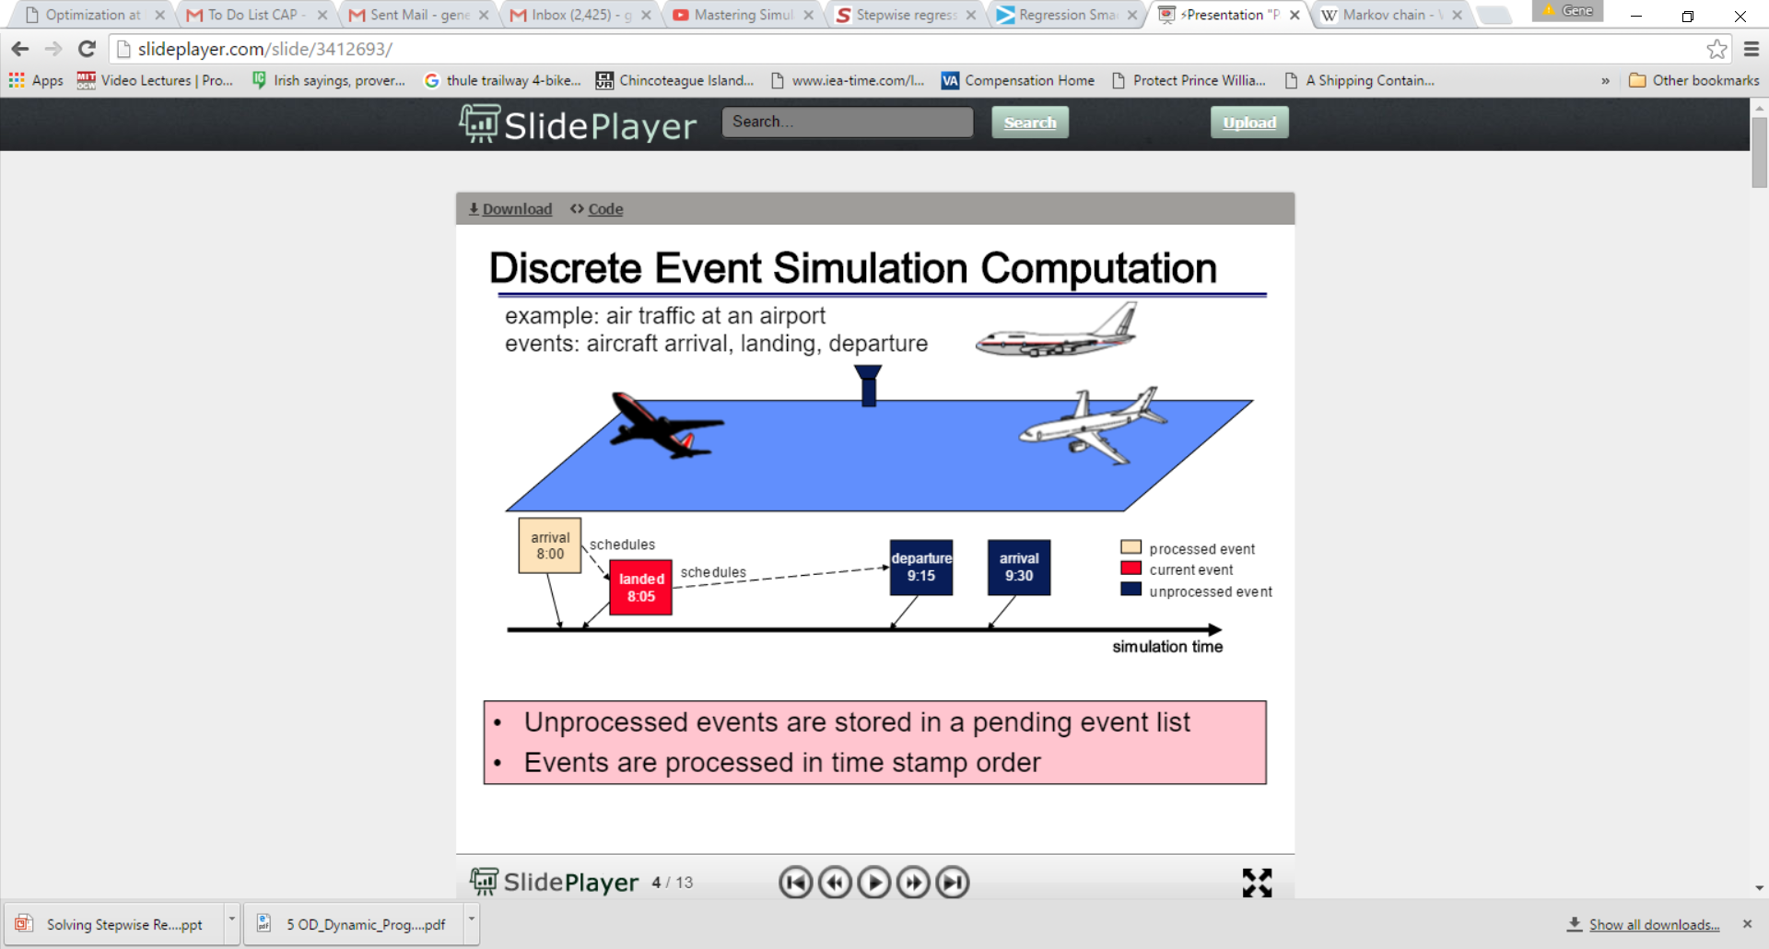
Discrete Event Simulation – Queuing Model Example
Definition – the process of codifying the behavior of a complex system as an ordered sequence of well-defined events. In this context, an event comprises a specific change in the system's state at a specific point in time.
Details – Whilst queueing theory can be used to analyse simple queueing systems more complex queueing systems are typically analysed using discrete-event simulation. A discrete-event simulation (DES) models the operation of a system as a discrete sequence of events in time. Between consecutive events, no change in the system is assumed to occur; thus the simulation can directly jump in time from one event to the next.
This contrasts with continuous simulation in which the simulation continuously tracks the system dynamics over time. Instead of being event-based, this is called an activity-based simulation; time is broken up into small time slices and the system state is updated according to the set of activities happening in the time slice.[2] Because discrete-event simulations do not have to simulate every time slice, they can typically run much faster.
How Used – Components: state, clock, event, and event list/future event list, randomizer*
Example – A common exercise is to model a queue, such as customers arriving at a bank to be served by a teller. In this example, the system entities are Customer-queue′ and Tellers. The system events are Customer-Arrival and Customer-Departure. (The event of Teller-Begins-Service can be part of the logic of the arrival and departure events.)
The system states, which are changed by these events, are Number-of-Customers-in-the-Queue (an integer from 0 to n) and Teller-Status (busy or idle). The random variables that need to be characterized to model this system stochastically are Customer-Interarrival-Time and Teller-Service-Time.
In the bank example, it is of interest to track the mean waiting times. In a simulation model, performance metrics are not analytically derived from probability distributions, but rather as averages over replications, that is different runs of the model.
Links – https://en.wikipedia.org/wiki/Discrete_event_simulation, http://people.brunel.ac.uk/~mastjjb/jeb/or/sim.html

Slide 7
Agent-Based Modeling
Definition – An agent-based model (ABM) is one of a class of computational models for simulating the actions and interactions of autonomous agents (both individual or collective entities such as organizations or groups) with a view to assessing their effects on the system as a whole.
Details – Most ABMs are composed of: (1) numerous agents specified at various scales (typically referred to as agent-granularity); (2) decision-making heuristics; (3) learning rules or adaptive processes; (4) an interaction topology; and (5) a non-agent environment.
How Used –. ABMs can explain the emergence of higher-order patterns—network structures of terrorist organizations and the Internet, power-law distributions in the sizes of traffic jams, wars, and stock-market crashes, and social segregation that persists.
Example – The Game of Life, also known simply as Life, is a cellular automaton devised by the British mathematician John Horton Conway in 1970. The "game" is a zero-player game, meaning that its evolution is determined by its initial state, requiring no further input. One interacts with the Game of Life by creating an initial configuration and observing how it evolves.
The universe of the Game of Life is an infinite two-dimensional orthogonal grid of square cells, each of which is in one of two possible states, alive or dead. Every cell interacts with its eight neighbours, which are the cells that are horizontally, vertically, or diagonally adjacent. At each step in time, the following transitions occur:
Any live cell with fewer than two live neighbours dies, as if caused by under-population.
Any live cell with two or three live neighbours lives on to the next generation.
Any live cell with more than three live neighbours dies, as if by over-population.
Any dead cell with exactly three live neighbours becomes a live cell, as if by reproduction.
The initial pattern constitutes the seed of the system. The first generation is created by applying the above rules simultaneously to every cell in the seed—births and deaths occur simultaneously, and the discrete moment at which this happens is sometimes called a tick (in other words, each generation is a pure function of the preceding one). The rules continue to be applied repeatedly to create further generations.
Links – https://en.wikipedia.org/wiki/Agent-based_model
https://en.wikipedia.org/wiki/Conway%27s_Game_of_Life
A single Gosper's Glider Gun creating "gliders"

Slide 8
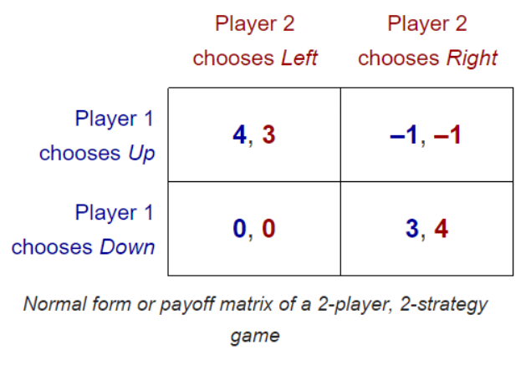
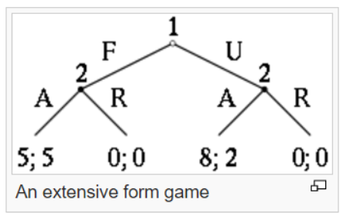
Game Theory
Definition – Game theory is "the study of mathematical models of conflict and cooperation between intelligent rational decision-makers."[1]
Details – Game theory is mainly used in economics, political science, and psychology, as well as logic, computer science, biology and poker.[2] Originally, it addressed zero-sum games, in which one person's gains result in losses for the other participants. Today, game theory applies to a wide range of behavioral relations, and is now an umbrella term for the science of logical decision making in humans, animals, and computers.
Basic features – A game must specify the following elements: the players of the game, the information and actions available to each player at each decision point, and the payoffs for each outcome. A game theorist typically uses these elements, along with a solution concept of their choosing, to deduce a set of equilibrium strategies
How Used – Typically used in economics. There are normal form games and extensive form games.
Example – The normal (or strategic form) game is usually represented by a matrix which shows the players, strategies, and payoffs (see the example to the right). More generally it can be represented by any function that associates a payoff for each player with every possible combination of actions. In the accompanying example there are two players; one chooses the row and the other chooses the column. Each player has two strategies, which are specified by the number of rows and the number of columns. The payoffs are provided in the interior. The first number is the payoff received by the row player (Player 1 in our example); the second is the payoff for the column player (Player 2 in our example). Suppose that Player 1 plays Up and that Player 2 plays Left. Then Player 1 gets a payoff of 4, and Player 2 gets 3.
When a game is presented in normal form, it is presumed that each player acts simultaneously or, at least, without knowing the actions of the other. If players have some information about the choices of other players, the game is usually presented in extensive form. The extensive form can be used to formalize games with a time sequencing of moves.
Links – https://en.wikipedia.org/wiki/Game_theory

Slide 9
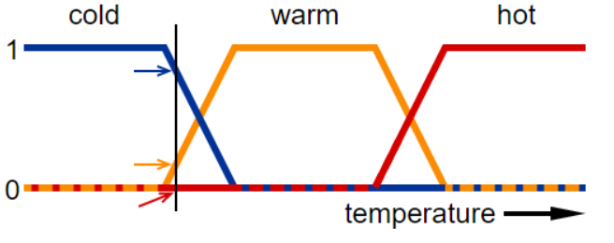
Fuzzy Logic
Definition – Fuzzy logic is an approach to computing based on "degrees of truth" rather than the usual "true or false" (1 or 0) Boolean logic on which the modern computer is based..
Details – Fuzzy logic and probability address different forms of uncertainty. While both fuzzy logic and probability theory can represent degrees of certain kinds of subjective belief, fuzzy set theory uses the concept of fuzzy set membership, i.e., how much a variable is in a set (there is not necessarily any uncertainty about this degree), and probability theory uses the concept of subjective probability, i.e., how probable is it that a variable is in a set (it either entirely is or entirely is not in the set in reality, but there is uncertainty around whether it is or is not)..
How Used – The first notable application was on the high-speed train in Sendai, in which fuzzy logic was able to improve the economy, comfort, and precision of the ride
Example – A basic application might characterize various sub-ranges of a continuous variable. For instance, a temperature measurement for anti-lock brakes might have several separate membership functions defining particular temperature ranges needed to control the brakes properly. Each function maps the same temperature value to a truth value in the 0 to 1 range. These truth values can then be used to determine how the brakes should be controlled..
. In this image, the meanings of the expressions cold, warm, and hot are represented by functions mapping a temperature scale. A point on that scale has three "truth values" — one for each of the three functions. The vertical line in the image represents a particular temperature that the three arrows (truth values) gauge. Since the red arrow points to zero, this temperature may be interpreted as "not hot". The orange arrow (pointing at 0.2) may describe it as "slightly warm" and the blue arrow (pointing at 0.8) "fairly cold".
Links – http://whatis.techtarget.com/definition/fuzzy-logic
https://en.wikipedia.org/wiki/Fuzzy_logic

