Slide 1
programming guide
of easy financial chart
http://finance.easychart.net

Slide 2
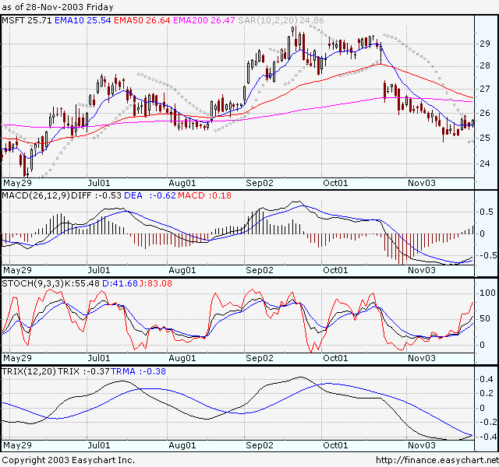
Easy financial chart class structures
CustomDraw
FormulaArea
FormulaData
FormulaChart
FormulaPackage
created by formular script
FormulaArea
FormulaArea
FormulaData
FormulaArea
CustomDraw
FormulaAxisX
FormulaAxisY

Slide 3
YahooDataManager:IDataManager
… …
FormulaPackage
FML.NATIVE.EMA(10)
MSFT
BORL
YAHO
CSVDataProvider:IDataProvider
… …
FormulaPackage
FML.NATIVE.EMA(50)
FormulaArea
FML.NATIVE.MAIN
FormulaSkin
Bind
FormulaPackage
FML.NATIVE.EMA(200)
Bind
FormulaPackage
FML.SAR(10,2,20)
FormulaChart
… …
FormulaArea
FML.MACD(26,12,9)
GetBitmap(…)
SaveToStream(…)
FormulaArea
FML.RSI
… …
FML.NATIVE.MAIN,FML.MACD(26,12,9),FML.SAR(10,2,20) … … are from
formula script system , can be compiled by our compiler.

Slide 4
//Sample code
FormulaChart fc = new FormulaChart();
//Create YahooDataManager , Get stock data from yahoo.
YahooDataManager ydm = new YahooDataManager();
CSVDataProvider cdp = (CSVDataProvider)ydm[“MSFT”];
//Add stock lines to main stock view
fc[0].AddFormula("FML.NATIVE.EMA(10)");
fc[0].AddFormula("FML.NATIVE.EMA(50)");
fc[0].AddFormula("FML.NATIVE.EMA(200)");
fc[0].AddFormula("FML.SAR(10,2,20)");
//Add indicators to stock chart
fc.AddArea("FML.MACD(26,12,9)");
fc.AddArea("FML.RSI");
//Apply build-in stock chart skin
fc.SetSkin(FormulaSkin.CyanGreen);
//Bind stock data
fc.DataProvider = cdp;
//Output the chart to webbrowser
fc.SaveToStream(Response.OutputStream,
640,480);

Slide 5
Formula script sample:
Below code is copy from basic_fml.xml
MACD:
DIFF : EMA(CLOSE,SHORT) - EMA(CLOSE,LONG);
DEA : EMA(DIFF,M);
MACD : 2*(DIFF-DEA), COLORSTICK
This formula will create three line DIFF,DEA and MACD.
Formula compiler can edit “native-en.xml” and compile the script to
Basic_fml.cs and basic_fml.dll, basic_fml.cs can be compiled to
Your main program, basic_fml.dll can be load on runtime.
For more information about the formula script language,
please see “formula-guide.htm”

