Slide 1

Masters Project Defense(Non-thesis) Heart Failure Prediction
Advisor Sreekar Alakanti
Dr.Yanqing Zhang MS in computer Science
Committee member
Dr. Ying Zhu

Slide 2
Problem Statement
Employ machine learning algorithms for heart failure prediction.
Enhance early intervention and personalized preventive measures.

Slide 3
Introduction
It is difficult to identify heart disease because of several contributory risk factors such as diabetes, High blood pressure, high cholesterol ,abnormal pulse rate and many other factors.
Among various life threatening disease , heart disease has garned a great deal of attention in medical research.
The diagnosis of heart disease is a challenging task which can offer automated prediction about heart condition of patient so that further treatment can be made effective.
The diagnosis of heart disease is usually based on signs, symptoms of the patient.

Slide 4
Abstract
The first stage in developing an accurate cardiac disease prediction system is to collect and preprocess data. This includes gathering patient information such as age, gender, medical history, lifestyle factors, and test results such as electrocardiograms (ECGs) etc. The data must be cleaned, standardized, and transformed before it can be used by machine learning algorithms.
After preprocessing, the data is divided into training and testing sets. The training set is used to train machine learning algorithms to find patterns and relationships in data, such as decision trees, random forests, logistic regressions etc. The testing set is used to assess the model's accuracy.

Slide 5
Motivation
A major challenge facing healthcare organizations is the provision of quality services like diagnosing patients correctly and administering treatments at an affordable cost.
Poor clinical decisions led to disastrous consequences.
Solution
Build an appropriate computer-based information and decision support system.

Slide 6
Objective
Develop a heart failure prediction system that can discover and extract hidden knowledge associated with heart disease.
This system aims to exploit machine learning techniques on medical data set to assist in prediction of heart disease.

Slide 7
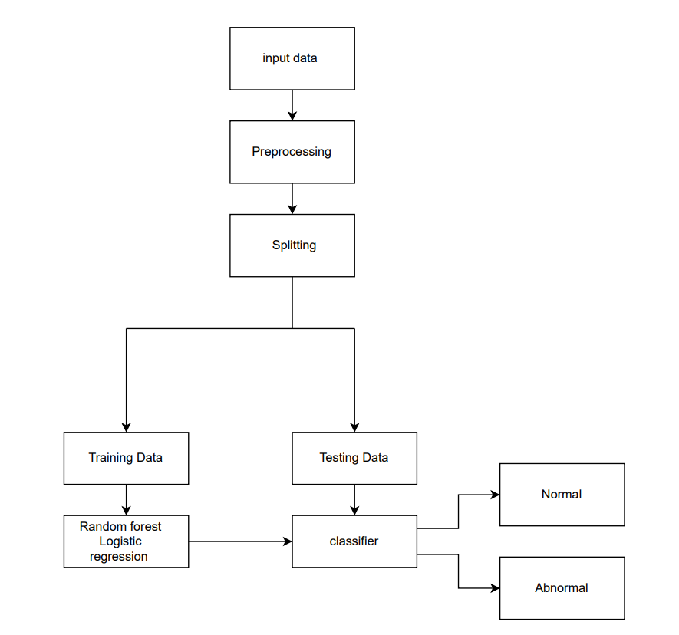
Proposed architecture

Slide 8
Dataset overview
Source : Kaggle.com
Number attributes :11
The Dataset was formed by combining 5 heart datasets which have 11 common features.
Datasets used:
Cleveland: 303 observations
Hungarian: 294 observations
Switzerland: 123 observations
Long Beach VA: 200 observations
Stalog (Heart) Data Set: 270 observations
Total: 1190 observations
Duplicated: 272 observations
Final dataset: 918 observations

Slide 9
Dataset Attributes
Input Attributes: Target Attribute:
Age (Int) Heart Disease(Boolean)
Sex (Boolean)
chestPainType(category)
Resting BP (Int)
Cholesterol (Int)
FastingBS(Boolean)
Resting ECG(category)
MaxHR (Int)
ExcerciseAngina(Boolean)
Oldspeak(float)
ST_Slope(Boolean)

Slide 10
Dataset Attributes
The data set has 11 attributes which we used to find the Prediction.
Age: age of the patient [years]
Sex: sex of the patient [M: Male, F: Female]
Chest Pain Type: chest pain type [TA: Typical Angina, ATA: Atypical Angina, NAP: Non-Anginal Pain, ASY: Asymptomatic]
Resting BP: resting blood pressure [mm Hg]
Cholesterol: serum cholesterol [mm/dl]
Fasting BS: fasting blood sugar [1: if Fasting BS > 120 mg/dl, 0: otherwise]
Resting ECG: resting electrocardiogram results [Normal: Normal, ST: having ST-T wave abnormality (T wave inversions and/or ST elevation or depression of > 0.05 mV), LVH: showing probable or definite left ventricular hypertrophy by Estes' criteria]
Max HR: maximum heart rate achieved [Numeric value between 60 and 202]
Exercise Angina: exercise-induced angina [Y: Yes, N: No]
Old peak : old peak = ST [Numeric value measured in depression]
ST_ Slope: the slope of the peak exercise ST segment [Up: upsloping, Flat: flat, Down: downsloping]
Heart Disease: output class [1: heart disease, 0: Normal]

Slide 11
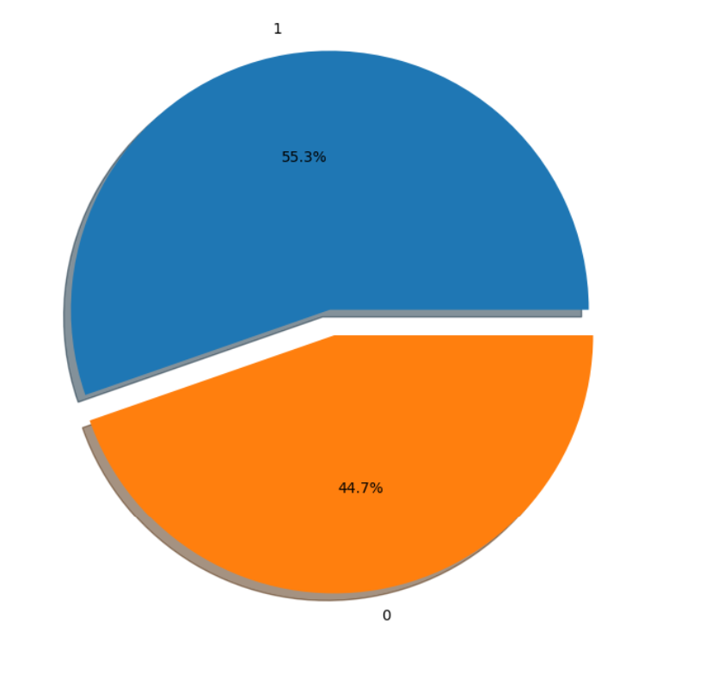
Dataset Preprocessing
The pie chart shows that both
the classes (Diseased) and
(Non-Diseased) are almost
equally distributed.
No imbalances exist in
the data and the data cleaning
is successful.

Slide 12
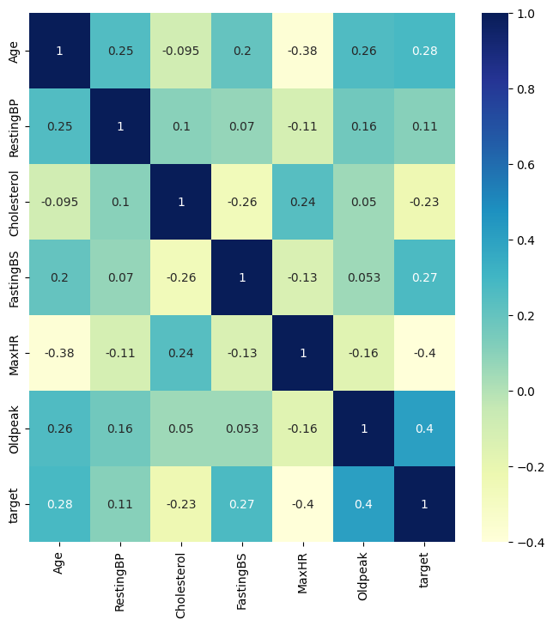
Correlation Matrix

Slide 13
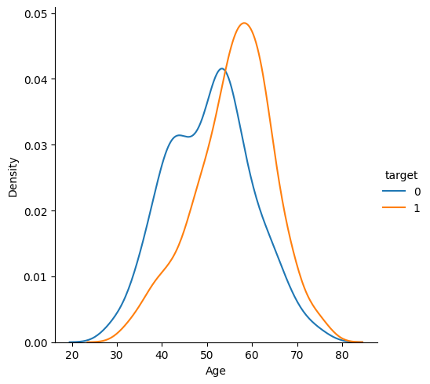
Density vs Age Distribution Graph
The following is the distribution for density vs age of people with respect to the target variable (Heart Disease).

Slide 14
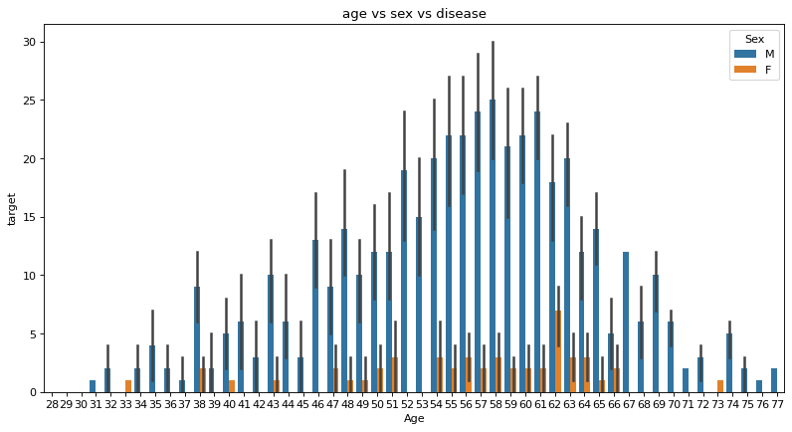
Age vs Sex vs Disease Prediction Ratio

Slide 15
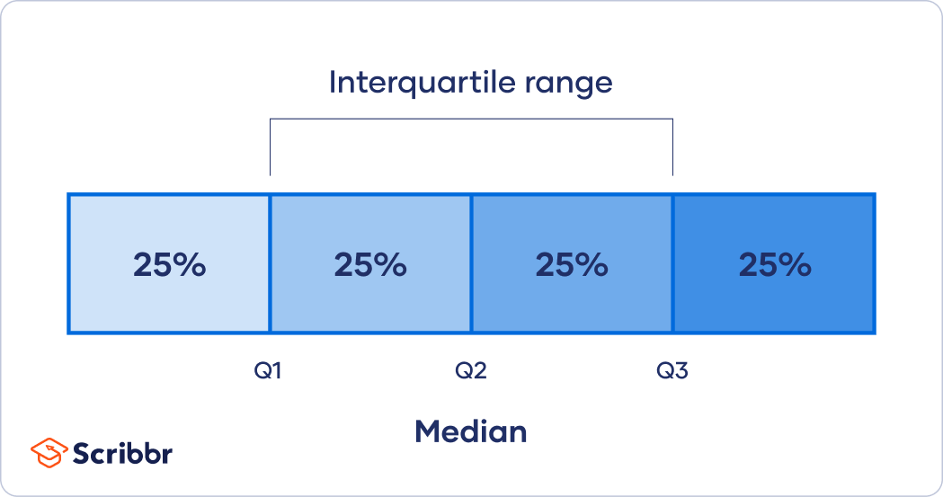
Outliers removal:
We used use IQR technique to find any outliers
IQR is known as Inter quartile Range
Q1 = df.quantile(0.25)
Q3 = df.quantile(0.75)
IQR = Q3 - Q1

Slide 16
Splitting
Here for the whole dataset, we have split dataset into testing and training the dataset.
For Training the dataset we have take 70%.
For Testing we are using 30% of the dataset.

Slide 17
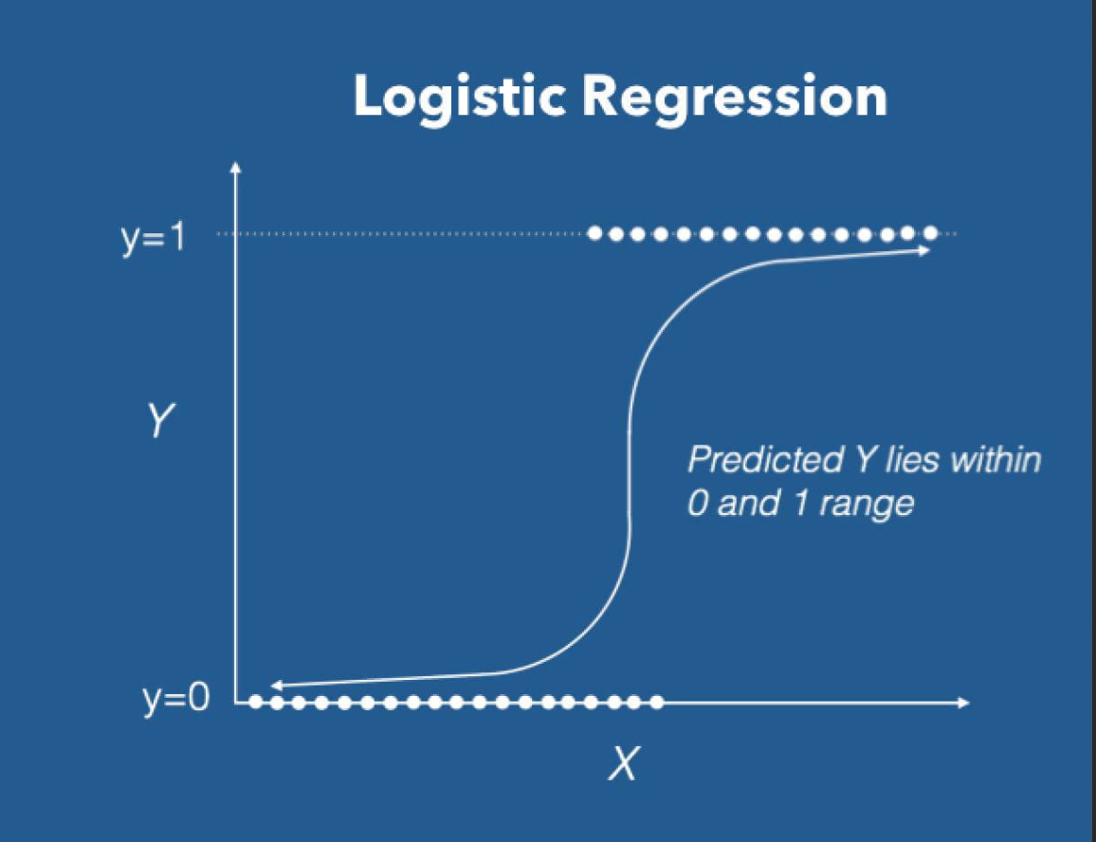
Logistic Regression
Logistic regression is a supervised machine learning algorithm mainly used for classification tasks where the goal is to predict the probability that an instance of belonging to a given class.

Slide 18
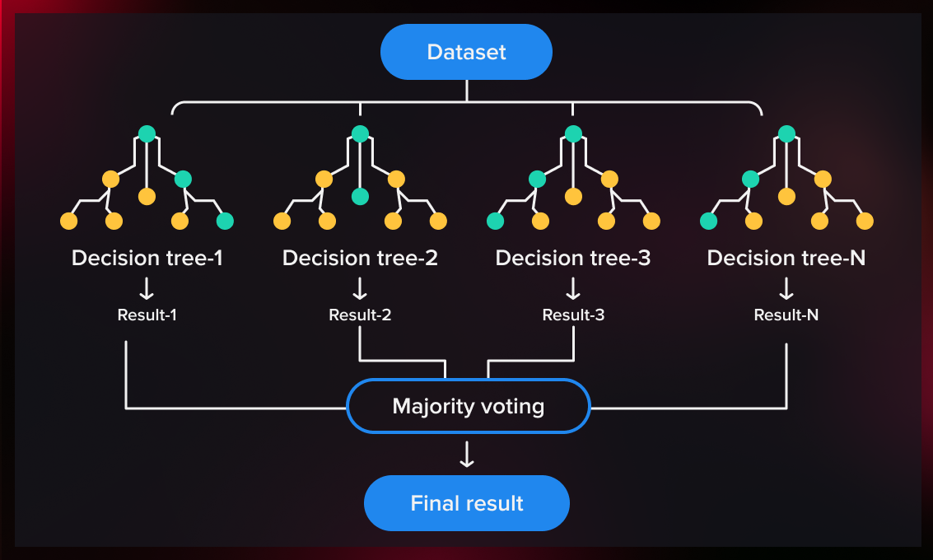
Random Forest
Random Forest is a powerful ensemble learning method used in machine learning for both classification and regression tasks. It operates by constructing a multitude of decision trees during training and outputs the mode of the classes (classification) or mean prediction (regression) of the individual trees.

Slide 19
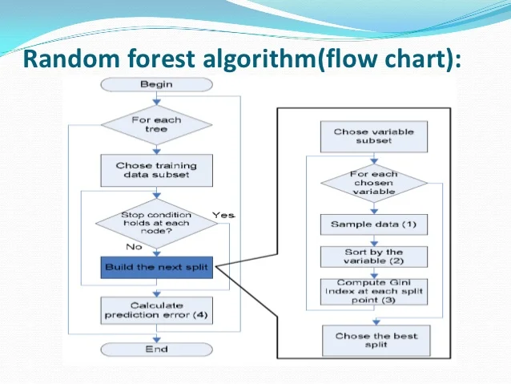

Slide 20



Evaluation
Metrics
Here we are using 3 Metrics for evaluating our models
Accuracy is how close a given set of measurements (observations or readings) are to their true value.
Sensitivity (true negative rate) is the probability of a negative test result, conditioned on the individual truly being negative.
Specificity (true positive rate) is the probability of a positive test result, conditioned on the individual truly being positive.

Slide 21
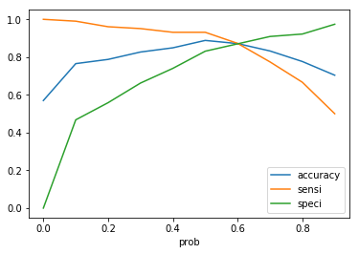
Results
Results by using logistic regression Model
For Train Dataset
Accuracy 85.30%
Sensitivity 85.52%
Specificity 85.11%
For Test Dataset
Accuracy 86.25%
Sensitivity 83.33%
Specificity 89.32%
AUC on Test data 93.96%

Slide 22
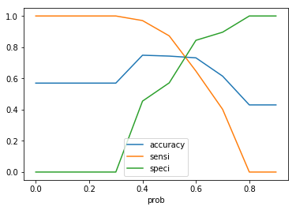
Results
Results by using Random forest Model
For Train Dataset
Accuracy 80.61%
Sensitivity 87.71%
Specificity 74.42%
For Test Dataset
Accuracy 86.72%
Sensitivity 88.88%
Specificity 84.46%
AUC on Test data 93.78%

Slide 23
Conclusion:

Slide 24


Slide 25


