Slide 1
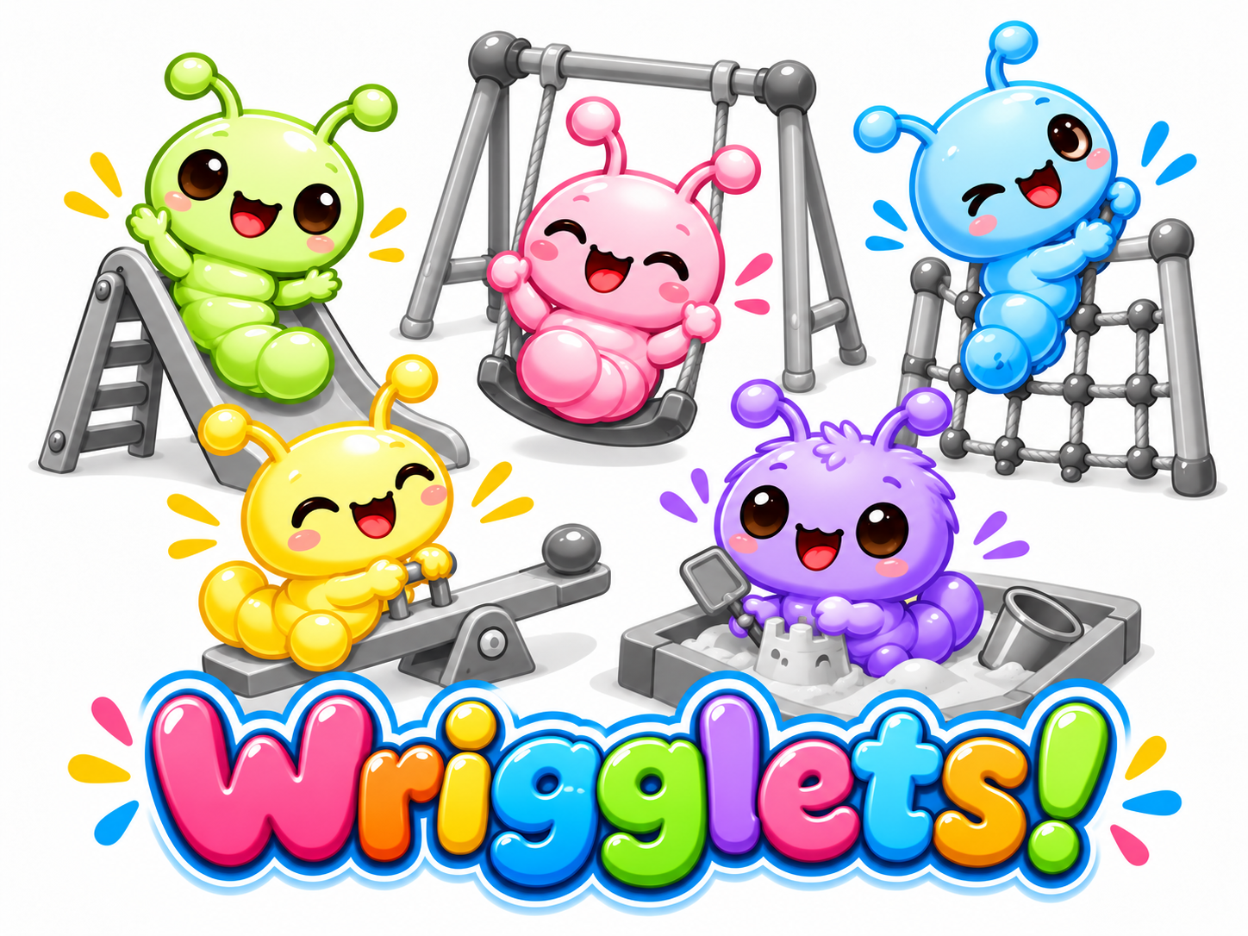



While they play...
Workflow Level Audit Log
Workflow Control & Persistance
Context-aware
Multi-turn prompt injection analysis
Control Plane
For Agentic Activities
MCP Gateway
Budget Control & Limits
MCP Servers
...some other guys must watch & protect.
LLM Guardrails
AI Models

