Slide 1
Servlets
Jason bullock
cit360

Slide 2
What are servlets?
Servlet is an API that provides many interfaces and classes including documentations.
Servlet is an interface that must be implemented for creating any servlet.
public class SendEmail extends HttpServlet{}
public class SendSMS extends Servlet{}
Servlet is a class that extend the capabilities of the servers and respond to the incoming request. It can respond to any type of requests.
Servlet is a web component that is deployed on the server to create dynamic web page.

Slide 3
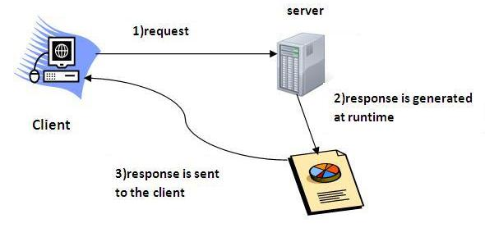
Servlets in java are client server

Slide 4
Servlets in java coding
Servlets replace older technologies like CGI and other server-side methods
CGI executes on the server and was dependent on server resources. Millions of hits meant millions of threads on the server.
Servlets are complied Java code that are stored on a web server
They are executed at runtime. Processing is done by the client

