Slide 1
MVC Pattern
Jason Bullock

Slide 2
Should be View-Control-Model (VCM) for flow
View requests data from the model via the Controller
Controller queries Model. Model returns data to the Controller
Controller passes data back to View
Repeat

Slide 3
VIEW Class
View represents the visualization of the data that model contains.
public class View {
public void printDetails(String Name, String RollNo){
System.out.println(": ");
System.out.println("Name: " + Name);
System.out.println("Roll No: " + RollNo);
}
}

Slide 4
Model Class
Model represents an object or JAVA POJO carrying data. It can also have logic to update controller if its data changes.
Public class Model {
private String rollNo;
private String name;
.... Getters and Setters(){
}
}

Slide 5
Controller Class
Controller acts on both model and view. It controls the data flow into model object and updates the view whenever data changes. It keeps view and model separate.
Public class Control {
private Model model;
private View view;
public Control(Model model, View view){
this.model = model;
this.view = view;
getters/setters() {
public void updateView(){
view.printDetails(model.getName(), model.getRollNo());
}
}

Slide 6
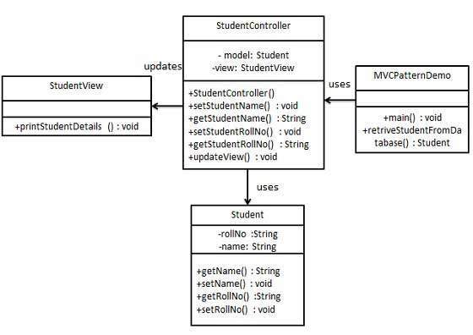
What it looks like in UML

