Slide 1
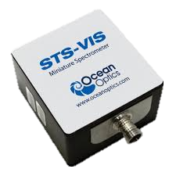
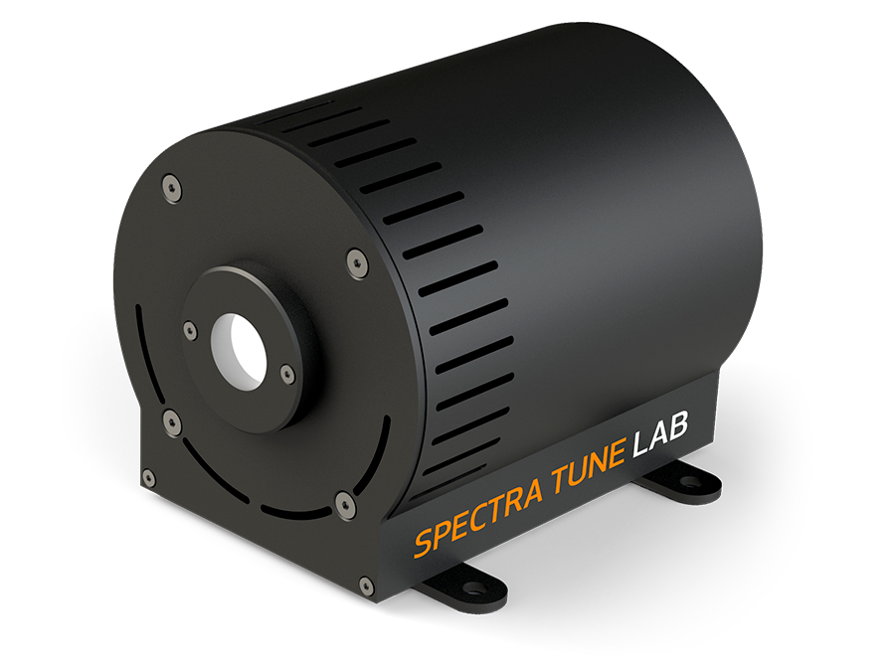
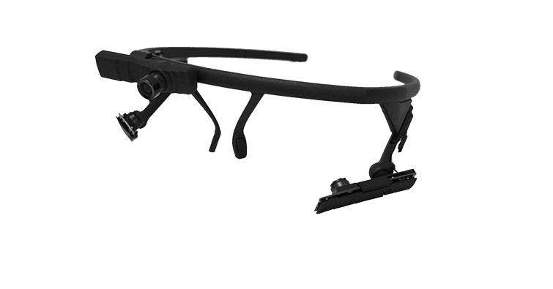



PyPlr
Spectrometer
Light source
Eye Tracker
OceanOptics STS-VIS
Spectra Tune Lab
Pupil Core
Hardware
oceanops.py
Module to help with obtaining OceanOptics spectrometer measurements for calibration
stlab.py
Object oriented device interface
Functions to assist with creating video files
pupil.py
Object oriented device interface
LightStamper(…)
PupilGrabber(…)
Software
pipeline.py
Tools to streamline analysis of pupil data
Blink interpolation, smoothing, trial extraction, etc.
plr.py
Pupillometer style parametrization of PLRs and PIPRs
Plotting functions
Pupil Labs software
Pupil Capture
Pupil Player
Network API

Slide 2
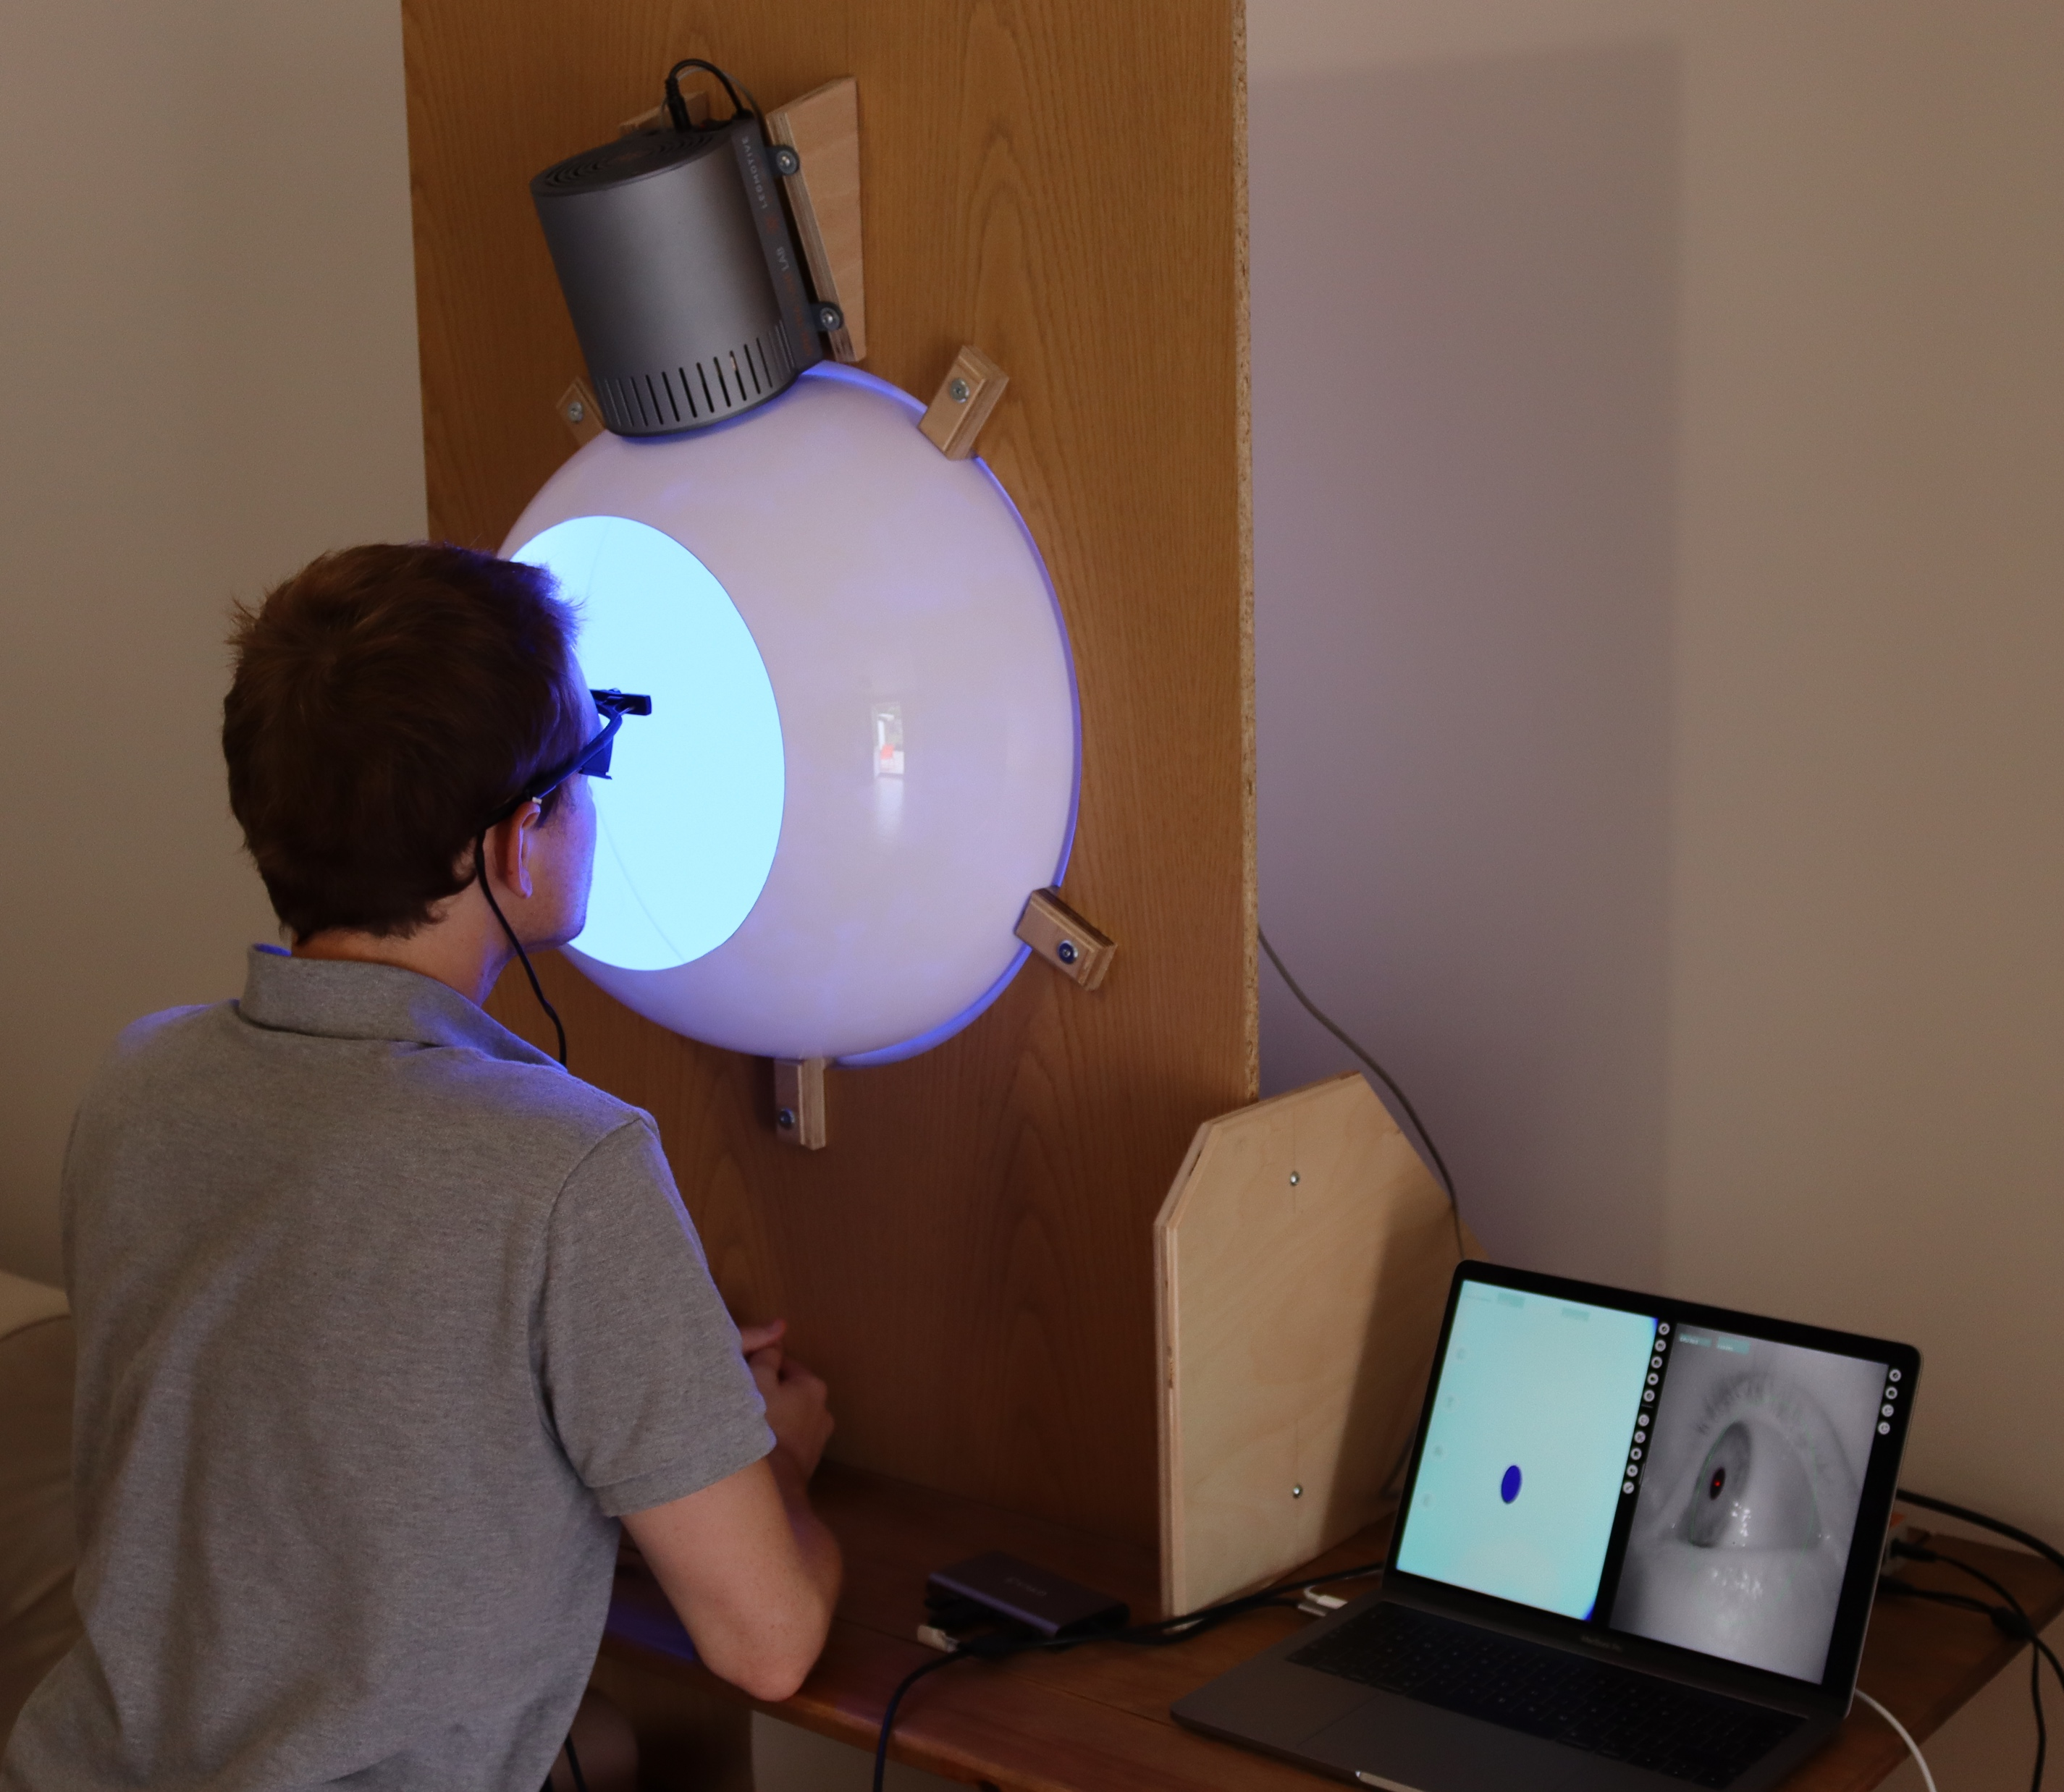
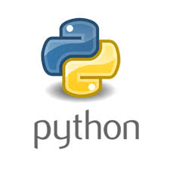


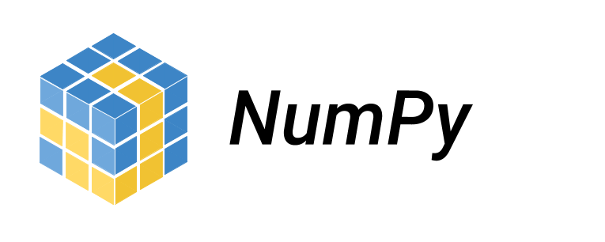
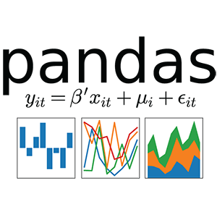

PyPlr
Spectrometer
Light source
Eye Tracker
Hardware
oceanops.py
stlab.py
pupil.py
pipeline.py
graphing.py
plr.py
Software

