Slide 1

Weather prediction using machine learning
DONE BY:
B.GOUTHAM-(160122737171)
B.SRIKAR-(160122737172)
A.KUNAL-(160122737170)

Slide 2
Abstract
Revolutionizing Weather Forecasting: Machine Learning Approaches for Enhanced Prediction” This abstract highlights the innovative use of machine learning in weather prediction, promising advancements in accuracy and reliability. It suggests a departure from traditional methods towards more sophisticated techniques, aiming to improve forecasting capabilities.
Traditional forecasting methods often face challenges in accurately predicting complex atmospheric phenomena. Leveraging advancements in machine learning, this study aims to improve the accuracy and reliability of weather predictions.
By analysing vast datasets of historical weather data and employing sophisticated machine learning algorithms, this research endeavours' to extract meaningful patterns and relationships to forecast future weather conditions with greater precision.

Slide 3
Introduction
Weather forecasting is the process of predicting the state of the atmosphere and its effects on Earth’s surface for a future time and specific location. The goal of weather forecasting is to provide accurate and timely information about upcoming weather conditions, which can help people prepare for potential hazards such as severe storms, floods, or heat wave Machine learning (ML) is increasingly being used in weather forecasting to improve the accuracy of weather predictions.
Practical Applications: By harnessing the potential of machine learning, weather prediction models can provide valuable insights into future weather conditions, enabling better planning and risk management strategies across various sectors.
With access to vast repositories of historical weather data, machine learning algorithms can discern complex patterns and relationships to generate more precise forecasts.

Slide 4
Literature survey
The reconciliation of HTML, CSS, and JavaScript empowers the production of an outwardly engaging and intelligent connection point, upgrading ease of use and client commitment. Through cautious plan and execution, the application looks to meet the different necessities of clients looking for climate data for individual, sporting, or proficient purposes. This paper presents an outline of the application’s engineering, featuring key plan contemplations and specialized highlights. Furthermore, it talks about the usage of outside APIs, like the Open Weather Map Programming interface, to recover climate information and shows how JavaScript works with dynamic substance updates and client connections. By and large, this paper means to exhibit the capability of online advances in conveying important administrations to clients and cultivating development in the domain of climate applications. It highlights the significance of client driven plan and strong specialized execution in making viable and effective web applications. Through proceeded with investigation and refinement, online climate applications can proceed to advance and adjust to meet the always changing necessities of clients in an undeniably computerized world.

Slide 5

Problem statement
Weather prediction using machine learning involves developing models that can accurately forecast various weather parameters such as temperature, humidity, precipitation, wind speed, and direction. This typically includes collecting historical weather data, preprocessing it, selecting relevant features, choosing appropriate algorithms, training the model, and evaluating its performance. The goal is to build models that can provide accurate and reliable weather forecasts for specific locations and time intervals, aiding in decision-making processes for various industries and applications.

Slide 6
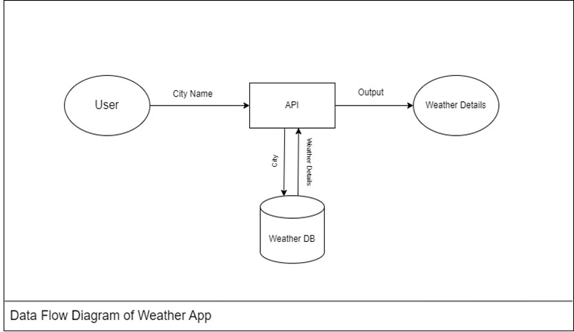
Methodology

Slide 7
PROPOSED SYSTEM
In our model type of weather prediction, the user gives any input(City, state, country, etc .)
That particular city or country name information is fetched from the weather database with the help of API KEY.
The information fetched by API key shows the weather details of place mentioned.
With the help of the weather details the output is given out to the user .
The output gives the user the data of the weather with an image of the place he wants and it also gives the user the data for the next one week
It also shows the humidity and wind speed for the user and it also predicts if any natural disaster is going show or if its safe to go out.

Slide 8
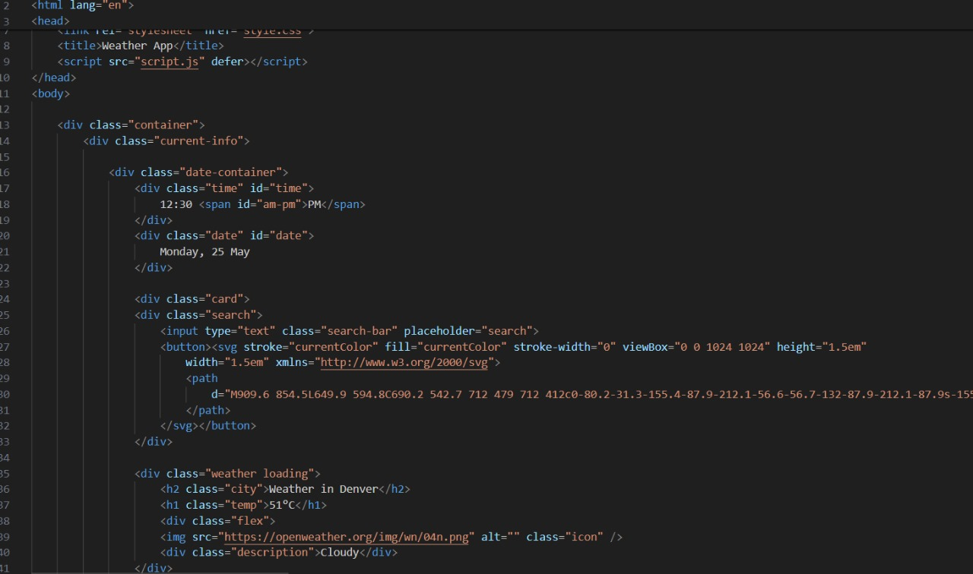
HTML COde

Slide 9
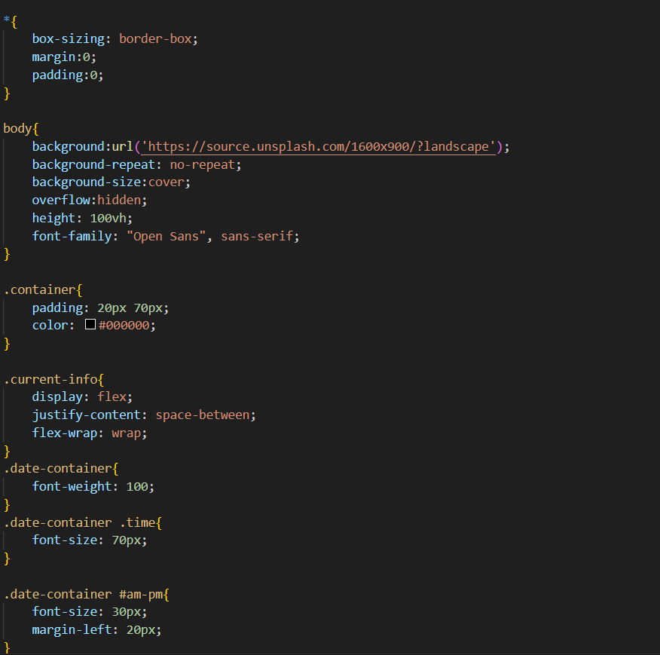
CSS CODE

Slide 10
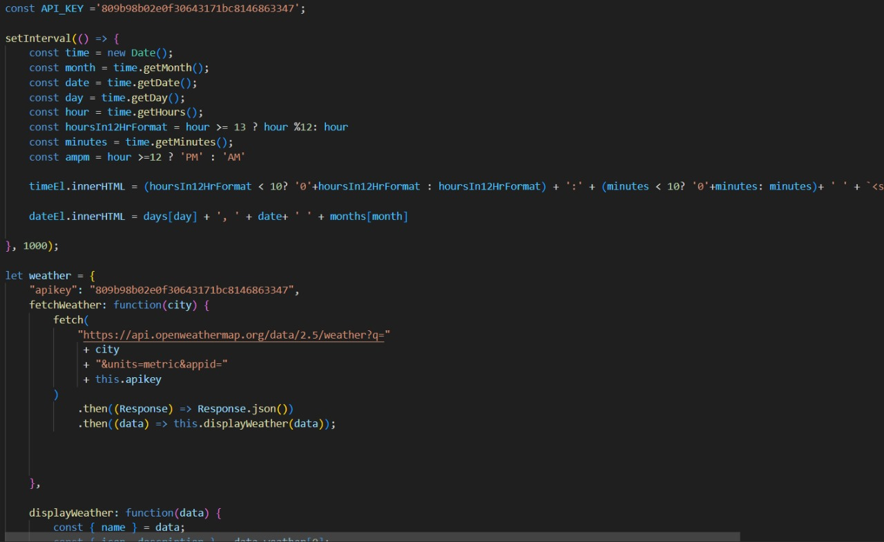
USING API KEY AND JS CODE

Slide 11
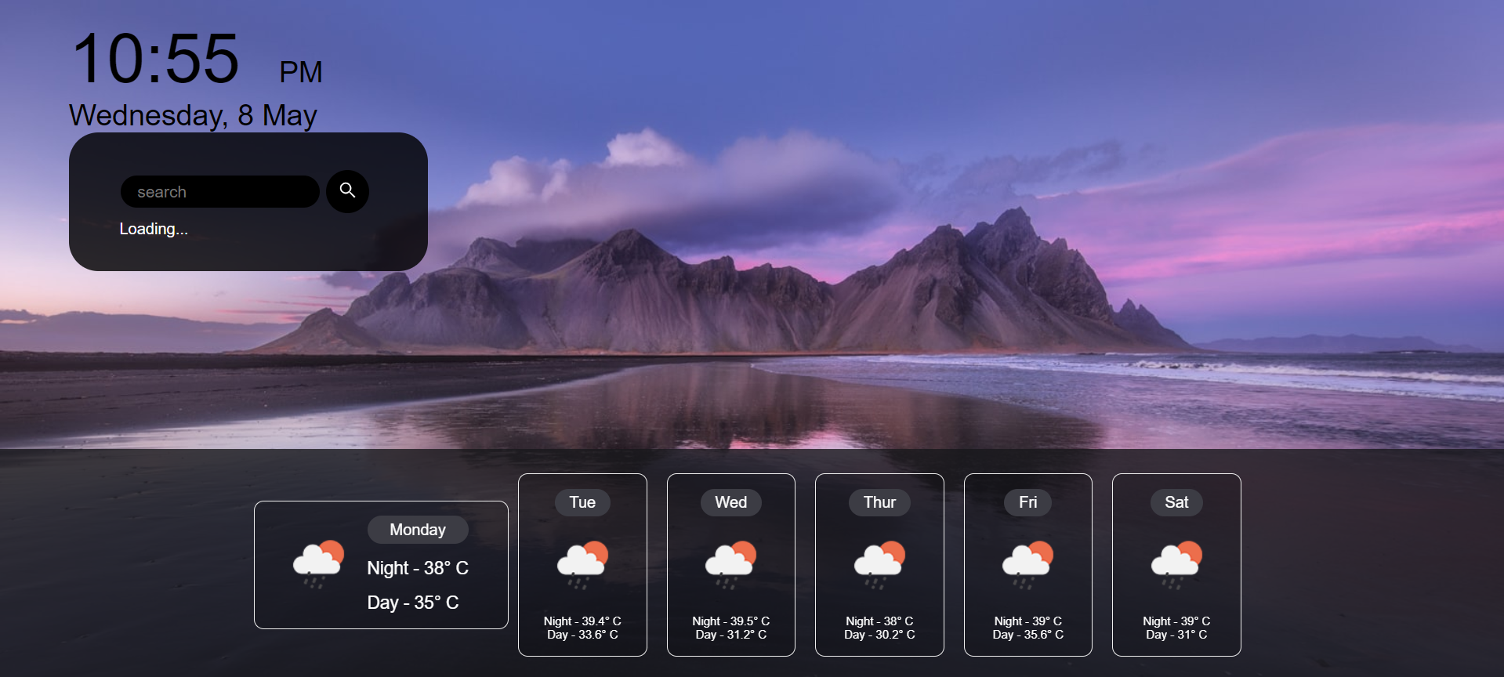
RESULTS

Slide 12
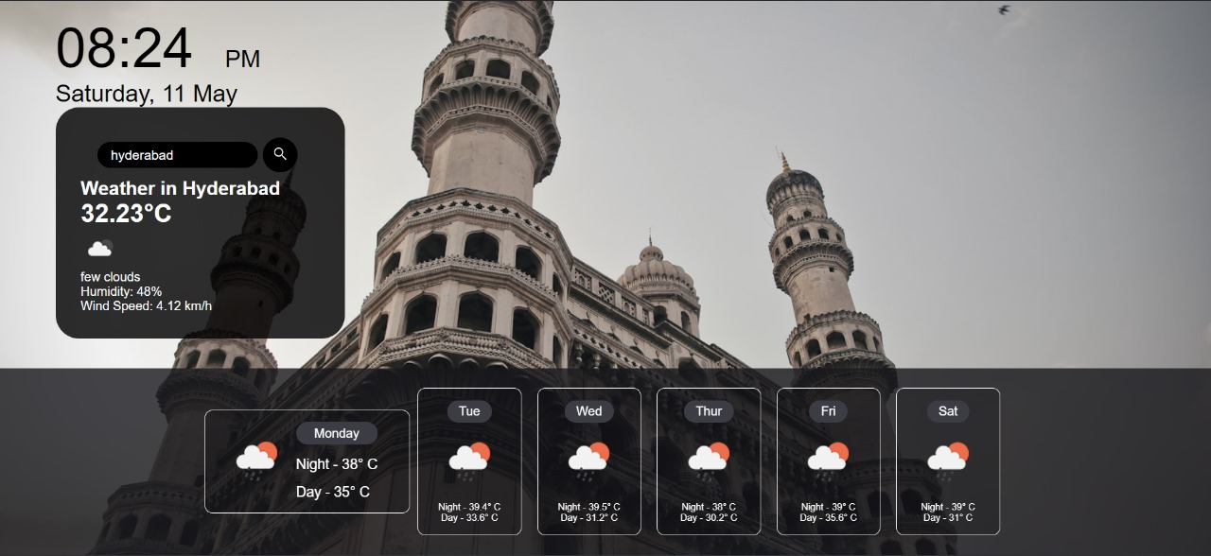
Results

Slide 13
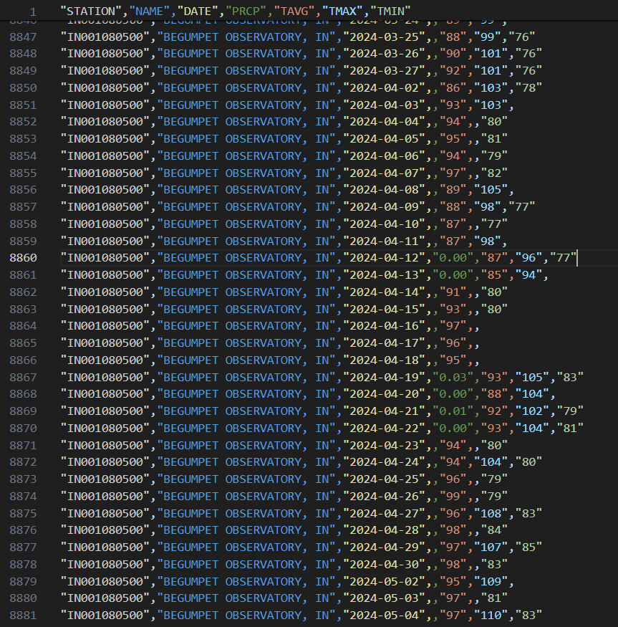

Slide 14
Conclusion
In conclusion, machine learning offers promising avenues for weather prediction, leveraging vast datasets and advanced algorithms to enhance accuracy and provide timely forecasts. However, continued research and development are crucial to address challenges such as data quality, model interpretability, and adapting to evolving climate patterns, ensuring reliable predictions for various applications and stakeholders.
By analysing historical weather data, the project aims to develop predictive models that can anticipate future weather conditions with greater precision.
Ultimately, the project contributes to advancing our understanding of weather prediction methodologies and serves as a foundation for future research and innovation in this critical field.

Slide 15
References
Department of Environmental and Construction Engineering, University of Central Florida, Orlando, FL. Department of Computer Science, University of USA(1) Massachusetts Boston, Boston, Climateof Iowa, [online] Available: http://www.crh.noaa.gov/Image/dvn/downloads/Clim_IA_01.pdf. Google Scholar NOAA H. L. Cloke and F. Pappenberger, “Ensemble flood forecasting: a review”, Journal of Hydrology, vol. 375, no. 3, pp. 613-626, 2009 J. Thielen, K. Bogner, F. Pappenberger, M. Kalas, M. Del Medico and A. De Roo, “Monthly – medium – and short – range flood warning: testing the limits of predictability”, Meteorological Applications, vol. 16, no. 1, pp. 77-90, 2009.

Slide 16



