Slide 1
Autonomous Factor
Research
A controlled search process and a one-shot 2016 holdout
Anthelion Capital take-home / September 2026

Slide 2
Research objective
Automated search can discover a factor that looks good by chance.
01
02
03
Constrain proposals
Hold evaluation fixed
Protect the final test
The generator submits a typed
factor expression.
Every candidate faces the
same walk-forward protocol.
Freeze the library before
opening 2016 once.
The deliverable is an auditable sequence of decisions and a final out-of-sample observation.
02

Slide 3
Research loop
1
2
3
4
5
6
Macro
Micro
Validate
Build
Evaluate
Cross
Choose action
and budget
Propose factor
AST
Check DSL
and leakage
Execute fixed
operators
Score folds,
costs, gates
Record lessons
and route
Macro actions: IMPROVE / COMBINE / PIVOT / STOP
Brains propose and remember. Deterministic code constructs signals and applies the gates.
03

Slide 4
Brain responsibilities and decision inputs
One research cycle, after each candidate receives the same deterministic evaluation
BRAIN
READS
JUDGMENT AND OUTPUT
MACRO
Coverage, failed gates, Parent clusters,
Elite archive and remaining budget
Selects IMPROVE / COMBINE / PIVOT / STOP;
sets mechanism, parents, repair target
and proposal budget.
MICRO
Macro plan, eligible Parent specs,
experiment history and tested formulas
Proposes bounded FactorSpec ASTs; records
hypothesis, lineage, expected metric effect
and falsification condition.
CROSS
Metrics, gate and integrity failures,
new Parent / Elite, cluster admissions
Updates GOOD / BAD lessons, mechanism
stats and stagnation in ResearchMemory
for the next Macro decision.
After coverage, Macro and Micro may use LLMs. Cross and all scoring gates remain deterministic.
04

Slide 5
Factor AST: structure, checks and deduplication
EXAMPLE: RESEARCH ELITE
sub(cs_rank(after_tax_roe), cs_rank(news_volume[60]))
TYPED TREE
CHECKS BEFORE SCORING
Op: sub
1 Grammar and inputs
Allowed features/operators, arity and parameters.
Groups: sector or subindustry.
cs_rank(after_tax_roe)
cs_rank(news_volume[60])
2 Complexity limits
Cost <= 4; depth <= 5; operators <= 6.
Separate rolling, binary and group caps.
Features encode input and window; nodes expose
history 60, complexity 3 and depth 2.
Canonicalizer sorts commutative children
and params; text dedupes, hash identifies.
3 Causality and deduplication
Static: reject future_return, negative shifts.
Dynamic: truncation / future-noise tests.
Canonical text rejects exact repeats.
A valid AST constrains search; it cannot prove tradability or out-of-sample alpha.
05

Slide 6
Point-in-time data and integrity
Expanding research folds; a physically separate final year
2010–12
2013
2014
2015
2016
Initial history
Validation
Validation
Validation
Final holdout
Fundamentals
News
Leakage tests
90-day availability lag
from fiscal period end
One-day lag after
publication date
Static rules, truncation,
future-noise checks
A signal formed at time t must not change when observations after t are altered.
06

Slide 7
Evaluation and survival gates
COMMON EVIDENCE
ELITE RESEARCH GATES
1 / 5 / 10-day cross-sectional RankIC
Mean RankIC
≥ 0.005
Newey–West t-statistic for 5-day IC
NW t-statistic
≥ 1.0
Sign consistency across 2013–2015
Positive validation folds
3 / 3
Top / bottom 20% long-short portfolio
Sharpe after 25 bp cost
≥ 0
10 and 25 bp costs, turnover, drawdown
Daily turnover
≤ 1.5
Parent = exploratory evidence. Elite = eligible for final-library selection.
07

Slide 8
Six-arm experiment design
Same 2010–2015 panel, folds, gates, seed and 60-candidate cap
SEARCH POLICY
MACRO
MICRO
EVALUATED
Fixed deterministic
Rule
Rule
33
Adaptive deterministic
Rule
Rule
60
Luna / Luna
Luna High
Luna High
60
Sol / Luna
Sol High
Luna High
60
Luna / Sol
Luna High
Sol High
60
Sol / Sol
Sol High
Sol High
60
Adaptive arms began with 16 coverage candidates. Fixed search exhausted new proposals at 33 tests.
08

Slide 9
Adaptive search broadened coverage
UNIQUE PARENT CLUSTERS
VALID EVIDENCE
PER 10 PROPOSALS
Fixed generation
6
Fixed
8.38
Adaptive search
Adaptive
17
9.33
The cap was 60 in both arms, but fixed search ended at 33 candidates. This single run does not isolate architecture from proposal coverage.
09

Slide 10
Model role comparison
Unique Parent clusters across four 60-candidate LLM arms
MACRO / MICRO
EST. API COST
Luna / Luna
14
$0.066
Sol / Luna
15
$0.686
Luna / Sol
20
$0.995
Sol / Sol
21
$1.663
Only Luna Macro / Sol Micro found an Elite (candidate 41). Single runs do not establish causality.
10

Slide 11
Two factor examples
RESEARCH ELITE
RESEARCH PARENT
Slow attention × profitability
One-day price reversal
rank(after_tax_roe)
− rank(news_volume[60])
−rank(return[1])
RankIC 0.0199
NW t 1.079
25 bp Sharpe 0.733
RankIC 0.015
NW t 1.918
25 bp Sharpe −12.474
Passed all research gates
Failed the cost gate
11

Slide 12
Elite factor generation trajectory
Luna High Macro and Sol High Micro, research rounds 13–14
ROUND 13 / PIVOT
ROUND 14 / IMPROVE
Macro left repeated reversal repairs for under-tested news attention. Micro tested six proposals; this one became a Parent.
Macro targeted weak significance. Micro replaced the product with a rank spread and a 60-day news window.
Parent candidate
Elite candidate
underfollowed_profitable_firms
slow_attention_profitability_spread
rank(after_tax_roe) ×
[1 − rank(news_volume[20])]
rank(after_tax_roe) −
rank(news_volume[60])
5-day RankIC
Newey–West t
Positive folds
25 bp Sharpe
0.0185 to 0.0199
0.493 to 1.079
2/3 to 3/3
0.313 to 0.733
Candidate #41 cleared every research Elite gate. The 2016 holdout had not been opened.
12

Slide 13
2016 final holdout
Frozen factor: slow_attention_profitability_spread
METRIC
RESEARCH 2013–15
FINAL 2016
Five-day RankIC
+0.0199
−0.0049
Newey–West t
+1.079
−0.686
25 bp Sharpe
+0.733
−1.637
Daily turnover
0.02335
0.02155
IC was negative at 1, 5 and 10 days. The frozen library was evaluated once; no re-selection followed.
13

Slide 14
Conclusion and next steps
The process rejected weak economics.
The selected factor still failed the final year.
WHAT THIS PROJECT DEMONSTRATES
PRIORITIES FOR A LARGER STUDY
Constrained LLM proposals and deterministic execution
Explicit reasons for rejection and failed repairs
A frozen, one-shot final evaluation
Historical universe and filing timestamps
Better spread, capacity and execution cost data
Repeated role runs and multiple-testing control
Passing research gates was useful evidence. The negative 2016 outcome limits any alpha claim.
14

Slide 15
Appendix: six-arm outcome ledger
All counts are from the completed final experiment. Costs are estimates from recorded API tokens.
ARM
TESTED
CLUSTERS
ELITES
API COST
Fixed deterministic
33
6
0
—
Adaptive deterministic
60
17
0
—
Luna / Luna
60
14
0
$0.066
Sol / Luna
60
15
0
$0.686
Luna / Sol
60
20
1
$0.995
Sol / Sol
60
21
0
$1.663
Fixed search stopped after 33 candidates. One run per arm cannot estimate expected performance.
15

Slide 16
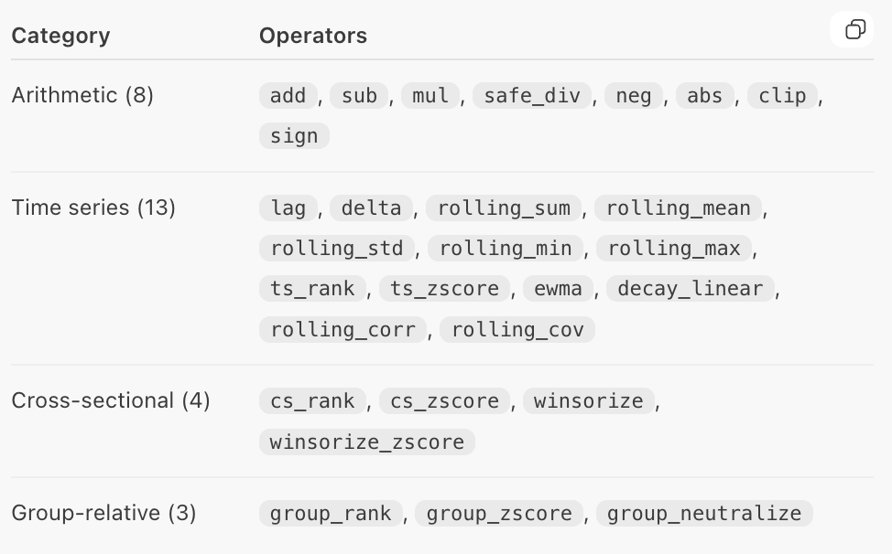
Appendix: operator
15

Slide 17
References and audit trail
Huang & Fan. Beyond Prompting: An Autonomous Framework for Systematic Factor Investing via Agentic AI. arXiv:2603.14288v1.
XALPHA: A Memory-Driven AI Quant Researcher for Hypothesis-to-Code Alpha Discovery. arXiv:2607.08332v2.
AutoScientist-Quant: Self-Evolving Coding Agents for Automatic Research in Quantitative Investment. arXiv:2608.28632v2.
Project research record: docs/final_experiment_results_gpt6.md
Final out-of-sample report: docs/final_holdout_results.md
Pre-test freeze and result manifests: artifacts/frozen/ and outputs/holdout/
16

