Slide 1
Symmetric Cryptography:
Block Cipher Modes

Slide 2
Block vs Stream Ciphers
There are two main classes of symmetric ciphers:
  Block Ciphers: Break message into blocks and operate on a block-by-block basis
  Stream Ciphers: Process messages bit-by-bit or byte-by-byte as data arrives.
Typically, block ciphers may be modified to run in a “stream mode”
Notes:
Block ciphers work a on block / word at a time, which is some number of bits. All of these bits have to be available before the block can be processed. Stream ciphers work on a bit or byte of the message at a time, hence process it as a “stream”.

Slide 3
The Many Modes of Block Cipher Operation
Block ciphers encrypt fixed size blocks, but typically our data is not a fixed block size or not the same size as the encryption block size
Four were defined for DES in ANSI standard ANSI X3.106-1983 Modes of Use, a 5th mode is now commonly used also
These modes may operate in either a block-by-block fashion, or in a streaming mode

Slide 4
Electronic Codebook Book (ECB)
The basic, natural (and insecure) method for encryption is the Electronic Code Book Mode
Here, the message is broken into independent blocks which are each encrypted
Weakness:
  Allows for correlation between subsequent encryptions of the same plaintext
  Hence, dictionary-type attacks are feasible

Slide 5
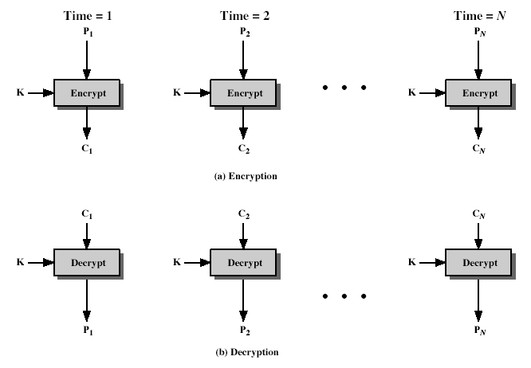
Electronic Codebook Book (ECB)
Notes:
Stallings Fig 3.11

Slide 6
Cipher Block Chaining (CBC)
A more advanced method is to encrypt the next block based upon the output of the previous encryption
This idea is called chaining since it links previous ciphertexts with current plaintexts
The basic scheme starts with setting C0 to be an Initial Vector (IV) to start process, and then:
Practical applications are in bulk data encryption, and authentication

Slide 7
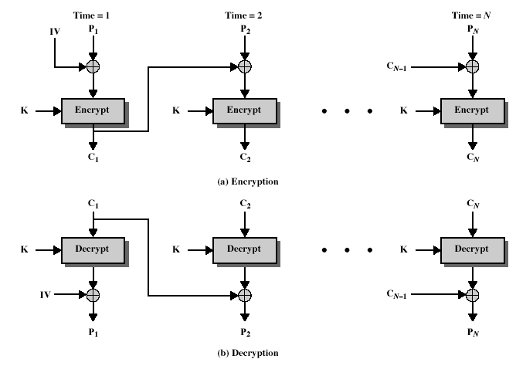
Cipher Block Chaining (CBC)
Notes:
Stallings Fig 3.12

Slide 8
Advantages and Limitations of CBC
Each ciphertext block depends on all message blocks
Thus a change in the message affects all ciphertext blocks after the change as well as the original block
Need the Initial Value (IV) known to sender & receiver
  However if IV is sent in the clear, an attacker can change bits of the IV
  Hence either IV must be a fixed value or it must be sent encrypted in ECB mode before rest of message
At end of message, handle possible last short block
  By padding either with known non-data value (eg nulls)
  Or pad last block with count of pad size

Slide 9
Cipher FeedBack (CFB)
Message is treated as a stream of bits (or stream of small chunks of bits)
Plaintext is added to previous output of the cipher:
Any number of bits (1,8 or 64 or whatever) to be feedback
  denoted CFB-1, CFB-8, CFB-64 etc
CFB is a stream mode of operation

Slide 10
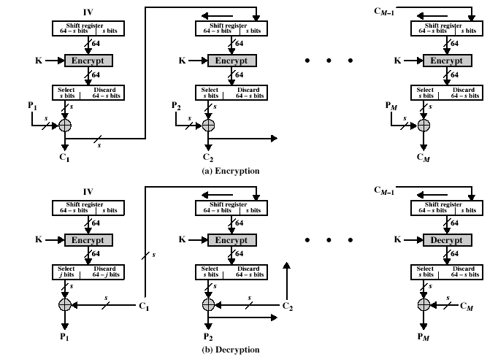
Cipher FeedBack (CFB)
Notes:
Stallings Fig 3.13

Slide 11
Advantages and Limitations of CFB
Appropriate when data arrives in bits/bytes
Most common stream mode and is effective in turning a block cipher algorithm, like DES, into a stream cipher algorithm
Observe that the block cipher is used in encryption mode at both ends
Errors propagate for several blocks after the error, but eventually flush themselves

Slide 12
Output FeedBack (OFB)
The message is treated as a stream of bits, and the output of the cipher is added to the plaintext message
Output is then feed back to produce next output
Feedback is independent of the message, and therefore can be computed in advance of data arriving
  C_{i} = P_{i} XOR O_{i}
  O_{i} = DES_{K1}(O_{i-1})
  O₋₁ = IV
Is commonly used for stream encryption over noisy channels
Notes:
The alternative to CFB is OFB. Here the generation of the "random" bits is independent of the message being encrypted. The advantage is that firstly, they can be computed in advance, good for bursty traffic, and secondly, any bit error only affects a single bit. Thus this is good for noisy links (eg satellite TV transmissions etc).

Slide 13
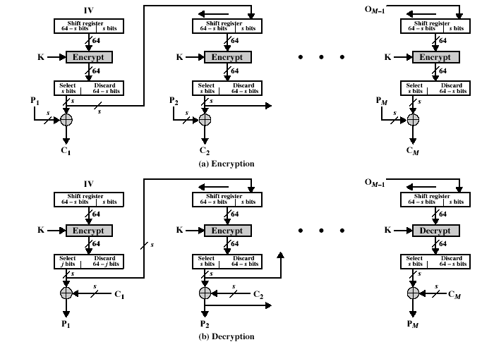
Output FeedBack (OFB)
Notes:
Stallings Fig 3.14

Slide 14
Advantages and Limitations of OFB
Used when error feedback a problem or where we need to encrypt before message is available
Since feedback is independent of message, pre-computation is facilitated
A variation of a Vernam cipher
  Hence must never reuse the same sequence (key+IV)
Synchronization is critical
If DES is used, all 64 bits should be fed back!
Notes:
Because the "random" bits are independent of the message, they must never ever be used more than once (otherwise the 2 ciphertexts can be combined, cancelling these bits, and leaving a "book" cipher to solve). Also, as noted, should only ever use a full block feedback ie OFB-64 mode.

Slide 15
Counter (CTR)
CTR, or counter mode, is a “new” encryption mode that finds application in networking, and is particularly suited for wireless applications
  Has been employed in sensor network applications
It is basically OFB but we encrypt a counter value rather than any feedback value
Like OFB, we must have a different key & counter value for every plaintext block (never reused)
  C_{i} = P_{i} XOR O_{i}
  O_{i} = DES_{K1}(i)

Slide 16
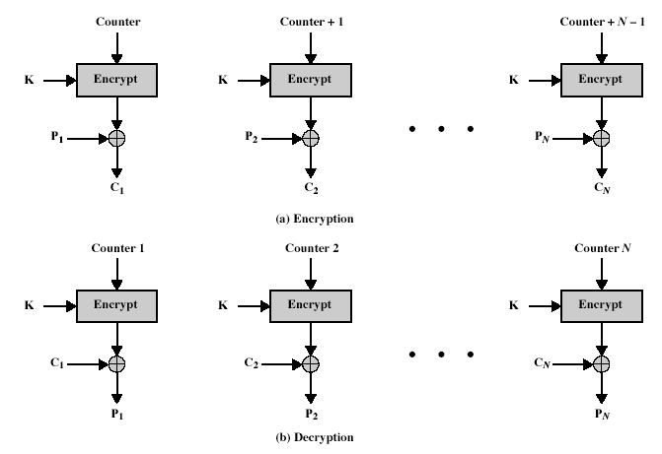
Counter (CTR)
Notes:
Stallings Fig 3.15

Slide 17
Advantages and Limitations of CTR
Efficiency
  Can do parallel encryptions in advance of need
  Good for bursty high speed links
Its security can be shown to be as good (or bad) as the other modes
Again, must never reuse key/counter values, otherwise CTR is easily breakable

