Slide 1
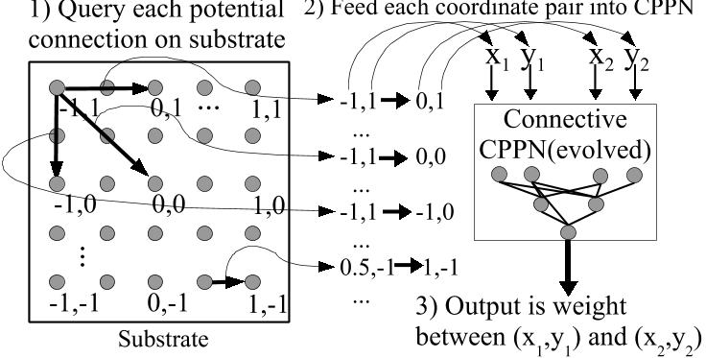
Initial population
Phenotype
space
Evaluate fitness
New generation
Genotype
space
Selection
Reproduction
Variation
operators
Direct encoding
Indirect encoding (source:A Hypercube-based Indirect Encoding for Evolving Large-scale Neural Networks)
Genotype
Phenotype
1010100
84
0000101
5

Slide 2
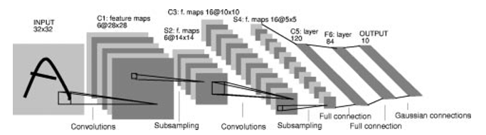
Source: LeCun 1998

Slide 3
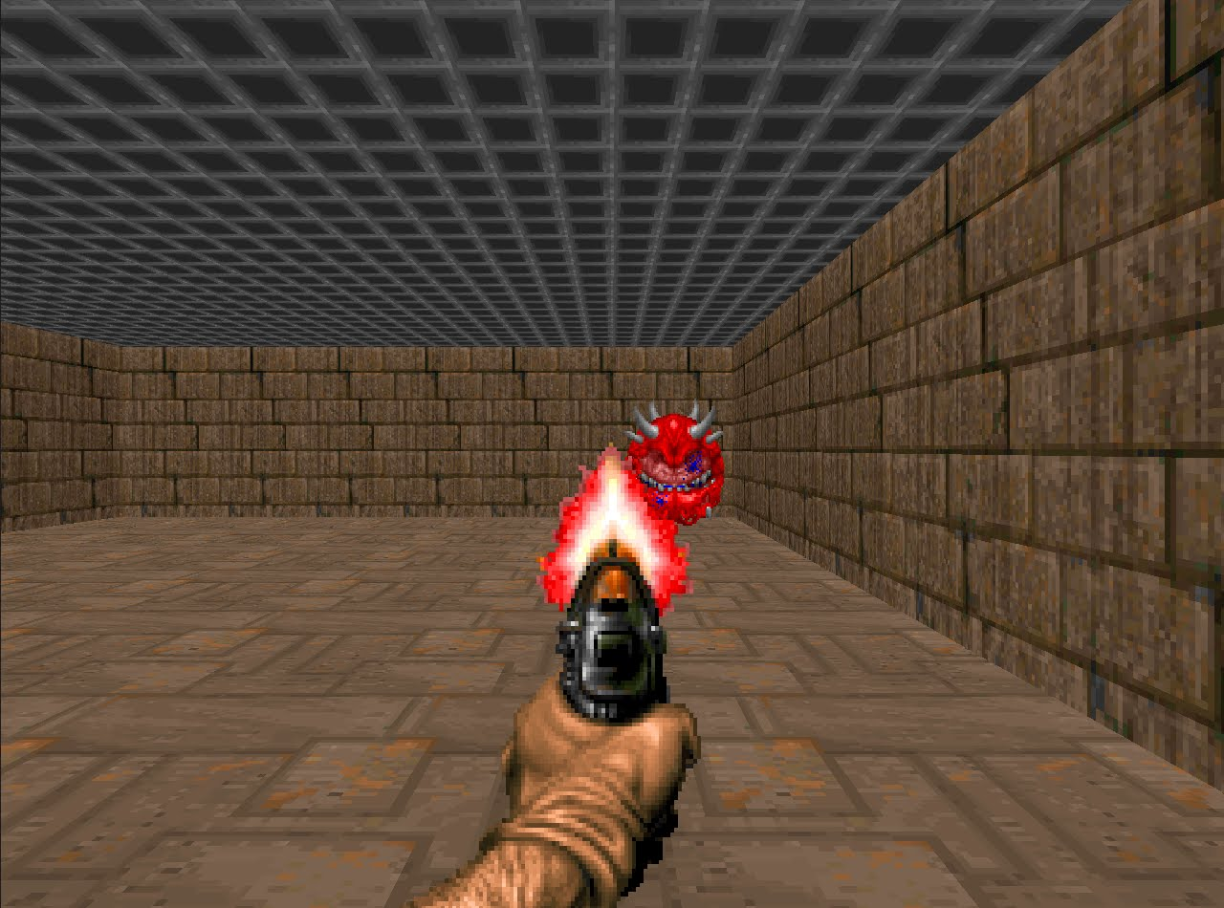
Overview of the approach
Feature extractor
Controller
Action
Raw pixel data
Deep CNN
Neural Network
Feature extractor architecture
Output features
Subsampling
Subsampling
Subsampling
RGB image
Fully connected MLP (128xfeatures)
18 kernels 7x7
24 kernels 4x4
32 kernels 3x3

Slide 4
Custom genetic algorithm
[0.1, 1.3, 0, 1,0.6,0.02,-0.9,-0.05...,0.27]
==
[0.2, 0.7, 0, 0,-0.6,1.02,-3.9,0.04...,0.06]
...
[-0.1, 0.3, 0, -1,-0.6,1.02,-0.09,-0.08...,0.32]
Mutation operators
Recombination
[0.1, 1.3, 0, 1,0.6,0.02,-0.9,-0.05...,0.27]
Parent A
Parent B
[0.1, 1.3, 0, 1,0.6,0.02,-0.9,-0.05...,0.27]
[0.2, 2.7, 1, 0,0.01,0.07,-0.6,-0.5...,0.22]
Replacement
Modification (+0.55)
[0.2, 0.7, 0, 0,-0.6,1.02,-3.9,0.04...,0.06]
[0.6, 0.1, 0, 0,-0.3,4.01,-0.11,0.4...,0.02]
Reset
[0.1, 1.3, 0, 1,0.6,-1.18,-0.9,-0.05...,0.27]
[0.1, 1.3, 0, 1,0.6,0.57,-0.9,-0.05...,0.27]
[0.1, 1.3, 0, 1,0.6,0.02,-0.9,-0.05...,0.27]
[0.6, 0.1, 0, 0,-0.3,4.01,-0.11,0.4...,0.02]
[-0.1, 0.3, 0, -1,-0.6,1.02,-0.09,-0.08...,0.32]

Slide 5
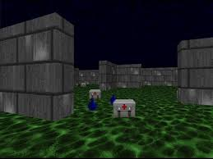
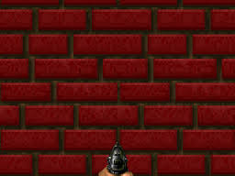
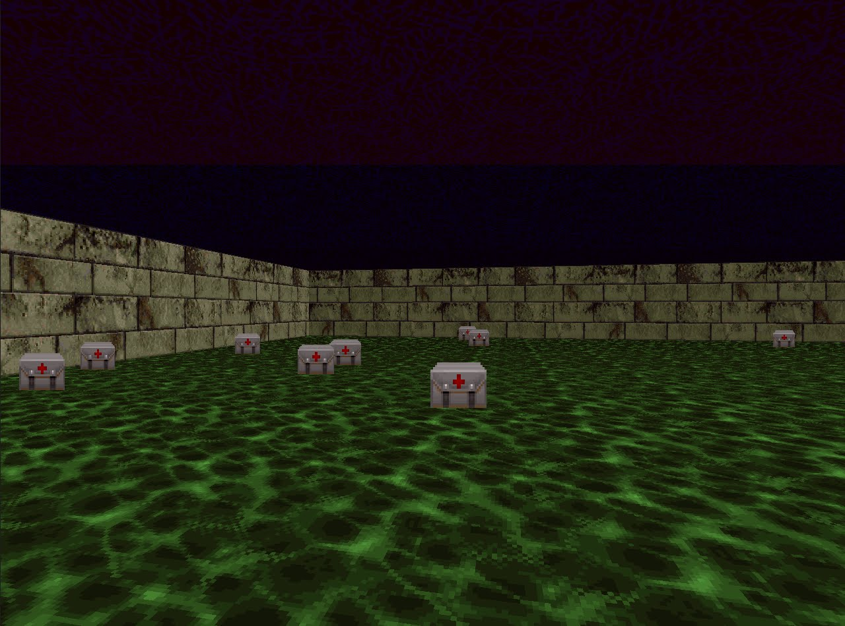

Training image set
Feature extractor candidate
Output features per image
FE
[-1,1,0,0.03,0.7,-0.5]
[-0.1,0,1,0.03,0.3,0.5]
Total fitness
7.1
Fitness
measurement
[-1,0,1,0.03,0.9,-0.5]
[0.1,0,0,0.17,0.3,0.6]

Slide 6
Image feature vectors
Distances
A = [-1,1,0]
 | A | B | C | D
A | - | 1.414 | 1 | 1.414
B | - | - | 1 | 1.414
C | - | - | - | 1.732
D | - | - | - | -
B = [-1,0,1]
Average: 1.329
Min: 1
Fitness = min + average = 1.329 + 1 = 2.329
C = [-1,1,1]
D = [0,0,0]
Image feature vectors
Average Species assignment
A = [1,0,1,0]
Shannon index
B = [0,1,0,0]
= 0.562335
C = [0,1,0,0]
Proportion ¾ of species 2
Proportion of ¼ of species 3
D = [0,0,1,0]
Image feature vectors
Binary species assignment
A = [1,0,1,0]
Shannon index
B = [0,1,0,0]
= 1.03972
C = [0,1,0,0]
D = [0,0,1,0]
Proportion ¼ of species 2 and 10
Proportion of ½ of species 4

Slide 7
Feature vector
Evolved Neural network
1
0
-1
0.5
-0.7
0
0
1
1
0
0
0
0
0
0
0
Do action with index 0 (turn left)

Slide 8
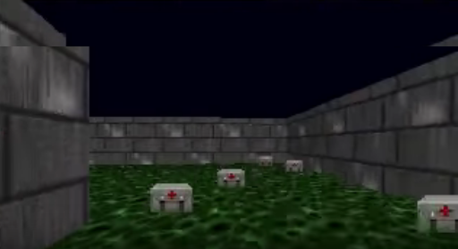
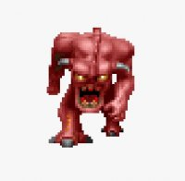

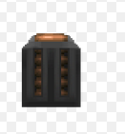
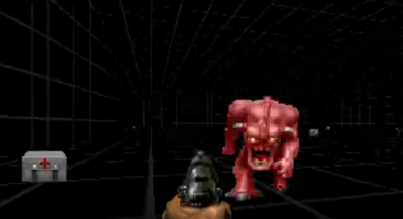
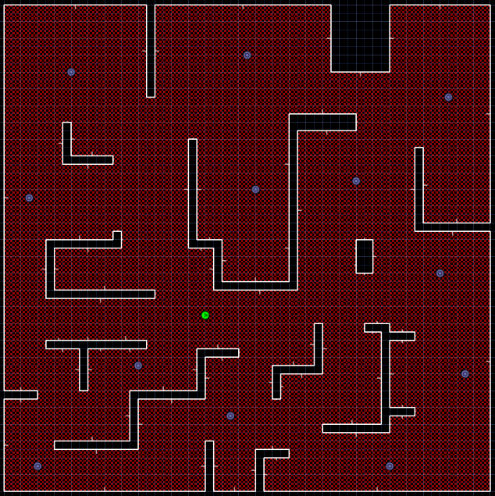
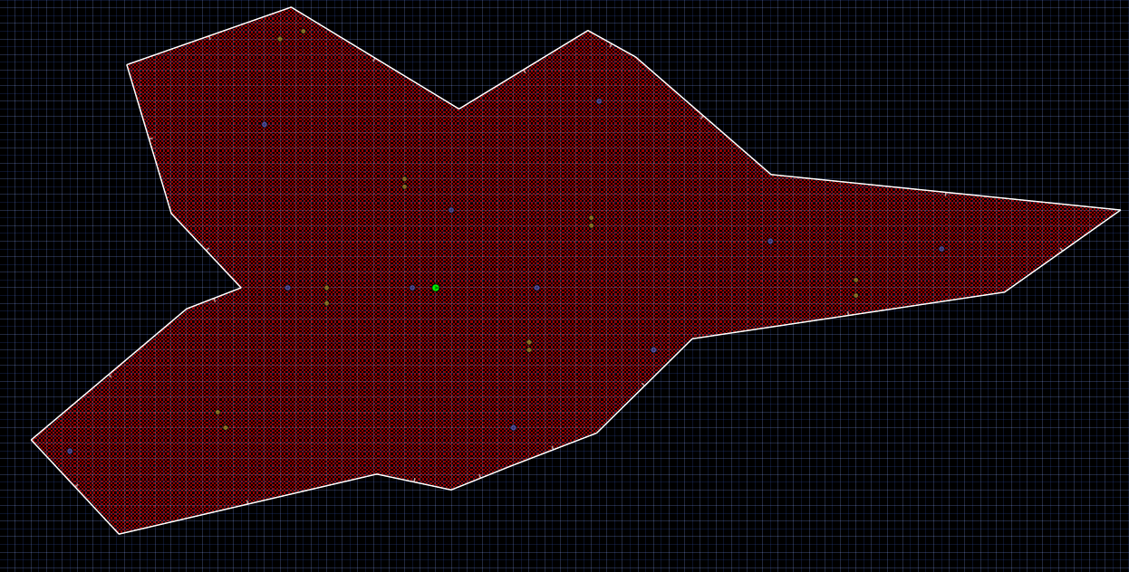
Health gathering and pursuit and gather floor plans

Slide 9
Learning graphs – fitness measurement and feature vector length
8
16
32

Slide 10
Performance graphs – fitness measurement and feature vector length
Best across all lengths
Euclidean distance
Reward only
Only shooting reward

Slide 11
Learning graphs – type of output function

Slide 12
Performance graphs – type of output function
Reward only
Only shooting reward

Slide 13
Learning graphs – NEAT algorithm and action selection

Slide 14
Performance graphs – NEAT algorithm and action selection
Reward only
Only shooting reward

Slide 15
APPENDIX

