Slide 1
GIT

Slide 2
What is version control
Git Command
Git compare SVN
Assignment

Slide 3
What is version control
Version control systems are a category of software tools that help a software team manage changes to source code over time.
Install
Git bash https://git-scm.com/downloads
Source Tree https://www.sourcetreeapp.com/

Slide 4
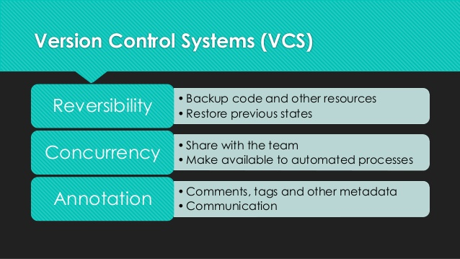
What is version control

Slide 5
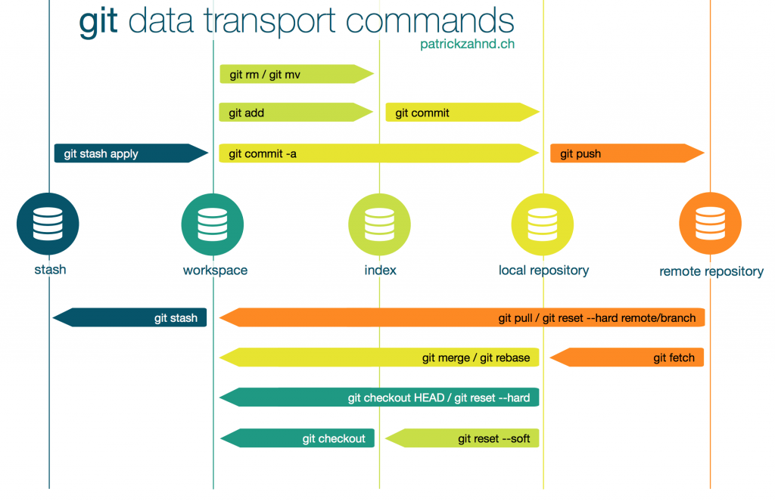
Git Command

Slide 6
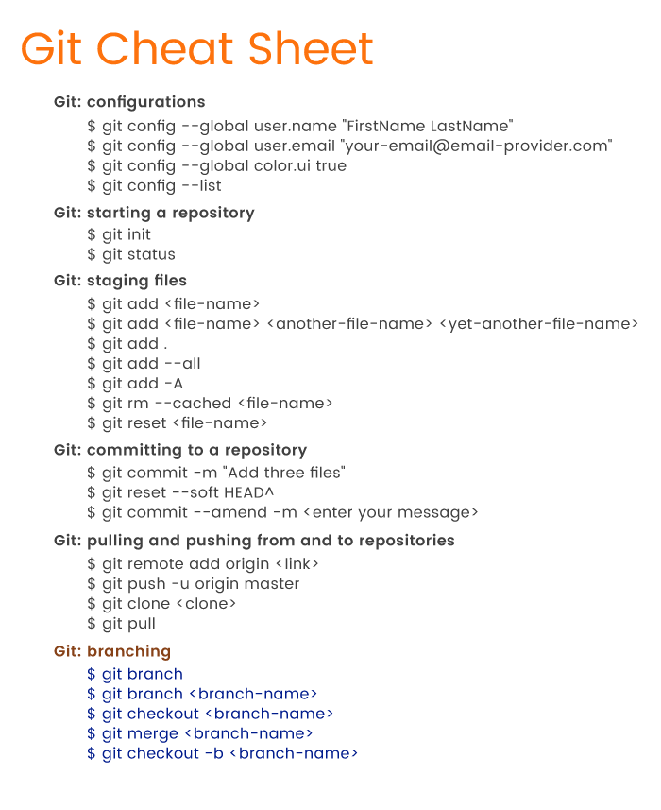
Git Command

Slide 7
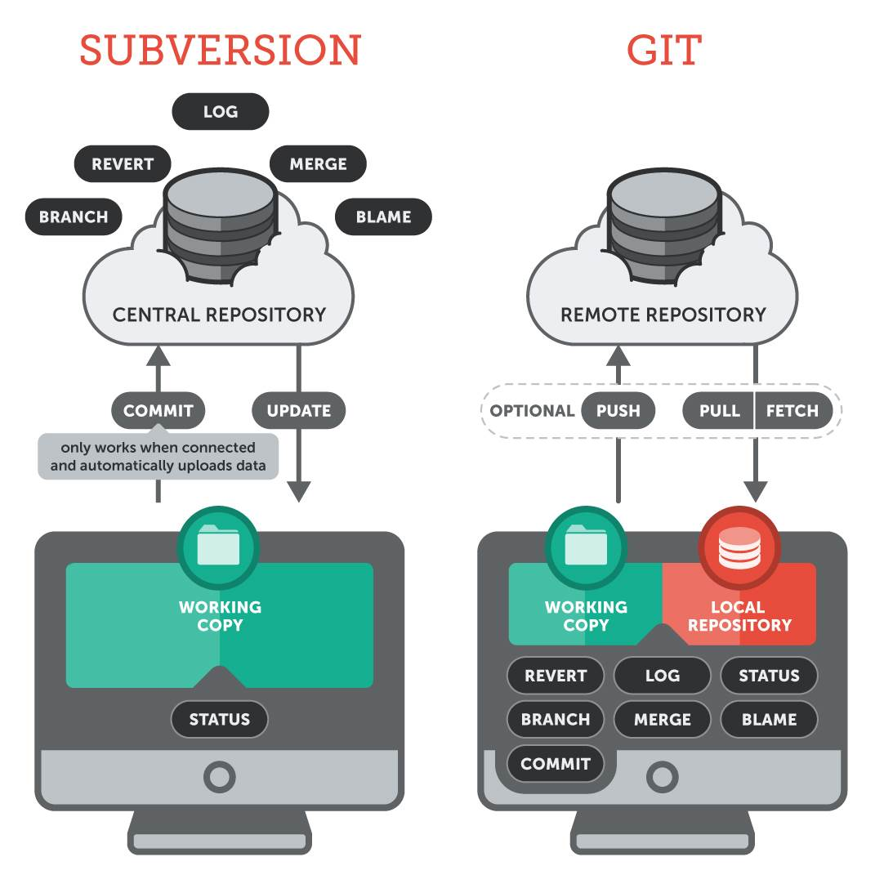
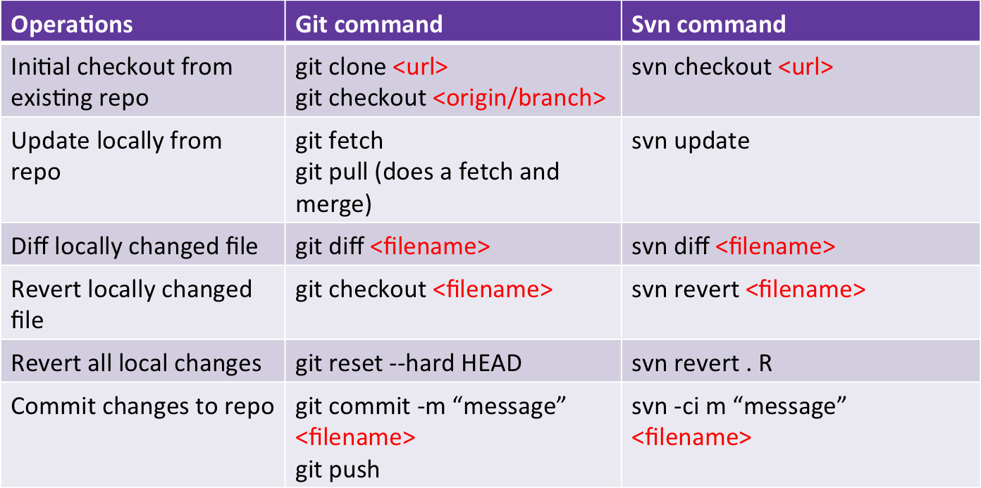
Git compare SVN

Slide 8
Assignment
Create new repository name “Backend-Training”
Add Collaborators “BunditSpace” and “tuntawin” to repository
Create new branch name “git101”
Add folder “Git” and add file “readme.txt” in folder “Git” commit push to branch git101
Merge branch git101 to master

