Slide 1
SMTP
Asst.Drusawin Vongpramate
Information Technology
Buriram Rajabhat University

Slide 2
SMTP
The Simple Mail Transfer Protocol (SMTP) is an internet standard communication protocol for electronic mail transmission. Mail servers and other message transfer agents use SMTP to send and receive mail messages.

Slide 3
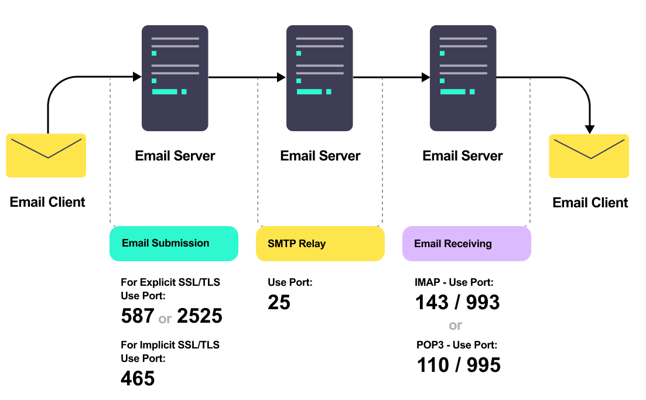
SMTP

Slide 4
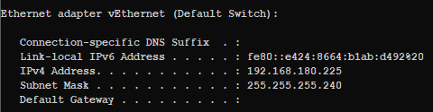
Install container
Step 1 :: Pull email container
>> docker run -d -p 1080:80 -p 25:25 djfarrelly/maildev
Step 2 :: Check Host IP (docker)
>> ipconfig

Slide 5
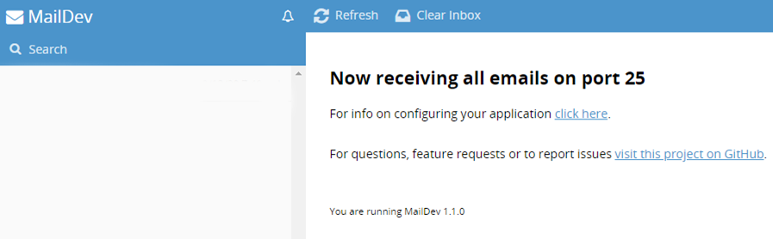
Install container
Step 3 :: Test host by 127.0.0.1:1080

Slide 6
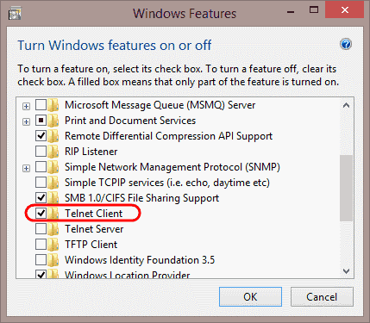
Install Telnet Client
Check Telnet Client
>> telnet

Slide 7
Test on Telnet
>> telnet 192.168.21.1 25 //25 or smtp
> ehlo lo
//helo 192.168.21.1
> mail from:<sender mail>
//email must use “<“ and “>” character
//etc. <drusawin@bru.ac.th>
> rcpt to:<receive mail>
> data
> Message …………………… // subject: ……….
> . //end
> quit //exit telnet

Slide 8
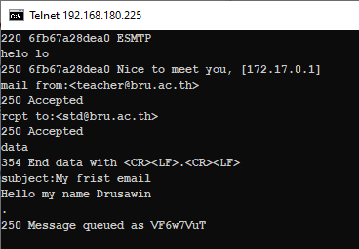
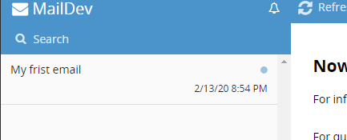

Slide 9
Q & A

